Slide 1
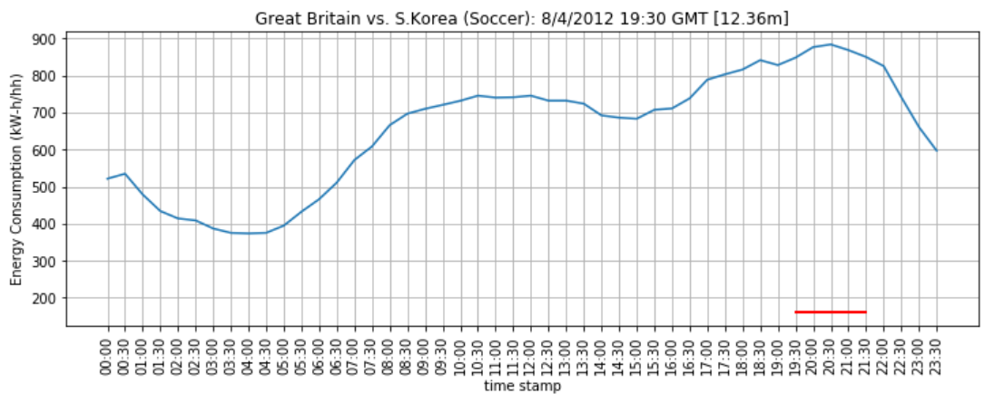
Case study: energy consumption during a soccer game
Break time
Game time
Energy consumption reached to a peak at game break time.

