Slide 1





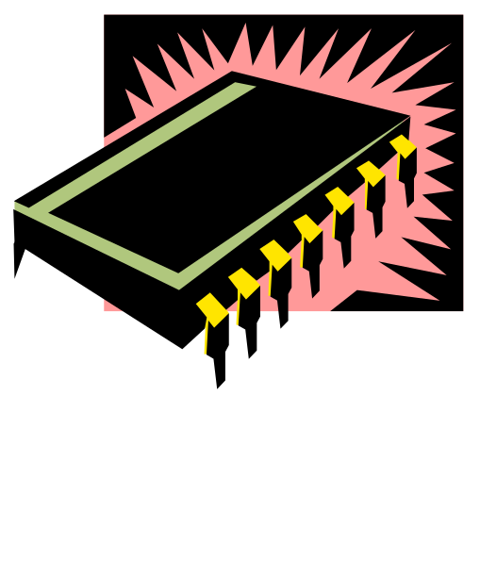
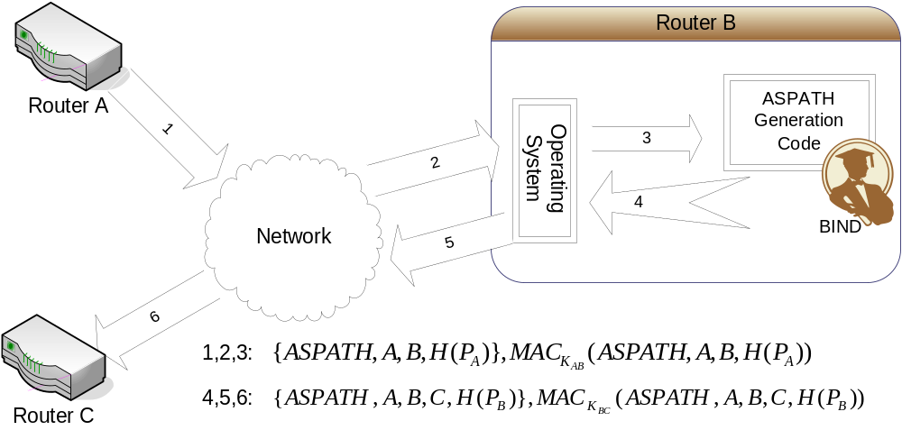
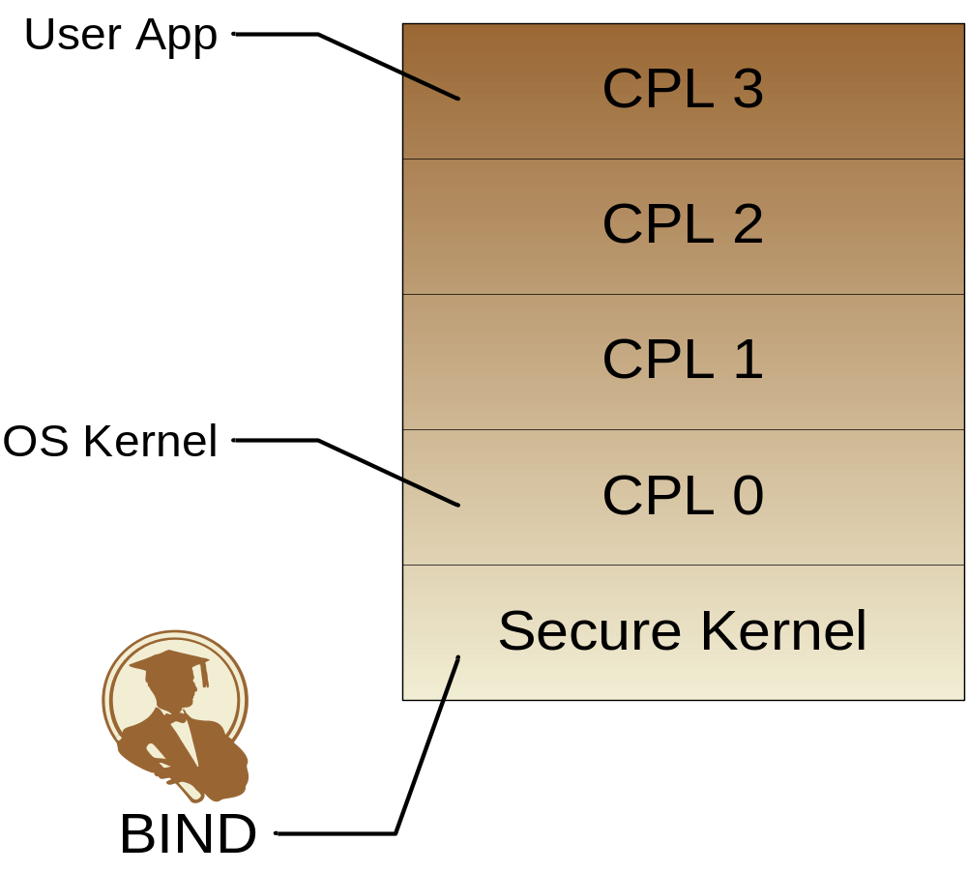

BIND: A Fine-Grained Attestation Service for Secure Distributed Systems
Elaine Shi, Adrian Perrig, Leendert Van Doorn
Goals
Approach
Remote code attestation:
  Verify what software code is running on a remote machine
  Prevent software attacks
Motivation:
  How is code attestation useful in securing real distributed systems?
  What are the problems with current code attestation technology?
  How can we best address these problems using up-to-date microprocessor and TCG technology?
Our approach:
  Binding Instructions and Data (BIND)
TPM
Fine-grained attestation:
  Attest to critical code that generated output data
Just-in-time attestation:
  Attestation right before time-of-use
  Sandboxing to protect execution of critical code
Tie data integrity with code integrity
  Transitive trust property
Technology
Application
TCG-aware modern processor, e.g., Secure Execution Mode (SEM) from AMD
Trusted Platform Module (TPM)
Application of BIND in securing BGP
TPM

