Slide 1
BIND: A Fine-Grained Attestation Service for Secure Distributed Systems
Elaine Shi, Adrian Perrig, Leendert Van Doorn
Carnegie Mellon University
IBM Research Center, T.J. Watson

Slide 2
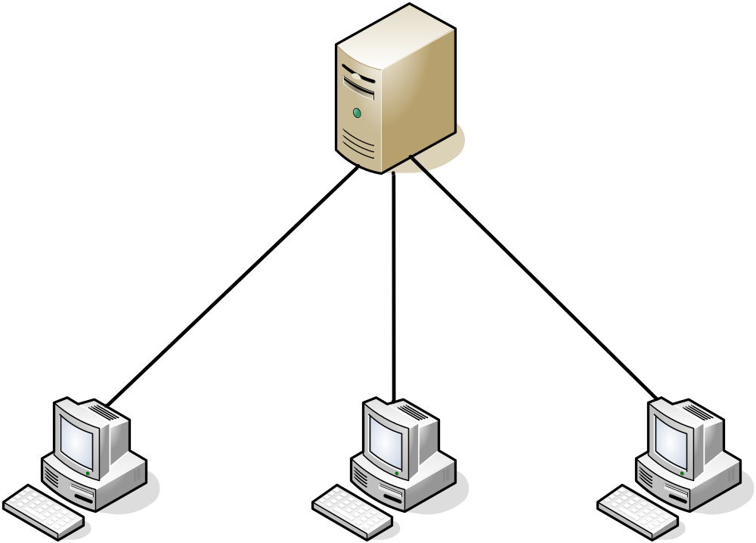

Why do we need code attestation?

Slide 3

Why do we need code attestation?

Slide 4

Why do we need code attestation?

Slide 5
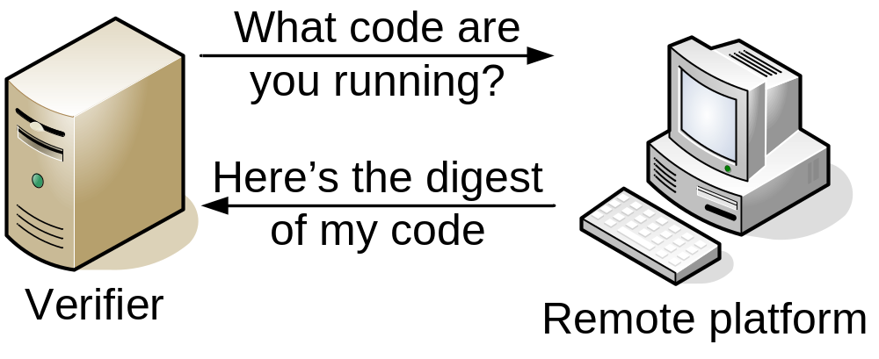
Why do we need code attestation?
Code attestation allows us to establish trust in a remote platform.

Slide 6
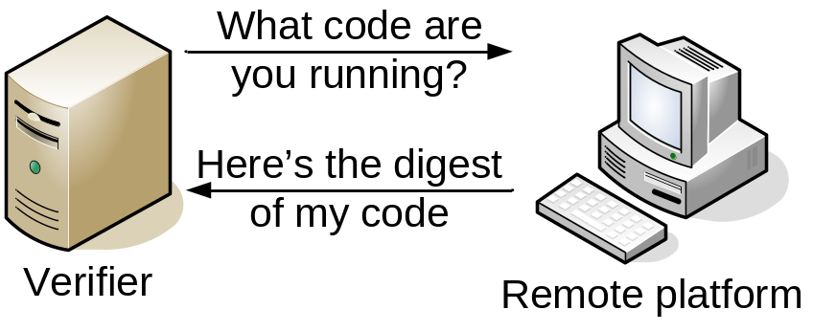
Motivation
Propose and achieve new desirable properties for code attestation
Make code attestation useful in real-world distributed systems
  BGP routing protocol
  Distributed computing

Slide 7
Threat Model
OS/Applications on remote platform may be comprised
  By local operator
  Through network-enabled attacks

Slide 8
Trusted Computing Group (TCG)
Trusted Platform Module (TPM)
TPM
SHA-1 hash engine
Hash measured code
Platform Configuration Registers
Store measurement results
Protected storage for secret keys
Store secret signing key
RSA cryptographic engine
Sign measurement results
Notes:
You need to make clear that throughout the talk “Perform measurement” means to compute a hash of either code or code+data.

Slide 9

Previous Work: TCG-Style Attestation
OS Kernel
OS Kernel
Module 1
Module 1
Apps
Apps
App 1
Module 2
App 1
Module 2
Boot Loader
Boot Loader
conf
conf
App 2
App 2
BIOS
BIOS
TPM
PCRs
Hardware
Software
K₋₁

Slide 10
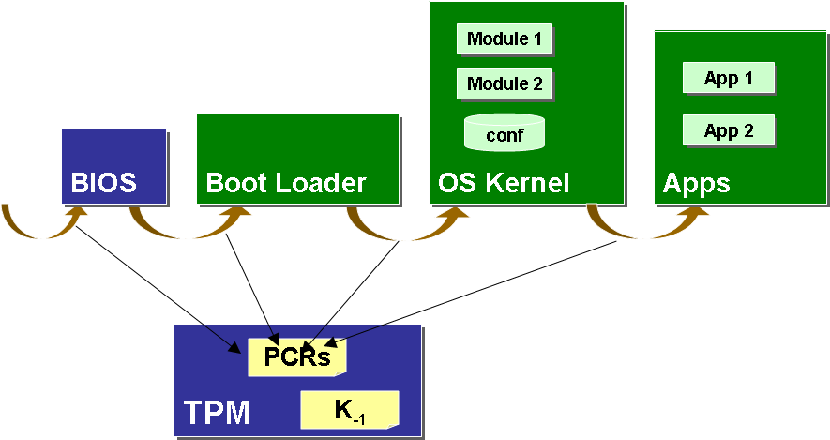

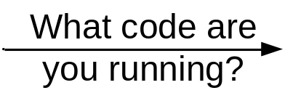

Previous Work: TCG-Style Attestation
Verifier
Remote platform

Slide 11
Drawbacks of TCG-Style Attestation
Coarse-grained: Measure entire software system
  Various software versions and configurations
  Verification of checksum is difficult
Load-time: Measure code at time-of-load
  Software may be compromised by time-of-use
No guarantee of execution
No binding between code and data integrity

Slide 12
BIND: Binding Instruction aNd Data
Fine-grained attestation
  Attest to critical code that generates output data
Just-in-time attestation
  Attestation right before time-of-use
Ensure execution
  Protected execution of critical code
Tie data integrity to code integrity

Slide 13
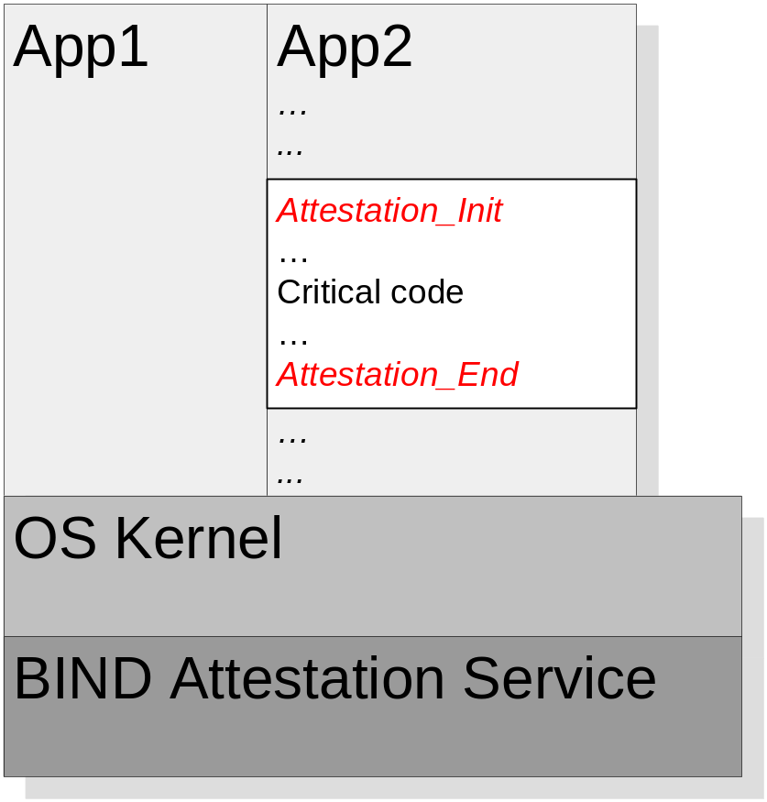
Fine-grained Attestation
Programmer annotates boundary of critical code
Attestation_Init & attestation_End call BIND service

Slide 14
Just-in-time Attestation/Ensuring Execution
BIND takes measurement right before code executes
BIND ensures execution by directly yielding control to critical code

Slide 15

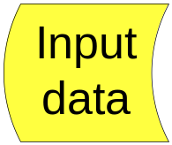
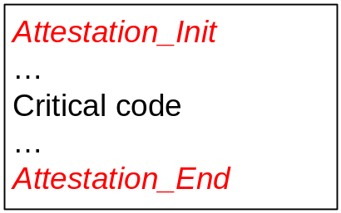

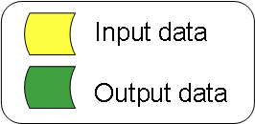
Tie Data and Code Integrity
output data integrity
= input data integrity +
code integrity

Slide 16

Tie Data and Code Integrity
BIND authenticator
= {output data, H(code)}
K⁻¹
Verifying the integrity of input data
  External inputs: require external mechanism
  BIND-authenticated inputs: verify signature, check hash

Slide 17


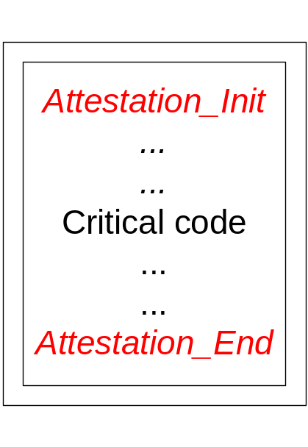



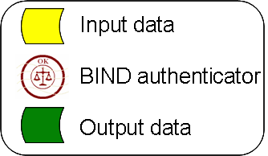
Operation of BIND
BIND Attestation
Service
Execute

Slide 18
Outline
Motivation
BIND Overview
BIND Implementation
Applications of BIND

Slide 19
BIND Hardware Assumptions
Modern TCG-aware microprocessor
  Hardware support for secure initialization
  Simple processor-based isolation
  E.g. SEM (Secure Execution Mode), Pacifica
TPM: Trusted Platform Module

Slide 20
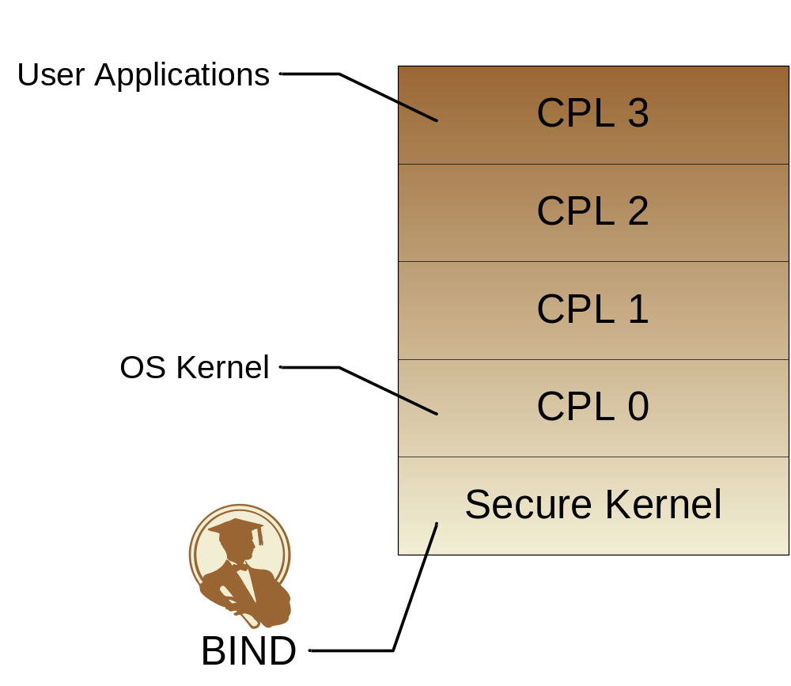


SEM: The Secure Kernel (SK)
TPM

Slide 21
Trust in BIND: HW/SW Hybrid Approach
Load-time integrity of BIND established through trusted bootstrap
Run-time integrity of BIND ensured through processor-based isolation technology

Slide 22

Trust in BIND: Load-time Integrity
Secure Kernel
BIND
Attestation
Service
Boot Loader
Secure Boot Loader
SKINIT
TPM
PCRs
K₋₁

Slide 23
Trust in BIND: HW/SW Hybrid Approach
Load-time integrity of BIND established through trusted bootstrap
Run-time integrity of BIND ensured through processor-based isolation technology

Slide 24
Trust in BIND: Run-time Integrity
OS/APP code cannot tamper with BIND
  BIND runs in protected memory, and highest privilege level
BIND is small in size and has gone through security evaluation

Slide 25
Summary: Implementation using TPM & SEM
BIND runs in Secure Kernel
  Takes integrity measurements of the critical code
  Sets up protected environment for verified code
TPM
  Talks to BIND through a protected channel
  Performs hashing
  Stores measurement results
  Signs and reports measurement results

Slide 26
Outline
Motivation
BIND Overview
BIND Implementation
Applications of BIND
  BGP example
  Distributed Computing

Slide 27


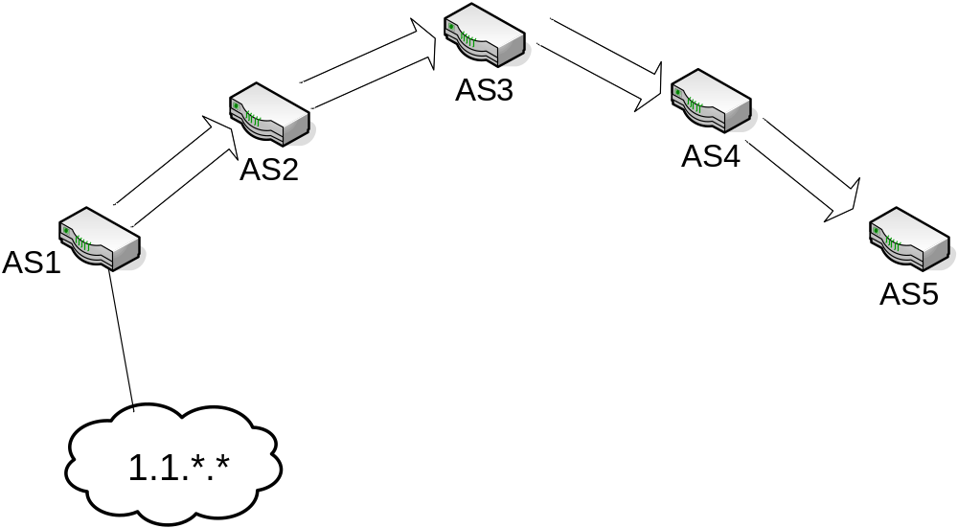


BGP Background

Slide 28

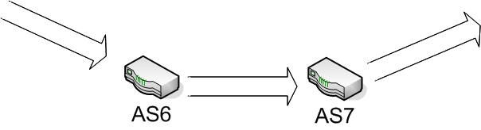


BGP Background: ASPATH Falsification

Slide 29


Using BIND to Defend against ASPATH Falsification
(AS1, AS2)
(AS1, AS2, AS3)
ASPATH Generation Code
ASPATH Generation Code
Transitive Integrity Verification: O(1) signature verification
SBGP: O(n) signature verifications
(AS1, AS2, AS3, AS4)

Slide 30
Summary: Securing BGP with BIND
Assume full deployment of BIND
Defend against ASPATH falsification attack
Easy to design
Efficient: transitive integrity verification

Slide 31
Discussion
Cannot deal with vulnerability in critical code
However
  Verification of input data integrity: attacker has limited attack interface
  Fine-grained attestation: software verification may be possible on a small piece of code

Slide 32
Summary
TCG Approach:
Coarse-grained
Load-time
No guarantee of execution
Code integrity only
BIND:
Fine-grained
Just-in-time
Ensure execution of verified code
Tie data integrity with code integrity

Slide 33
Conclusion
A generic solution to ensure code and data integrity in distributed systems
Real-world applications of BIND
  BGP
  Distributed Computing

Slide 34
Thank you
Contact info:
rshi@cmu.edu
http://sparrow.ece.cmu.edu/~elaine/

Slide 35
TCG Trusted Platform Module (TPM)
Platform
Configuration
Register (PCR)
Non-Volatile
Storage
(EK AIK, SRK)
I/O
LPC bus
Random
Number
Generator
Secure
Hash
SHA-1
Key
Generation
Crypto
RSA

Slide 36
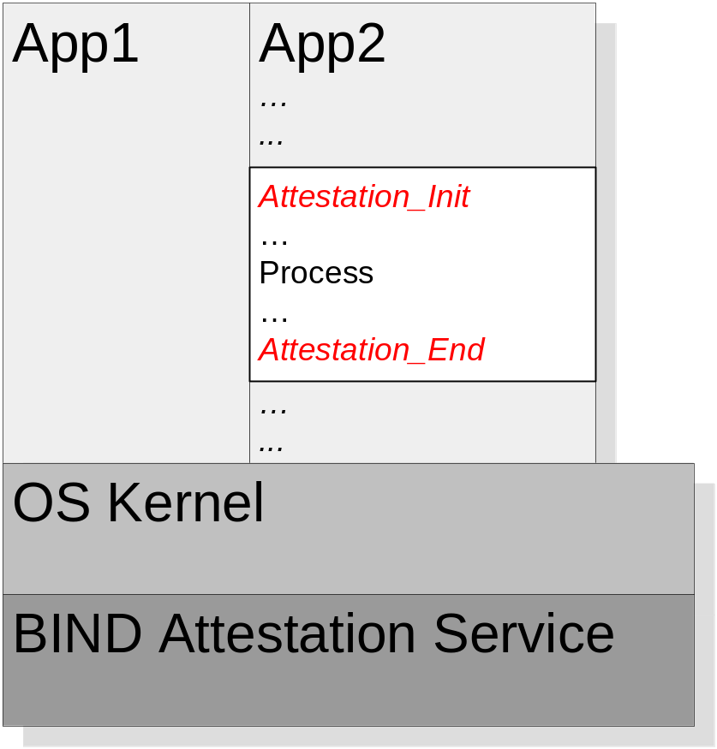
Just-in-time Attestation/Ensuring Execution
BIND takes measurement right before code executes
BIND ensures execution by directly yielding control to critical code

Slide 37
Trust in BIND
Load-time integrity of BIND established through trusted bootstrap
Secure Kernel
BIND
Attestation
Service
Boot Loader
Secure Boot Loader
SKINIT
TPM
PCRs
Hardware
Software
K₋₁

Slide 38

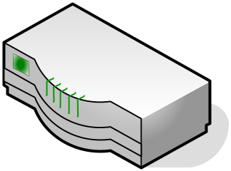
BGP Background
1.1.*.*
AS 1
AS 4
Prefix | ASPATH
1.1.*.* | AS1
Prefix | ASPATH
1.1.*.* | AS1, AS6, AS7
Prefix | ASPATH
1.1.*.* | AS1, AS2
AS 2
AS 3

Slide 39
BGP Attack: ASPATH Falsification
1.1.*.*
AS 1
AS 4
Prefix | ASPATH
1.1.*.* | AS1
Prefix | ASPATH
1.1.*.* | AS1, AS4
Prefix | ASPATH
1.1.*.* | AS1, AS6
AS 2
AS 3

