Slide 1
BIND: A Fine-Grained Attestation Service for Secure Distributed Systems
Elaine Shi, Adrian Perrig, Leendert Van Doorn

Slide 2
Outline
Motivation
BIND Overview
BIND Implementation
Application of BIND

Slide 3
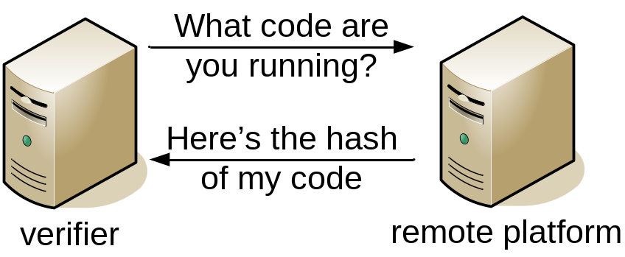
Motivation
Address issues with current code attestation technology
Application of code attestation in real distributed systems

Slide 4
Code Attestation: State-of-the-art
Coarse-grained attestation
  Various software versions and configurations
  Verification of checksum is difficult
Load-time attestation
  Code may be correct at load-time but compromised by time-of-use
No guarantee of execution

Slide 5
BIND: Binding Instruction aNd Data
Fine-grained attestation
  Attest to critical code that generates output data
Just-in-time attestation
  Attestation right before time-of-use
Ensure execution
  Sandboxing to protect execution of critical code
Tie data integrity with code integrity
  Transitive integrity verification

Slide 6
BIND: Design Guidelines
Previous work:
Coarse-grained
Load-time
No guarantee of Execution
Code integrity only
BIND:
Fine-grained
Just-in-time
Ensure execution of verified code
Tie data integrity with code integrity

Slide 7
Outline
Motivation
BIND Overview
BIND Implementation
Application of BIND

Slide 8
BIND Assumptions
SEM: Secure Execution Mode
  TCG-aware microprocessor
TPM: Trusted Computing Module
  Secure co-processor
  Hardware root of trust
  Cryptography Engine
  Sealed Storage

Slide 9
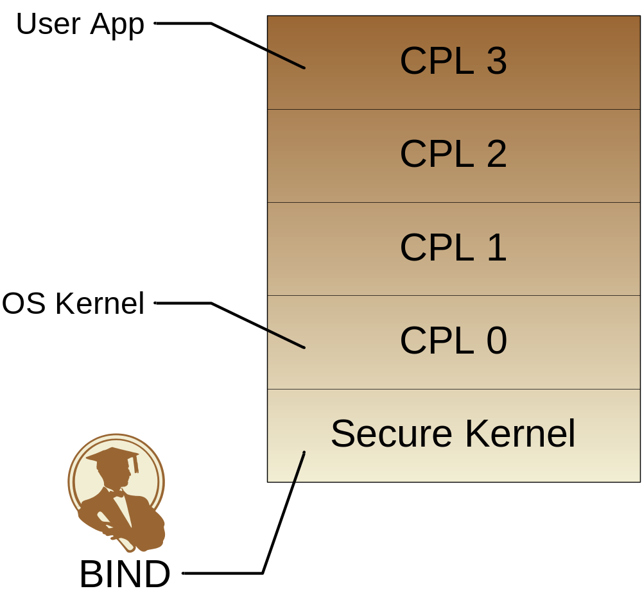


SEM: The Secure Kernel (SK)
SK Protection:
  Memory
  Ctrl. Reg.
  IO
  DMA
TPM

Slide 10
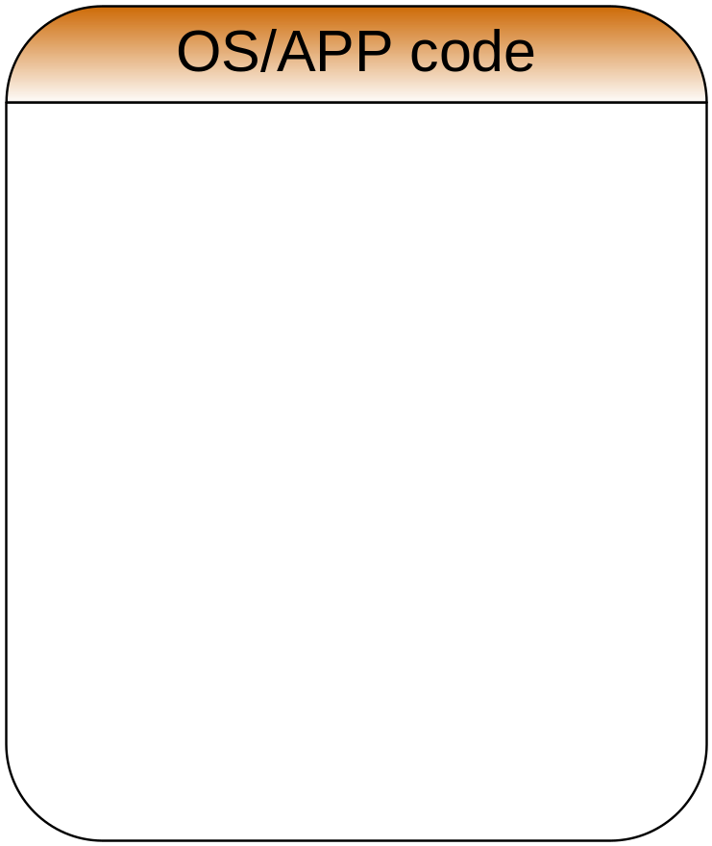


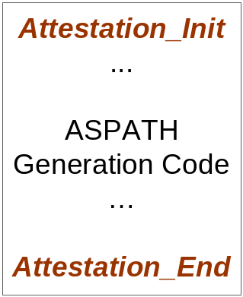

Fine-Grained/Just-in-time Attestation
Input data
Input data addr
OK to run
Output data addr
TPM
Output data

Slide 11
BIND Detail
Attestation_Init
  Verify input data integrity
  Hash critical code
  Set up sandbox protections
  Yield to critical code
Attestation_End
  Sign output data w/ hash of code
  Clear sandbox protections
  Return

Slide 12
Outline
Motivation
BIND Overview
BIND Implementation
Application of BIND

Slide 13

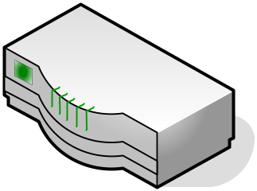
The BGP Case
1.1.*.*
AS 1
AS 4
Prefix | ASPATH
1.1.*.* | AS1
Prefix | ASPATH
1.1.*.* | AS1, AS2, AS3
Prefix | ASPATH
1.1.*.* | AS1, AS2
AS 2
AS 3

Slide 14

The BGP Case: ASPATH Falsification
1.1.*.*
AS 1
AS 4
Prefix | ASPATH
1.1.*.* | AS1
Prefix | ASPATH
1.1.*.* | AS1, AS3
Prefix | ASPATH
1.1.*.* | AS1, AS2
AS 2
AS 3

Slide 15
Securing BGP w/ BIND
(AS1, AS2)
(AS1, AS2, AS3)
ASPATH Generation Code
ASPATH Generation Code
Transitive Integrity Verification
(AS1, AS2, AS3, AS4)
Notes:
Has to run malicious code to produce malicious routing update

Slide 16
Limitations
Cannot deal with vulnerability in critical code
However
  Integrity of input data is verified: attacker has limited attack interface
  Fine-grained attestation: software verification may be possible on a small piece of code

Slide 17
Conclusion
Fine-grained attestation
Just-in-time attestation
Ensure execution
Tie data integrity with code integrity
Real-world applications of BIND

Slide 18
Thank you

Slide 19
Remote Code Attestation
Verify what code is running on a remote machine
Overcome software attacks

Slide 20
Questions:
What are the problems with current approaches to code attestation?
How do we address these problems with latest trusted hardware technology?
How is code attestation useful in real distributed systems?

Slide 21
Fine-Grained/Just-in-time Attestation
Input data addr
TPM

