Slide 1
TACKing Together Authentication and Anonymity in VANETs
Ahren Studer, Elaine Shi, Adrian Perrig
5/14/07

Slide 2
Why do we need TACK?
VANET is used in safety critical applications
To prevent abuse, we need:
  Authentication
  Non-repudiation (accountability)
The above can be achieved using Digital Signatures

Slide 3
Why do we need TACK?
Traditional digital signatures tie a vehicle to its public key
An eavesdropper can track a vehicle by its public key
This compromises users’ privacy

Slide 4
Vehicles want…
Authentication
Long-term unlinkability (i.e., anonymity)
  Crucial to user privacy
Short-term linkability
  Crucial to some VANET applications
  Short-term linkability is not a privacy compromise, since cars cannot tele-transport!

Slide 5
DMV wants…
When abuse happens, authorities (e.g., DMV) want:
Traceability
Revocability

Slide 6
TACK Intro
Cars use temporary keys (aka, TACK keys) for authentication
TACK keys are certified by a nearby RSU
TACK keys are updated periodically

Slide 7
TACK key update
OBU: pick new TACK key pair (tSK, tPK)
OBU ! RSU: proof that it is a valid OBU (i.e., has not been revoked)
RSU: verify proof
OBU ! RSU: tPK
RSU ! OBU: cert(tPK)

Slide 8
Authentication, Short-term Linkability
OBUs use TACK keys to authenticate each other
An OBU can be linked as long as it uses the same TACK key

Slide 9
Long-term Unlinkability
OBU ! RSU: proof that it is a valid OBU (i.e., has not been revoked)
Proof done in a “zero-knowledge” way
RSU can check that the requesting OBU is valid, w/o learning its identity
Technique: group signatures

Slide 10
Traceability, revocability
When an OBU misbehaves, an RSU can collaborate with DMV to retrieve its identity
DMV can compute and publish a revocation token for that OBU
A revoked OBU can no longer get a TACK certificate from an RSU

Slide 11
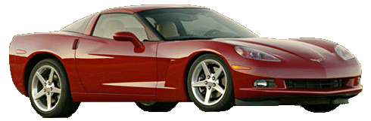
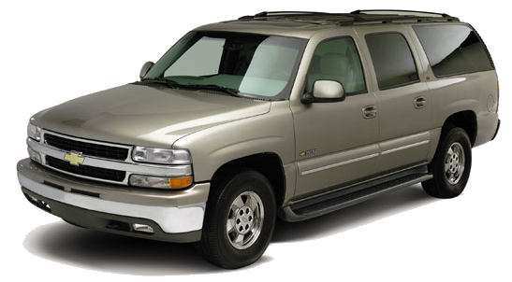
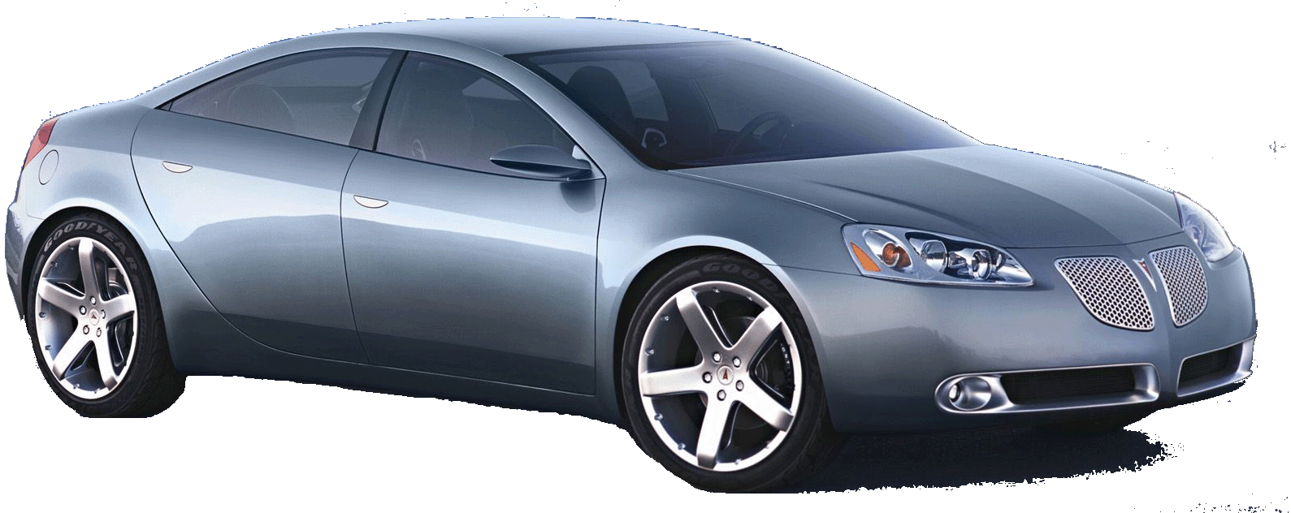

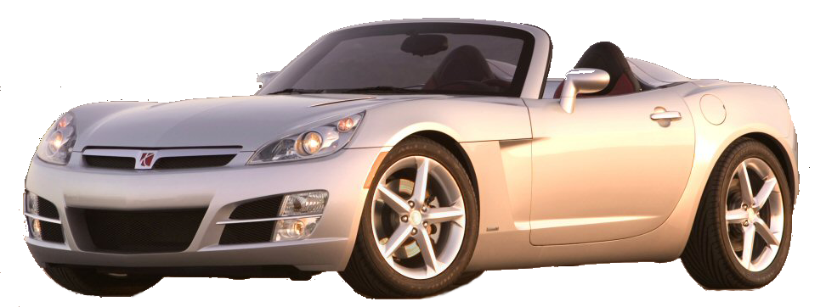
Thank You

