Slide 1



Step by Step Towards a Safe Contract: Insights from an Undergraduate Ethereum Lab
Elaine Shi, Andrew Miller
University of Maryland

Slide 2
Ethereum Lab Setup
Students worked in groups of 4.
Each group is assigned one graduate student advisor
My Ph.D. students

Slide 3
Ethereum Lab Setup
Phase 1: Proposer phase
Students develop of choice on Ethereum
Phase 2: Amendment/critique phase
Instructors and graduate TAs give feedback
Students critique each other’s designs
Students amend their designs

Slide 4
Ethereum Lab Outcome
The good news:
An inspiring experience where the students, my Ph.D. students, and I learned together
Some students said that they really enjoy learning about crypto-currency. Crypto-currency is awesome.
All students did an impressive job!

Slide 5
Ethereum Lab Outcome
The bad news:
Some students did not like the experience due to the in-development nature of the Serpent language -- despite the fact that they all did an impressive job!!

Slide 6
Apps Created by Students
Games (where people play for money)
Rock paper scissors, Russian Roulette, and many others
Escrow service
Auctions
blind auctions, silent auction
Parking meter
Stock market app

Slide 7
Lessons Learned
In Phase 1, we noticed that students created many “insecure” contracts.
Conclusion:
Security is difficult.
Programming smart contracts: you can mess up in new ways in comparison with traditional programming.

Slide 8
Step by Step Towards a Safe Contract

Slide 9

The Simplified Contract Programming Model
Contract
Store messages
Store $$$
Program logic
$$$
msg

Slide 10
The Simplified Contract Programming Model
Contract
Store messages
Store $$$
Program logic
$$$
msg
Data stored on block chain
Program executed by all miners

Slide 11
The Simplified Contract Programming Model
Contract
Store messages
Store $$$
Program logic
$$$
msg
“A trusted 3rd party with
no privacy”

Slide 12
Rock Paper Scissors Example
def add_player()
/* Player 1 and 2 enter the game by sending money.
Contract records their identities. */
def input()
/* Player 1 and 2 sends their input to contract
Contract records their inputs*/
def winner()
/* Decide the winner and sends balance on the contract
to the winner*/

Slide 13
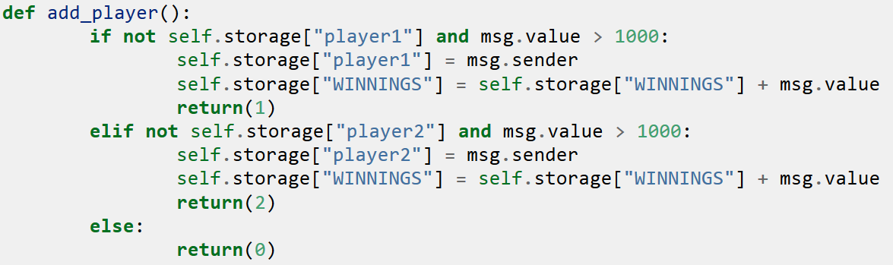
Typical mistake 1: corner cases in state machine

Slide 14
Typical mistake 1: corner cases in state machine
If 3rd player enters, or player sends < 1000 ethers, money is leaked
Similar mistakes arise in other applications.

Slide 15
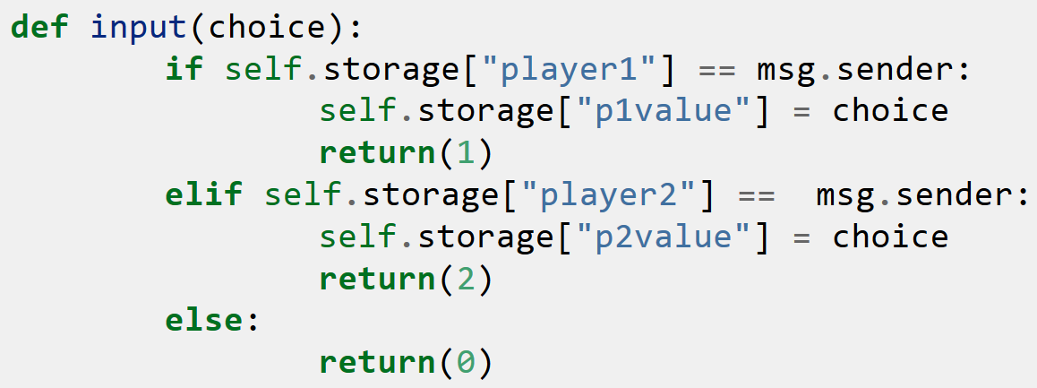
Typical mistake 2: failure to use cryptography

Slide 16
Typical mistake 2: failure to use cryptography
Players’ choices sent and stored in cleartext.

Slide 17
Typical mistake 2: failure to use cryptography
Solution: use cryptographic commitment

Slide 18
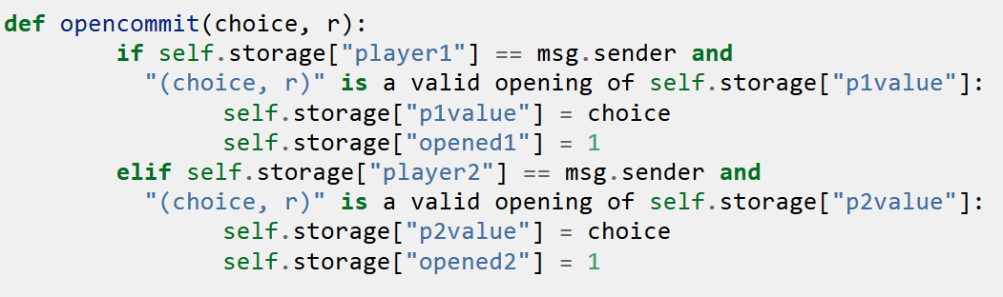
Typical mistake 3: incentive incompatible contracts

Slide 19
Typical mistake 3: incentive incompatible contracts
Player has no incentive to open commitment when he sees that he is losing.

Slide 20
Typical mistake 3: incentive incompatible contracts
Solution:
Require deposit to play. Player loses deposit if commitment is not opened after a time-out.

Slide 21
Coming Up Soon
Online course materials for programming smart contracts
Lab instructions and accompanying virtual machines
For instructors teaching cryptocurrency

Slide 22
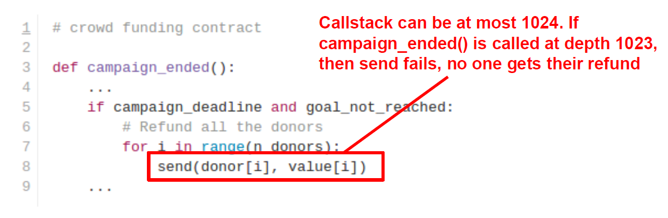

More Subtle Bugs

Slide 23
More Subtle Bugs

Slide 24
Thank you!
elaine@cs.umd.edu
http://www.cs.umd.edu/~elaine

