Slide 1
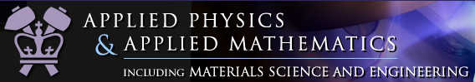


DiffPy - an open source library
for powder crystallography
Pavol Juhás

Slide 2
Design features
object oriented, designed for code sharing and long-term use
clean minimum interfaces between the library objects,
avoid spaghetti code
maximum code reuse, avoid exponential growth in code complexity
written in Python, safe naming scheme “diffpy.PackageName”
computationally intensive parts coded in C++, designed for speed and extensibility, can be used as a pure C++ library “libdiffpy”
Python bindings to the C++ functions,
Python layer designed for ease of use.
selected objects can be extended either from Python or C++
without re-compiling the library. Python is aware of C++ add-ons
and vice versa.
unit tests for Python and C++ functions

Slide 3
DiffPy – Python libraries for structure analysis
PDFgui (GUI)
diffpy.pdfgui → the PDFgui program, GUI definitions, interaction, refinement data organization
diffpy.pdffit2 → functions for PDF calculation and refinement
diffpy.Structure → structure data storage, input and ouput for CIF, PDB, xyz…
SrRietveld (GUI)
diffpy.srrietveld → the program launcher, GUI definitions and interaction
diffpy.refinementdata → HDF5 data storage for sequential Rietveld results
diffpy.pygsas → interface to GSAS, reading and writing of EXP files
diffpy.pyfullprof → interface to FullProf, reading and writing of PCR files
SrFit/SrReal (scripts)
diffpy.srfit → setup and control of general fitting problems, control of constraints and restraints, complex structure refinement to multiple datasets
diffpy.srreal → calculators of pair based quantities from structure model
(PDF, bond lengths, bond valence sums, empirical radii overlap)
pyobjcryst → Python bindings to the ObjCryst C++ library, advanced crystal structure (asymmetric unit, molecules, rigid groups)
[ V. Favre-Nicolin, J. Appl. Cryst. 35 (2002), 734-743]
contacts: Billinge group http://groups.google.com/group/diffpy-users
http://www.diffpy.org/ http://groups.google.com/group/diffpy-dev

Slide 4
Demonstration of diffpy.srreal
SrReal is
collection of calculators for bond distances, atom radii overlap,
valence sums, pair distribution function
intended for structure analysis using atomic pair distribution function (PDF), future calculation engine for the PDFgui program
useful for structure determination and validation, investigation of local distortions in crystalline samples, disordered and amorphous materials
highly configurable, extensible, easy to use. Amendable for future
improvements in PDF modeling. PDF calculation can be tweaked by the users. New calculators can be added by the users.
SrReal is not
GUI or standalone program. SrReal can be used only from Python or C++.
structure refinement code. SrReal needs to be combined with other optimization software, e.g. SrFit, to perform structure refinement.

Slide 5
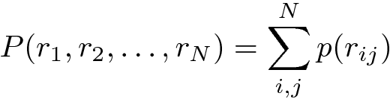
PairQuantity
the base calculator – shared recipe for evaluating physical quantities based on pair-interactions. Used as a blueprint for all calculators.
support for partial sums
optional upper and lower distance bounds
support for parallel evaluation
related:
class StructureAdapter
  adapts arbitrary structure representation to a srreal-compatible interface
  implemented for PDFgui Structure representation and for
  Crystal and Molecule objects in the ObjCryst C++ library
  [V. Favre-Nicolin, J. Appl. Cryst. 35 (2002), 734-743]
  extensible for other structure representations in Python or C++

Slide 6
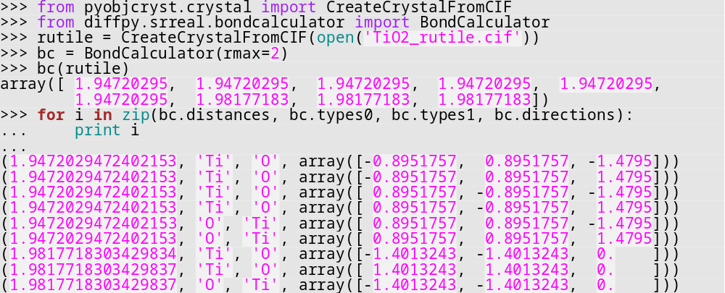
BondCalculator
calculate oriented bond vectors up to a specified distance limit
optional filtering by atom types, site indices, direction cones
example:

Slide 7
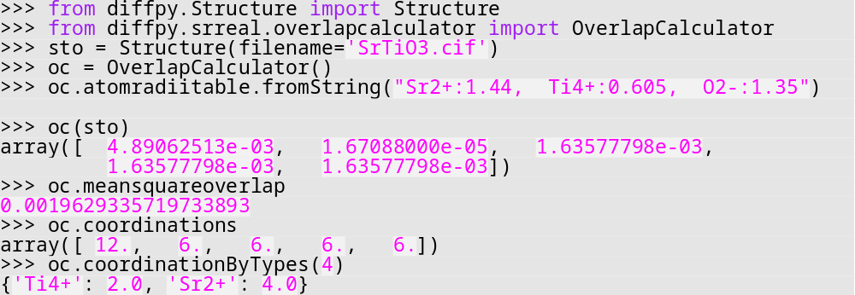
OverlapCalculator
calculate overlap of empirical atom radii
other results: site square overlap, coordination numbers, coordination histograms, neighborhoods of touching sites, overlap gradients
related: class AtomRadiiTable
  radius lookup by atom symbol
  support for custom atom radii
example:

Slide 8
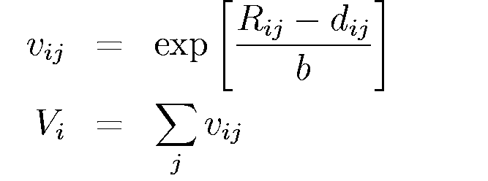
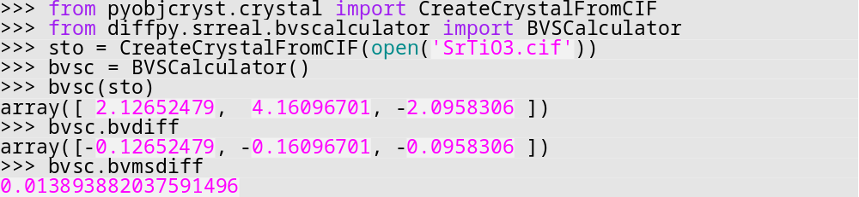
BVSCalculator
bond valence sums – approximate
formula for ion valences
evaluates valence at each site, BVS difference, mean square BVS difference which accounts for partial occupancies and site multiplicities
related: class BVParametersTable
  lookup of bond valence parameters, [bvparm2009.cif by I. D. Brown]
  option to define and revert custom BVS parameters
example:
Brese, Acta Cryst. B47, 192-197 (1991)

Slide 9
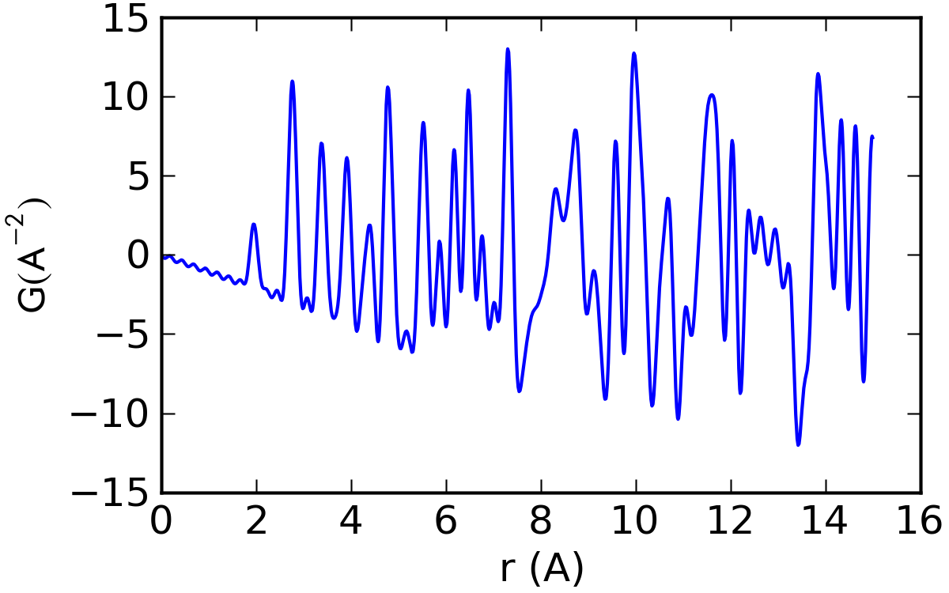

PDFCalculator
PDF calculation in real-space
  suitable for periodic systems
  one structure per calculator → mixed-phase PDFs obtained by
  combining several PDFCalculator objects
other results: radial distribution function, partial PDFs, F(Q)
class ScatteringFactorTable
  lookup of xray, netron or electron scattering factors
  support for custom scattering factors
class PeakProfile – the profile function for a pair contribution
class PeakWidthModel – calculates profile width for a given atom pair
class PDFEnvelope – one or more r-dependent scaling envelopes
class PDFBaseline – the baseline function, by default –4πρ₀ r
example:

Slide 10
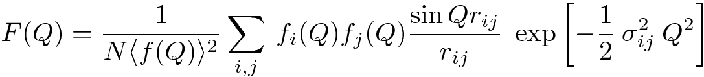
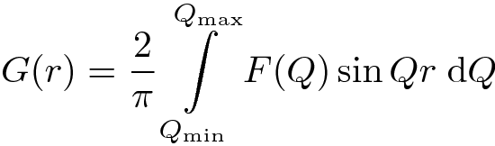
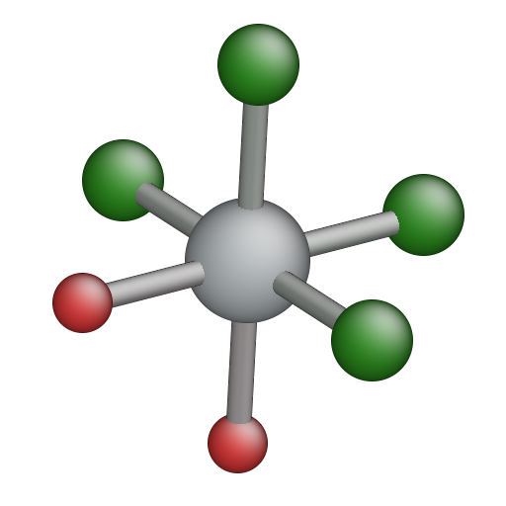
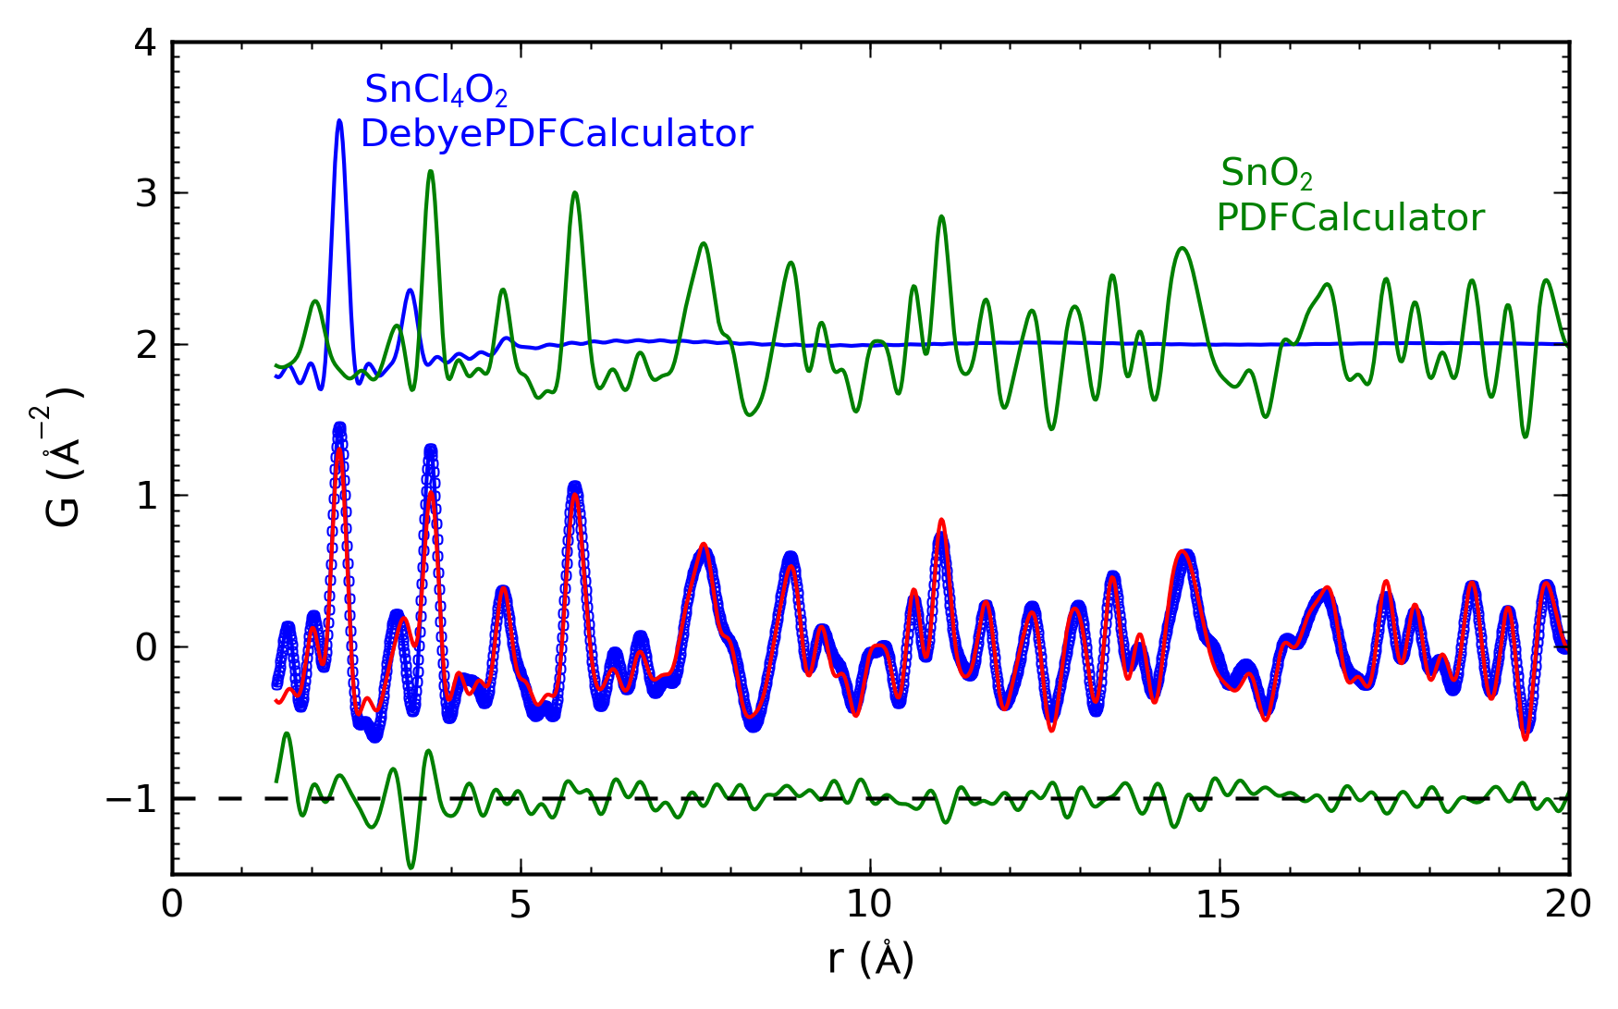
DebyePDFCalculator
PDF calculation in Q-space – F(Q) calculated by Debye scattering equation
and Fourier transformed to G(r)
suitable for molecules or nano-clusters
PDF baseline simulated by Q_{min} cutoff in the calculated S(Q)
example:
work by Kirsten L. Jensen, Aarhus Universitat, Denmark
in-situ studies of SnO₂ formation from SnCl₄.5H₂O
time dependence of the precursor – target ratios

Slide 11
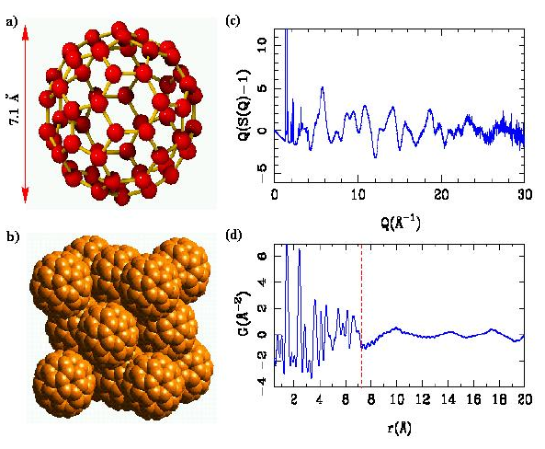
PDF modeling of fcc-C₆₀
neutron PDF measured on C₆₀ fcc structure
[GLAD IPNS, E. Bozin]
low-r sharp peaks – correlations within C₆₀
high-r broad peaks – correlations between randomly oriented balls
Can we simulate PDF on
a full measured range?
calculate as a sum of single particle PDF and PDF from a lattice of spherical shells

Slide 12
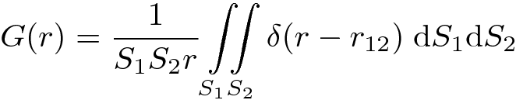
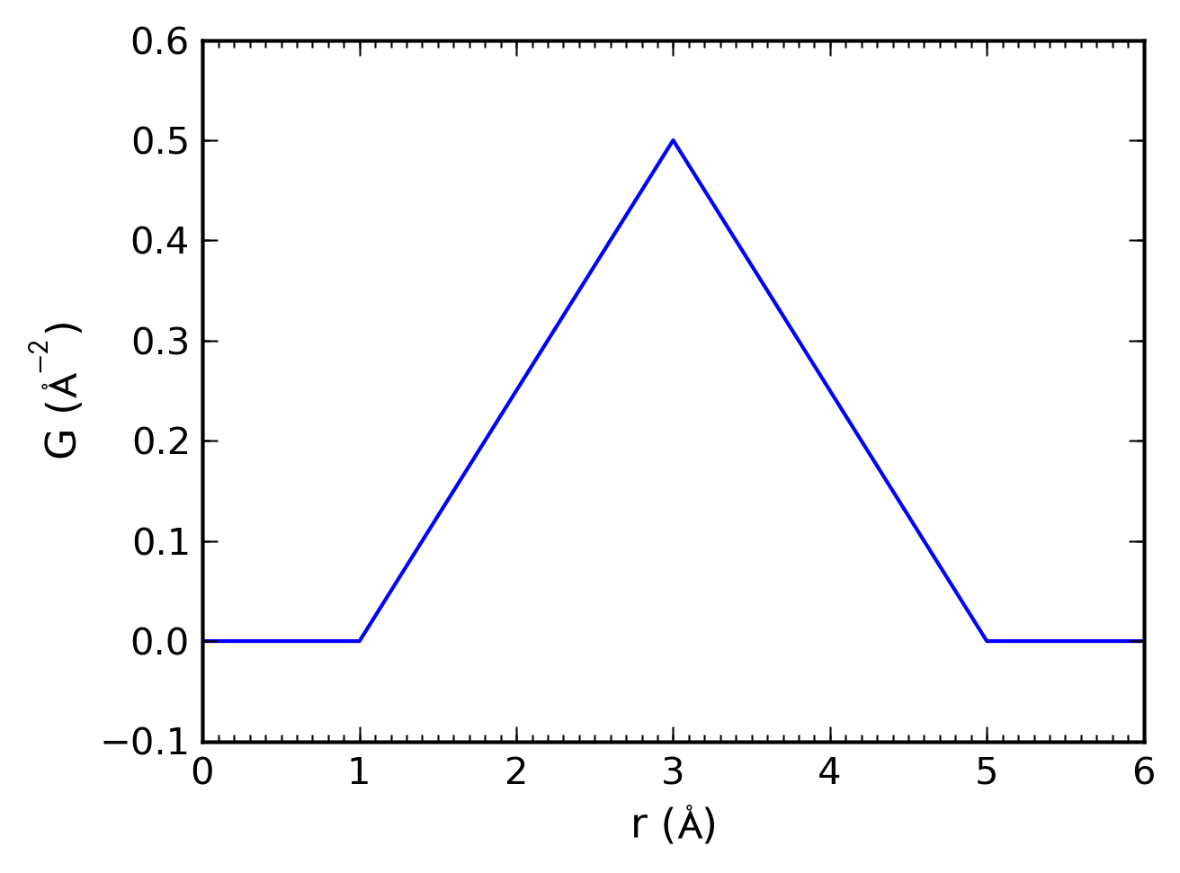
PDF peak profile for spherical shells
D
PDF of two spherical shells can be calculated analytically
triangular profile centered at spheres’ distance D
cluster of spherical shells →
PDF calculation requires
triangular profile function
non-standard PDF profile requires
  definition of the profile function
  select it for a PDFCalculator instance

Slide 13
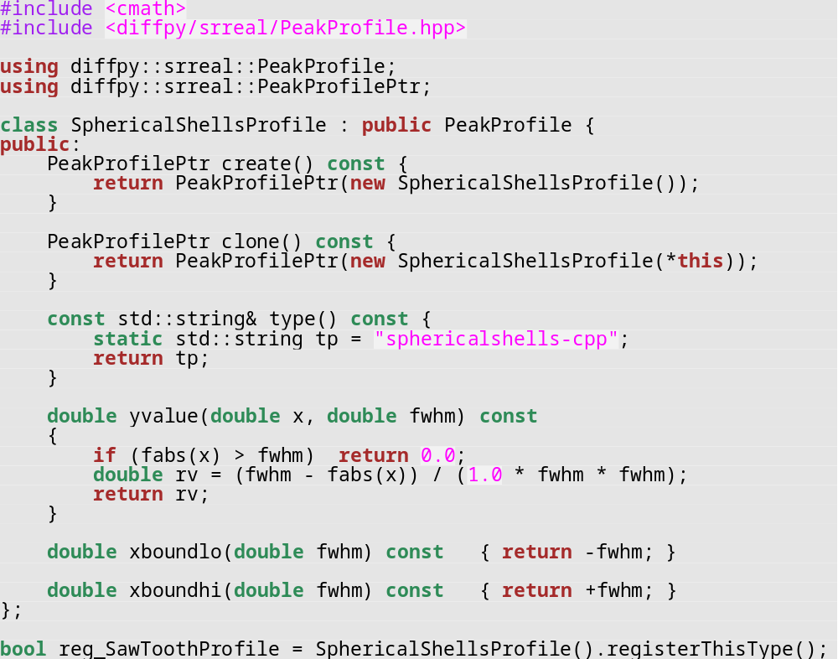
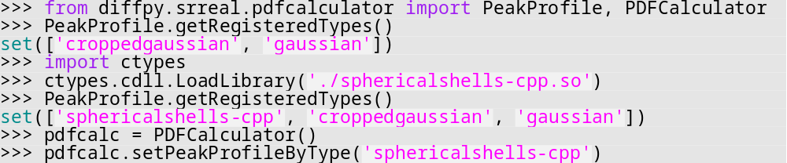
Custom PDF peak profile
profile defined in C++
new profile functions can be defined either in Python or C++
for C++ the profile function is compiled as a dynamic link library sphericalshells-cpp.so
on loading the library adds new profile to the global registry → profile ready for use in Python
no need to rebuild any other C++ sources related to PDFCalculator
no need to write any Python wrappers for the new profile function
profile used in Python

Slide 14
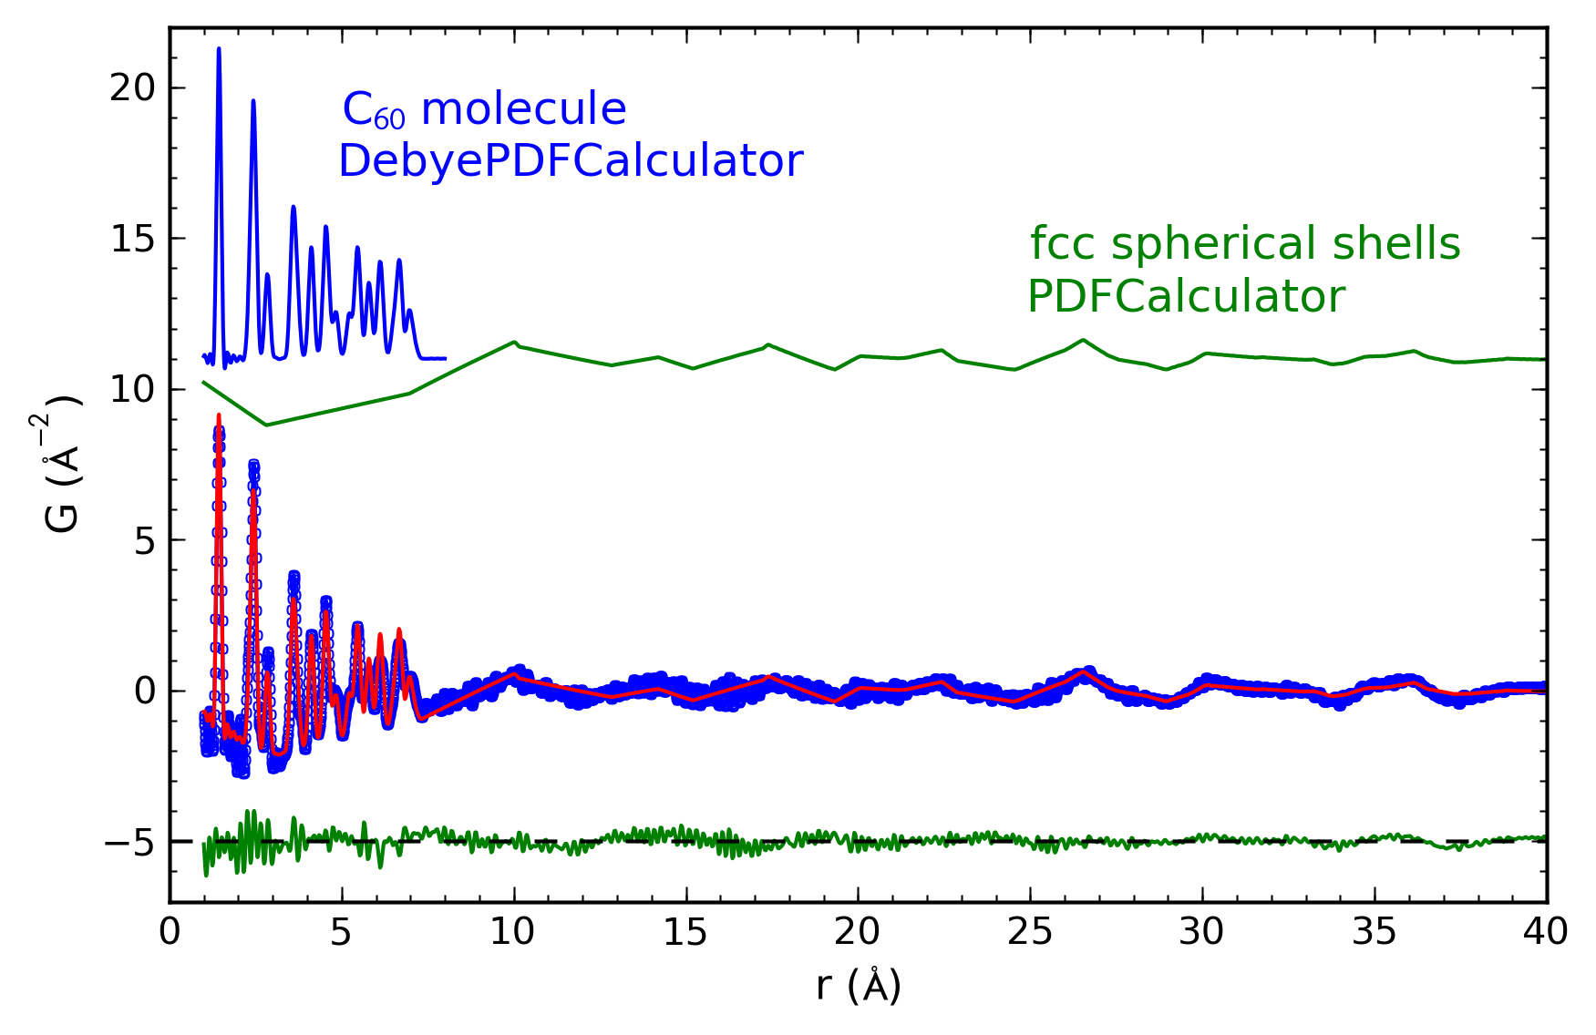
PDF refinement of fcc C₆₀
fit residuum R_{w} = 0.26 scale ratio = 60.0(1) U_{iso} = 0.00323(4)
molecule diameter = 7.113(2) shell diameter = 7.22(4)
PDF from fcc C₆₀ can be refined on the full measured range accounting for
both intra and inter-molecular correlations

Slide 15
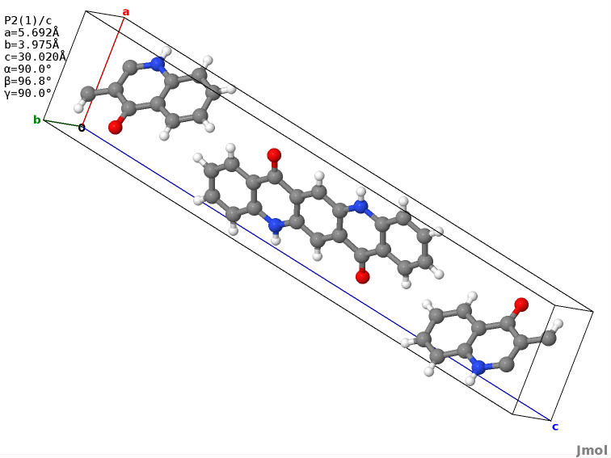
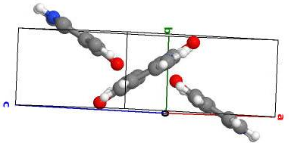
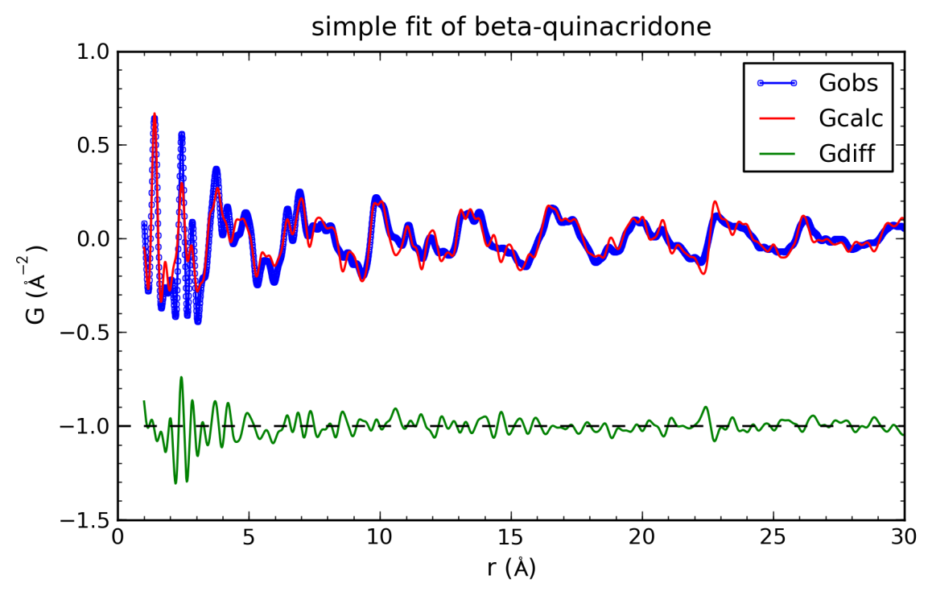
PDF modeling of beta-quinacridone
monoclinic P2₁/c, 2 molecules per unit cell
simple refinement gives poor
R_{w} = 0.405
  low-r peaks too wide
  high-r peaks too sharp
simple model assumes indepen-dent isotropic thermal vibrations
peak widths depend strongly on r
  sharp peaks for intra-molecular atom pairs
  broad peaks for inter-molecular correlations
PDF model has to use different thermal factors for pairs in the same molecule and inter-molecule pairs

Slide 16
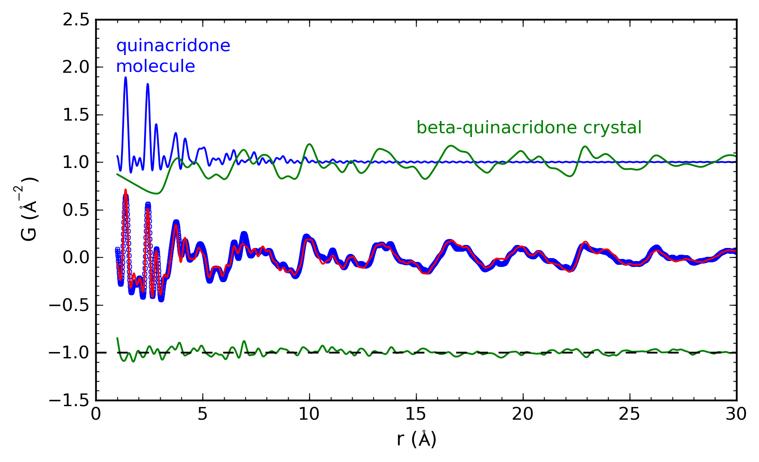
PDF modeling of beta-quinacridone
PDF calculated from three-components as a + b - c
  (a) isolated quinacridone molecule with small thermal factors
  (b) beta-phase crystal with large thermal factors
  (c) isolated molecule with the same thermal factors as in b)
fit residuum improved, R_{w} = 0.236

