Slide 1
Sample, compare, improve
GRPO-based online RL for diffusion models
Jie Liu
The Chinese University of Hong Kong
https://jieliu.site
Diffusion Alignment · ECCV 2026

Slide 2
How this session fits
Approach | Feedback used for the update | Data collection
Direct reward backpropagation | Gradient through a differentiable reward | Generated samples
DPO-style preference learning | Chosen / rejected pairs | Fixed or refreshed pairs
Online policy gradient | Scalar rewards and trajectory log-probabilities | Repeated policy rollouts
Today: generate a group, score it, update the policy, then sample again.
2

Slide 3
From rewards to online optimization
VideoAlign
What should the reward measure for video generation?
Flow-GRPO
How can we optimize flow matching models with online RL?
UniGRPO
How can text and image generation learn together through RL?
3

Slide 4





Improving Video Generation with Human Feedback
VideoAlign
Jie Liu*, Gongye Liu*, Jiajun Liang, Ziyang Yuan, Xiaokun Liu, Mingwu Zheng
Xiele Wu, Qiulin Wang, Menghan Xia, Xintao Wang, Xiaohong Liu, Fei Yang
Pengfei Wan, Di Zhang, Kun Gai, Yujiu Yang✉, Wanli Ouyang
4

Slide 5
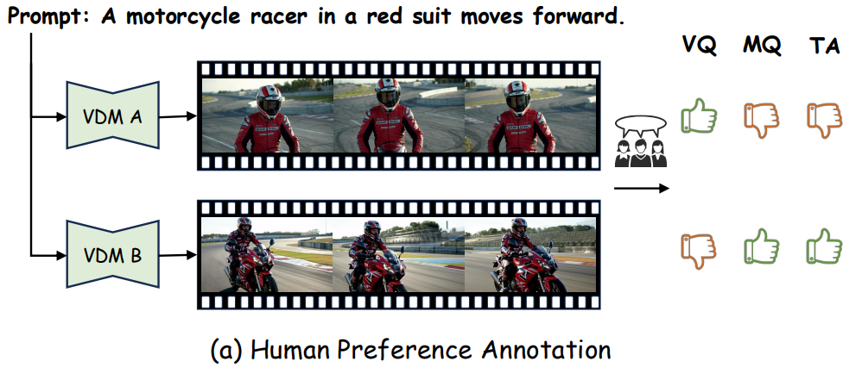
VideoAlign: defining useful feedback
12 video models
182k annotated triplets
VQ | Visual quality
MQ | Motion quality
TA | Text alignment
5

Slide 6
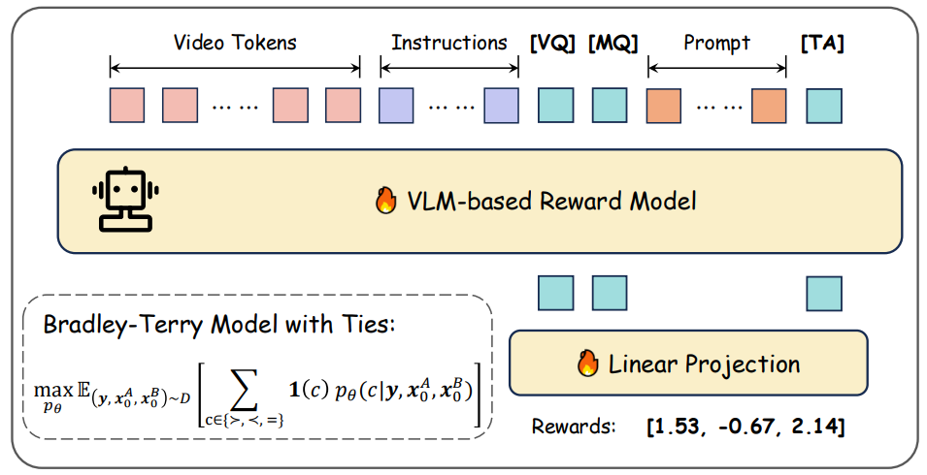
VideoAlign: reward modeling
VQ and MQ precede the prompt; TA also conditions on the prompt.
6

Slide 7
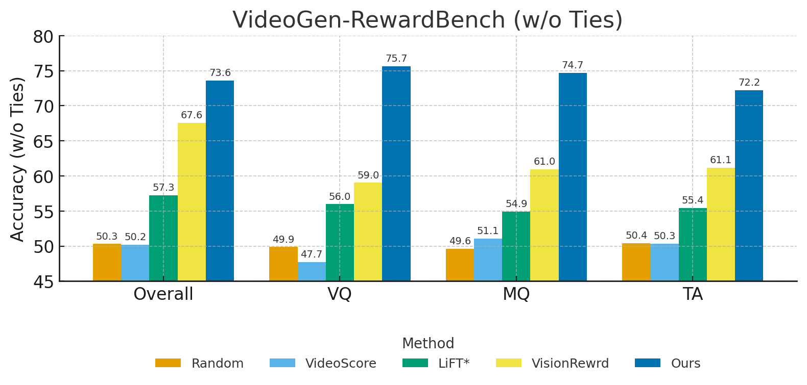
Reward quality needs its own evaluation
Agreement with human preferences is one check before policy optimization.
7

Slide 8
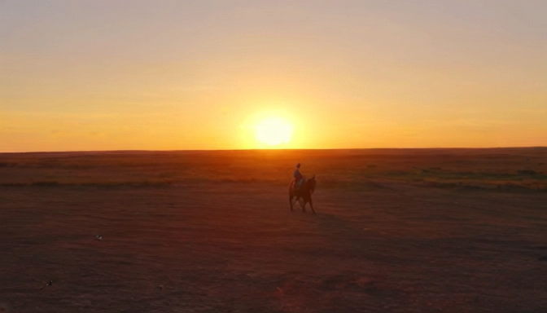
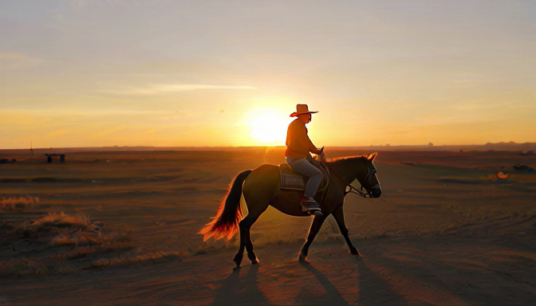
VideoAlign: a generation example
A cowboy rides his horse across an open plain at sunset.
Base model
After alignment
VideoAlign qualitative example; original embedded clips
8

Slide 9

Flow-GRPO:
Training Flow Matching Models via Online RL
Jie Liu*, Gongye Liu*, Jiajun Liang, Yangguang Li,
Jiaheng Liu, Xintao Wang, Pengfei Wan, Di Zhang, Wanli Ouyang✉
9

Slide 10
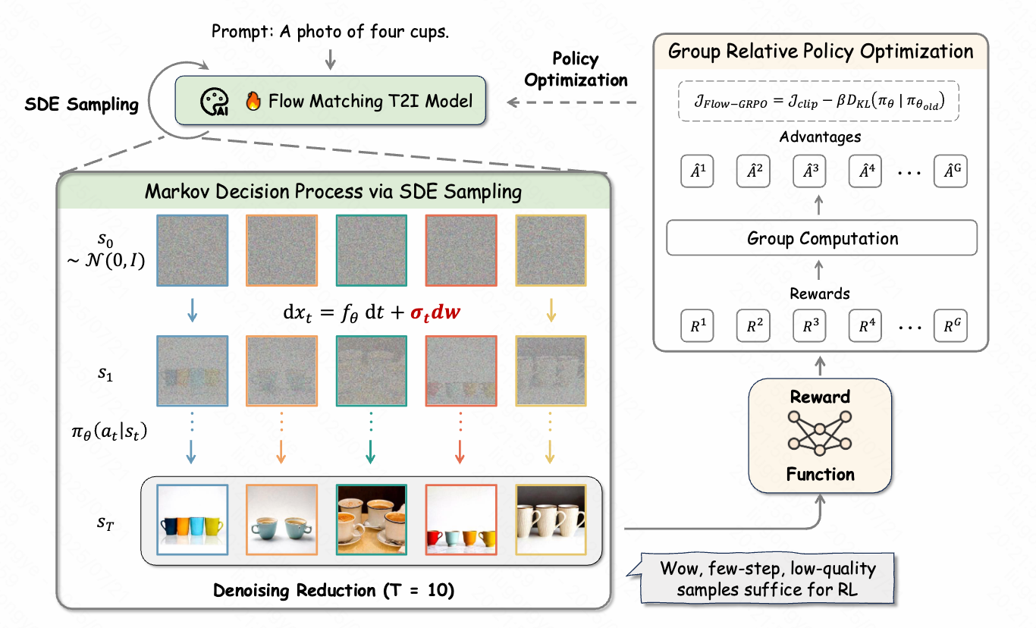
Flow-GRPO: the full training loop
Flow-GRPO, NeurIPS 2025
10

Slide 11
Denoising as a policy
RL quantity | Denoising interpretation
State
Action
Policy | Distribution of the next denoising step
Terminal reward | Score of the decoded final image
MDP formulation: DDPO (Black et al., 2024).
11

Slide 12
One prompt, one group of samples
Prompt: “A photo of four cups.”
Sample | Detected cups | Reward
A | 0 | 0.0
B | 2 | 0.5
C | 2 | 0.5
D | 4 | 1.0
Group sampling: GRPO (Shao et al., 2024). Counting reward: Flow-GRPO.
Counts and reward values shown here are illustrative.
12

Slide 13
Group-relative advantage
Sample | Reward | Advantage
A | 0.0 | −1.414
B | 0.5 | 0
C | 0.5 | 0
D | 1.0 | +1.414
The group supplies the baseline; no separate value network is needed.
Group-relative advantage: GRPO (Shao et al., 2024).
Illustrative example uses population standard deviation and a negligible stabilizer.
13

Slide 14
The probability ratio
Same sampled transition
Compare the current policy with the policy that collected the rollout.
Signed learning signal
Positive advantage favors the transition; negative advantage discourages it.
The old-policy log-probability is stored during sampling
14

Slide 15
Clipping limits the update incentive
Advantage | Ratio ρ | ρA | Clipped term | Minimum
+1 | 1.5 | 1.5 | 1.2 | 1.2
−1 | 0.5 | −0.5 | −0.8 | −0.8
Clipping stops rewarding an excessively large change in the favored direction.
Clipped surrogate: PPO (Schulman et al., 2017).
Clipping limits the objective incentive, not the final probability ratio.
15

Slide 16
One update, then fresh rollouts
1 Sample groups with the rollout policy and cache the trajectories.
2 Score final images and compute group advantages.
3 Optimize the clipped surrogate, with a reference KL term.
4 Refresh the rollout policy from the updated model and collect new groups.
 | Policy that collected the current rollout batch
 | Fixed reference policy used for regularization
GRPO updates the generator; reward-model training is a separate stage
16

Slide 17
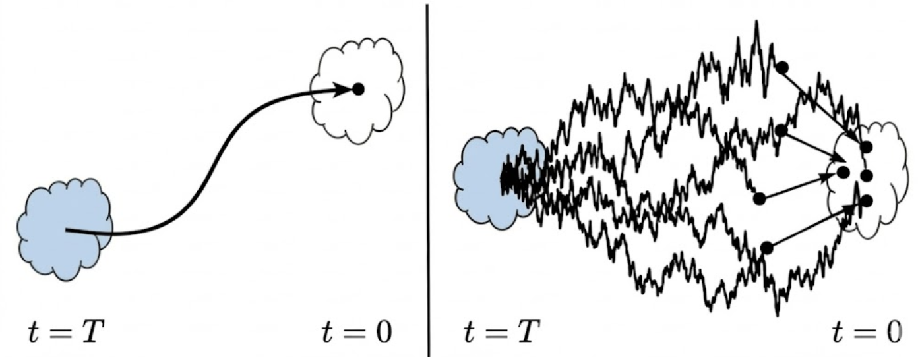
From ODE sampling to a stochastic policy
ODE sampling
Once the current latent is fixed, the next step is deterministic.
SDE sampling
Gaussian noise makes intermediate transitions stochastic, with a tractable density.
Noise changes the distribution. The drift compensates for that change.
With the correct drift, the ODE and SDE share the same marginal distributions.
Continuous-time statement with an exact velocity/score. Flow-GRPO, Sec. 4.
17

Slide 18
Flow-GRPO: the ODE-to-SDE construction
A reverse-time SDE with the same marginal distributions
The added drift term compensates for the sampling noise.
Euler–Maruyama sampling with a positive step size h
The Gaussian transition gives tractable policy ratios and a closed-form reference KL.
Flow-GRPO, Sec. 4, Eqs. (8)–(9). Here h > 0 and the sampler moves from t to t − h.
18

Slide 19
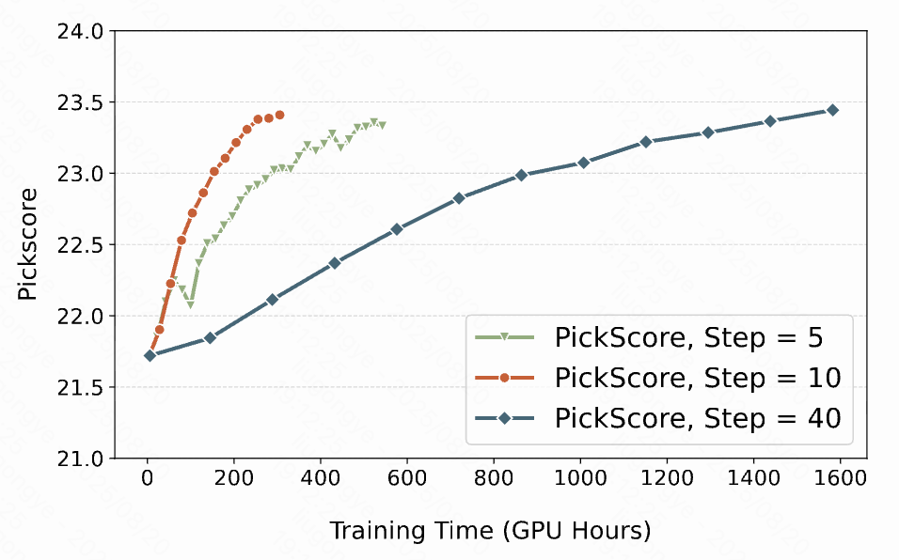
Fewer rollout steps reduce training cost
Training
10 steps
Inference
40 steps
SD3.5-M setting; PickScore versus training time from the original experiment
19

Slide 20
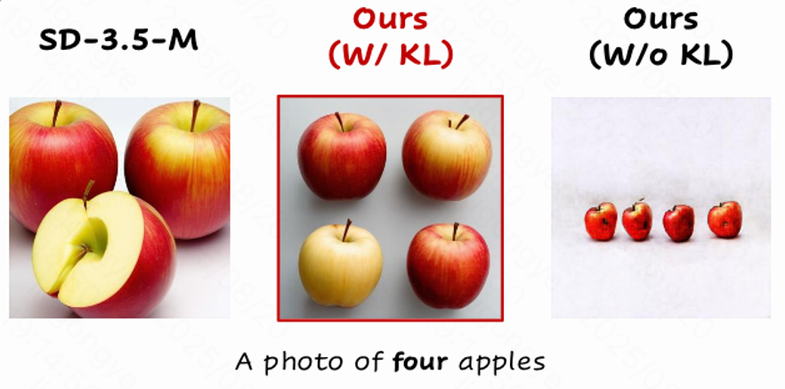
Reference KL and reward hacking
Task reward, visual quality, and diversity need separate checks.
20

Slide 21
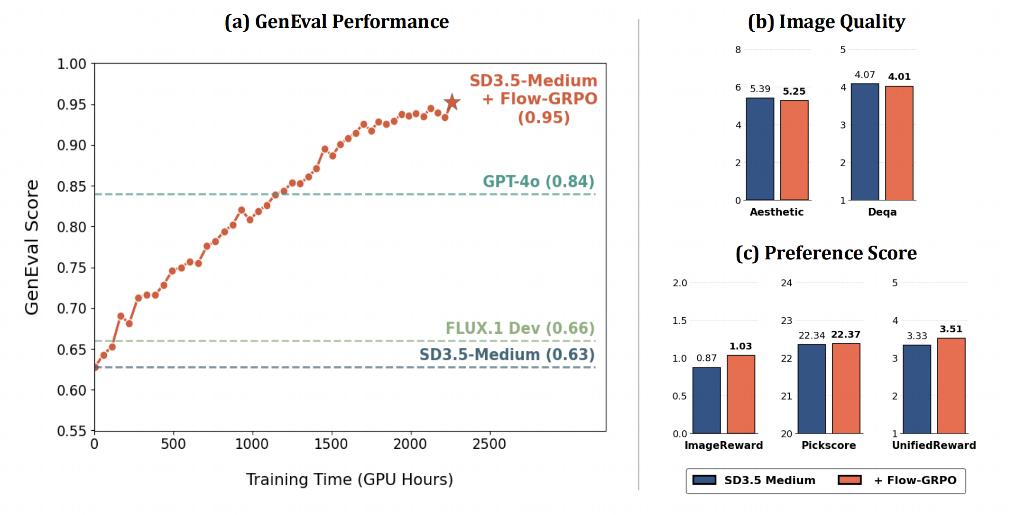
Flow-GRPO: measured gains
Original Flow-GRPO experiment; historical model versions and benchmark protocol
21

Slide 22
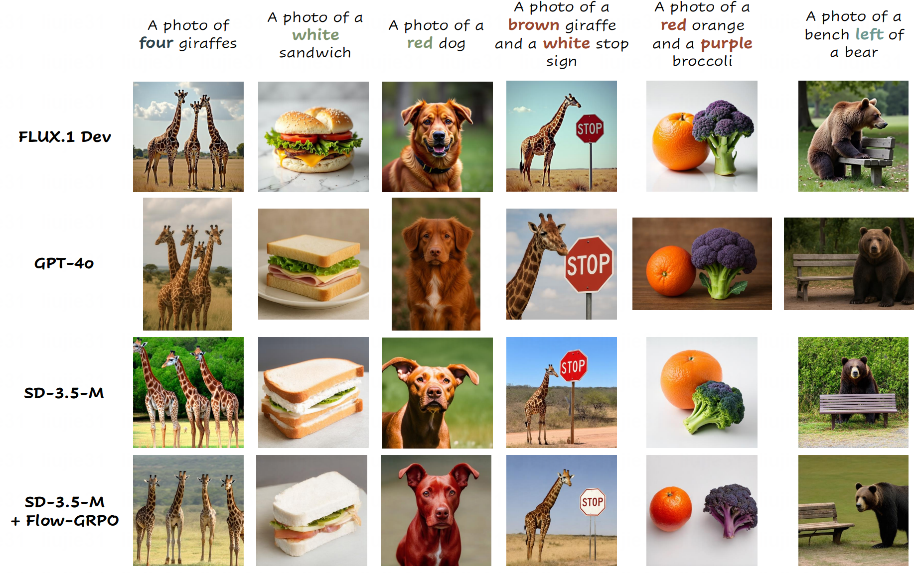
Flow-GRPO: qualitative examples
Selected examples from the original paper; aggregate results are reported separately
22

Slide 23
What to monitor during online RL
Observation | First checks
Groups have identical rewards | Prompt difficulty, reward resolution, group diversity
Updates drift or oscillate | Learning rate, clipping, rollout freshness, reference KL
Reward rises but images deteriorate | Held-out prompts, independent quality metrics, diversity
Training is too slow | Rollout steps, group size, reward inference cost
A useful run improves independent evaluation within a known compute budget.
23

Slide 24
UniGRPO on BAGEL: text before image generation
BAGEL combines autoregressive text generation with flow-based image generation in one model.
Both runs start from the same BAGEL checkpoint after SFT.
FlowGRPO trains the DiT part, with thinking off or on.
FlowGRPO training | TA score | GenEval
Thinking off during RL | 0.8112 | 0.88
Thinking on during RL | 0.8208 | 0.86
Adding thinking during image-only RL does not consistently improve GenEval.
BAGEL: Deng et al. (2025). Results: UniGRPO, Table 1.
TA measures text alignment. GenEval measures compositional generation.
24

Slide 25
A joint policy over text and image trajectories
Text policy
Choose a text sequence y conditioned on the original prompt c.
Image policy
Generate a denoising trajectory τ conditioned on c and y.
25

Slide 26
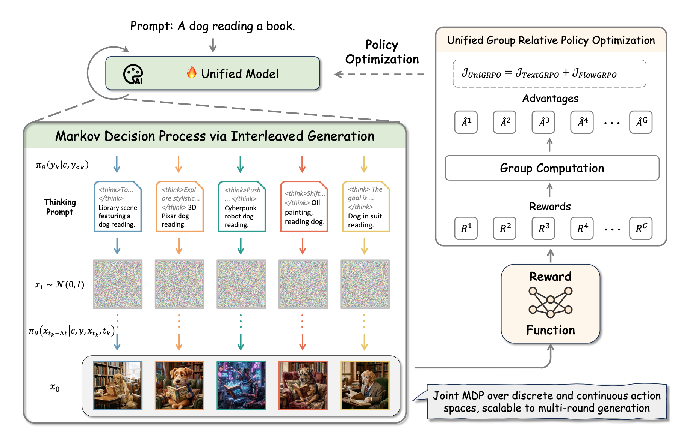
UniGRPO: unified group-relative optimization
Reported experiments use λ = 1.
26

Slide 27
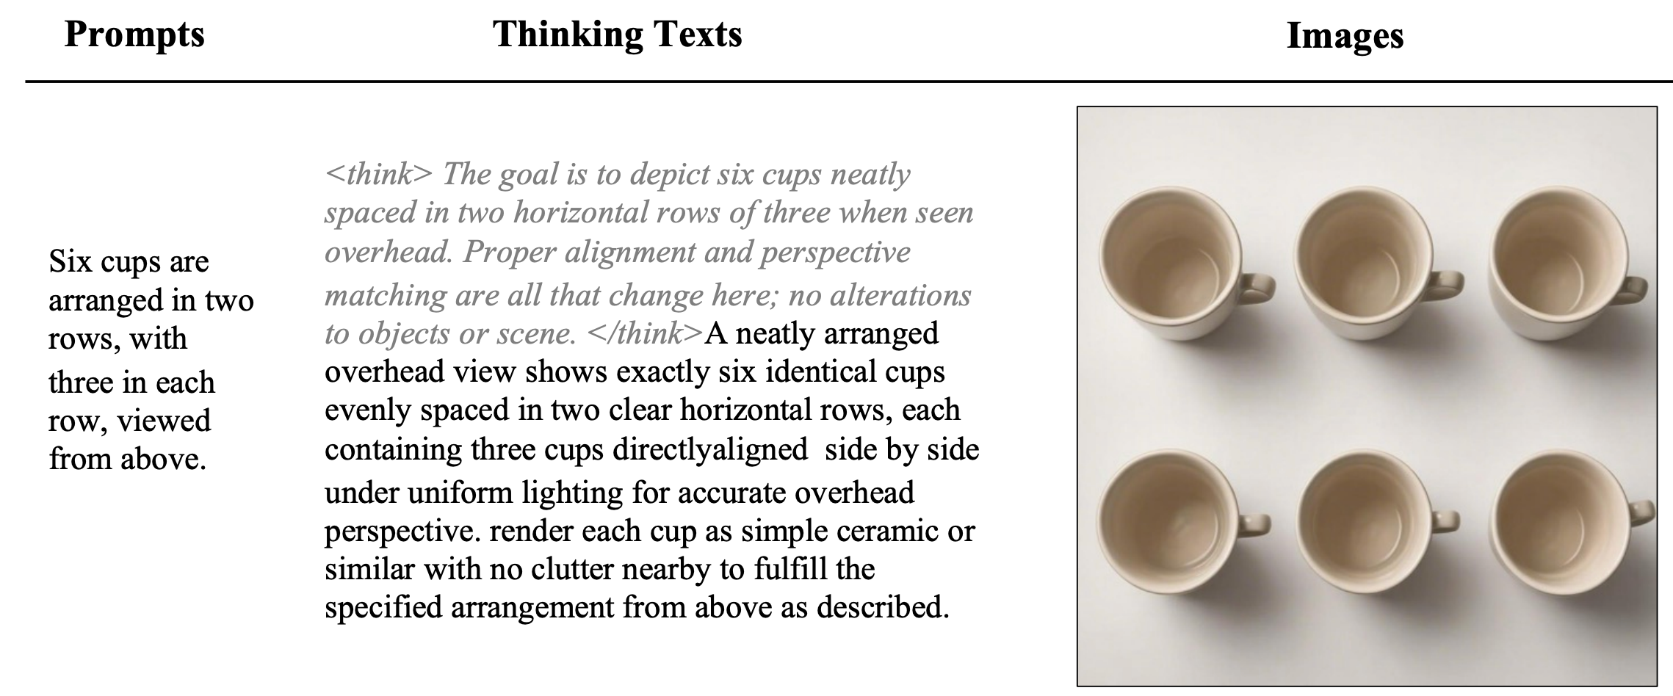
UniGRPO: a layout example
Original UniGRPO example, including the complete generated text.
27

Slide 28
UniGRPO: results of joint optimization
Method | Thinking | TA score | GenEval
FlowGRPO | No | 0.8112 | 0.88
FlowGRPO | Yes | 0.8208 | 0.86
TextGRPO | Yes | 0.8078 | 0.88
UniGRPO | Yes | 0.8381 | 0.90
All RL methods start from the fine-tuned Bagel checkpoint.
UniGRPO experiments; full results in the appendix
28

Slide 29
Takeaways and discussion
VideoAlign
A useful reward separates the qualities we want to improve.
Flow-GRPO
Group comparisons train a stochastic denoising policy online.
UniGRPO
Text and image generation can share an optimization objective.
Jie Liu · https://jieliu.site · Code: github.com/yifan123/flow_grpo
29

