Slide 1
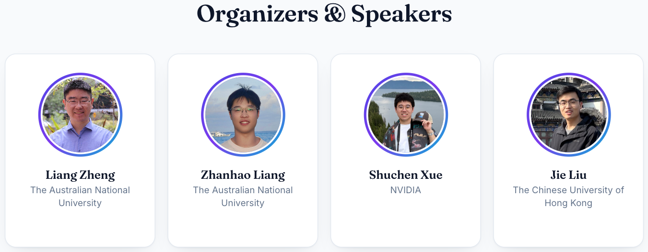
Aligning Diffusion Models with Human Preferences
https://diffusion-alignment.github.io/

Slide 2
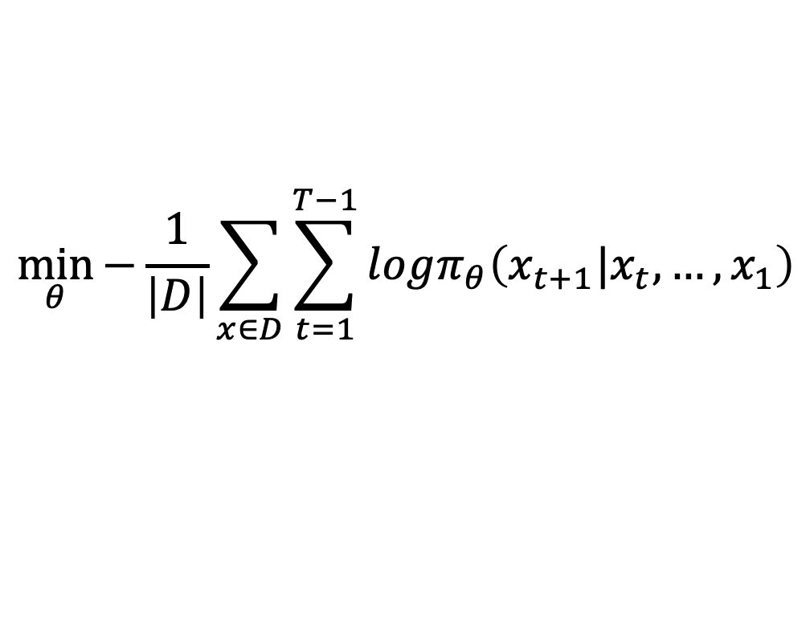
Why post-training for LLMs?
LLMs cannot chat with people merely after pre-training
Instruction tuning:
Let LLMs be able to communicate with people and follow instructions
Example 1: Simple Q&A Prompt
Question: What is the capital of France?
Answer:
GPT-2 continues after Answer:.
DPO/GRPO:
Improve LLM responses to be more aligned with human preferences / accurate
$$\min_{θ}{−\frac{1}{\left|D\right|}\sum_{x∈D}{\sum_{t=1}^{T−1}{logπ_{θ}\left(x_{t+1}|x_{t},…,x_{1}\right)}}}$$

Slide 3
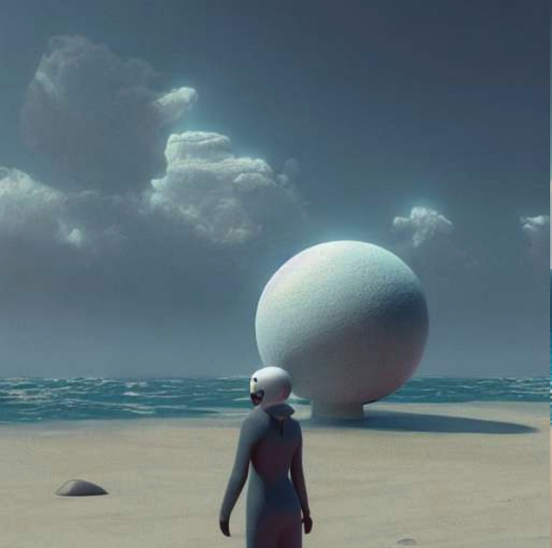
Why post-training for diffusion model?
Is there a need for instruction tuning?
  No need for t2i diffusion models
What do we aim for diffusion post-training then?
  Pre-training images have a large amount, have a wide coverage, and have various quality
  Good-quality images have a smaller distribution
Improve image quality
  Text-image alignment
  Aesthetics
  Realism
  Text rendering
  etc
Spaceship and waves, 3d, unreal engine 5, octane render, detailed, cinematografic, cinema 4 d, nvidia ray tracing graphics, artstation, greg rutkowski style, style rene magritte.

Slide 4
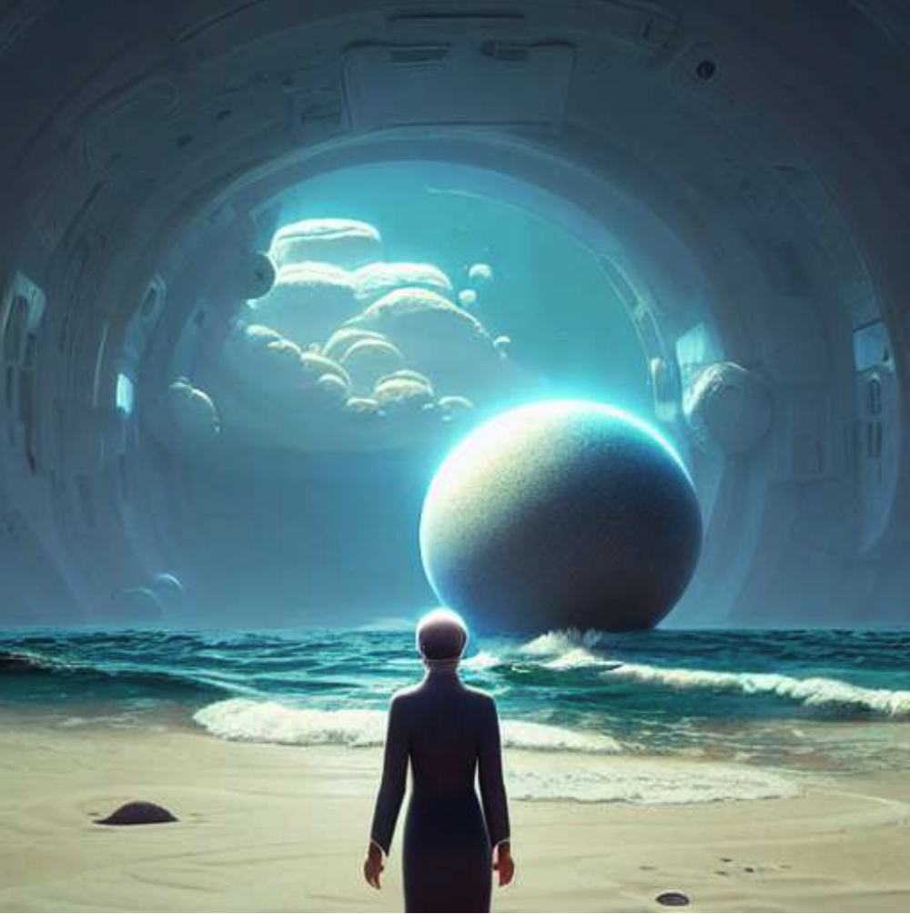
Why post-train diffusion models?
Original (only with pre-training)
w/ post-training
Spaceship and waves, 3d, unreal engine 5, octane render, detailed, cinematografic, cinema 4 d, nvidia ray tracing graphics, artstation, greg rutkowski style, style rene magritte.
Xu et al., ImageReward: Learning and Evaluating Human Preferences for Text-to-Image Generation. April 2023

Slide 5
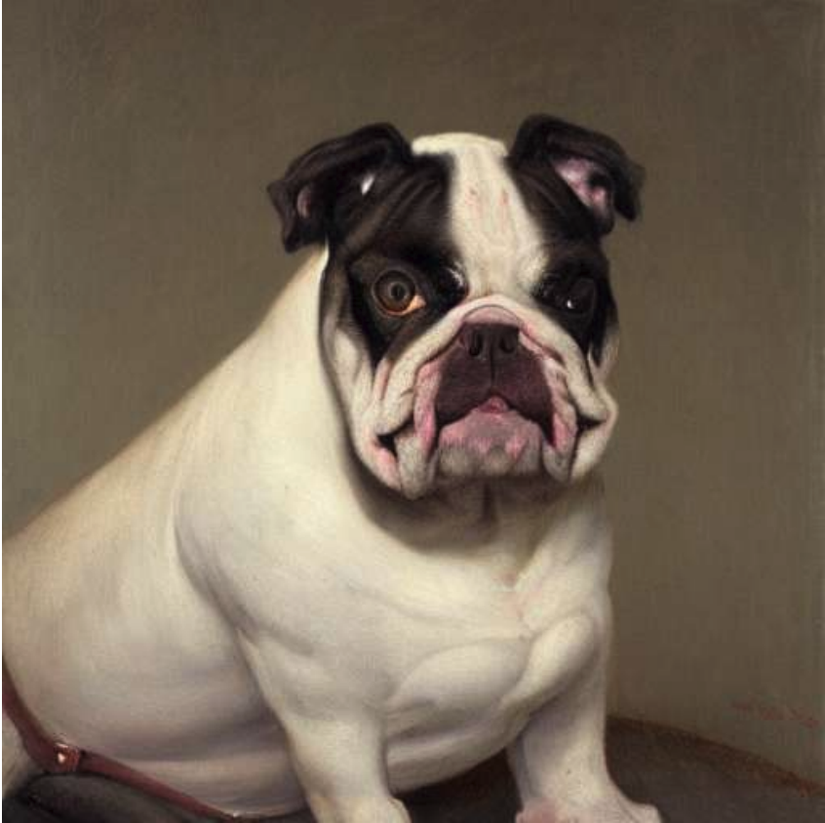
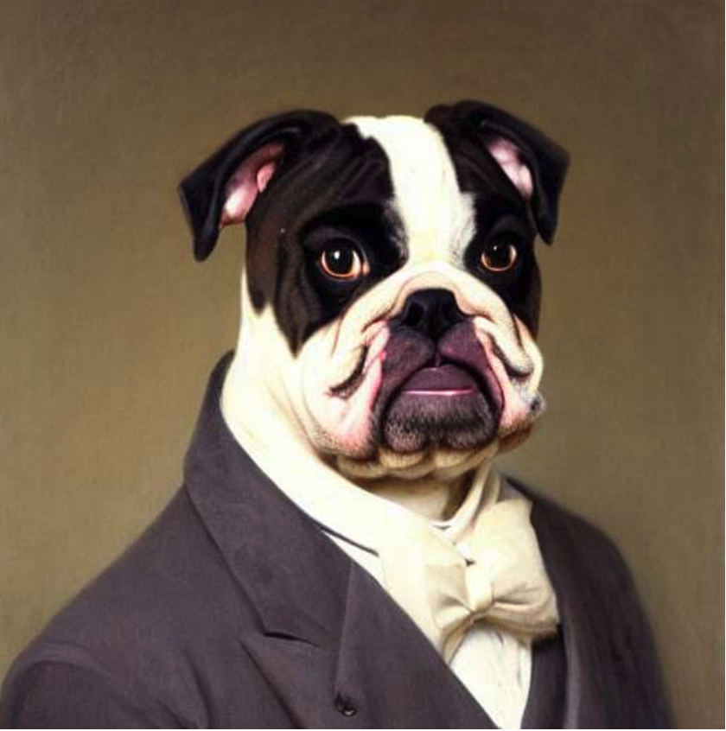
Why post-train diffusion models?
Original (only with pre-training)
w/ post-training
Portrait of a man who looks like a bulldog, oil on canvas by william sidney mont, 1 8 8 3, trending on art station.
Xu et al., ImageReward: Learning and Evaluating Human Preferences for Text-to-Image Generation. April 2023

Slide 6
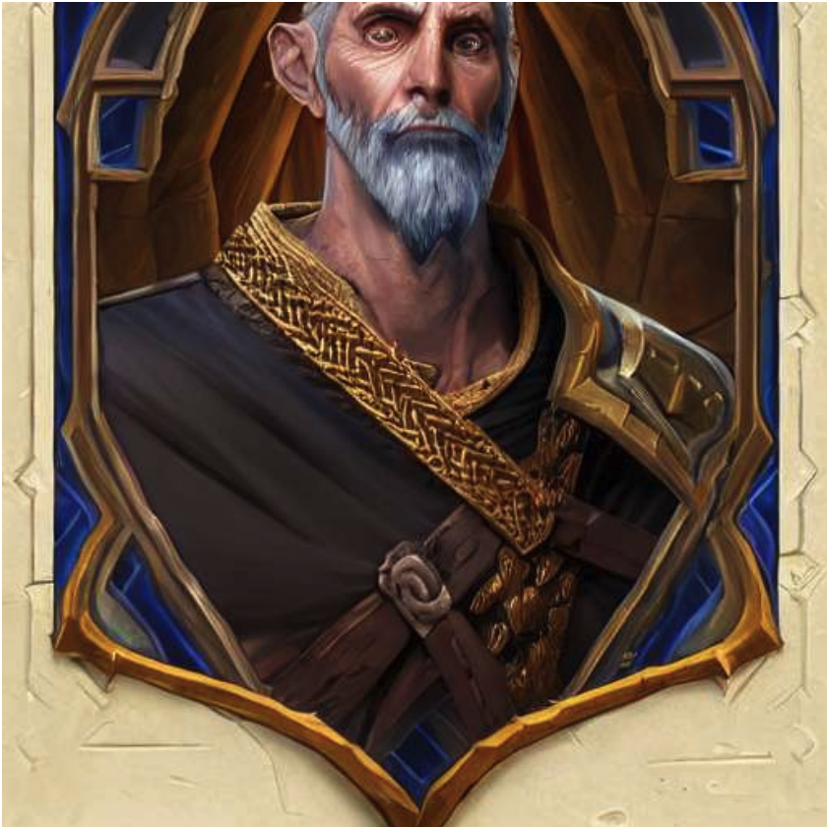
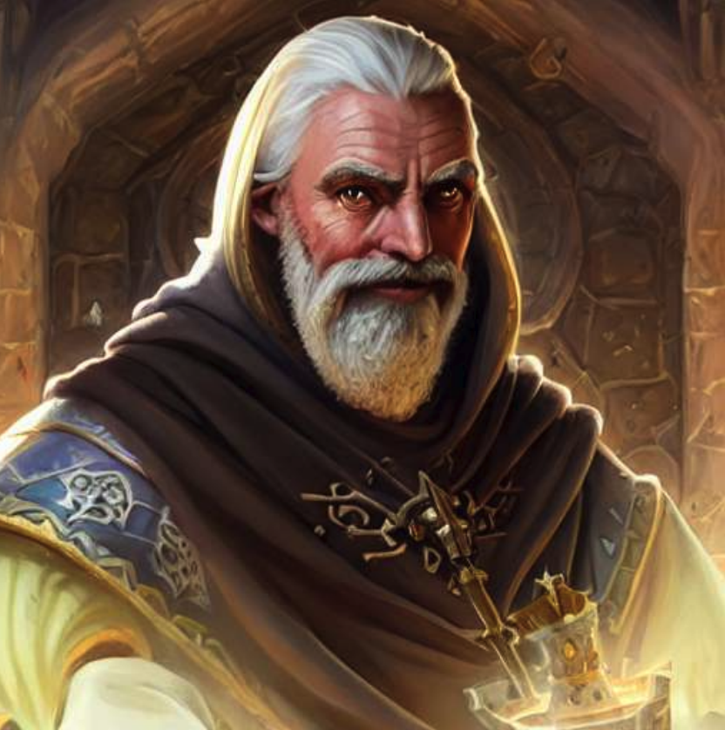
Why post-train diffusion models?
Original (only with pre-training)
w/ post-training
Portrait of a man who looks like a bulldog, oil on canvas by william sidney mont, 1 8 8 3, trending on art station.
Xu et al., ImageReward: Learning and Evaluating Human Preferences for Text-to-Image Generation. April 2023

Slide 7
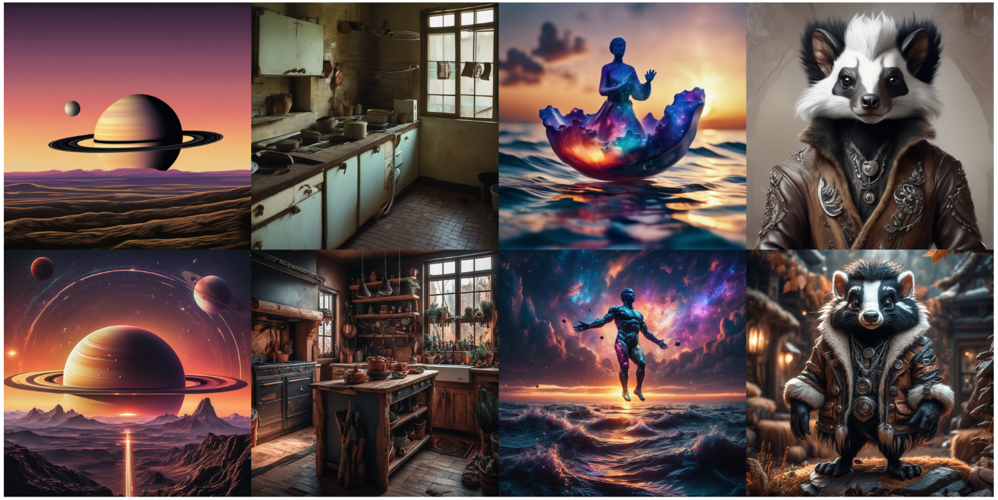
Why post-train diffusion models?
Z. Liang et al., Aesthetic post-training diffusion models from generic preferences with step-by-step preference optimization. CVPR 2025

Slide 8

Why post-train diffusion models?
Z. Liang et al., Aesthetic post-training diffusion models from generic preferences with step-by-step preference optimization. CVPR 2025

Slide 9
Three major categories of post-training methods
Policy gradient: DDPO, AWM (Shuchen Xue), GRPO (Jie Liu)
Direct-gradient backpropagation: ReFL, LeapAlign (Zhanhao Liang)
DPO: diffusion DPO, SPO etc (Zhanhao Liang)

Slide 10
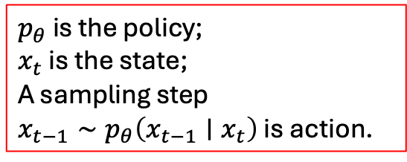
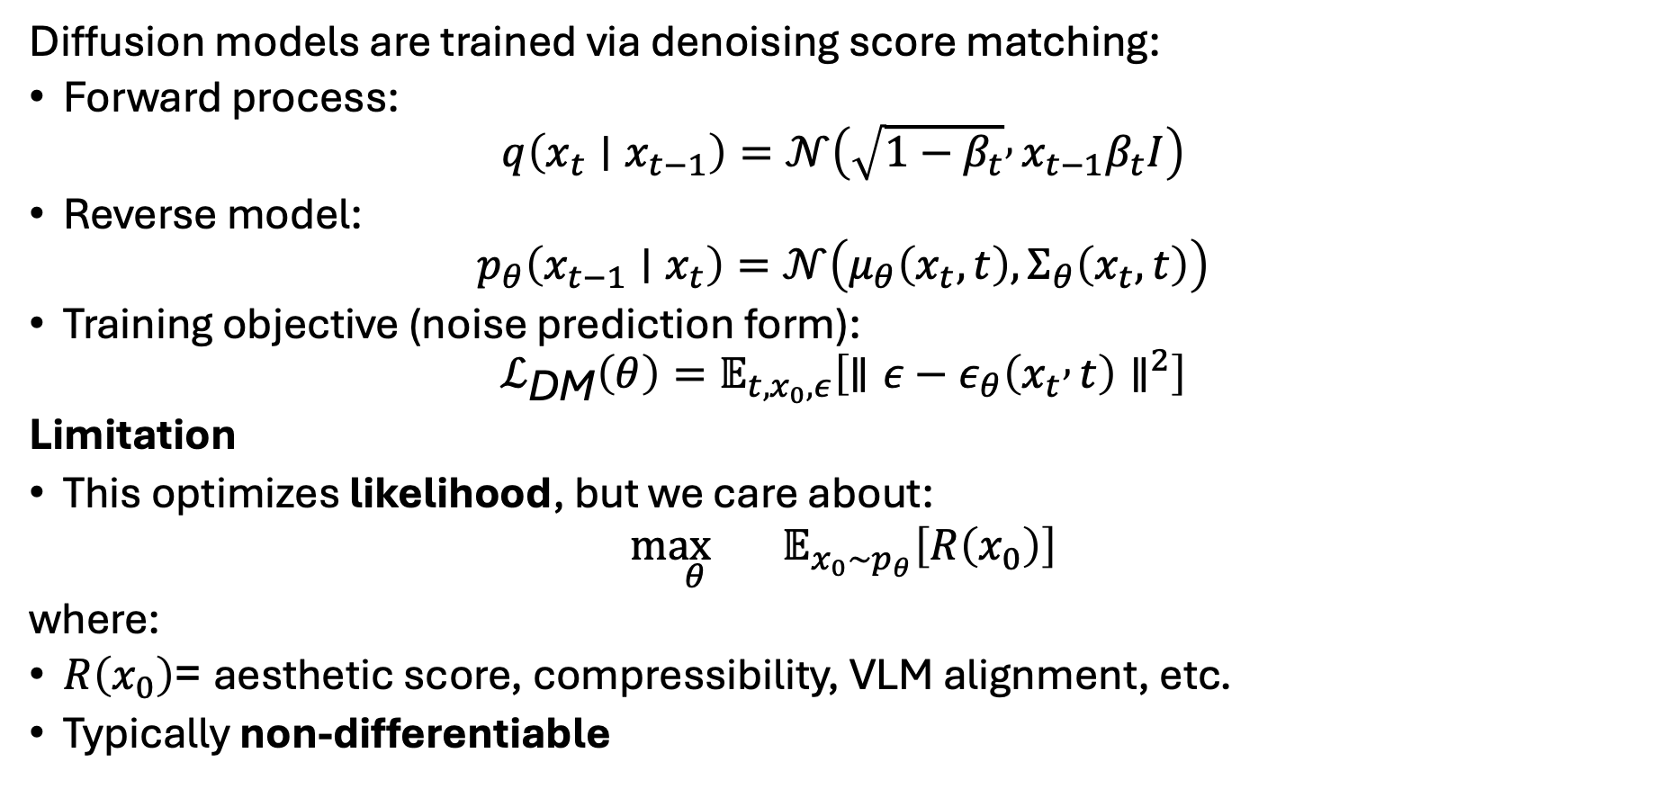

Policy gradient: Denoising diffusion policy optimization (DDPO)
Diffusion models are trained via denoising score matching:
Forward process:
$$q\left(x_{t}∣x_{t−1}\right)=𝒩\left(\sqrt{1−β_{t}} , x_{t−1}β_{t}I\right)$$
Reverse model:
$$p_{θ}\left(x_{t−1}∣x_{t}\right)=𝒩\left(μ_{θ}\left(x_{t},t\right),Σ_{θ}\left(x_{t},t\right)\right)$$
Training objective (noise prediction form):
$$ℒ_{\text{DM}}\left(θ\right)=𝔼_{t,x_{0},ε}\left[∥ε−ε_{θ}\left(x_{t} , t\right)∥^{2}\right]$$
Limitation
This optimizes likelihood, but we care about:
$$\underset{θ}{\max{}} 𝔼_{x_{0}∼p_{θ}}\left[R\left(x_{0}\right)\right]$$
where:
$R\left(x_{0}\right)$= aesthetic score, compressibility, VLM alignment, etc.
Typically non-differentiable
$p_{θ}$ is the policy;
$x_{t}$ is the state;
A sampling step
$x_{t−1}∼p_{θ}\left(x_{t−1}∣x_{t}\right)$ is action.
Because the sampling process is stochastic (Gaussian), we can apply policy gradient methods to directly compute gradients of the final reward $R\left(x_{0}\right)$, e.g., aesthetic score, with respect to the policy parameters,
Black et al., Training Diffusion Models with Reinforcement Learning. May 2023

Slide 11
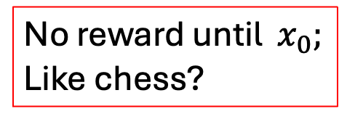
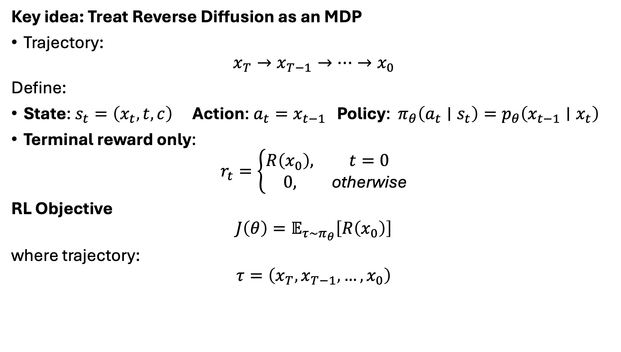
Diffusion as a Markov Decision Process
Key idea: Treat Reverse Diffusion as an MDP
Trajectory:
$$x_{T}→x_{T−1}→⋯→x_{0}$$
Define:
State: $s_{t}=\left(x_{t} , t , c\right)$Action: $a_{t}=x_{t−1}$ Policy: $π_{θ}\left(a_{t}∣s_{t}\right)=p_{θ}\left(x_{t−1}∣x_{t}\right)$
Terminal reward only:
$$r_{t}=\left\{\begin{matrix}R\left(x_{0}\right), & t=0 \\ 0, & \text{otherwise}\end{matrix}\right.$$
RL Objective
$$J\left(θ\right)=𝔼_{τ∼π_{θ}}\left[R\left(x_{0}\right)\right]$$
where trajectory:
$$τ=\left(x_{T} , x_{T−1} , … , x_{0}\right)$$
No reward until $x_{0};$
Like chess?
Black et al., Training Diffusion Models with Reinforcement Learning. May 2023

Slide 12
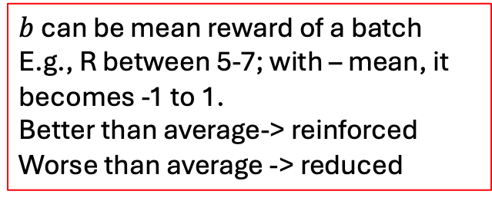
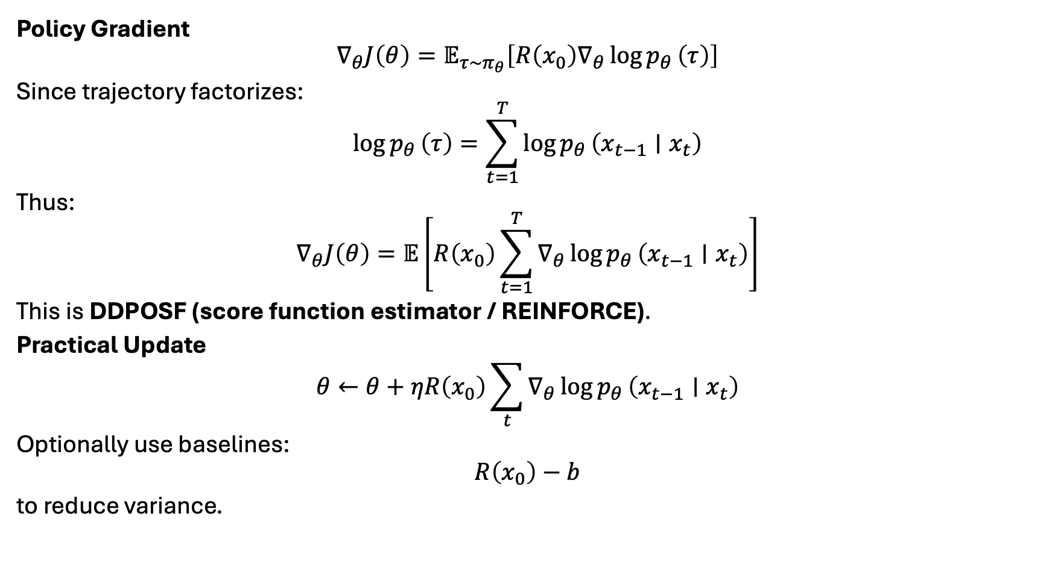
DDPO: Policy Gradient for Diffusion
Policy Gradient
$$∇_{θ}J\left(θ\right)=𝔼_{τ∼π_{θ}}\left[R\left(x_{0}\right)∇_{θ}\log{p_{θ}}\left(τ\right)\right]$$
Since trajectory factorizes:
$$\log{p_{θ}}\left(τ\right)=\sum_{t=1}^{T}{log}{p_{θ}}\left(x_{t−1}∣x_{t}\right)$$
Thus:
$$∇_{θ}J\left(θ\right)=𝔼\left[R\left(x_{0}\right)\sum_{t=1}^{T}{∇_{θ}}\log{p_{θ}}\left(x_{t−1}∣x_{t}\right)\right]$$
This is DDPOSF (score function estimator / REINFORCE).
Practical Update
$$θ←θ+ηR\left(x_{0}\right)\sum_{t}{∇_{θ}}\log{p_{θ}}\left(x_{t−1}∣x_{t}\right)$$
Optionally use baselines:
$$R\left(x_{0}\right)−b$$
to reduce variance.
Log-derivative trick;
Compute derivative w.r.t sampling + log probability.
R doesn’t have to be differentiable
REINFORCE suffers from large gradient variance, so training is not stable
$b$ can be mean reward of a batch
E.g., R between 5-7; with – mean, it becomes -1 to 1.
Better than average-> reinforced
Worse than average -> reduced
This formula does not distinguish which denoising step was good or bad but applies the reward signal uniformly to the entire trajectory.

Slide 13
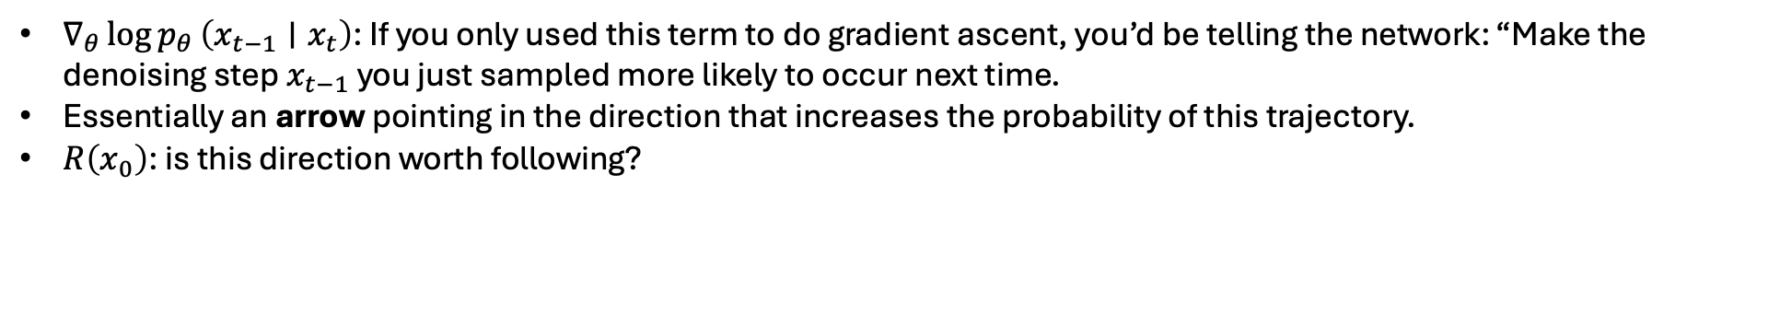
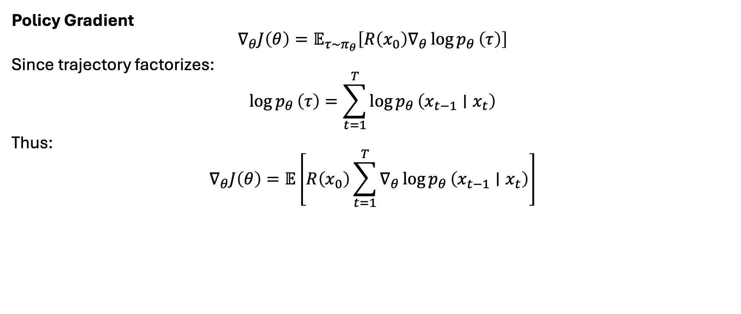
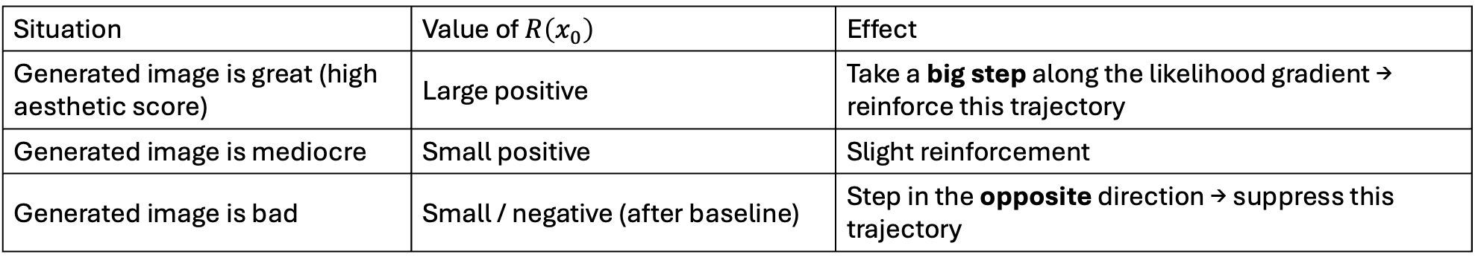
DDPO: Policy Gradient for Diffusion
Policy Gradient
$$∇_{θ}J\left(θ\right)=𝔼_{τ∼π_{θ}}\left[R\left(x_{0}\right)∇_{θ}\log{p_{θ}}\left(τ\right)\right]$$
Since trajectory factorizes:
$$\log{p_{θ}}\left(τ\right)=\sum_{t=1}^{T}{log}{p_{θ}}\left(x_{t−1}∣x_{t}\right)$$
Thus:
$$∇_{θ}J\left(θ\right)=𝔼\left[R\left(x_{0}\right)\sum_{t=1}^{T}{∇_{θ}}\log{p_{θ}}\left(x_{t−1}∣x_{t}\right)\right]$$
Log-derivative trick;
Compute derivative w.r.t sampling + log probability.
R doesn’t have to be differentiable
$∇_{θ}\log{p_{θ}}\left(x_{t−1}∣x_{t}\right)$: If you only used this term to do gradient ascent, you’d be telling the network: “Make the denoising step $x_{t−1}$ you just sampled more likely to occur next time.
Essentially an arrow pointing in the direction that increases the probability of this trajectory.
$R\left(x_{0}\right)$: is this direction worth following?
Situation | Value of $R\left(x_{0}\right)$ | Effect
Generated image is great (high aesthetic score) | Large positive | Take a big step along the likelihood gradient → reinforce this trajectory
Generated image is mediocre | Small positive | Slight reinforcement
Generated image is bad | Small / negative (after baseline) | Step in the opposite direction → suppress this trajectory

Slide 14
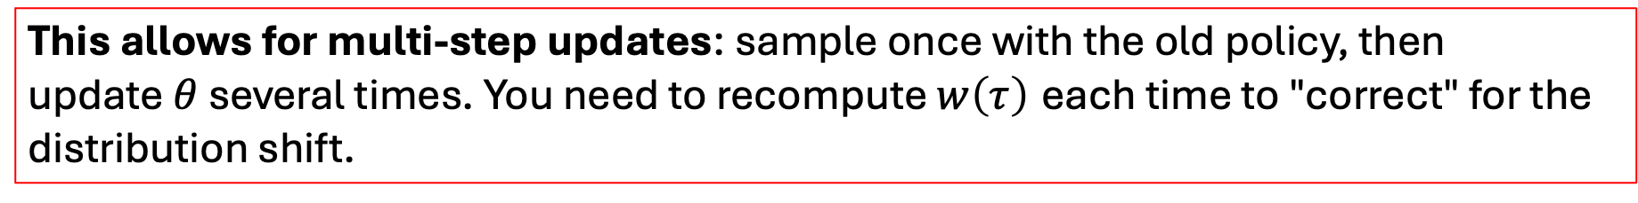
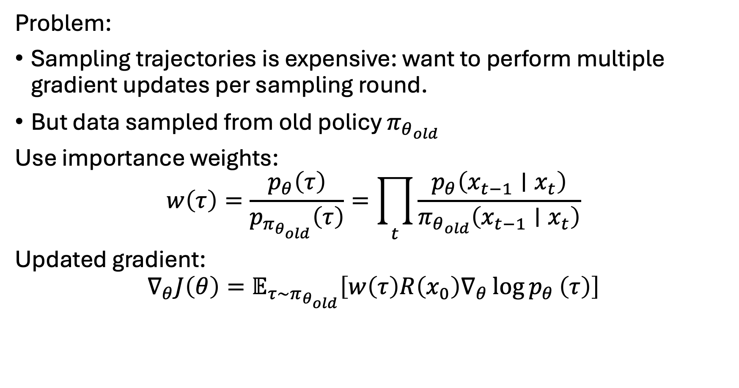
DDPO with Importance Sampling (DDPOIS)
Problem:
Sampling trajectories is expensive: want to perform multiple gradient updates per sampling round.
But data sampled from old policy $π_{θ_{old}}$
Use importance weights:
$$w\left(τ\right)=\frac{p_{θ}\left(τ\right)}{p_{π_{θ_{old}}}\left(τ\right)}=\prod_{t}{\frac{p_{θ}\left(x_{t−1}∣x_{t}\right)}{π_{θ_{old}}\left(x_{t−1}∣x_{t}\right)}}$$
Updated gradient:
$$∇_{θ}J\left(θ\right)=𝔼_{τ∼π_{θ_{old}}}\left[w\left(τ\right)R\left(x_{0}\right)∇_{θ}\log{p_{θ}}\left(τ\right)\right]$$
This allows for multi-step updates: sample once with the old policy, then update $θ$ several times. You need to recompute $w\left(τ\right)$ each time to "correct" for the distribution shift.

Slide 15
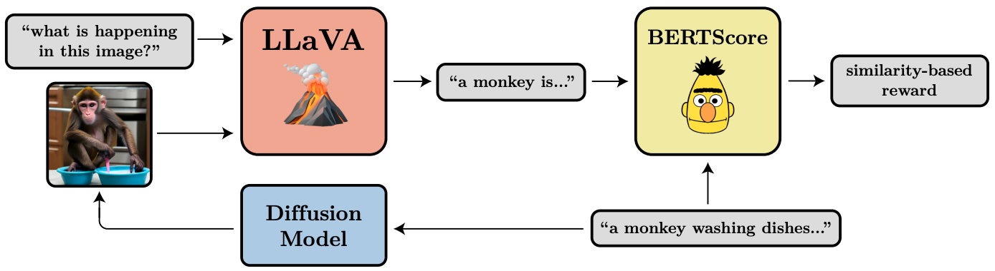

Results: Reward Optimization
They optimize:
$$\underset{θ}{\max{}}𝔼_{x_{0}∼p_{θ}}\left[R\left(x_{0}\right)\right]$$
for rewards such as:
JPEG compressibility
Aesthetic predictor score
Vision-language alignment score

Slide 16
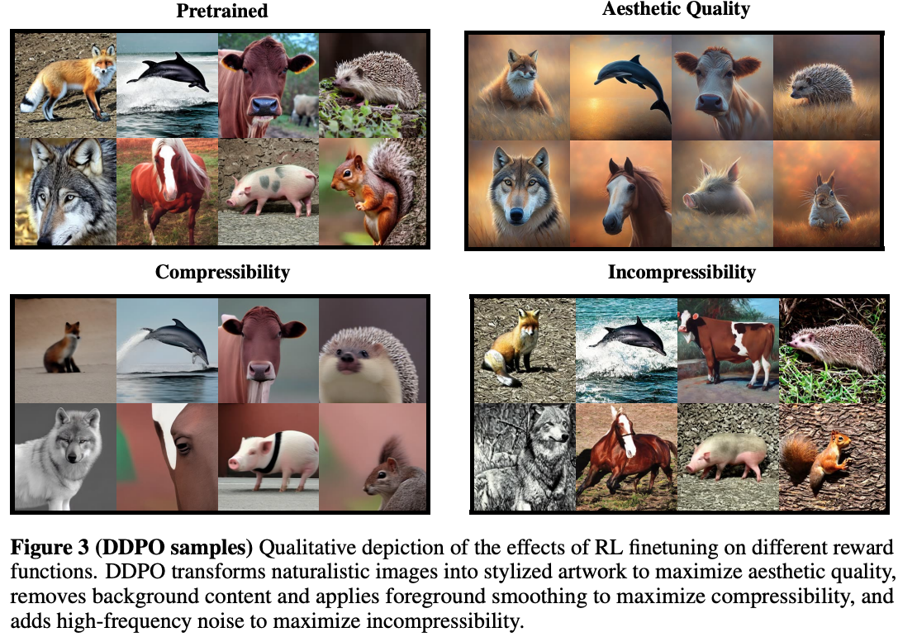

Slide 17
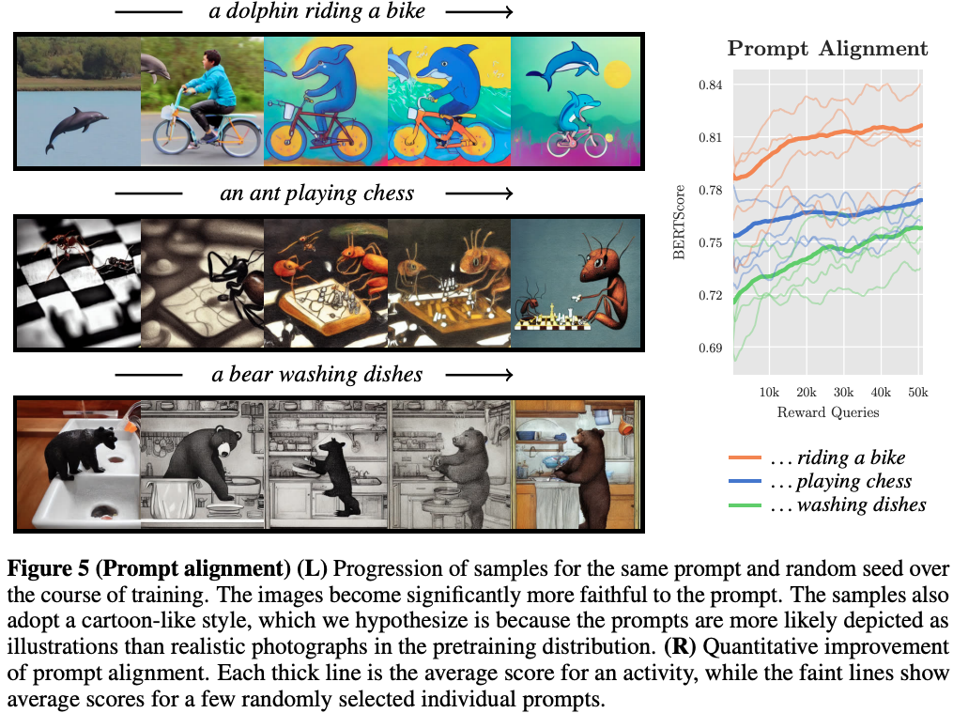

Slide 18
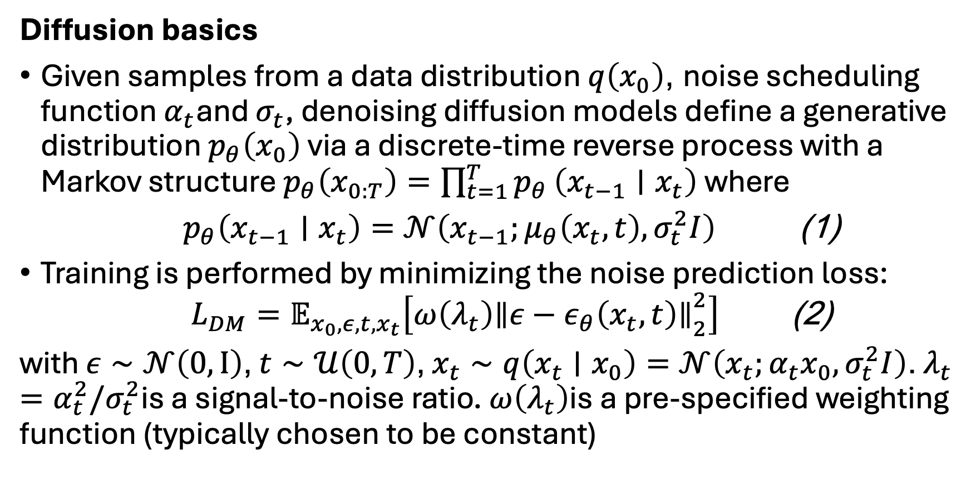
Direct preference optimization for diffusion models
Diffusion basics
Given samples from a data distribution $q\left(x_{0}\right)$, noise scheduling function $α_{t}$and $σ_{t}$, denoising diffusion models define a generative distribution $p_{θ}\left(x_{0}\right)$ via a discrete-time reverse process with a Markov structure $p_{θ}\left(x_{0:T}\right)=\prod_{t=1}^{T}{p_{θ}}\left(x_{t−1}∣x_{t}\right)$ where
$$\begin{matrix} & p_{θ}\left(x_{t−1}∣x_{t}\right)=𝒩\left(x_{t−1};μ_{θ}\left(x_{t},t\right),σ_{t}^{2}I\right) & & \text{(1)}\end{matrix}$$
Training is performed by minimizing the noise prediction loss:
$$\begin{matrix} & L_{DM}=𝔼_{x_{0},ε,t,x_{t}}\left[ω\left(λ_{t}\right){∥ε−ε_{θ}\left(x_{t},t\right)∥}_{2}^{2}\right] & & \text{(2)}\end{matrix}$$
with $ε∼𝒩\left(0,I\right)$, $t∼𝒰\left(0,T\right)$, $x_{t}∼q\left(x_{t}∣x_{0}\right)=𝒩\left(x_{t};α_{t}x_{0},σ_{t}^{2}I\right)$. $λ_{t}=α_{t}^{2}/σ_{t}^{2}$is a signal-to-noise ratio. $ω\left(λ_{t}\right)$is a pre-specified weighting function (typically chosen to be constant)
Wallace et al., Diffusion Model Alignment Using Direct Preference Optimization. Nov 2023

Slide 19
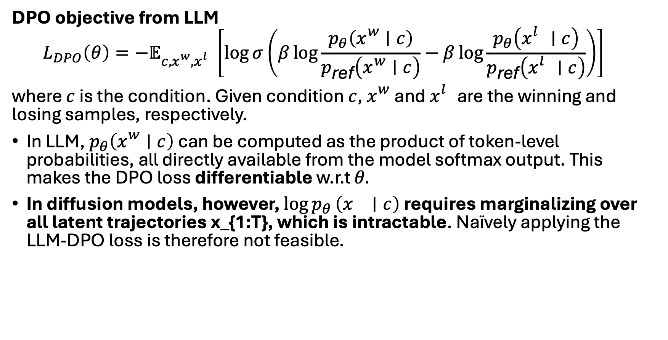
Direct preference optimization for diffusion models
DPO objective from LLM
$$\begin{matrix} & L_{DPO}\left(θ\right)=−𝔼_{c,x_{}^{w},x_{}^{l}}\left[\log{σ}\left(β\log{\frac{p_{θ}\left(x_{}^{w}∣c\right)}{p_{\text{ref}}\left(x_{}^{w}∣c\right)}}−β\log{\frac{p_{θ}\left(x_{}^{l}∣c\right)}{p_{\text{ref}}\left(x_{}^{l}∣c\right)}}\right)\right] & & \end{matrix}$$
where $c$ is the condition. Given condition $c$, $x_{}^{w}$ and $x_{}^{l}$ are the winning and losing samples, respectively.
In LLM, $p_{θ}\left(x_{}^{w}∣c\right)$ can be computed as the product of token-level probabilities, all directly available from the model softmax output. This makes the DPO loss differentiable w.r.t $θ.$
In diffusion models, however, $\log{p_{θ}}\left(x_{}∣c\right)$ requires marginalizing over all latent trajectories x_{1:T}, which is intractable. Naïvely applying the LLM-DPO loss is therefore not feasible.
Wallace et al., Diffusion Model Alignment Using Direct Preference Optimization. Nov 2023

Slide 20
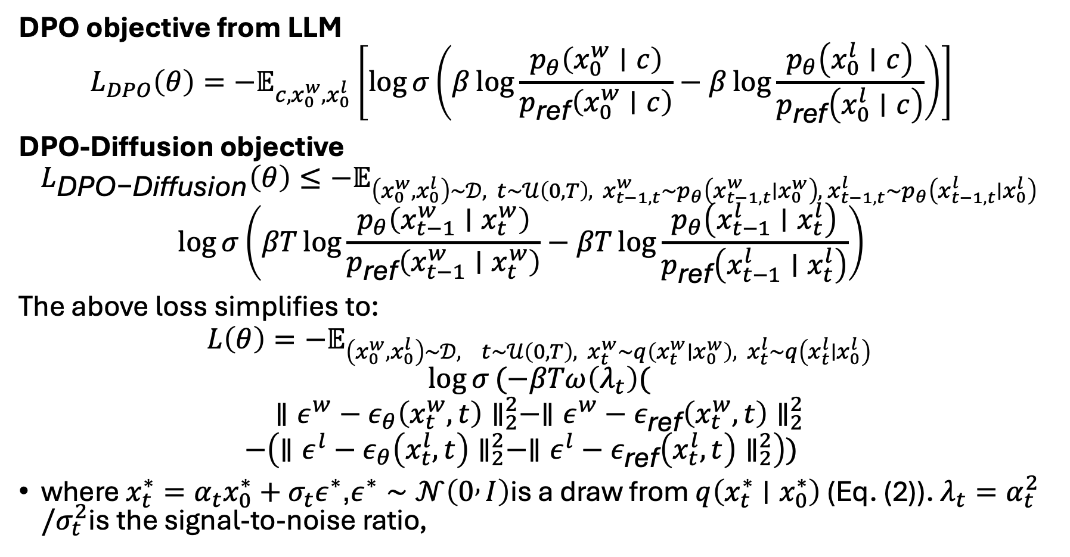
Direct preference optimization for diffusion models
DPO objective from LLM
$$\begin{matrix} & L_{DPO}\left(θ\right)=−𝔼_{c,x_{0}^{w},x_{0}^{l}}\left[\log{σ}\left(β\log{\frac{p_{θ}\left(x_{0}^{w}∣c\right)}{p_{\text{ref}}\left(x_{0}^{w}∣c\right)}}−β\log{\frac{p_{θ}\left(x_{0}^{l}∣c\right)}{p_{\text{ref}}\left(x_{0}^{l}∣c\right)}}\right)\right] & & \end{matrix}$$
DPO-Diffusion objective
$$L_{\text{DPO−Diffusion}}\left(θ\right)≤−𝔼_{\left(x_{0}^{w},x_{0}^{l}\right)∼𝒟, t∼𝒰\left(0,T\right),{ x}_{t−1,t}^{w}∼p_{θ}\left(x_{t−1,t}^{w}∣x_{0}^{w}\right), { x}_{t−1,t}^{l}∼p_{θ}\left(x_{t−1,t}^{l}∣x_{0}^{l}\right)}$$
$$\begin{matrix} & \log{σ}\left(βT\log{\frac{p_{θ}\left(x_{t−1}^{w}∣x_{t}^{w}\right)}{p_{\text{ref}}\left(x_{t−1}^{w}∣x_{t}^{w}\right)}}−βT\log{\frac{p_{θ}\left(x_{t−1}^{l}∣x_{t}^{l}\right)}{p_{\text{ref}}\left(x_{t−1}^{l}∣x_{t}^{l}\right)}}\right) & & \end{matrix}$$
The above loss simplifies to:
$$L\left(θ\right)=−𝔼_{\left(x_{0}^{w},x_{0}^{l}\right)∼𝒟, t∼𝒰\left(0,T\right), x_{t}^{w}∼q\left(x_{t}^{w}∣x_{0}^{w}\right), x_{t}^{l}∼q\left(x_{t}^{l}∣x_{0}^{l}\right)}$$
$$\log{σ}(−βTω\left(λ_{t}\right)($$
$$∥ε^{w}−ε_{θ}\left(x_{t}^{w},t\right)∥_{2}^{2}−∥ε^{w}−ε_{\text{ref}}\left(x_{t}^{w},t\right)∥_{2}^{2}$$
$$\begin{matrix} & −\left(∥ε^{l}−ε_{θ}\left(x_{t}^{l},t\right)∥_{2}^{2}−∥ε^{l}−ε_{\text{ref}}\left(x_{t}^{l},t\right)∥_{2}^{2}\right)) & & \end{matrix}$$
where $x_{t}^{∗}=α_{t}x_{0}^{∗}+σ_{t}ε^{∗}$,$ε^{∗}∼𝒩\left(0 , I\right)$is a draw from $q\left(x_{t}^{∗}∣x_{0}^{∗}\right)$ (Eq. (2)). $λ_{t}=α_{t}^{2}/σ_{t}^{2}$is the signal-to-noise ratio,
Wallace et al., Diffusion Model Alignment Using Direct Preference Optimization. Nov 2023

Slide 21
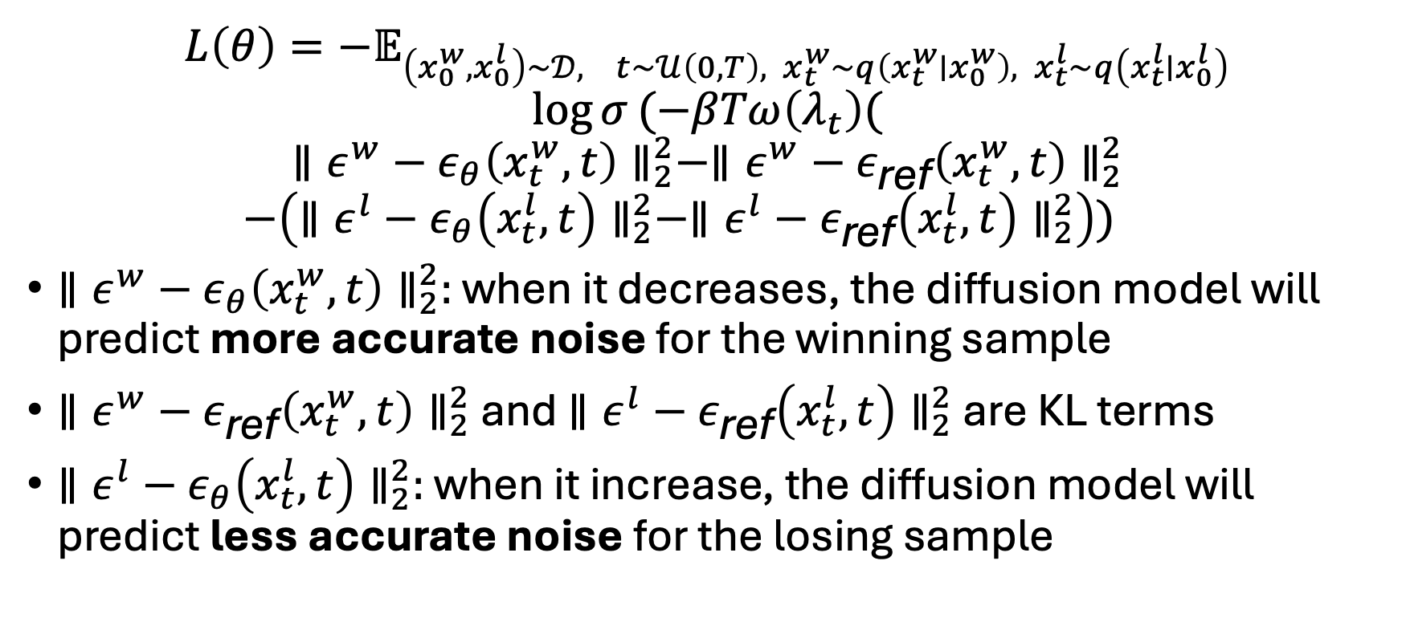
Diffusion DPO
$$L\left(θ\right)=−𝔼_{\left(x_{0}^{w},x_{0}^{l}\right)∼𝒟, t∼𝒰\left(0,T\right), x_{t}^{w}∼q\left(x_{t}^{w}∣x_{0}^{w}\right), x_{t}^{l}∼q\left(x_{t}^{l}∣x_{0}^{l}\right)}$$
$$\log{σ}(−βTω\left(λ_{t}\right)($$
$$∥ε^{w}−ε_{θ}\left(x_{t}^{w},t\right)∥_{2}^{2}−∥ε^{w}−ε_{\text{ref}}\left(x_{t}^{w},t\right)∥_{2}^{2}$$
$$\begin{matrix} & −\left(∥ε^{l}−{ε_{θ}\left(x_{t}^{l},t\right)∥}_{2}^{2}−∥ε^{l}−ε_{\text{ref}}\left(x_{t}^{l},t\right)∥_{2}^{2}\right)) & & \end{matrix}$$
$∥ε^{w}−ε_{θ}\left(x_{t}^{w},t\right)∥_{2}^{2}:$ when it decreases, the diffusion model will predict more accurate noise for the winning sample
$∥ε^{w}−ε_{\text{ref}}\left(x_{t}^{w},t\right)∥_{2}^{2}$ and $∥ε^{l}−ε_{\text{ref}}\left(x_{t}^{l},t\right)∥_{2}^{2}$ are KL terms
$∥ε^{l}−ε_{θ}\left(x_{t}^{l},t\right)∥_{2}^{2}:$ when it increase, the diffusion model will predict less accurate noise for the losing sample
Wallace et al., Diffusion Model Alignment Using Direct Preference Optimization. Nov 2023

Slide 22
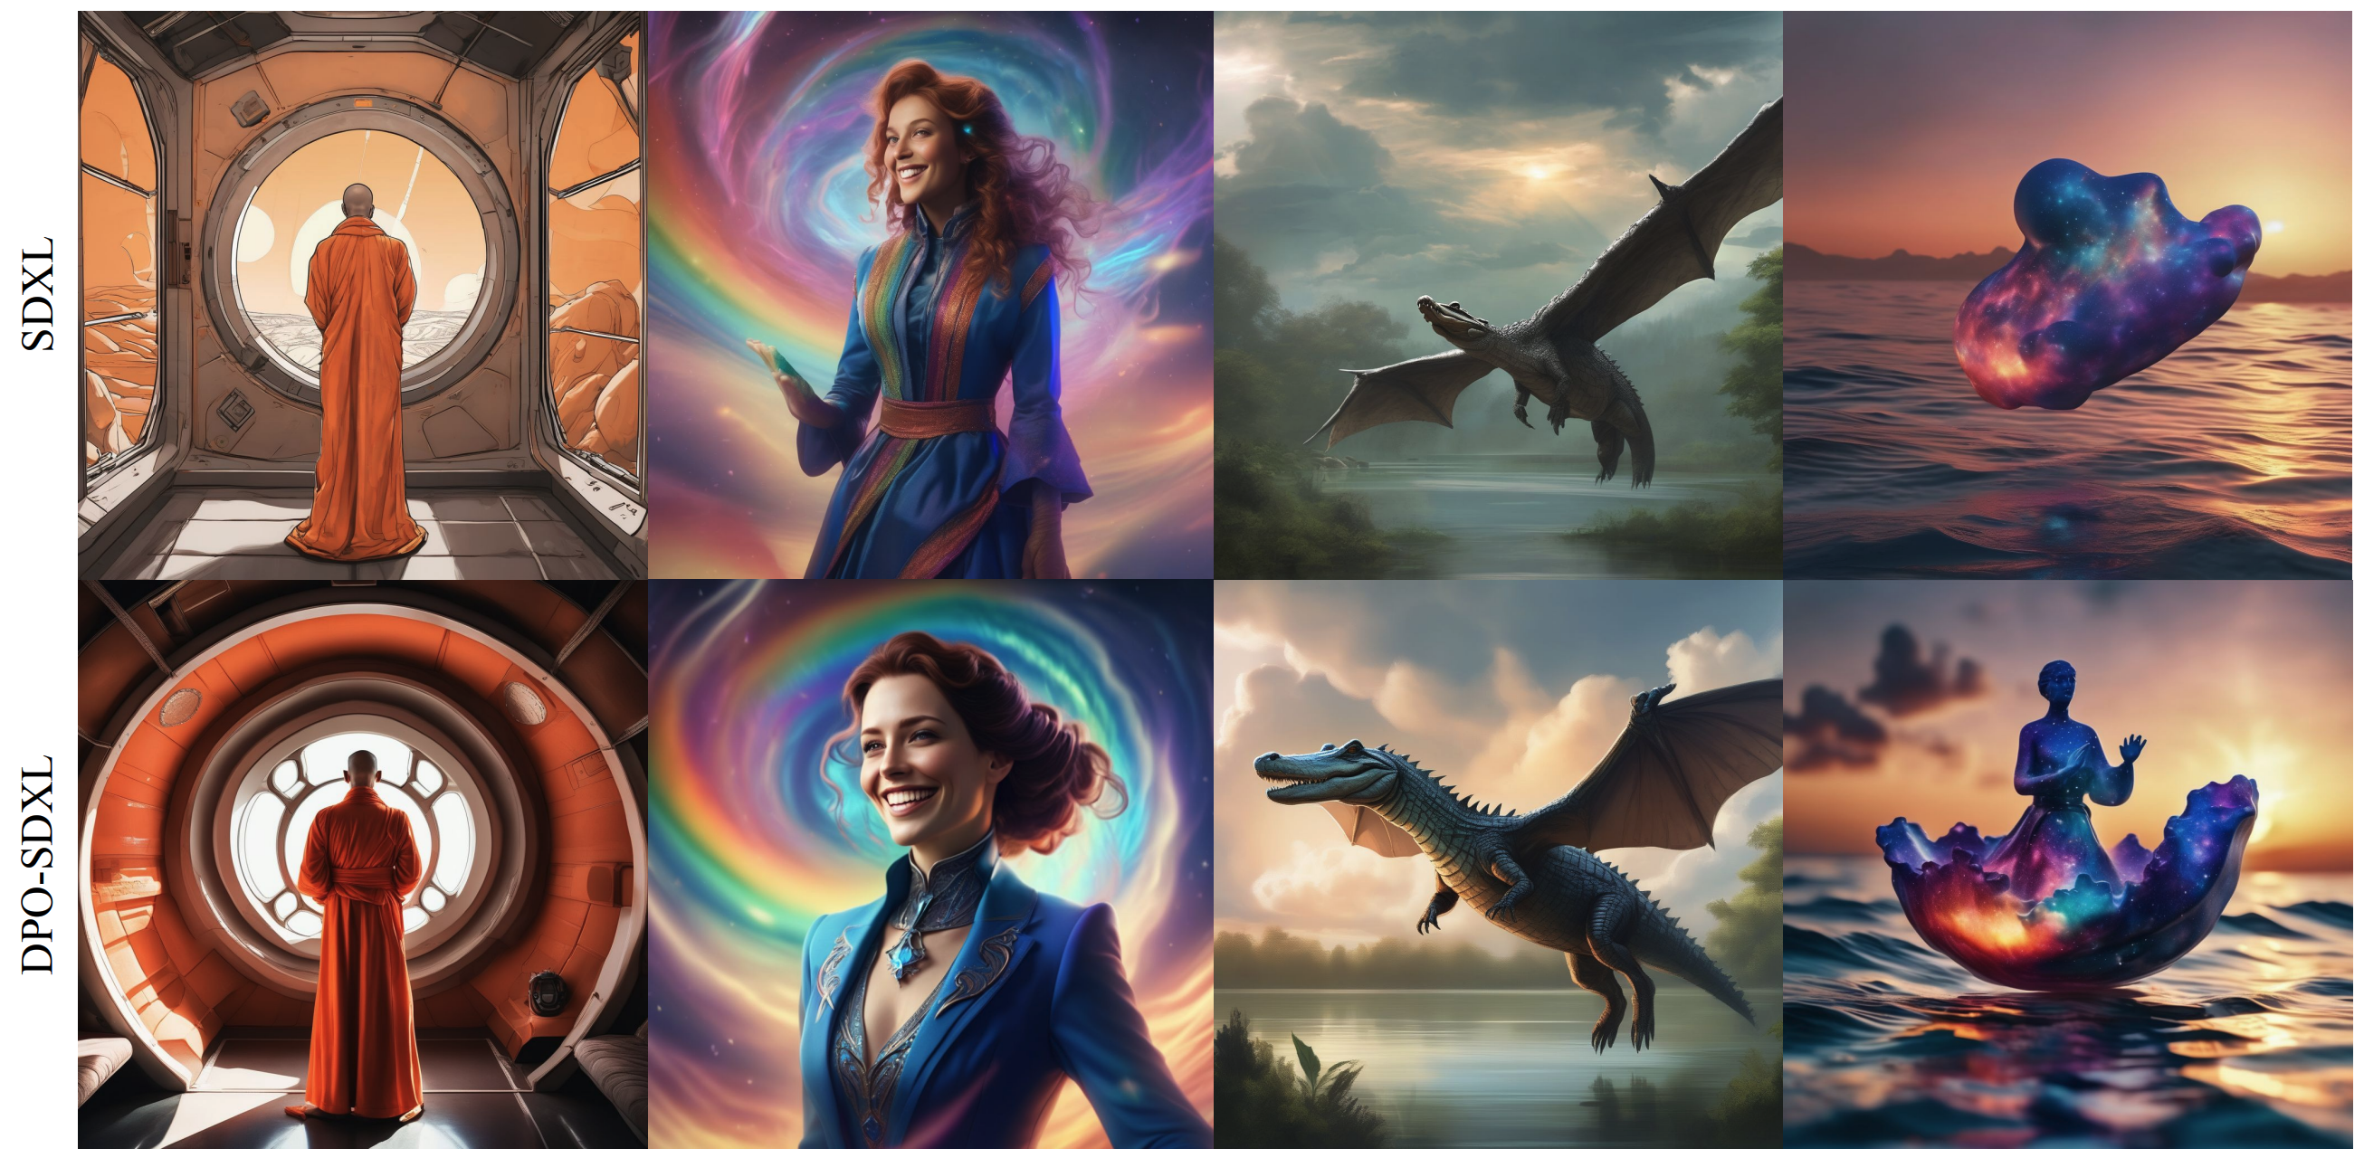
Diffusion DPO
Wallace et al., Diffusion Model Alignment Using Direct Preference Optimization. Nov 2023

Slide 23
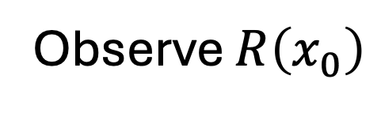
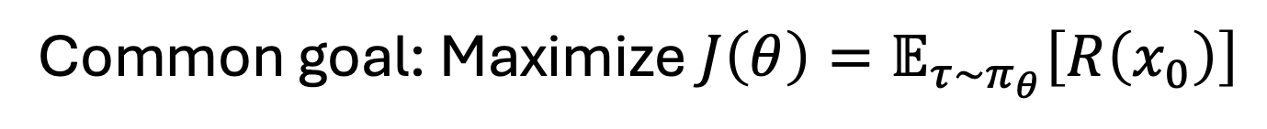
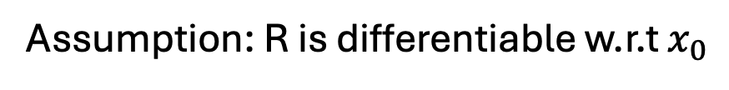
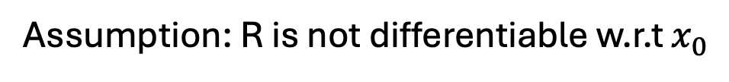
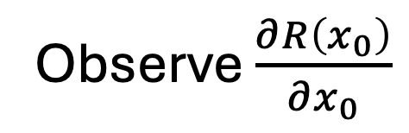
Policy gradient vs direct reward-gradient
Common goal: Maximize $J\left(θ\right)=𝔼_{τ∼π_{θ}}\left[R\left(x_{0}\right)\right]$
Policy gradient
Direct reward gradient
Observe $\frac{∂R\left(x_{0}\right)}{∂x_{0}}$
Observe $R\left(x_{0}\right)$
Assumption: R is not differentiable w.r.t $x_{0}$
Assumption: R is differentiable w.r.t $x_{0}$
Training see more useful information

Slide 24
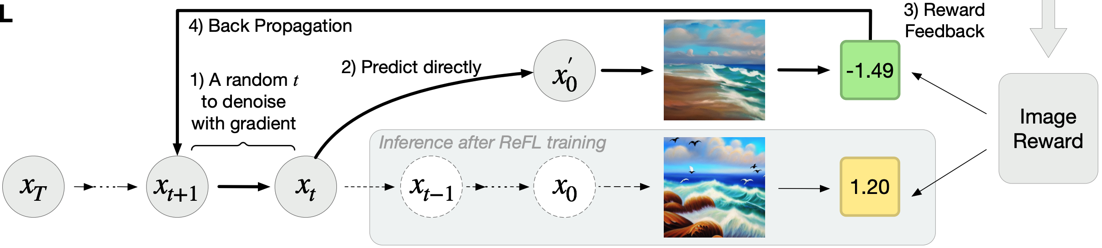
Direct-gradient backpropagation: Reward Feedback Learning (ReFL)
ReFL uses reward feedback to directly optimize diffusion models at a random latter denoising step
Xu et al., ImageReward: Learning and Evaluating Human Preferences for Text-to-Image Generation. Dec 2023

Slide 25
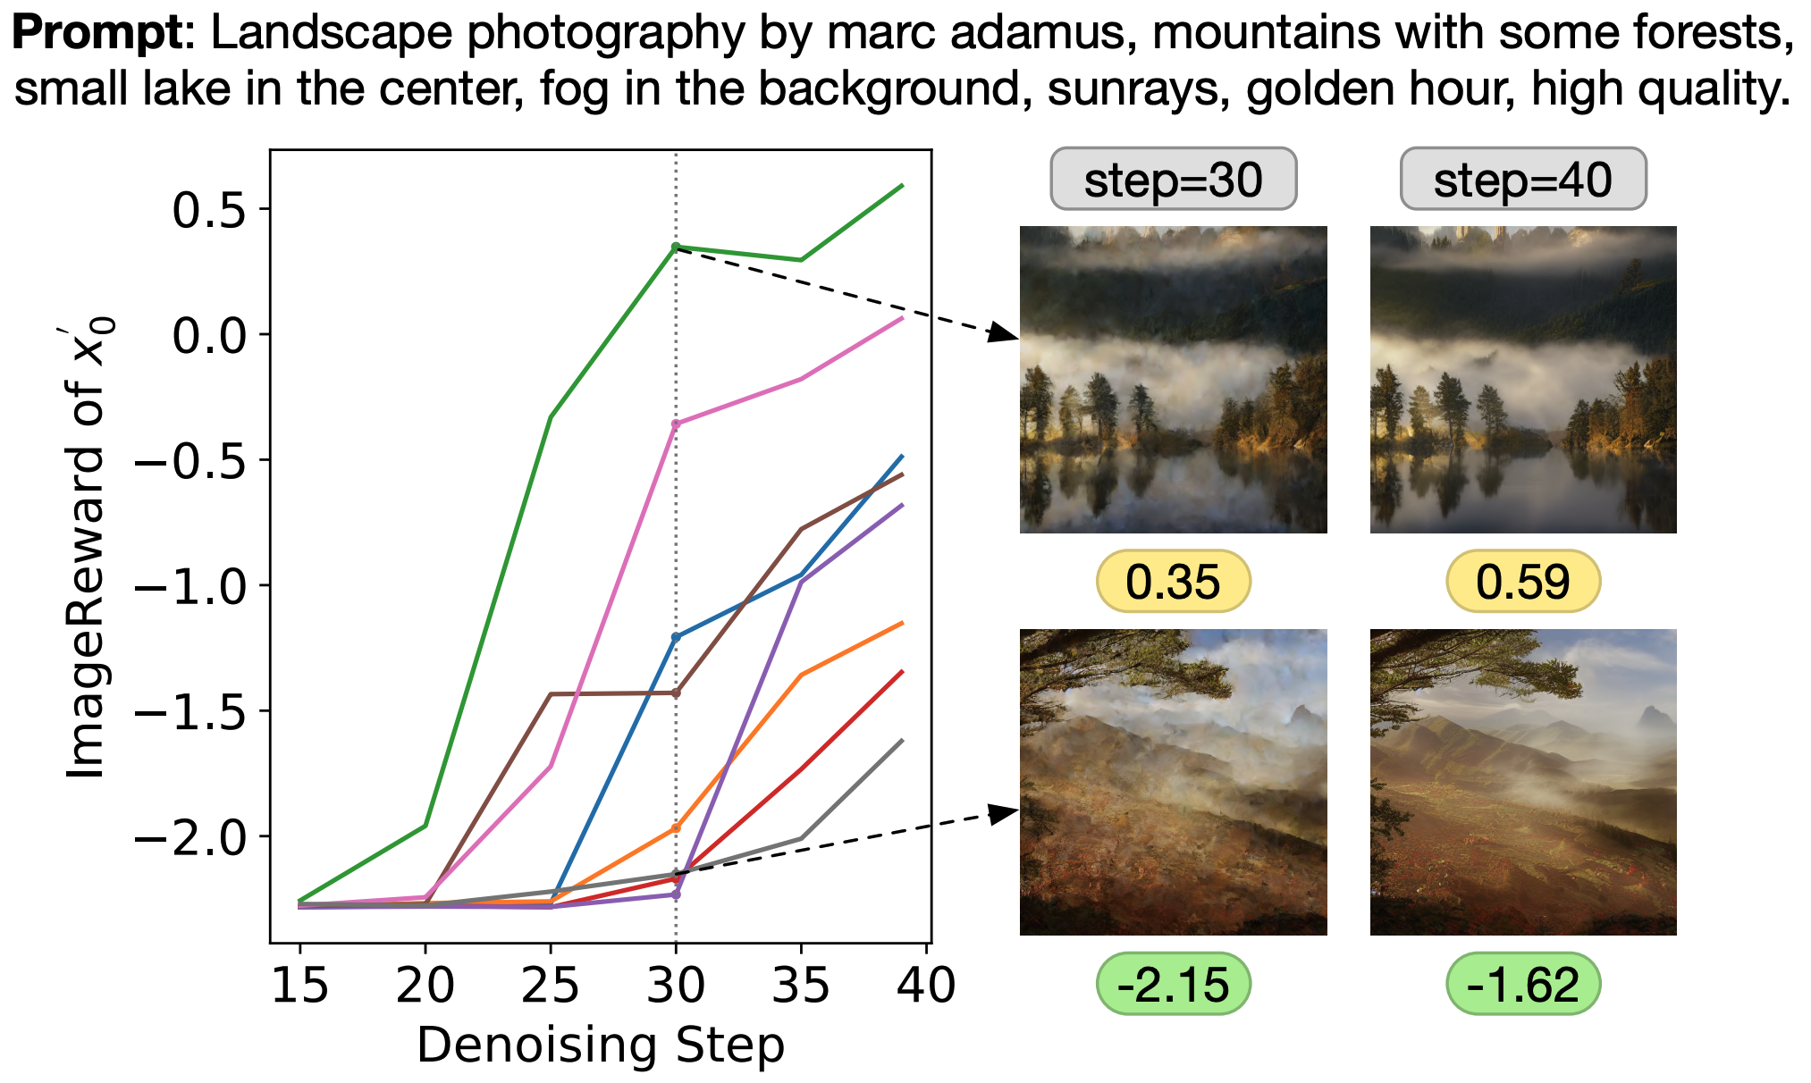
ReFL: Why optimizing at latter denoising steps?
Different lines: from different generation seeds
When t<15, reward is low for all generations
When 15<t<30, high-quality generations begin to stand out, but still not clear enough.
When t>30, quality of generated images of different reward scores is more distinguishable.

Slide 26
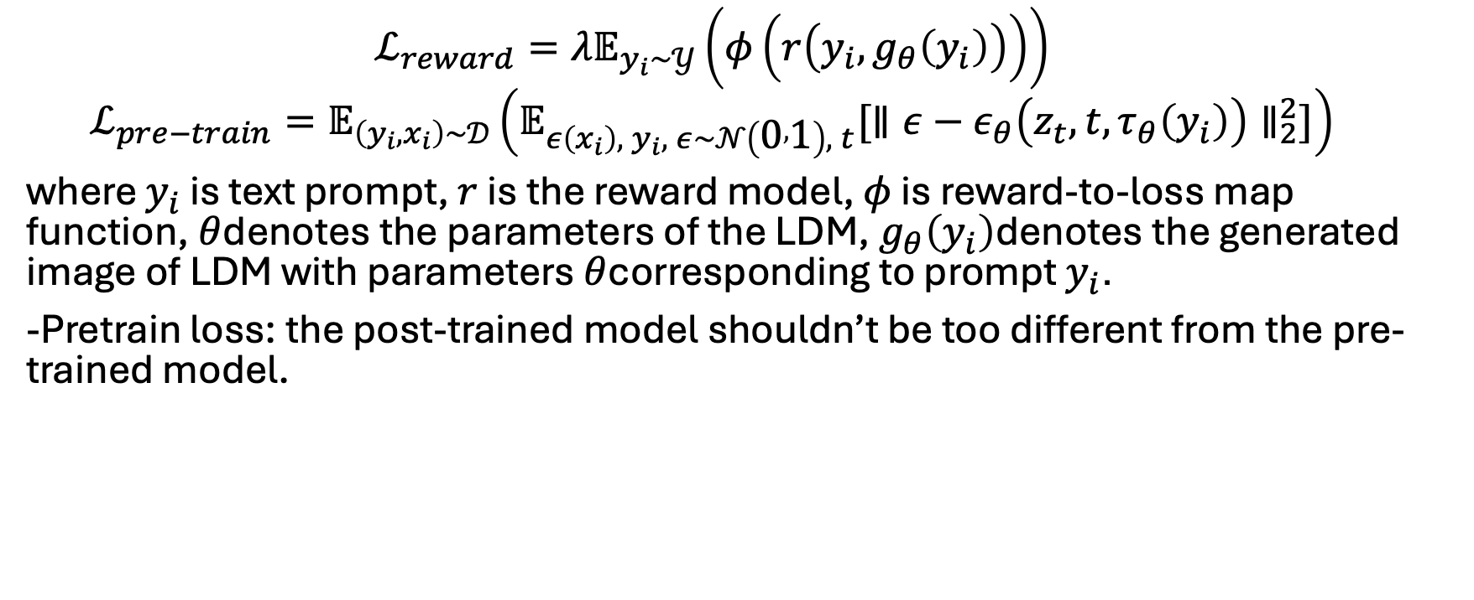
ReFL loss function
$$\begin{matrix} & ℒ_{reward}=λ𝔼_{y_{i}∼𝒴}\left(φ\left(r\left(y_{i},g_{θ}\left(y_{i}\right)\right)\right)\right) & & \end{matrix}$$
$$\begin{matrix} & ℒ_{pre−train}=𝔼_{\left(y_{i},x_{i}\right)∼𝒟}\left(𝔼_{ε\left(x_{i}\right), y_{i}, ε∼𝒩\left(0 , 1\right), t}[∥ε−ε_{θ}\left(z_{t},t,τ_{θ}\left(y_{i}\right)\right)∥_{2}^{2}]\right) & & \end{matrix}$$
where $y_{i}$ is text prompt, $r$ is the reward model, $φ$ is reward-to-loss map function, $θ$denotes the parameters of the LDM, $g_{θ}\left(y_{i}\right)$denotes the generated image of LDM with parameters $θ$corresponding to prompt $y_{i}$.
-Pretrain loss: the post-trained model shouldn’t be too different from the pre-trained model.

Slide 27
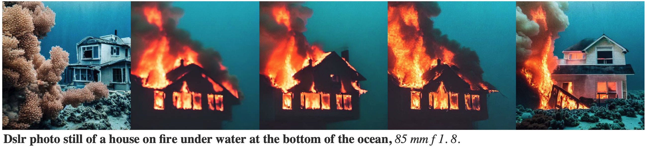
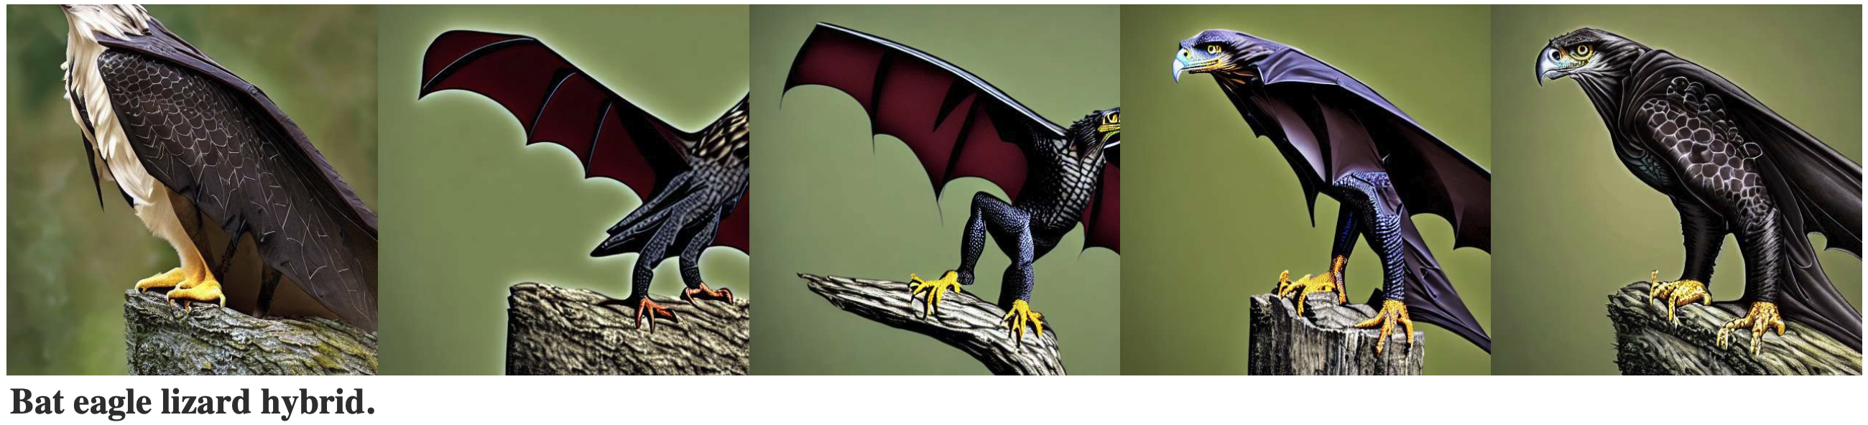
ReFL results

Slide 28
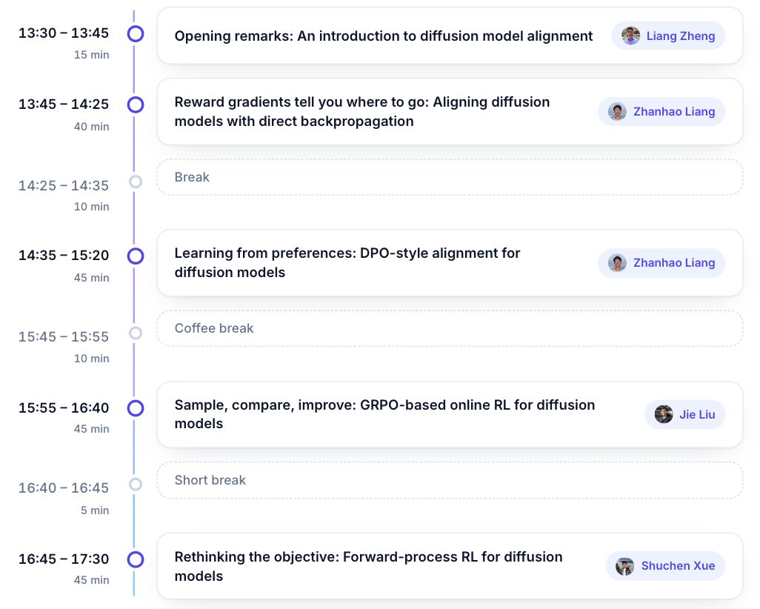
Today’s schedule

