Slide 1
Hands on analysis of conventional and advanced diffusion weighted MRI in the brain
Sonal Krishan, M. D.
Associate Director, Body and GI Imaging
Medanta Hospital, India
Virendra R. Mishra, Ph.D.
Associate Professor, Department of Radiology
The University of Alabama at Birmingham

Slide 2
Hands on analysis of conventional and advanced diffusion weighted MRI in the brain body
Sonal Krishnan, M. D.
Associate Director, Body and GI Imaging
Medanta Hospital, India
Virendra R. Mishra, Ph.D.
Associate Professor, Department of Radiology
The University of Alabama at Birmingham

Slide 3

Collaborators and Funding Acknowledgements (Mishra)
Hao Huang, Ph.D. and other mentors at The University of Texas at Southwestern Medical Center (UTSW) at Dallas, TX.
Neurologists at the Cleveland Clinic Lou Ruvo Center for Brain Health, Las Vegas, NV
Neuroimaging Research Laboratory Members at the Cleveland Clinic Lou Ruvo Center for Brain Health, Las Vegas, NV
Neuroimaging Research Laboratory Members at the EN4D2 lab at the University of Alabama at Birmingham, Birmingham, AL; https://sites.uab.edu/en4d2/
Research Participants
Mothers of the UTSW Developing Brains Cohort Study
Professional Fighters Brain Health Study
Funding Sources:
NIH: Grant numbers P20GM109025 (PI: Cummings; Project-2 Leader: Mishra), R01NS117547 (PI: Mishra);
Radiology Research Pilot Award (PI: Mishra);
Philanthropy: Keep Memory Alive Young Scholar (PI: Mishra)

Slide 4

Outline
Basics of Diffusion MRI
Artifacts and their corrected in preprocessing of dMRI
Groupwise analysis consideration
Advanced dMRI: DKI, NODDI, etc.…
dMRI outside the brain
Discussion

Slide 5
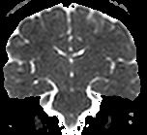
dMRI is based on water diffusion measurement
Non-invasive
2.5 – 3.0 x 10⁻³
mm²/s
In situ
0.6 - 0.8 x 10⁻³
mm²/s

Slide 6
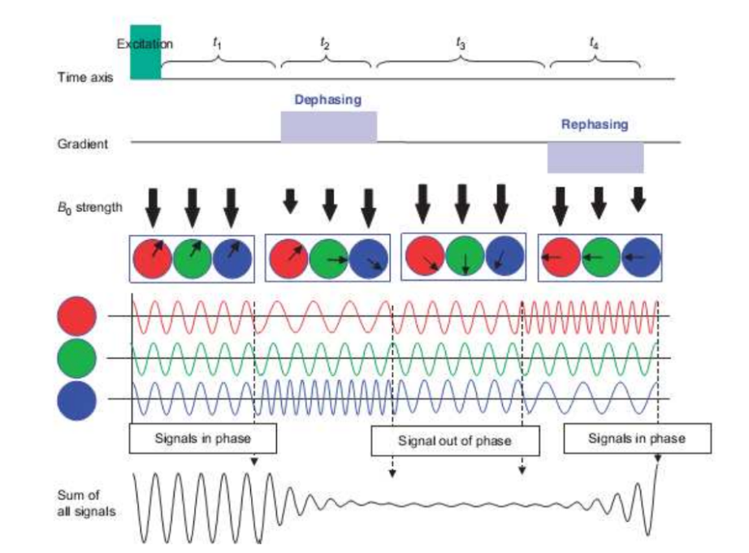
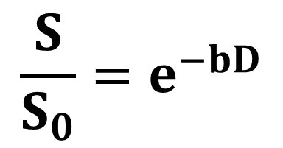
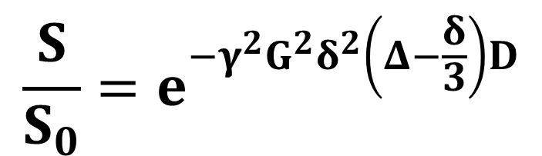
Image Acquisition
90
180
RF
δ
G
Δ
$$\frac{S}{S_{0}}=e^{−γ^{2}G^{2}δ^{2}\left(Δ−\frac{δ}{3}\right)D}$$
$$\frac{S}{S_{0}}=e^{−bD}$$
Mori, 2007
6

Slide 7
Outline
Basics of Diffusion MRI
Artifacts and their corrected in preprocessing of dMRI
Groupwise analysis consideration
Advanced dMRI: DKI, NODDI, etc.…
dMRI outside the brain
Discussion

Slide 8
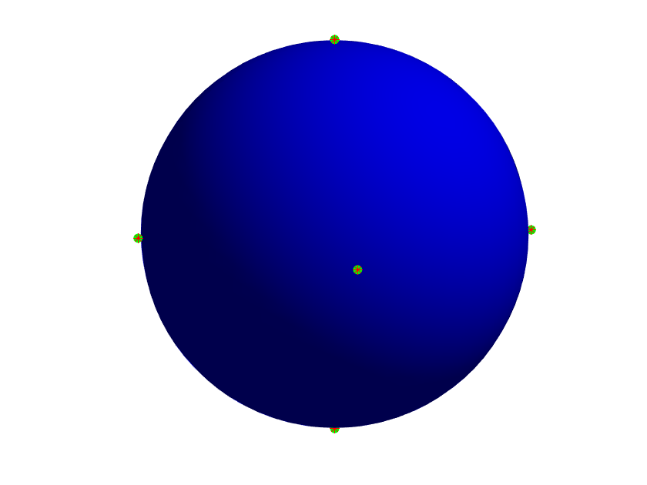


Problem # 1: Diffusion encoding gradients
Take home: DEC should be span the entire sphere in a non-planar and a non-collinear direction
You can check the directions of the acquisition using showdirs.m located at the GitHub page
(A)
(B)
(C)
Jones and Cercignani, 2010
8

Slide 9
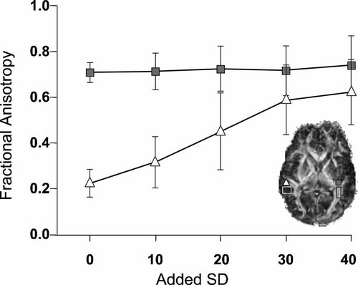
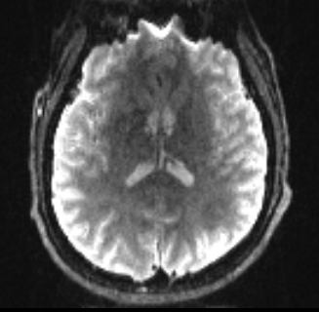
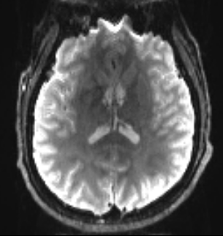
Problem # 2: Noise
Take home: Use dwidenoise in MrTrix located at https://www.mrtrix.org/; Steps also on GitHub page
-- Run Denoise: dwidenoise your_input_DWI.nii.gz your_denoised_DWI_output.nii.gz -noise your_noise_output.nii.gz -nthreads 96 -quiet -force
(A)
(B)
Jones and Cercignani, 2010
9

Slide 10
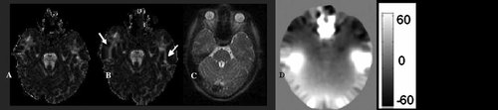
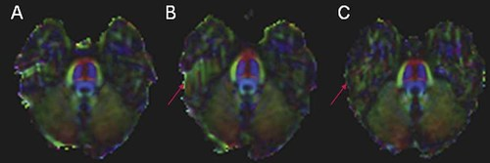
Problem # 3: Susceptibility Artifacts
Take home: Always correct for these artifacts: See next slide on how to correct this in FSL
Using field map technique with two different echo times
Using reverse gradient method
Jones and Cercignani, 2010
10

Slide 11
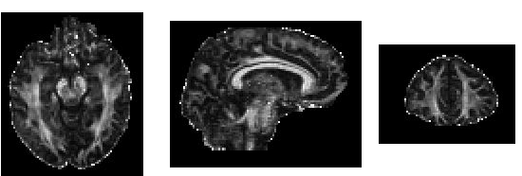
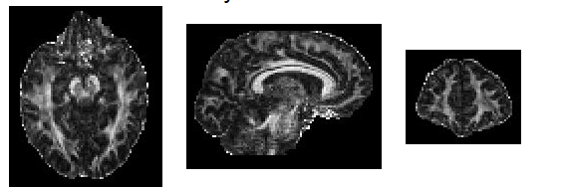
Problem # 4: Eddy current and Motion Artifacts
(A)
Conventional eddy-current correction
(B)
State of the art: eddy-current correction
11

Slide 12
Problem # 4: Eddy current and Motion Artifacts
Take home: Always correct for these artifacts: FSL is currently the best. See GitHub document for the exact steps
-- Run Topup : topup –imain=your_denoised_data (AP/PA) –datain=acqparams.txt –config --config=b02b0.cnf --out=topup_results --iout=corr_b0 --fout=fieldmap --nthr=96
Acqparams.txt file:
0 1 0 0.1 → Tells FSL that PA is the first volume
0 -1 0 0.1 → Tells FSL that AP is the second volume
-- Run Eddy: eddy_cuda10.2 --imain=your_dwi_file --mask=skull_extracted_brain --acqp=acqparams.txt --index= row_of_1s_as_the_number_of_DEC --bvals=txt_file_with_b_values --bvecs=txt_file_with_bvecs --topup=topup_results --cnr_maps --residuals --estimate_move_by_susceptibility --mb=3 --mb_offs=1 --repol --out=desired_output_name -v
Tells FSL about the echo dwell time" multiplied by "number of PE steps - 1" and it is also the reciprocal of the PE bandwidth/pixel; Echo Spacing * EPI Factor - 1
Important points: You can also run topup and pass the results even if you don’t have opposite polarity data. Requirement is to have T1 and your DWI. You can download https://github.com/MASILab/Synb0-DISCO . Execution steps in GitHub
12

Slide 13
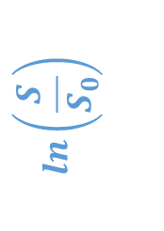
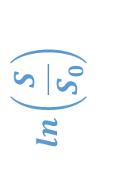
Fit single tensors only at b-value<=1000s/mm²
$$ln\left(\frac{S}{S_{0}}\right)$$
$$ln\left(\frac{S}{S_{0}}\right)$$
~b>1500s/mm²
b-value
(s/mm²)
b-value
(s/mm²)
500
1000
2000
3000
500
1000
2000
3000
Take home: Only use b<=1000s/mm² data if your acquisition has b-values>1000s/mm². You can run dtifit in FSL to get your tensors. Exact execution steps in GitHub.
13

Slide 14
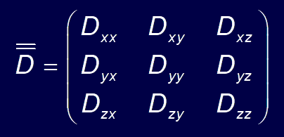
Diffusion Tensor Imaging (DTI)
Positive symmetric
2nd order tensor
Diffusion ellipsoid
λ₁
λ₂
Tensor Calculation
λ₃
Measure diffusion along
various directions (> 6)
Diffusion ellipsoid
14

Slide 15
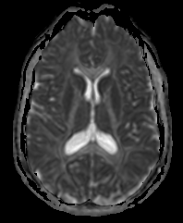
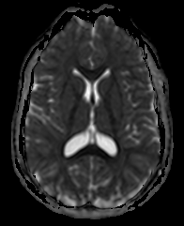
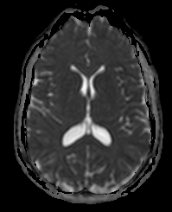
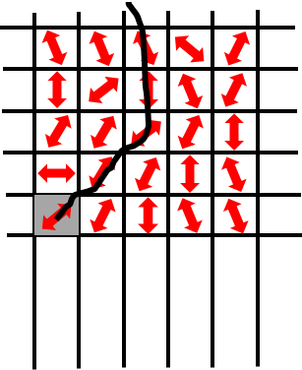
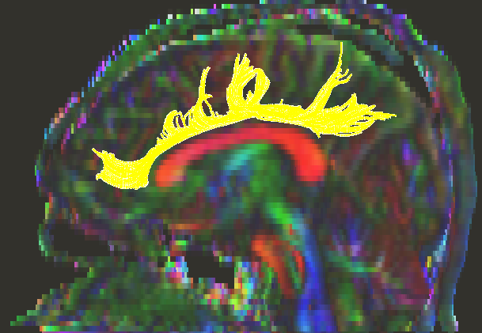
Contrasts derived from Diffusion Tensor Imaging (DTI)
Axial Diffusivity
AxD = λ₁
Radial Diffusivity
RD = λ₂+ λ₃
2
Mean Diffusivity
MD = λ₁+ λ₂+ λ₃
3
DTI-based Tractography
15

Slide 16
Outline
Basics of Diffusion MRI
Artifacts and their corrected in preprocessing of dMRI
Groupwise analysis consideration
Advanced dMRI: DKI, NODDI, etc.…
dMRI outside the brain
Discussion

Slide 17
Run voxelwise statistics to answer your hypothesis
TBSS: Tract Based Spatial Statistics in FSL
Follow the steps outlined:
https://fsl.fmrib.ox.ac.uk/fsl/fslwiki/TBSS/UserGuide
TBSS uses intensity based registration which may not prove very sensitive to detecting differences
DTI-TK: Tensor Based Registration
Follow the steps outlined:
https://dti-tk.sourceforge.net/pmwiki/pmwiki.php?n=Documentation.HomePage and them run TBSS on this tensor registered file

Slide 18
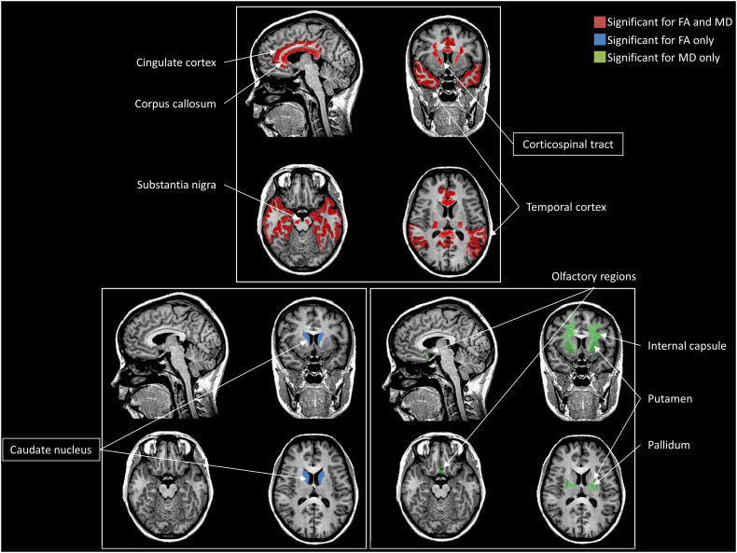
DTI changes in PD
Atkinson-Clement et al., 2017

Slide 19
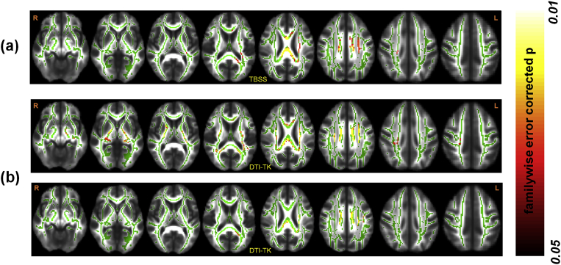
DTI changes correlated with disease in PD
Mishra et al., 2019

Slide 20
Run nonparametric statistics in FSL
Either run randomise in FSL
randomise -i your_DWI_contrast -o your_desired_output_prefix -d design.mat -t design.con -m typically_your_denoised_eddy_corrected_brain_mask_derived_from_b0 -n 500 –T
2) You may also run palm in Matlab/Octave if you want to dig deeper into some complex analysis.
Execution steps in GitHub

Slide 21
Outline
Basics of Diffusion MRI
Artifacts and their corrected in preprocessing of dMRI
Groupwise analysis consideration
Advanced dMRI: DKI, NODDI, etc.…
dMRI outside the brain
Discussion

Slide 22
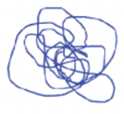

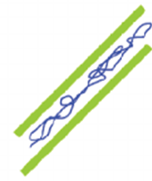
Additionally, brain voxels can contain cells or macromolecules
Gray Matter (GM) / CSF
Isotropic
unrestricted
diffusion
Isotropic
restricted
diffusion
GM and WM
Anisotropic
Hindered
diffusion
Coherent WM
Assaf et al, 2004

Slide 23
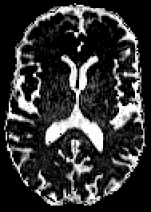
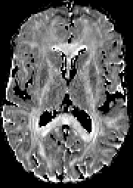
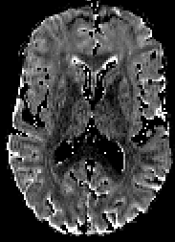
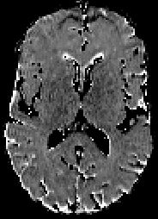
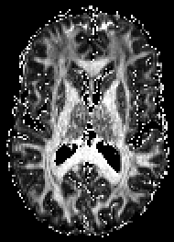
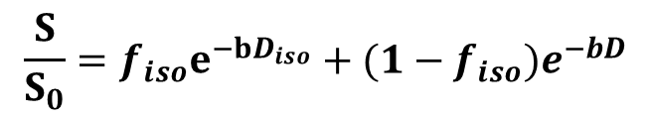
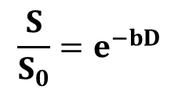
Free-Water Corrected Diffusion Tensor Imaging (FW-DTI)
$$\frac{S}{S_{0}}=e^{−bD}$$
$$\frac{S}{S_{0}}=f_{iso}e^{−bD_{iso}}+(1−f_{iso})e^{−bD}$$
Free-water (f_{iso})
f_{iso}-corrected AxD
f_{iso}-corrected RD
f_{iso}-corrected MD
f_{iso}-corrected FA
Due to nonlinear fitting, at least 2 b-values dMRI data is required, both should be less than or equal to 1000s/mm²
You can run your eddy corrected dMRI data in DiPY: https://dipy.org/documentation/0.16.0./examples_built/reconst_fwdti/
Pasternak et al, 2009

Slide 24
And there is intra-axonal water diffusion too!
Gray Matter (GM) / CSF
Isotropic
unrestricted
diffusion
Isotropic
restricted
diffusion
GM and WM
Anisotropic
Hindered and Restricted diffusion
WM
Assaf et al, 2004

Slide 25
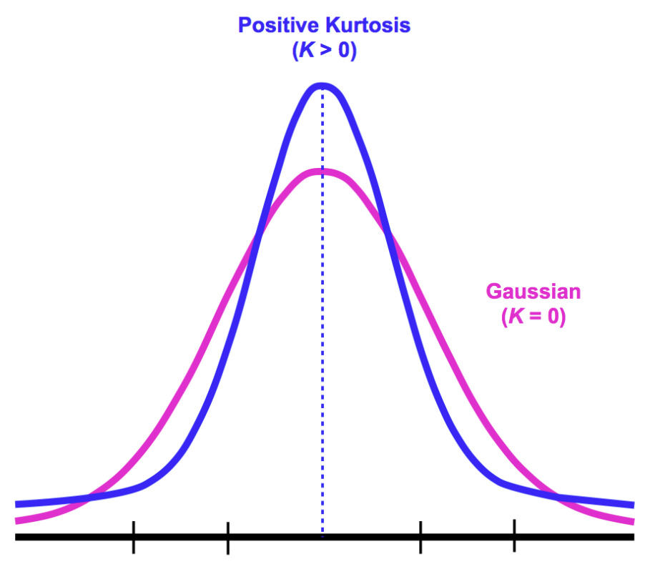
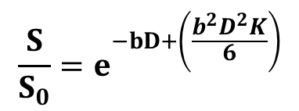
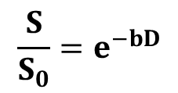
Diffusion Kurtosis Imaging (DKI)
$$\frac{S}{S_{0}}=e^{−bD}$$
$$\frac{S}{S_{0}}=e^{−bD+\left(\frac{b^{2}D^{2}K}{6}\right)}$$

Slide 26
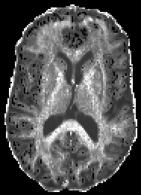
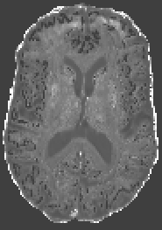
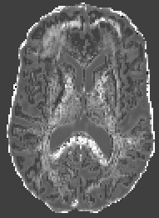
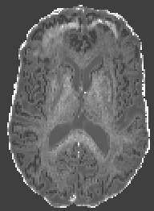
Diffusion Kurtosis Imaging (DKI)
$$\frac{S}{S_{0}}=e^{−bD}$$
$$\frac{S}{S_{0}}=e^{−bD+\left(\frac{b^{2}D^{2}K}{6}\right)}$$
Axonal Water
Fraction (AWF)
Axonal Kurtosis
(AK)
Radial Kurtosis
(RK)
Mean Kurtosis
(MK)
Due to nonlinear fitting, at least 2 b-values dMRI data is required, with one equal to 1000s/mm² and one greater than or equal to 1500s/mm²
You can run DKI parameters on your eddy corrected dMRI using the code from NYU: https://github.com/jelleveraart/RobustDKIFitting
Jensen et al, 2005

Slide 27
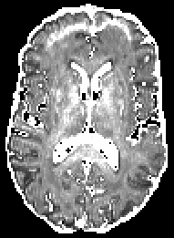
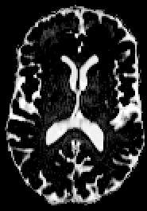
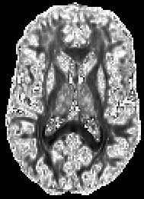
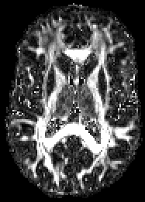
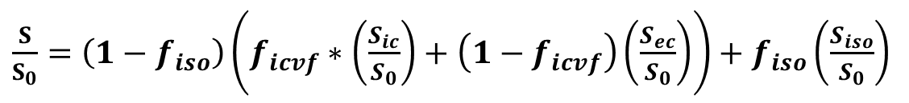
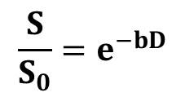
Neurite Orientation Dispersion and Density Imaging (NODDI)
$$\frac{S}{S_{0}}=e^{−bD}$$
$\frac{S}{S_{0}}=$ $\left(1−f_{iso}\right)\left(f_{icvf}∗\left(\frac{S_{ic}}{S_{0}}\right)+\left(1−f_{icvf}\right)\left(\frac{S_{ec}}{S_{0}}\right)\right)+f_{iso}\left(\frac{S_{iso}}{S_{0}}\right)$
f_{icvf}
f_{iso}
Orientation Dispersion
Index (ODI)
KAPPA
Due to nonlinear fitting, at least 2 b-values dMRI data is required, with one equal to 1000s/mm² and one greater than or equal to 1500s/mm²
You can run NODDI parameters on your eddy corrected dMRI using the Matlab code here: http://mig.cs.ucl.ac.uk/index.php?n=Download.NODDI
Zhang et al, 2012

Slide 28
Outline
Basics of Diffusion MRI
Artifacts and their corrected in preprocessing of dMRI
Groupwise analysis consideration
Advanced dMRI: DKI, NODDI, etc.…
dMRI outside the brain
Discussion

Slide 29
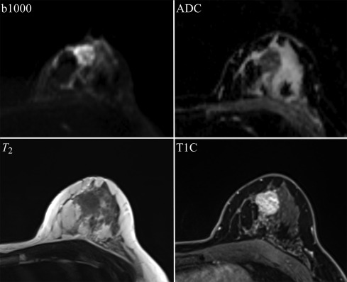
Diffusion imaging in the breast
Donners et al, 2020

Slide 30
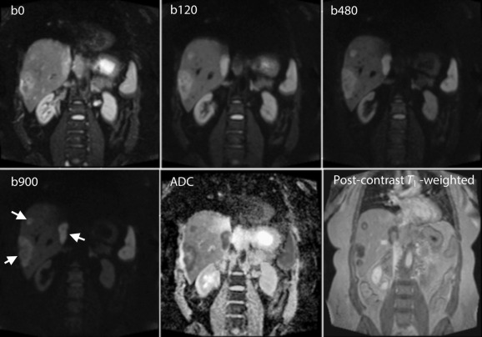
Abdominal Diffusion Imaging
Donners et al, 2020

Slide 31
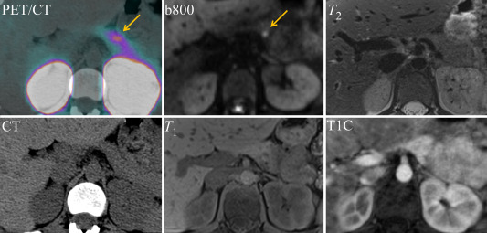
Diffusion imaging in the pancreas
Donners et al, 2020

Slide 32
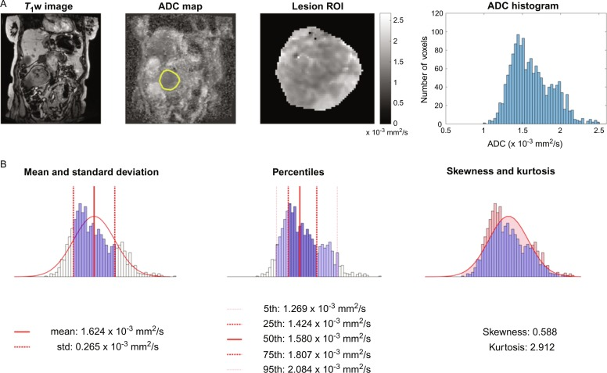
Diffusion imaging in the kidneys
Donners et al, 2020

Slide 33
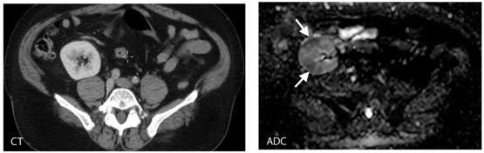
Diffusion imaging in the kidneys
Donners et al, 2020

Slide 34
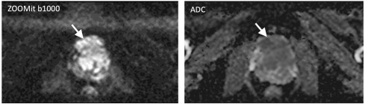
Limited FOV diffusion imaging in the prostate
Donners et al, 2020

Slide 35

Models routinely used for diffusion imaging outside the brain
Conventional single tensor model
2) Intravoxel incoherent motion (IVIM) model:
3) Diffusion Kurtosis Imaging
Le Bihan et al, 1986

Slide 36
Outline
Basics of Diffusion MRI
Artifacts and their corrected in preprocessing of dMRI
Groupwise analysis consideration
Advanced dMRI: DKI, NODDI, etc.…
dMRI outside the brain
Discussion

Slide 37
Discussions and Future Work
dMRI is a powerful technique to evaluate white matter disorganization in both neurodevelopment and neurodegenerative disorders.
Single tensor (ST)-dMRI metrics are very powerful and give us a good starting point to understand both white matter strength and brain configuration in neurological studies.
However ST-dMRI metrics are biased. Beyond ST-dMRI might provide additional insights into fiber dispersion, orientation, and inflammation through DKI and NODDI metrics.
Single tensor tractography is also biased in the crossing-fiber regions. Hence results derived from any tractographic techniques should be interpreted with caution.
Analysis of dMRI significantly affects the interpretation. Hence, a careful data processing is required.
Contact me

