Slide 1

CUDA C++ BASICS
NVIDIA Corporation

Slide 2
WHAT IS CUDA?
CUDA Architecture
Expose GPU parallelism for general-purpose computing
Expose/Enable performance
CUDA C++
Based on industry-standard C++
Set of extensions to enable heterogeneous programming
Straightforward APIs to manage devices, memory etc.
This session introduces CUDA C++
Other languages/bindings available: Fortran, Python, Matlab, etc.

Slide 3
INTRODUCTION TO CUDA C++
What will you learn in this session?
Start with vector addition
Write and launch CUDA C++ kernels
Manage GPU memory
(Manage communication and synchronization)-> next session
(Some knowledge of C or C++ programming is assumed.)

Slide 4
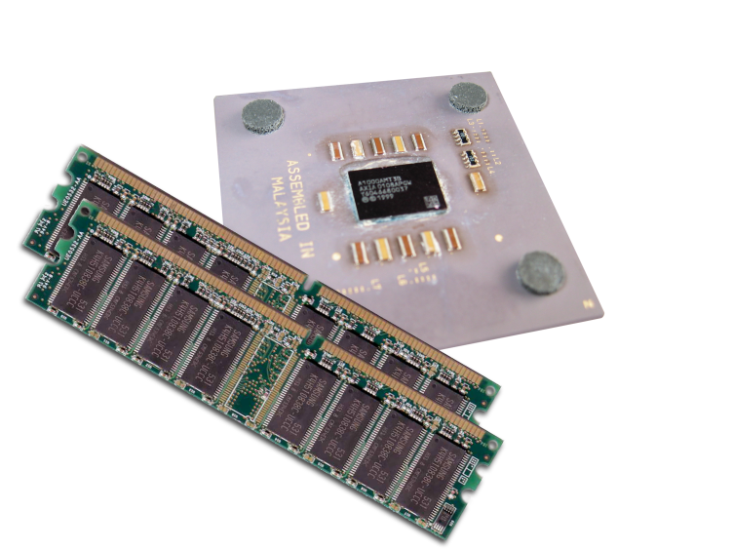
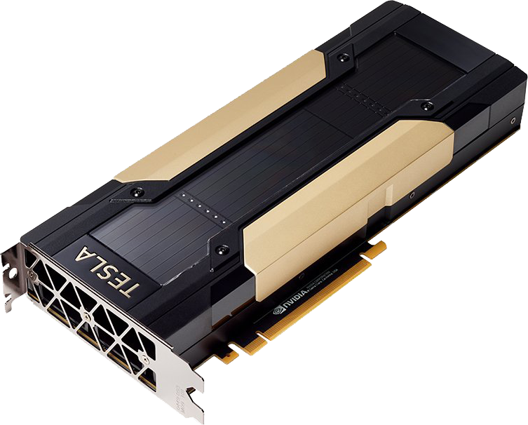
HETEROGENEOUS COMPUTING
Host The CPU and its memory (host memory)
Device The GPU and its memory (device memory)

Slide 5








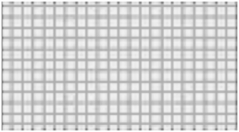
PORTING TO CUDA
Application Code
Rest of Sequential
CPU Code
Compute-Intensive Functions
Use GPU to Parallelize
GPU
CPU
+

Slide 6
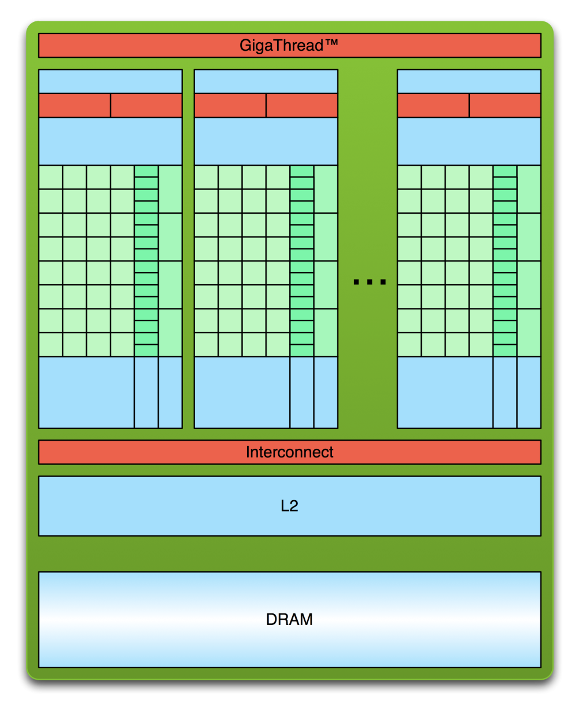
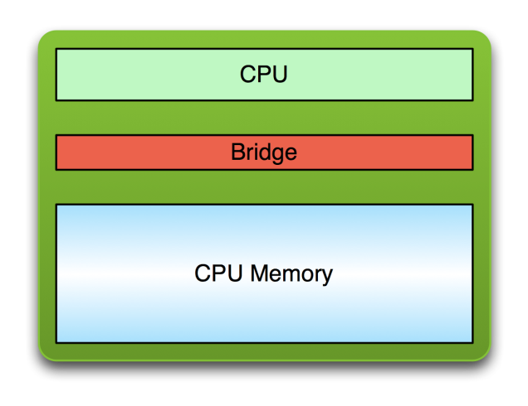
SIMPLE PROCESSING FLOW
PCIe or NVLink Bus
1. Copy input data from CPU memory to GPU memory

Slide 7
SIMPLE PROCESSING FLOW
PCIe or NVLink Bus
Copy input data from CPU memory to GPU memory
Load GPU program and execute, caching data on chip for performance

Slide 8
SIMPLE PROCESSING FLOW
PCIe or NVLink Bus
Copy input data from CPU memory to GPU memory
Load GPU program and execute, caching data on chip for performance
Copy results from GPU memory to CPU memory

Slide 9










PARALLEL PROGRAMMING IN CUDA C++
GPU computing is about massive parallelism!
We need an interesting example…
We’ll start with vector addition
a
b
c

Slide 10
GPU KERNELS: DEVICE CODE
global
void mykernel(void) {
}
CUDA C++ keyword
global
indicates a defined function that:
Runs on the GPU device
Is called from host code (can also be called from other device code)
nvcc separates source code into host and device components
Device functions (e.g. mykernel()) processed by NVIDIA compiler
Host functions (e.g. main()) processed by standard host compiler:
gcc, cl.exe

Slide 11
GPU KERNELS: Call DEVICE CODE
mykernel<<<Blocks,Threads>>>(); // run a kernel on GPU
Triple angle brackets mark a call to device code
Also called a “kernel launch”
the number of CUDA threads that execute that kernel for a given kernel call is specified using a new <<<...>>> execution configuration syntax
Each CUDA thread that executes the kernel is given a unique thread ID (threadIdx) that is accessible within the kernel through built-in variables.
The parameters inside the triple angle brackets are the CUDA kernel execution configuration
That’s all that is required to execute a function on the GPU!

Slide 12
GPU KERNELS: Call DEVICE CODE
mykernel<<<Blocks,Threads>>>(); // run a kernel on GPU
Triple angle brackets mark a call to device code
Blocks and Threads can be dim3 object
Struct type dim3 has three elements (x, y, z)

Slide 13
GPU KERNELS: Call DEVICE CODE
mykernel<<<Blocks,Threads>>>(); // run a kernel on GPU
Triple angle brackets mark a call to device code
Blocks and Threads can be dim3 object
Struct type dim3 has three elements (x, y, z)
Built-in variables: threadIdx, blockIdx, blockDim for identifying CUDA thread

Slide 14
MEMORY MANAGEMENT
Host and device memory are separate entities
Device pointers point to GPU memory
Typically passed to device code
Typically not dereferenced in host code
Host pointers point to CPU memory
Typically not passed to device code
Typically not dereferenced in device code
Simple CUDA API for handling device memory
cudaMalloc(), cudaFree(), cudaMemcpy()
Similar to the C equivalents malloc(), free(), memcpy()

Slide 15

RUNNING CODE IN PARALLEL
GPU computing is about massive parallelism
So how do we run code in parallel on the device?
add<<< 1, 1 >>>();
add<<< N, 1 >>>();
Instead of executing add() once, execute N times in parallel

Slide 16
VECTOR ADDITION ON THE DEVICE
With add() running in parallel we can do vector addition
Terminology: each parallel invocation of add() is referred to as a block
The set of all blocks is referred to as a grid
Each invocation can refer to its block index using blockIdx.x
global void add(int *a, int *b, int *c) {
c[blockIdx.x] = a[blockIdx.x] + b[blockIdx.x];
}
By using blockIdx.x to index into the array, each block handles a different index
Built-in variables like blockIdx.x are zero-indexed (C/C++ style), 0..N-1, where N is from the kernel execution configuration indicated at the kernel launch

Slide 17
VECTOR ADDITION ON THE DEVICE
#define N 512 int main(void) {
int *a, *b, *c;
int *d_a, *d_b, *d_c;
// host copies of a, b, c
// device copies of a, b, c
int size = N * sizeof(int);
// Alloc space for device copies of a, b, c
cudaMalloc((void |  | **)&d_a, | size);
cudaMalloc((void |  | **)&d_b, | size);
cudaMalloc((void |  | **)&d_c, | size);
// Alloc | space for host copies of a, b, |  |  | c and setup input values
a = (int | *)malloc(size); random_ints(a, |  |  | N);
b = (int c = (int | *)malloc(size); random_ints(b, *)malloc(size); |  |  | N);

Slide 18
VECTOR ADDITION ON THE DEVICE
// Copy inputs to device
cudaMemcpy(d_a, a, size, cudaMemcpyHostToDevice); cudaMemcpy(d_b, b, size, cudaMemcpyHostToDevice);
// Launch add() kernel on GPU with N blocks
add<<<N,1>>>(d_a, d_b, d_c);
// Copy result back to host
cudaMemcpy(c, d_c, size, cudaMemcpyDeviceToHost);
// Cleanup
free(a); free(b); free(c);
cudaFree(d_a); cudaFree(d_b); cudaFree(d_c); return 0;
}

Slide 19
REVIEW (1 OF 2)
Difference between host and device
Host CPU
Device GPU
Using
global
to declare a function as device code
Executes on the device
Called from the host (or possibly from other device code)
Passing parameters from host code to a device function

Slide 20
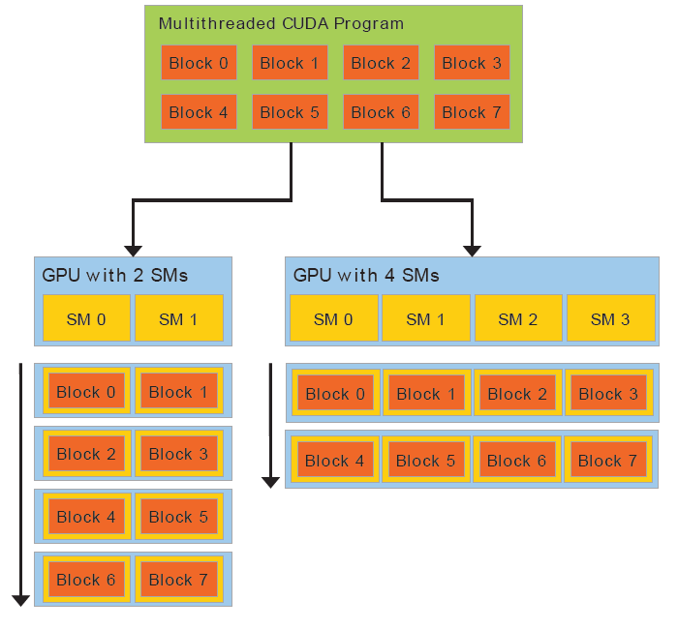
REVIEW (1 OF 2)
A GPU is built around an array of Streaming Multiprocessors (SMs, SIMD Processors)
A multithreaded program is partitioned into blocks of threads that execute independently from each other
A GPU with more multiprocessors will automatically execute the program in less time than a GPU with fewer multiprocessors

Slide 21
REVIEW (2 OF 2)
Basic device memory management
cudaMalloc()
cudaMemcpy()
cudaFree()
Launching parallel kernels
Launch N copies of add() with add<<<N,1>>>(…);
Use blockIdx.x to access block index

Slide 22
CUDA THREADS
Terminology: a block can be split into parallel threads
Let’s change add() to use parallel threads instead of parallel blocks
global void add(int *a, int *b, int *c) { c[threadIdx.x] = a[threadIdx.x] + b[threadIdx.x];
}
We use threadIdx.x instead of blockIdx.x
Need to make one change in main():
add<<< 1, N >>>();// N <= 1024, a thread block may contain up to 1024 threads

Slide 23
COMBINING BLOCKS AND THREADS
We’ve seen parallel vector addition using:
Many blocks with one thread each
One block with many threads
Let’s adapt vector addition to use both blocks and threads
Why? We’ll come to that…
First let’s discuss data indexing…

Slide 24

















































INDEXING ARRAYS WITH BLOCKS AND THREADS
No longer as simple as using blockIdx.x and threadIdx.x
Consider indexing an array with one element per thread (8 threads/block):
threadIdx.x threadIdx.x
threadIdx.x
threadIdx.x
0
1 | 2 | 3 | 4 | 5 | 6 | 7 | 0 | 1 | 2 | 3 | 4 | 5 | 6 | 7 | 0 | 1 | 2 | 3 | 4 | 5 | 6 | 7 | 0 | 1 | 2 | 3 | 4 | 5 | 6
7
blockIdx.x = 0
blockIdx.x = 1
blockIdx.x = 2
blockIdx.x = 3
With M threads/block a unique index for each thread is given by:
int index = threadIdx.x + blockIdx.x * M;

Slide 25





















































































































INDEXING ARRAYS: EXAMPLE
Which thread will operate on the red element?
0
1 | 2 | 3 | 4 | 5 | 6 | 7 | 8 | 9 | 10 | 11 | 12 | 13 | 14 | 15 | 16 | 17 | 18 | 19 | 20 | 21 | 22 | 23 | 24 | 25 | 26 | 27 | 28 | 29 | 30
31
M = 8
threadIdx.x = 5
0
1
2
3
4
5
6
7
0
1
2
3
4
5
6
7
0
1
2
3
4
5
6
7
0
1
2
3
4
5
6
7
int index = | threadIdx.x | blockIdx.x + blockIdx.x | = 2 * M;
= | 5 | + 2 | * 8;
= | 21;

Slide 26
VECTOR ADDITION WITH BLOCKS AND THREADS
Use the built-in variable blockDim.x for threads per block in the vector
int index = threadIdx.x + blockIdx.x * blockDim.x
Combined version of add() to use parallel threads and parallel blocks:
global void add(int *a, int *b, int *c) {
int index = threadIdx.x + blockIdx.x * blockDim.x;
c[index] = a[index] + b[index];
}
What changes need to be made in main()?

Slide 27
ADDITION WITH BLOCKS AND THREADS
#define N (2048*2048) #define THREADS_PER_BLOCK 512
int main(void) {
int *a, *b, *c;
int *d_a, *d_b, *d_c;
int size = N * sizeof(int);
// host copies of a, b, c
// device copies of a, b, c
// Alloc space for device copies of a, b, c
cudaMalloc((void | **)&d_a, | size);
cudaMalloc((void | **)&d_b, | size);
cudaMalloc((void | **)&d_c, | size);
// Alloc space for host copies of a, b, c and setup input values
a = | (int | *)malloc(size); random_ints(a, | N);
b = c = | (int (int | *)malloc(size); random_ints(b, *)malloc(size); | N);

Slide 28
ADDITION WITH BLOCKS AND THREADS
// Copy inputs to device
cudaMemcpy(d_a, a, size, cudaMemcpyHostToDevice); cudaMemcpy(d_b, b, size, cudaMemcpyHostToDevice);
// Launch add() kernel on GPU
add<<<N/THREADS_PER_BLOCK,THREADS_PER_BLOCK>>>(d_a, | d_b, | d_c);
// Copy result back to host
cudaMemcpy(c, d_c, size, cudaMemcpyDeviceToHost);
// Cleanup
free(a); free(b); free(c); cudaFree(d_a); cudaFree(d_b); cudaFree(d_c); return 0;
 |  | 25
}

Slide 29
HANDLING ARBITRARY VECTOR SIZES
Typical problems are not friendly multiples of blockDim.x
Avoid accessing beyond the end of the arrays:
global void add(int *a, int *b, int *c, int n) {
int index = threadIdx.x | + | blockIdx.x | * blockDim.x;
if (index < n)
c[index] = a[index] | + | b[index];
}
Update the kernel launch:
add<<<(N + M-1) / M,M>>>(d_a, d_b, d_c, N);

Slide 30
Multi-Dimensional CUDA Grids
In previous 1D example
thr_per_blk = 128
blk_in_grid = ceil( float(N) / thr_per_blk );
vec_add<<< blk_in_grid, thr_per_blk >>>(d_a, d_b, d_c);
In general
dim3 is c struct with member variables x, y, z.
dim3 | threads_per_block( | threads | per | block | in | x-dim,
 |  | threads | per | block | in | y-dim,
 |  | threads | per | block | in | z-dim);
dim3 | blocks_in_grid( grid | blocks | in | x-dim,
 | grid | blocks | in | y-dim,
 | grid | blocks | in | z-dim );

Slide 31
Multi-D CUDA Grids
In previous 1D example
thr_per_blk = 128
blk_in_grid = ceil( float(N) / thr_per_blk );
vec_add<<< blk_in_grid, thr_per_blk >>>(d_a, d_b, d_c);
So we could have used
dim3 threads_per_block( 128, 1, 1 );
dim3 is c struct with member variables x, y, z.
dim3 blocks_in_grid( ceil( float(N) / threads_per_block.x), 1, 1 );
vec_add<<< blocks_in_grid, threads_per_block >>>(d_a, d_b, d_c);

Slide 32
Map CUDA threads to 2D array
^{A}0,0
^{A}0,1
^{A}0,2
^{A}0,3
^{A}0,4
^{A}0,5
^{A}0,6
^{A}0,7
^{A}0,8
^{A}0,9
M = 7 rows
N = 10 columns
Assume a 4x4 threads per block…
Then to cover all elements in the array, we need 3 blocks in x-dim and 2 blocks in y-dim.
^{A}1,0
^{A}1,1
^{A}1,2
^{A}1,3
^{A}1,4
^{A}1,5
^{A}1,6
^{A}1,7
^{A}1,8
^{A}1,9
^{A}2,0
^{A}2,1
^{A}2,2
^{A}2,3
^{A}2,4
^{A}2,5
^{A}2,6
^{A}2,7
^{A}2,8
^{A}2,9
^{A}3,0
^{A}3,1
^{A}3,2
^{A}3,3
^{A}3,4
^{A}3,5
^{A}3,6
^{A}3,7
^{A}3,8
^{A}3,9
^{A}4,0
^{A}4,1
^{A}4,2
^{A}4,3
^{A}4,4
^{A}4,5
^{A}4,6
^{A}4,7
^{A}4,8
^{A}4,9
^{A}5,0
^{A}5,1
^{A}5,2
^{A}5,3
^{A}5,4
^{A}5,5
^{A}5,6
^{A}5,7
^{A}5,8
^{A}5,9
^{A}6,0
^{A}6,1
^{A}6,2
^{A}6,3
^{A}6,4
^{A}6,5
^{A}6,6
^{A}6,7
^{A}6,8
^{A}6,9
dim3 threads_per_block( 4, 4, 1 );
dim3 blocks_in_grid( ceil(float(N) / threads_per_block.x ),ceil( float(M) / threads_per_block.y )) , 1 );
ceil( mat_add<<< blocks_in_grid, threads_per_block >>>(d_a, d_b, d_c));

Slide 33
Row-Major Order
^{A}0,0 | ^{A}0,1 | ^{A}0,2 | ^{A}0,3 | ^{A}0,4
^{A}1,0 | ^{A}1,1 | ^{A}1,2 | ^{A}1,3 | ^{A}1,4
^{A}2,0 | ^{A}2,1 | ^{A}2,2 | ^{A}2,3 | ^{A}2,4
^{A}3,0 | ^{A}3,1 | ^{A}3,2 | ^{A}3,3 | ^{A}3,4
…
0 | 1 | 2 | 3 | 4 | 5 | 6 | 7 | 8 | 9 | 10 | 11 | 12 | 13 | 14 | 15 | 16 | 17 | 18 | 19
…

Slide 34
Row-Major Order
^{A}0,0 | ^{A}0,1 | ^{A}0,2 | ^{A}0,3 | ^{A}0,4
^{A}1,0 | ^{A}1,1 | ^{A}1,2 | ^{A}1,3 | ^{A}1,4
^{A}2,0 | ^{A}2,1 | ^{A}2,2 | ^{A}2,3 | ^{A}2,4
^{A}3,0 | ^{A}3,1 | ^{A}3,2 | ^{A}3,3 | ^{A}3,4
…
^{A}0,0 | ^{A}0,1 | ^{A}0,2 | ^{A}0,3 | ^{A}0,4
0 | 1 | 2 | 3 | 4 | 5 | 6 | 7 | 8 | 9 | 10 | 11 | 12 | 13 | 14 | 15 | 16 | 17 | 18 | 19
…

Slide 35
Row-Major Order
^{A}0,0 | ^{A}0,1 | ^{A}0,2 | ^{A}0,3 | ^{A}0,4
^{A}1,0 | ^{A}1,1 | ^{A}1,2 | ^{A}1,3 | ^{A}1,4
^{A}2,0 | ^{A}2,1 | ^{A}2,2 | ^{A}2,3 | ^{A}2,4
^{A}3,0 | ^{A}3,1 | ^{A}3,2 | ^{A}3,3 | ^{A}3,4
…
^{A}0,0 | ^{A}0,1 | ^{A}0,2 | ^{A}0,3 | ^{A}0,4 | ^{A}1,0 | ^{A}1,1 | ^{A}1,2 | ^{A}1,3 | ^{A}1,4
0 | 1 | 2 | 3 | 4 | 5 | 6 | 7 | 8 | 9 | 10 | 11 | 12 | 13 | 14 | 15 | 16 | 17 | 18 | 19
…

Slide 36
Row-Major Order
^{A}0,0 | ^{A}0,1 | ^{A}0,2 | ^{A}0,3 | ^{A}0,4
^{A}1,0 | ^{A}1,1 | ^{A}1,2 | ^{A}1,3 | ^{A}1,4
^{A}2,0 | ^{A}2,1 | ^{A}2,2 | ^{A}2,3 | ^{A}2,4
^{A}3,0 | ^{A}3,1 | ^{A}3,2 | ^{A}3,3 | ^{A}3,4
…
^{A}0,0 | ^{A}0,1 | ^{A}0,2 | ^{A}0,3 | ^{A}0,4 | ^{A}1,0 | ^{A}1,1 | ^{A}1,2 | ^{A}1,3 | ^{A}1,4 | ^{A}2,0 | ^{A}2,1 | ^{A}2,2 | ^{A}2,3 | ^{A}2,4
0 | 1 | 2 | 3 | 4 | 5 | 6 | 7 | 8 | 9 | 10 | 11 | 12 | 13 | 14 | 15 | 16 | 17 | 18 | 19
…

Slide 37
Row-Major Order
^{A}0,0 | ^{A}0,1 | ^{A}0,2 | ^{A}0,3 | ^{A}0,4
^{A}1,0 | ^{A}1,1 | ^{A}1,2 | ^{A}1,3 | ^{A}1,4
^{A}2,0 | ^{A}2,1 | ^{A}2,2 | ^{A}2,3 | ^{A}2,4
^{A}3,0 | ^{A}3,1 | ^{A}3,2 | ^{A}3,3 | ^{A}3,4
…
^{A}0,0 | ^{A}0,1 | ^{A}0,2 | ^{A}0,3 | ^{A}0,4 | ^{A}1,0 | ^{A}1,1 | ^{A}1,2 | ^{A}1,3 | ^{A}1,4 | ^{A}2,0 | ^{A}2,1 | ^{A}2,2 | ^{A}2,3 | ^{A}2,4 | ^{A}3,0 | ^{A}3,1 | ^{A}3,2 | ^{A}3,3 | ^{A}3,4
0 | 1 | 2 | 3 | 4 | 5 | 6 | 7 | 8 | 9 | 10 | 11 | 12 | 13 | 14 | 15 | 16 | 17 | 18 | 19
…

Slide 38
Map CUDA threads to 2D array
^{A}0,0
^{A}0,1
^{A}0,2
^{A}0,3
^{A}0,4
^{A}0,5
^{A}0,6
^{A}0,7
^{A}0,8
^{A}0,9
M = 7 rows
N = 10 columns
Assume 4x4 blocks of threads…
Then to cover all elements in the array, we need 3 blocks in x-dim and 2 blocks in y-dim.
^{A}1,0
^{A}1,1
^{A}1,2
^{A}1,3
^{A}1,4
^{A}1,5
^{A}1,6
^{A}1,7
^{A}1,8
^{A}1,9
^{A}2,0
^{A}2,1
^{A}2,2
^{A}2,3
^{A}2,4
^{A}2,5
^{A}2,6
^{A}2,7
^{A}2,8
^{A}2,9
^{A}3,0
^{A}3,1
^{A}3,2
^{A}3,3
^{A}3,4
^{A}3,5
^{A}3,6
^{A}3,7
^{A}3,8
^{A}3,9
^{A}4,0
^{A}4,1
^{A}4,2
^{A}4,3
^{A}4,4
^{A}4,5
^{A}4,6
^{A}4,7
^{A}4,8
^{A}4,9
^{A}5,0
^{A}5,1
^{A}5,2
^{A}5,3
^{A}5,4
^{A}5,5
^{A}5,6
^{A}5,7
^{A}5,8
^{A}5,9
^{A}6,0
^{A}6,1
^{A}6,2
^{A}6,3
^{A}6,4
^{A}6,5
^{A}6,6
^{A}6,7
^{A}6,8
^{A}6,9
global void add_matrices(int *a, int *b, int *c){
int column = blockDim.x * blockIdx.x + threadIdx.x;
int row = blockDim.y * blockIdx.y + threadIdx.y;
if (row < M && column < N){
int thread_id = row * N + column;
c[thread_id] = a[thread_id] + b[thread_id];
}
}

Slide 39
Map CUDA threads to 2D array
0
1
2
3
4
5
6
7
8
9 10
11
M = 7 rows
N = 10 columns
Assume 4x4 blocks of threads…
Then to cover all elements in the array, we need 3 blocks in x-dim and 2 blocks in y-dim.
0
^{A}0,0
^{A}0,1
^{A}0,2
^{A}0,3
^{A}0,4
^{A}0,5
^{A}0,6
^{A}0,7
^{A}0,8
^{A}0,9
1
^{A}1,0
^{A}1,1
^{A}1,2
^{A}1,3
^{A}1,4
^{A}1,5
^{A}1,6
^{A}1,7
^{A}1,8
^{A}1,9
2
^{A}2,0
^{A}2,1
^{A}2,2
^{A}2,3
^{A}2,4
^{A}2,5
^{A}2,6
^{A}2,7
^{A}2,8
^{A}2,9
3
^{A}3,0
^{A}3,1
^{A}3,2
^{A}3,3
^{A}3,4
^{A}3,5
^{A}3,6
^{A}3,7
^{A}3,8
^{A}3,9
4
^{A}4,0
^{A}4,1
^{A}4,2
^{A}4,3
^{A}4,4
^{A}4,5
^{A}4,6
^{A}4,7
^{A}4,8
^{A}4,9
5
^{A}5,0
^{A}5,1
^{A}5,2
^{A}5,3
^{A}5,4
^{A}5,5
^{A}5,6
^{A}5,7
^{A}5,8
^{A}5,9
Ex: What element of the array does the highlighted thread correspond to?
thread_id = row * N + column
6
^{A}6,0
^{A}6,1
^{A}6,2
^{A}6,3
^{A}6,4
^{A}6,5
^{A}6,6
^{A}6,7
^{A}6,8
^{A}6,9
7
_global void add_matrices(int *a, int *b, int *c){
int column = blockDim.x * blockIdx.x + threadIdx.x;
int row = blockDim.y * blockIdx.y + threadIdx.y;
if (row < M && column < N){
int thread_id = row * N + column;
c[thread_id] = a[thread_id] + b[thread_id];
}
}
(0 – 11)
(0 – 7)
(0 – 69)

Slide 40
Now let’s run the matrix_addition program.
Run the matrix_addition program
Change execution configuration parameters
threads_per_block( 16, 16, 1 );
NOTE: you cannot exceed 1024 threads per block (in total)
threads_per_block(
threads_per_block(
threads_per_block(
16, 16, 1 ); _{256 ✔}
32, 32, 1 ); 1024 ✔
64, 64, 1 ); 4096 x

Slide 41
WHY BOTHER WITH THREADS?
Threads seem unnecessary
They add a level of complexity
What do we gain?
Unlike parallel blocks, threads have mechanisms to:
Communicate
Synchronize
To look closer, we need a new example… (next session)

Slide 42
REVIEW
Launching parallel kernels
Launch N copies of add() with add<<<N/M,M>>>(…);
Use blockIdx.x to access block index
Use threadIdx.x to access thread index within block
Assign elements to threads:
int index = threadIdx.x + blockIdx.x * blockDim.x;

Slide 43
FUTURE SESSIONS
CUDA Shared Memory
CUDA GPU architecture and basic optimizations
Atomics, Reductions, Warp Shuffle
Using Managed Memory
Concurrency (streams, copy/compute overlap, multi-GPU)
Analysis Driven Optimization
Cooperative Groups

Slide 44
FURTHER STUDY
An introduction to CUDA:
https://devblogs.nvidia.com/easy-introduction-cuda-c-and-c/
Another introduction to CUDA:
https://devblogs.nvidia.com/even-easier-introduction-cuda/
CUDA Programming Guide:
https://docs.nvidia.com/cuda/cuda-c-programming-guide/index.html
CUDA Documentation:
https://docs.nvidia.com/cuda/index.html https://docs.nvidia.com/cuda/cuda-runtime-api/index.html (runtime API)

