Slide 1

CUDA SHARED MEMORY
NVIDIA Corporation

Slide 2
REVIEW (1 OF 2)
Difference between host and device
Host CPU
Device GPU
global
to declare a function as device code
Using
Executes on the device
Called from the host (or possibly from other device code)
Passing parameters from host code to a device function

Slide 3
REVIEW (2 OF 2)
Basic device memory management
cudaMalloc()
cudaMemcpy()
cudaFree()
Launching parallel kernels
Launch N copies of add() with add<<<N,1>>>(…);
Use blockIdx.x to access block index

Slide 4
Shared Memory
Shared memory is equivalent to a user-managed cache: The application explicitly allocates and accesses it.
Recall: how does cache work in OS and computer organization courses
Launching parallel kernels
Launch N copies of add() with add<<<N,1>>>(…);
Use blockIdx.x to access block index

Slide 5











1D STENCIL
Consider applying a 1D stencil to a 1D array of elements
Each output element is the sum of input elements within a radius
If radius is 3, then each output element is the sum of 7 input elements:
radius
radius

Slide 6


















































IMPLEMENTING WITHIN A BLOCK
Each thread processes one output element
blockDim.x elements per block
Input elements are read several times
With radius 3, each input element is read seven times
……
Block 1
Block 2

Slide 7
Shared Memory: SHARING DATA BETWEEN THREADS
Terminology: within a block, threads share data via shared memory
Shared memory is equivalent to a user-managed cache:
The application explicitly allocates and accesses it.
Extremely fast on-chip memory, user-managed
Declare using shared , allocated a variable per block that:
Resides in the shared memory space of a thread block,
Has the lifetime of the block,
Has a distinct object per block,
Is only accessible from all the CUDA threads within the block,

Slide 8
Shared Memory: SHARING DATA BETWEEN THREADS
Typical programming pattern:
Load data from device memory to shared memory
Synchronize with all the other threads of the block so that each thread can safely read shared memory locations that were populated by different threads,
Process the data in shared memory
Synchronize again if necessary to make sure that shared memory has been updated with the results,
Write the results back to device memory.

Slide 9
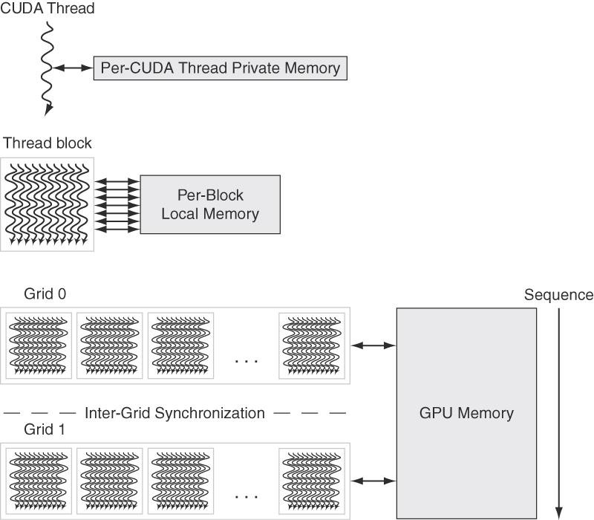

Shared Memory: SHARING DATA BETWEEN THREADS
No cache coherence mechanism, compared to CPU. (wide and shallow)
Shared memory
Shared memory
Shared memory

Slide 10
























































IMPLEMENTING WITH SHARED MEMORY
Cache data in shared memory
Read (blockDim.x + 2 * radius) input elements from global memory to shared memory
Compute blockDim.x output elements
Write blockDim.x output elements to global memory
Each block needs a halo of radius elements at each boundary
Readonly on left
Readonly on right
blockDim.x output elements

Slide 11











































































































STENCIL KERNEL
global void stencil_1d(int *in, int *out) {
shared int temp[BLOCK_SIZE + 2 * RADIUS];
int gindex = threadIdx.x + blockIdx.x * blockDim.x;
int lindex = threadIdx.x + RADIUS;
// Read input elements into shared memory
temp[lindex] = in[gindex];
if (threadIdx.x < RADIUS) {
temp[lindex - RADIUS] = in[gindex - RADIUS]; temp[lindex + BLOCK_SIZE] =in[gindex+BLOCK_SIZE];
}
A thread block[0-15] calculates stencil
The 3 CUDA threads move left 3 orange elements from in[] to temp[]
The 3 CUDA threads move right 3 orange elements from in[] to temp[]

Slide 12
STENCIL KERNEL
// Apply the stencil in shared memory
int result = 0;
for (int offset = -RADIUS ; offset <= RADIUS ; offset++) result += temp[lindex + offset];
// Store the result
out[gindex] = result;
}

Slide 13












































DATA RACE!
The stencil example will not work…
Suppose thread 15 in Block 1 reads the temp[19] for calculating stencil after thread 0 in block 2 has fetched temp[19] from global memory in[].
Block 1, Thread 15, write temp[19]
Block1, Thread 0,
write temp[2]
Thread Block 1, 16 threads
temp[lindex] = in[gindex];
if (threadIdx.x < RADIUS) {
temp[lindex – RADIUS] = in[gindex – RADIUS]; temp[lindex + BLOCK_SIZE] = in[gindex + BLOCK_SIZE];
Block 2, Thread 0, temp[19]
}
int result = 0;
result += temp[lindex + 1];
Load at temp[2] by block 1, thread 0
Thread Block 1, 16 threads
Might cause write-read hazard!
E.g. one thread reads an element of in[]; another thread writes the same element.
Store from temp[2] by block 0, thread 15

Slide 14
SYNCTHREADS()
void syncthreads();
Synchronizes all threads within a CUDA block, how to explain in GPU architecture
Used to prevent RAW / WAR / WAW hazards
All threads must reach the barrier
In conditional code, the condition must be uniform across the block

Slide 15
STENCIL KERNEL
global__ void stencil_1d(int *in, int *out) {
shared__ int temp[BLOCK_SIZE + 2 * RADIUS];
int gindex = threadIdx.x + blockIdx.x * blockDim.x; int lindex = threadIdx.x + radius;
// Read input elements into shared memory
temp[lindex] = in[gindex]; if (threadIdx.x < RADIUS) {
temp[lindex – RADIUS] = in[gindex – RADIUS];
temp[lindex + BLOCK_SIZE] = in[gindex + BLOCK_SIZE];
}
// Synchronize (ensure all the data is available)
syncthreads();

Slide 16
STENCIL KERNEL
// Apply the stencil int result = 0;
for (int offset = -RADIUS | ; | offset <= RADIUS ; offset++)
result += temp[lindex | + | offset];
// Store the result
out[gindex] = result;
}

Slide 17
REVIEW
Use shared
to declare a variable/array in shared memory
Data is shared between threads in a block
Not visible to threads in other blocks
Use syncthreads() as a barrier
Use to prevent data hazards

Slide 18
FUTURE SESSIONS
CUDA GPU architecture and basic optimizations
Atomics, Reductions, Warp Shuffle
Using Managed Memory
Concurrency (streams, copy/compute overlap, multi-GPU)
Analysis Driven Optimization
Cooperative Groups

Slide 19
FURTHER STUDY
Shared memory:
https://devblogs.nvidia.com/using-shared-memory-cuda-cc/
CUDA Programming Guide:
https://docs.nvidia.com/cuda/cuda-c-programming-guide/index.html#shared-memory
CUDA Documentation:
https://docs.nvidia.com/cuda/index.html https://docs.nvidia.com/cuda/cuda-runtime-api/index.html (runtime API)

