Slide 1

CUDA OPTIMIZATION, PART 2
NVIDIA Corporation

Slide 2







OUTLINE
Most concepts in this presentation apply to any language or API on NVIDIA GPUs
Architecture:
Kepler/Maxwell/Pascal/Volta
Kernel optimizations
Launch configuration
Part 2 (this session):
Global memory throughput
Shared memory access

Slide 3
GLOBAL MEMORY THROUGHPUT

Slide 4
MEMORY HIERARCHY REVIEW
Local storage
Each thread has own local storage
Typically off-node DRAM and registers (managed by the compiler)
Shared memory / L1
Program configurable: typically up to 48KB shared (or 64KB, or 96KB…)
Shared memory is accessible by threads in the same threadblock
Very low latency
Very high throughput: >1 TB/s aggregate

Slide 5
MEMORY HIERARCHY REVIEW
L2
All accesses to global memory go through L2, including copies to/from CPU host Global
Global Memory
Accessible by all threads as well as host (CPU)
High latency (hundreds of cycles)
Throughput: up to ~900 GB/s (Volta V100)

Slide 6
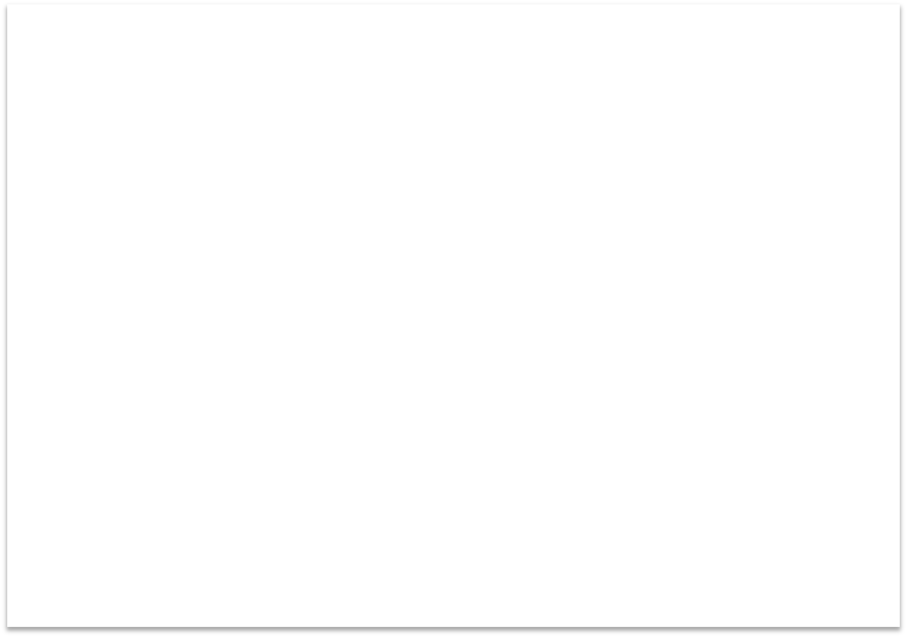


























MEMORY ARCHITECTURE
Device
GPU
Multiprocessor
Host
DRAM
Multiprocessor
CPU
Chipset
DRAM
Multiprocessor
Local
Registers
Shared Memory
Global
L1 / L2 Cache
Constant
Constant and Texture Caches
Texture

Slide 7









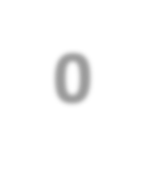



















MEMORY HIERARCHY REVIEW
SM-0
SM-1
SM-N
Registers
Registers
Registers
L1
SMEM
L1
SMEM
L1
SMEM
L2
Global Memory

Slide 8
GPU MEM OPERATIONS
Loads:
Caching
Default mode
Attempts to hit in L1, then L2, then GMEM
Load granularity is 128-byte line
Stores:
Invalidate L1, write-back for L2

Slide 9
GPU MEM OPERATIONS
Loads:
Non-caching
Compile with –Xptxas –dlcm=cg option to nvcc
Attempts to hit in L2, then GMEM
Do not hit in L1, invalidate the line if it’s in L1 already
The L1 can be bypassed with a non-caching load.
Load granularity is 32-bytes (segment)

Slide 10
LOAD OPERATION
Memory operations are issued per warp (32 CUDA threads, a SIMD thread)
Just like all other instructions
Operation:
CUDA Threads in a warp provide memory addresses
Determine which lines/segments are needed
Request the needed lines/segments

Slide 11






CACHING LOAD
Warp requests 32 aligned, consecutive 4-byte words
Addresses fall within 1 cache-line
Warp needs 128 bytes
128 bytes move across the bus on a miss (data load granularity)
Bus utilization: 100%
int c = a[idx];
addresses from a warp
...
0
32 64 96 128 160 192 224 256 288 320 352 384 416 448
Memory addresses

Slide 12






CACHING LOAD
Warp requests 32 aligned, permuted 4-byte words
Addresses fall within 1 cache-line
Warp needs 128 bytes
128 bytes move across the bus on a miss
Bus utilization: 100%
int c = a[rand()%warpSize];
addresses from a warp
...
0
32 64 96 128 160 192 224 256 288 320 352 384 416 448
Memory addresses

Slide 13






CACHING LOAD
Warp requests 32 misaligned, consecutive 4-byte words, e.g. bytes[126, 253]
Addresses fall within 2 cache-lines
Warp needs 128 bytes
256 bytes move across the bus on misses
Bus utilization: 50%
int c = a[idx-2];
addresses from a warp
...
0
32 64 96 128 160 192 224 256 288 320 352 384 416 448
Memory addresses

Slide 14





CACHING LOAD
All threads in a warp request the same 4-byte word
Addresses fall within a single cache-line
Warp needs 4 bytes
128 bytes move across the bus on a miss
Bus utilization: 3.125% (4/128), load 128 bytes, only using 4 bytes
int c = a[40];
addresses...from a warp
0
32 64 96 128 160 192 224 256 288 320 352 384 416 448
Memory addresses

Slide 15





CACHING LOAD
Warp requests 32 scattered 4-byte words
Addresses fall within N cache-lines
Warp needs 128 bytes
N*128 bytes move across the bus on a miss
Bus utilization: 128 / (N*128) (3.125% worst case N=32)
int c = a[rand()];
addresses from...a warp
0
32 64 96 128 160 192 224 256 288 320 352 384 416 448
Memory addresses

Slide 16
NON-CACHING LOAD
Warp requests 32 scattered 4-byte words
Addresses fall within N segments
Warp needs 128 bytes
N*32 bytes move across the bus on a miss
Bus utilization: 128 / (N*32) (12.5% worst case N = 32)
int c = a[rand()]; –Xptxas –dlcm=cg
addresses from.a.. warp
0
32 64 96 128 160 192 224 256 288 320 352 384 416 448
Memory addresses

Slide 17
GPU MEM OPTIMIZATION GUIDELINES
Strive for perfect coalescing
(Align starting address - may require padding)
A warp should access within a contiguous region
Have enough concurrent accesses to saturate the bus
Process several elements per thread
Multiple loads get pipelined
Indexing calculations can often be reused
Launch enough warps to maximize throughput
Latency is hidden by switching warps
Use all the caches!

Slide 18
A x B = C, split C into thread blocks
TB 1
TB 1
TB 1
TB 1: A[row 0-1] B[col 0-7]
TB 1: A[row 0-7] B[col 0-1]
TB 1: A[row 0-3] B[col 0-3]

Slide 19
SHARED MEMORY

Slide 20
SHARED MEMORY
Uses:
Inter-thread communication within a block
Cache data to reduce redundant global memory accesses , like CPU cache
Use it to improve global memory access patterns
The shared memory is expected to be a low-latency memory near each processor core (much like an L1 cache)
Can be managed (allocate and free) via programming API
Organization:
32 banks, 4-byte wide banks
Successive 4-byte words belong to different banks

Slide 21
SHARED MEMORY
Performance:
Typically: 4 bytes per bank per 1 or 2 clocks per multiprocessor
shared accesses are issued per 32 threads (warp)
serialization: if N threads of 32 access different 4-byte words in the same bank (bank conflict), N accesses are executed serially

Slide 22
BANK ADDRESSING EXAMPLES
No Bank Conflicts
No Bank Conflicts
Thread 0
Thread 1
Thread 2
Thread 3
Thread 4
Thread 5
Thread 6
Thread 7
Bank 0
Bank 1
Bank 2
Bank 3
Bank 4
Bank 5
Bank 6
Bank 7
Thread 0
Thread 1
Thread 2
Thread 3
Thread 4
Thread 5
Thread 6
Thread 7
Bank 0
Bank 1
Bank 2
Bank 3
Bank 4
Bank 5
Bank 6
Bank 7
Thread 31
Bank 31
Thread 31
Bank 31

Slide 23
BANK ADDRESSING EXAMPLES
2-way Bank Conflicts
16-way Bank Conflicts
Thread 0
Thread 1
Thread 2
Thread 3
Thread 4
Bank 0
Bank 1
Bank 2
Bank 3
Bank 4
Bank 5
Bank 6
Bank 7
Thread 0
Thread 1
Thread 2
Thread 3
Thread 4
Thread 5
Thread 6
Thread 7
x16
Bank 0
Bank 1
Bank 2
Bank 7
Bank 8
Bank 9
Thread 28
Thread 29
Thread 30
Thread 31
x16
Bank 31
Thread 31
Bank 31

Slide 24
SHARED MEMORY: AVOIDING BANK CONFLICTS
32x32 Shared MEM array
Warp accesses a column of 32x32 matrix (stored in row-major):
32-way bank conflicts (threads in a warp access the same bank)
warps:
0 | 1 | 2 |  | 31
0 | 1 | 2 |  | 31
0 | 1 | 2 |  | 31
0 | 1 | 2 |  | 31
Bank 0
Bank 1
… Bank 31
0
1
2
31

Slide 25
SHARED MEMORY: AVOIDING BANK CONFLICTS
Add a column for padding:
32x33 SMEM array
Warp accesses a column of 32x33 matrix with 1 padding column (stored in row-major):
32 different banks, no bank conflicts
warps:
0 | 1 | 2 |  | 31 | padding
0 | 1 | 2 |  | 31
0 | 1 | 2 |  | 31
0 | 1 | 2 |  | 31
Bank 0
Bank 1
Bank 31
0
1
2
31

Slide 26
SUMMARY
Kernel Launch Configuration:
Launch enough threads per SIMD Processor to hide latency
Launch enough threadblocks to load the GPU
Global memory:
Maximize throughput (GPU has lots of bandwidth, use it effectively)
Use shared memory when applicable (over 1 TB/s bandwidth)
Use analysis/profiling when optimizing:
“Analysis-driven Optimization” (future session)

Slide 27
FUTURE SESSIONS
Atomics, Reductions, Warp Shuffle
Using Managed Memory
Concurrency (streams, copy/compute overlap, multi-GPU)
Analysis Driven Optimization
Cooperative Groups

Slide 28
FURTHER STUDY
Optimization in-depth:
http://on-demand.gputechconf.com/gtc/2013/presentations/S3466-Programming-Guidelines- GPU-Architecture.pdf
Analysis-Driven Optimization:
http://on-demand.gputechconf.com/gtc/2012/presentations/S0514-GTC2012-GPU-Performance- Analysis.pdf
CUDA Best Practices Guide:
https://docs.nvidia.com/cuda/cuda-c-best-practices-guide/index.html
CUDA Tuning Guides:
https://docs.nvidia.com/cuda/index.html#programming-guides (Kepler/Maxwell/Pascal/Volta)

