Slide 1

CUDA CONCURRENCY
Bob Crovella, 7/21/2020

Slide 2
AGENDA
Concurrency - Motivation
Pinned Memory
CUDA Streams
Overlap of Copy and Compute
Use Case: Vector Math/Video Processing Pipeline
Additional Stream Considerations
Copy-Compute Overlap with Managed Memory
Multi-GPU Concurrency
Other Concurrency Scenarios: Kernel
Concurrency, Host/Device Concurrency
Further Study
Homework

Slide 3
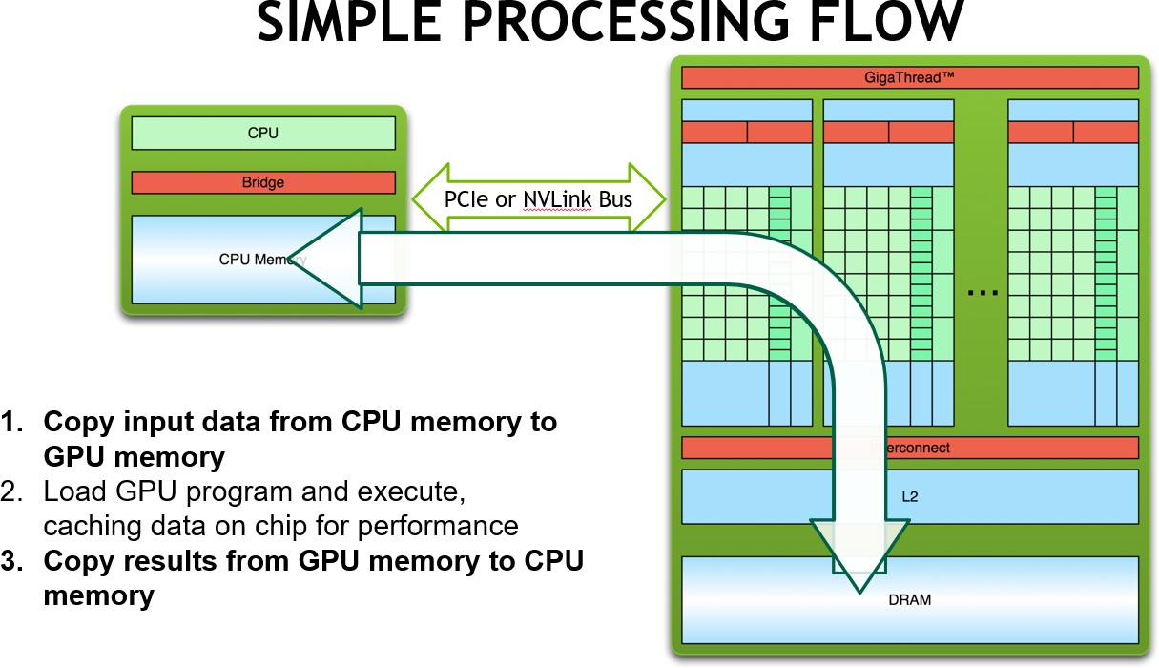
MOTIVATION
Recall 3 steps from session 1:
Naïve implementation leads to a processing flow like this:
1. Copy data to the GPU
2. Run kernel(s) on GPU
3. Copy results to host
->Wouldn’t it be nice if we could do this:
duration
1. Copy data to the GPU
2. Run kernel(s) on GPU
3. Copy results to host
duration
3

Slide 4
PINNED MEMORY
固定内存

Slide 5
PINNED (NON-PAGEABLE) MEMORY
Pinned memory enables:
faster Host<->Device copies
memcopies asynchronous with CPU
memcopies asynchronous with GPU
Usage
cudaHostAlloc / cudaFreeHost
instead of malloc / free or new / delete
cudaHostRegister / cudaHostUnregister
pin regular memory (e.g. allocated with malloc) after allocation
Implication:
pinned memory is essentially removed from host virtual (pageable) memory

Slide 6
CUDA STREAMS

Slide 7
STREAMS AND ASYNC API OVERVIEW
Default API:
GPU kernel launches are synchronous with CPU
cudaMemcpy (D2H, H2D) block CPU thread (if memory not page-locked)
CUDA calls are serialized by the driver (legacy default stream)
Streams and async functions provide:
cudaMemcpyAsync (D2H, H2D) asynchronous with CPU
Ability to concurrently execute a kernel and a memcopy
Concurrent copies in both directions (D2H, H2D) possible on most GPUs
Stream = sequence of operations that execute in issue-order on GPU, like task queue
Operations from different streams may be interleaved
A kernel and memcopy from different streams can be overlapped

Slide 8

STREAM SEMANTICS
Two operations issued into the same stream will execute in issue-order in GPU. Operation B issued after Operation A will not begin to execute until Operation A has completed.
Two operations issued into separate streams have no ordering prescribed by CUDA.
Operation A issued into stream 1 may execute before, during, or after Operation B issued into stream 2.
Operation: Usually, cudaMemcpyAsync or a kernel call.
More generally, most CUDA API calls that take a stream parameter, as well as stream callbacks.

Slide 9
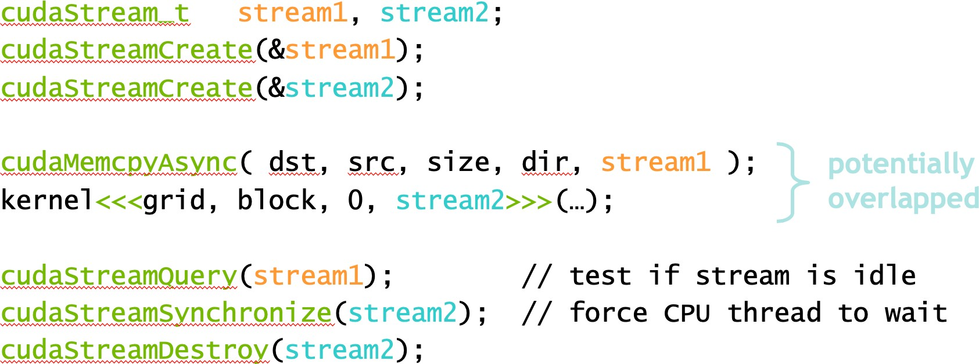
STREAM CREATION AND COPY/COMPUTE OVERLAP
Requirements:
D2H or H2D memcopy from pinned memory Kernel and memcopy in different, non-0 streams
Code:

Slide 10










STREAM EXAMPLES
K1,M1,K2,M2:
K1
K2
M1
M2
K1,K2,M1,M2:
K1
K2
M1
M2
K:
M:
Kernel Memcopy
K1,M1,M2:
K1
Integer: Stream ID
M1
M2
K1,M2,M1:
K1
M2
M1
K1,M2,M2:
K1
M2
M2
Time

Slide 11









EXAMPLE STREAM BEHAVIOR FOR VECTOR MATH
(assumes algorithm decomposability)
non-streamed
cudaMemcpy(d_x, h_x, size_x, cudaMemcpyHostToDevice); Kernel<<<b, t>>>(d_x, d_y, N); cudaMemcpy(h_y, d_y, size_y, cudaMemcpyDeviceToHost);
streamed
H->D copy
 | kernel
 |  | D->H copy
Stream ID:
0 1 0 1 0 1 0
for (int size_t size_t
i = 0,
offx = offy =
i<c; i++){ (size_x/c)*i; (size_y/c)*i;
cudaMemcpyAsync(d_x+offx, h_x+offx, size_x/c, cudaMemcpyHostToDevice, stream[i%ns]);
Kernel<<<b/c, t, 0, stream[i%ns]>>>(d_x+offx, d_y+offy, N/c);
cudaMemcpyAsync(h_y+offy, d_y+offy,
size_y/c, cudaMemcpyDeviceToHost, stream[i%ns]);}
Similar: video processing pipeline

Slide 12
DEFAULT STREAM
Kernels or cudaMemcpy… that do not specify stream (or use 0 for stream) are using the default stream
Legacy default stream behavior: synchronizing (on the device):
Stream 1
Stream 2
Default stream
All device activity issued prior to the item in the default stream must complete before default stream item begins
All device activity issued after the item in the default stream will wait for the default stream item to finish
All host threads share the same default stream for legacy behavior
Consider avoiding use of default stream during complex concurrency scenarios
Behavior can be modified to convert it to an “ordinary” stream
nvcc --default-stream per-thread …
Each host thread will get its own “ordinary” default stream

Slide 13
CUDALAUNCHHOSTFUNC() (STREAM “CALLBACKS”)
Allows definition of a host-code function that will be issued into a CUDA stream
Follows stream semantics: function will not be called until stream execution reaches that point
Uses a thread spawned by the GPU driver to perform the work
Has limitations: do not use any CUDA runtime API calls (or kernel launches) in the function
Useful for deferring CPU work until GPU results are ready
cudaLaunchHostFunc() replaces legacy cudaStreamAddCallback()

Slide 14
COPY-COMPUTE OVERLAP WITH UNIFIED MEMORY
In particular, with demand-paging
Follow same pattern, except use cudaMemPrefetchAsync() instead of cudaMemcpyAsync()
Stream semantics will guarantee that any needed migrations are performed in proper order
However, cudaMemPrefetchAsync() has more work to do than cudaMemcpyAsync() (updating of page tables in CPU and GPU)
This means the call can take substantially more time to return than an “ordinary” async call – can introduce unexpected gaps in timeline
Behavior varies for “busy” streams vs. idle streams. Counterintuitively, “busy” streams may result in better throughput
Read about it:
https://devblogs.nvidia.com/maximizing-unified-memory-performance-cuda/

Slide 15
ASIDE: CUDAEVENT
cudaEvent is an entity that can be placed as a “marker” in a stream
A cudaEvent is said to be “recorded” when it is issued
A cudaEvent is said to be “completed” when stream execution reaches the point where it was recorded
Most common use: timing
cudaEvent_t start, stop; | // | cudaEvent has its own type
cudaEventCreate(&start); | // | cudaEvent must be created
cudaEventCreate(&stop); | // | before use
cudaEventRecord(start); | // | “recorded” (issued) into default stream
Kernel<<<b, t>>>(…); | // | could be any set of CUDA device activity
cudaEventRecord(stop);
cudaEventSynchronize(stop); | // | wait for stream execution to reach “stop” event
cudaEventElapsedTime(&float_var, start, stop);
// measure Kernel duration
Also useful for arranging complex concurrency scenarios
Event-based timing may give unexpected results for host activity or complex concurrency scenarios

Slide 16
MULTI-GPU

Slide 17
MULTI-GPU – DEVICE MANAGEMENT
Not a replacement for OpenMP, MPI, etc.
Application can query and select GPUs
cudaGetDeviceCount(int *count) cudaSetDevice(int device) cudaGetDevice(int *device)
cudaGetDeviceProperties(cudaDeviceProp *prop, int device)
Multiple host threads can share a device
A single host thread can manage multiple devices
cudaSetDevice(i) to select current device
cudaMemcpyPeerAsync(…) for peer-to-peer copies

Slide 18
MULTI-GPU – STREAMS
Streams (and cudaEvent) have implicit/automatic device association
Each device also has its own unique default stream
Kernel launches will fail if issued into a stream not associated with current device
cudaStreamWaitEvent() can synchronize streams belonging to separate devices, cudaEventQuery() can test if an event is “complete”
Simple device concurrency:
cudaSetDevice(0); cudaStreamCreate(&stream0); cudaSetDevice(1); cudaStreamCreate(&stream1); Kernel<<<b, t, 0, stream1>>>(…); cudaSetDevice(0);
Kernel<<<b, t, 0, stream0>>>(…);
//associated with device 0
//associated with device 1
// these kernels have the possibility
// to execute concurrently

Slide 19
MULTI-GPU – DEVICE-TO-DEVICE DATA COPYING
If system topology supports it, data can be copied directly from one device to another over a fabric (PCIE, or NVLink)
Device must first be explicitly placed into a peer relationship (“clique”)
Must enable “peering” for both directions of transfer (if needed)
Thereafter, memory copies between those two devices will not “stage” through a system memory buffer (GPUDirect P2P transfer)
cudaDeviceEnablePeerAccess ( int peerDevice, unsigned int flags ), peerDevice Peer device to enable direct access to from the current device, flags Reserved for future use and must be set to 0
cudaSetDevice(0);
cudaDeviceCanAccessPeer(&canPeer, | 0, | 1); | // | test for | 0, 1 | peerable
cudaDeviceEnablePeerAccess(1, 0); |  |  | // | device 0 | sees | device 1 as a “peer”
cudaSetDevice(1); cudaDeviceEnablePeerAccess(0, 0); |  |  | // | device 1 | sees | device 0 as a “peer”
cudaMemcpyPeerAsync(dst_ptr, 0, src_ptr, 1, size, stream0); //dev 1 to dev 0 copy cudaDeviceDisablePeerAccess(0); // dev 0 is no longer a peer of dev 1
Limit to the number of peers in your “clique”

Slide 20
STREAM PRIORITY
CUDA streams allow an optional definition of a priority
This affects execution of concurrent kernels (only).
The GPU block scheduler will attempt to schedule blocks from high priority (stream) kernels before blocks from low priority (stream) kernels
Current CUDA implementation only has 2 priorities
Current CUDA implementation does not cause preemption of blocks
// get the range of stream priorities for this device int priority_high, priority_low;
cudaDeviceGetStreamPriorityRange(&priority_low, &priority_high);
// create streams with highest and lowest available priorities cudaStream_t st_high, st_low;
cudaStreamCreateWithPriority(&st_high, cudaStreamNonBlocking, priority_high); cudaStreamCreateWithPriority(&st_low, cudaStreamNonBlocking, priority_low);

Slide 21
FURTHER STUDY
Concurrency with Unified Memory:
https://devblogs.nvidia.com/maximizing-unified-memory-performance-cuda/
Programming Guide:
https://docs.nvidia.com/cuda/cuda-c-programming-guide/index.html#asynchronous-concurrent- execution
CUDA Sample Codes: concurrentKernels, simpleStreams, asyncAPI, simpleCallbacks, simpleP2P
Video processing pipeline with callbacks:
https://stackoverflow.com/questions/31186926/multithreading-for-image-processing-at-gpu- using-cuda/31188999#31188999

