Slide 1

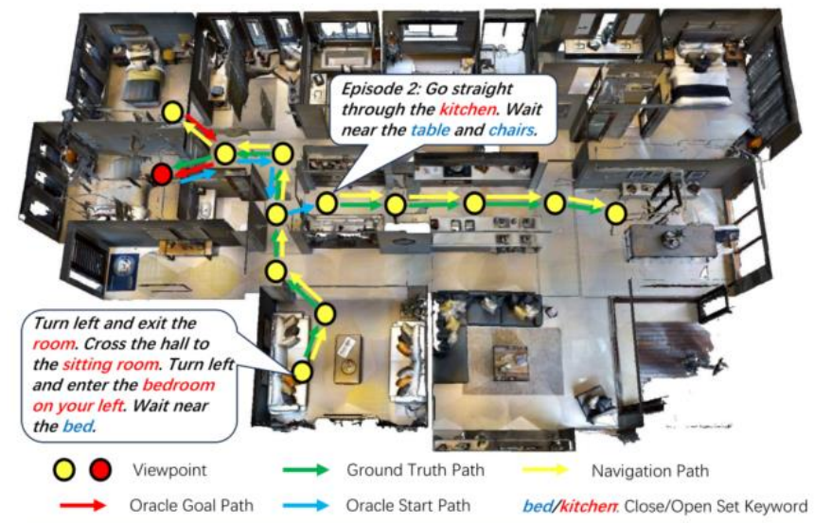
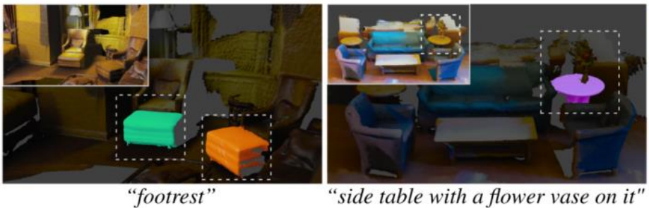
Downstream Applications of Open-Vocabulary Visual Perception: Scene Understanding
Xinyu Chen, chenxy835@mail2.sysu.edu.cn
Abstract:
Advancements in deep learning and computer visi-
on have revolutionized tasks like image recognition and object detection. Yet, traditional models are li- mited by fixed vocabularies, hindering their adapta-
bility to new objects and scenes. Open-vocabulary visual perception overcomes this hurdle by enablin- g systems to recognize an expansive array of novel concepts. This flexibility is pivotal for scene unders- tanding, crucial in autonomous driving, surveillance, and augmented reality. This review focuses on ope-
n-vocabulary approaches, highlighting advanceme-
nts in scene graph generation, 3D instance segmen-
tation, and vision-language navigation.
Introduction:
Open-Vocabulary Visual Perception enhances com- puter vision by recognizing new objects beyond fix-
ed vocabularies. It integrates Vision-Language Mo-dels (VLMs) for semantic understanding and emp-loys zero-shot learning to recognize unseen catego- ries.
Scene understanding extracts meaning from images or videos, including object detection, relationships, and scene structure.
Scene understanding tasks: Object detection, scene classification, scene graph generation (SGG), sema-
ntic and instance segmentation.
Review OVVP techniques in scene understanding:
From Pixels to Graphs : Open-vocabulary scene graph generation.
OpenMask3D : Open-vocabulary 3D instance segmen-
tation.
OVER-NAV : Iterative vision-and-language navigation with open-vocabulary detection.
Results:
From Pixels to Graphs: Uses generative Vision-Language Models (VLMs) for open-vocabulary Scene Graph Generation (SGG), improving efficiency and performance in vision-language tasks.
OpenMask3D: Introduces zero-shot 3D instance segmentation, expanding object category recognition and enhancing robot interaction in new environments.
OVER-NAV: Innovates Iterative Vision-and-Language Navigation (IVLN) with Large Language Models (LLMs) and Open-Vocabulary Detection (OVD), improving navigation in complex settings.

