Slide 1
Artist Similarity with Graph Neural Networks
Andrea Giuseppe Di Francesco - 1836928
Neural Networks
Sapienza University of Rome
Giuliano Giampietro - 2024160
Neural Networks
Sapienza University of Rome
Notes:
Time

Slide 2
Table of contents
Task description
Graph Neural Networks
Olga dataset
Architectures
Results
Conclusions

Slide 3
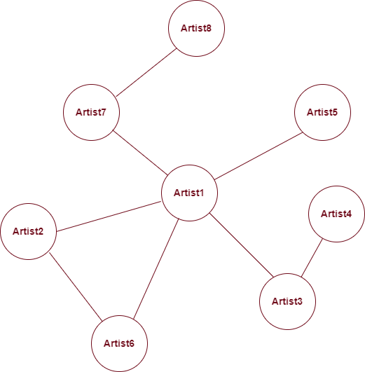
Task description
Artist similarity task aims to find patterns within large collection of artists
Artists’ relations are modeled according to a given graph structure, retrieved from
the https://www.allmusic.com/ website
To each node in the graph corrensponds a vector of features, related to the music content of the artist
Given the different natures of input information, this problem has been tackled with an hybrid approach, by considering both content and cultural aspects.

Slide 4
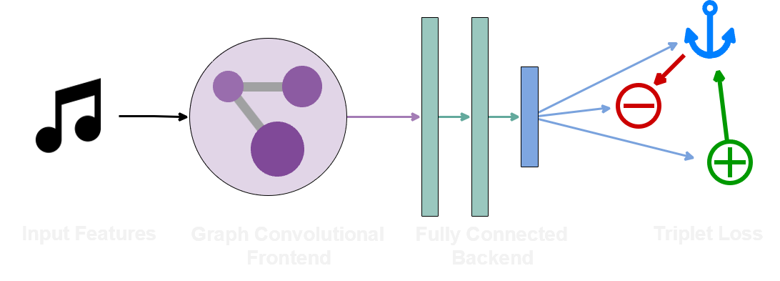
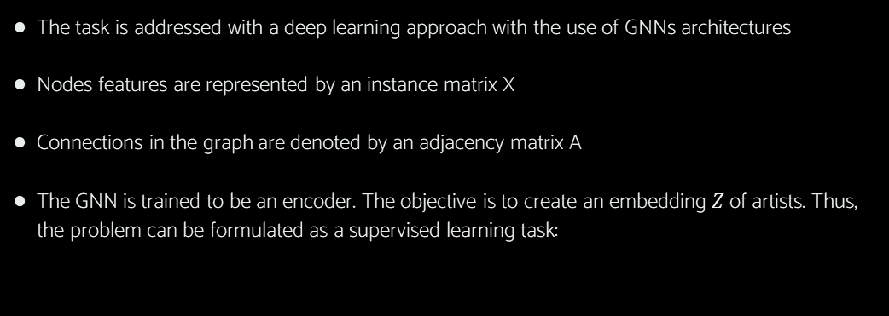

Graph Neural Networks (GNNs)
The task is addressed with a deep learning approach with the use of GNNs architectures
Nodes features are represented by an instance matrix X
Connections in the graph are denoted by an adjacency matrix A
The GNN is trained to be an encoder. The objective is to create an embedding $Z$ of artists. Thus, the problem can be formulated as a supervised learning task:
$$ENC_{ϴ}: X,A →Z.$$
Encoder
X
Z
A

Slide 5
OLGA Dataset
Olga description | Original | Ours
Avg n°of connections/artist | 11.43 | 11.20
Tot. n° of connections | 101,029 | 63,096
1st quartile | 3 | 3
2nd quartile | 7 | 8
3rd quartile | 16 | 16
The model was trained on a dataset of artists called OLGA
It contains the information required to construct the graph
Not all the OLGA dataset was available.
The original OLGA has 17673 artists
whereas our has 11261 of them.
Number of connections per artist distribution

Slide 6
Architectures
The architectures used to perform the task were 7. Three of them were taken from the original paper and the remaining four were used to conduct additional experiments.
SAGE-based
Spectral-based
GAT-based
SAGE (1,2,3 layers) | Conf.1 | Conf.2 | Conf.3 | Conf.4
SAGEConv(2613,256) | FC(2613,256) | GCNConv(2613,256) | FC(2613,256) | GATConv(2613,256)
SAGEConv(256,256) | FC(256,256) | GraphConv(256,256) | FC(256,256) | GATConv(256,256)
SAGEConv(256,256) | GCNConv(256,256) | GCNConv(256,256) | FC(256,256) | FC(256,256)
FC(256,256) | GCNConv(256,256) | GCNConv(256,256) | GATConv(256,256) | FC(256,256)
FC(256,256) | - | FC(256,256) | GATConv(256,256) | -
FC(256,100) | - | FC(256,256) | - | -
Original architectures
Our architectures

Slide 7
Architectures
The architectures used to perform the task were 7. Three of them were taken from the original paper and the remaining four were used to conduct additional experiments.
SAGE-based
Spectral-based
GAT-based
SAGE (1,2,3 layers) | Conf.1 | Conf.2 | Conf.3 | Conf.4
SAGEConv(2613,256) | FC(2613,256) | GCNConv(2613,256) | FC(2613,256) | GATConv(2613,256)
SAGEConv(256,256) | FC(256,256) | GraphConv(256,256) | FC(256,256) | GATConv(256,256)
SAGEConv(256,256) | GCNConv(256,256) | GCNConv(256,256) | FC(256,256) | FC(256,256)
FC(256,256) | GCNConv(256,256) | GCNConv(256,256) | GATConv(256,256) | FC(256,256)
FC(256,256) | - | FC(256,256) | GATConv(256,256) | -
FC(256,100) | - | FC(256,256) | - | -
Original architectures
Our architectures

Slide 8
Architectures
The architectures used to perform the task were 7. Three of them were taken from the original paper and the remaining four were used to conduct additional experiments.
SAGE-based
Spectral-based
GAT-based
SAGE (1,2,3 layers) | Conf.1 | Conf.2 | Conf.3 | Conf.4
SAGEConv(2613,256) | FC(2613,256) | GCNConv(2613,256) | FC(2613,256) | GATConv(2613,256)
SAGEConv(256,256) | FC(256,256) | GraphConv(256,256) | FC(256,256) | GATConv(256,256)
SAGEConv(256,256) | GCNConv(256,256) | GCNConv(256,256) | FC(256,256) | FC(256,256)
FC(256,256) | GCNConv(256,256) | GCNConv(256,256) | GATConv(256,256) | FC(256,256)
FC(256,256) | - | FC(256,256) | GATConv(256,256) | -
FC(256,100) | - | FC(256,256) | - | -
Original architectures
Our architectures

Slide 9
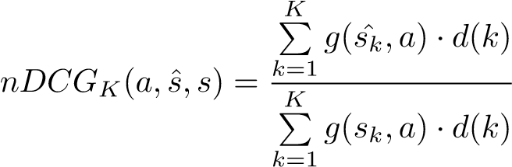

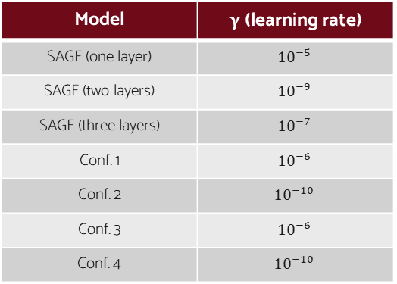
Architectures + experiments
Since data was reduced, was necessary to optimize the hyperparameters, even those already specified in the paper
Weight decay was set to 0.01
Batch size was 512
Activation functions were ELU and ReLU
Optimizer was ADAM
The function to minimize was the Triplet Loss Function:
Model | γ (learning rate)
SAGE (one layer) | $${10}^{−5}$$
SAGE (two layers) | $${10}^{−9}$$
SAGE (three layers) | $${10}^{−7}$$
Conf. 1 | $${10}^{−6}$$
Conf. 2 | $${10}^{−10}$$
Conf. 3 | $${10}^{−6}$$
Conf. 4 | $${10}^{−10}$$
$$L\left(y_{a},y_{p},y_{n}\right){=[d\left(y_{a},y_{p}\right)−d\left(y_{a},y_{n}\right)+∆]}^{+}$$
The evaluation metric used was the Normalized Discounted Cumulative Gain:
;

Slide 10
Results
Comparison with the original paper results:
Models comparison:
Input | Low level features |  | Random features
Dataset | Original | Ours | Original | Ours
SAGE (1 layer) | 49% | 26% | 28% | —
SAGE (2 layer) | 53% | 32% | 42% | —
SAGE (3 layer) | 55% | 43% | 45% | 8%
Conf.1 | — | 57% | — | —
Conf.2 | — | 48% | — | —
Conf.3 | — | 69% | — | 70%
Conf.4 | — | 62% | — | —

Slide 11
Results - Some field-test
Conf.3 |  | Conf.3
Snoop Dogg |  | Nancy Sinatra |  | Rod Stewart
Related artists | Distance | Related artists | Distance | Related artists | Distance
2Pac | 0.1406 | Dusty Springfield | 0.1921 | Fleetwood Mac | 0.1170
Tha Dogg Pound | 0.1415 | Cilla Black | 0.2103 | Ringo Starr | 0.1201
Mack 10 | 0.1471 | Harpers Bizarre | 0.2162 | Phil Collins | 0.1244
Luniz | 0.1524 | Helen Shapiro | 0.2193 | Dire Straits | 0.1410
Benzino | 0.1555 | Sonny & Cher | 0.2256 | Paul Carrack | 0.1430
Accuracy Scores:
69%
Conf.3 (random) |  | Conf.3 (random)
Snoop Dogg |  | Nancy Sinatra |  | Rod Stewart
Related artists | Distance | Related artists | Distance | Related artists | Distance
Luniz | 0.1744 | Dusty Springfield | 0.2107 | Paul McCartney | 0.1334
Tha Dogg Pound | 0.1768 | Cilla Black | 0.2116 | Steve Winwood | 0.1357
Spice 1 | 0.1833 | Harpers Bizarre | 0.2116 | Phil Collins | 0.1379
Warren G | 0.1867 | Air Supply | 0.2141 | Fleetwood Mac | 0.1387
Ice Cube | 0.1913 | The 5th Dimension | 0.2151 | Bruce Hornsby | 0.1389
70%

Slide 12
Other test with real artists
Three Layers GraphSAGE |  | Three Layers GraphSAGE
Snoop Dogg |  | Nancy Sinatra |  | Rod Stewart
Related artists | Distance | Related artists | Distance | Related artists | Distance
Ice Cube | 0.0266 | Bobby Vinton | 0.0367 | Argent | 0.0355
Kurupt | 0.0266 | Ferlin Husky | 0.0383 | The Doobie Brothers | 0.0406
Petey Pablo | 0.0268 | Dusty Springfield | 0.0393 | Levon Helm | 0.0406
Obie Trice | 0.0277 | Tammy Wynette | 0.0394 | Delaney & Bonnie | 0.0408
2Pac | 0.0279 | Irma Thomas | 0.0394 | The Moody Blues | 0.0415
Accuracy Scores:
43%
Three Layers GraphSAGE (random) | Three Layers GraphSAGE (random)
Snoop Dogg |  | Nancy Sinatra |  | Rod Stewart
Related artists | Distance | Related artists | Distance | Related artists | Distance
Lars Winnerback | 0.0555 | Chris Spheeris | 0.0537 | The Box Tops | 0.0475
The Afghan Whigs | 0.0581 | Chris Connor | 0.0544 | OneRepublic | 0.0484
Bill Wyman’s Rhythm Kings | 0.0585 | Divinyls | 0.0549 | Guns N’ Roses | 0.0493
Marisa Monte | 0.0585 | Lydia Lunch | 0.0553 | Big Wreck | 0.0501
Fukkk Offf | 0.0587 | Sophie B. Hawkins | 0.0553 | MV & EE | 0.0511
8%
62%
Conf.4 |  | Conf.4
Snoop Dogg |  | Nancy Sinatra |  | Rod Stewart
Related artists | Distance | Related artists | Distance | Related artists | Distance
Tha Dogg Pound | 0.3131 | Cilla Black | 0.3588 | Ringo Starr | 0.3591
Luniz | 0.3823 | Sonny & Cher | 0.4853 | Steve Winwood | 0.3985
Mack 10 | 0.3872 | The Mamas & the Papas | 0.5645 | The Doobie Brothers | 0.4132
Eminem | 0.4575 | Adam Faith | 0.6053 | Tom Petty | 0.4228
Fler | 0.4586 | Bobbie Gentry | 0.6174 | Dave Mason | 0.4556

Slide 13

Conclusions
The Graph Neural Networks proved to be effective even in a small data availabilty scenario. We strongly believe that this approach could be scalable with respect to the dataset.
It’s interesting to see how SAGE-based models relies particularly on node features whereas the GAT-based ones mostly on graph connections.
GATs architectures can deal with artist similarity task in an unsupervised manner, since features can be chosen arbitrarily without affecting model’s performances.
Encoder
$$X_{random}$$
Z
$$ENC_{ϴ}: A →Z. (unsupervised learning)$$
A

Slide 14


Thank you for the attention!
https://github.com/difra100/NN_project_ArtistSimilarity
https://arxiv.org/abs/2107.14541

