Slide 1
Generalising game environments with curiosity-driven agents
Andrea Giuseppe Di Francesco - 1836928
Reinforcement Learning
Sapienza University of Rome

Slide 2
Table of contents
Task Introduction
Related Works
Methodology
Quantitative results
Conclusion + Bonus
Qualitative results

Slide 3
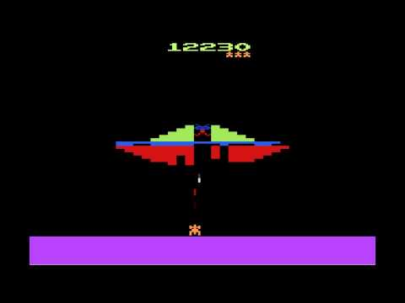
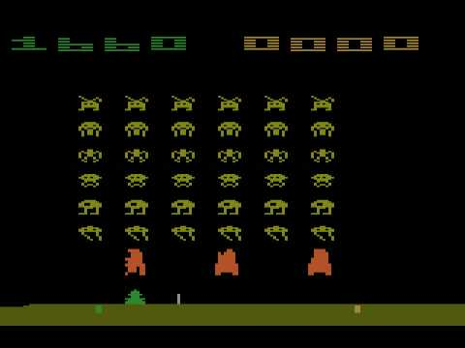
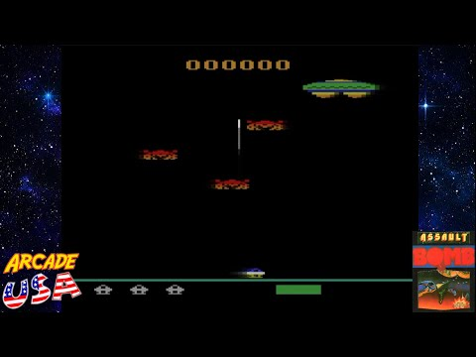
Task Introduction: Curiosity-driven agent
The aim of the project is to develop a curiosity-driven agent, that is able to play shoot ‘em up arcade games from ATARI.
Among these games there are Phoenix, Space Invaders and Assault.
In the project i focused on the Phoenix environment.
Phoenix
Space Invaders
Assault
Generalising game environments with curiosity-driven agents - Andrea Giuseppe Di Francesco

Slide 4
Task Introduction: Curiosity-driven agent
Other than the extrinsic reward, that an agent achieves when playing a game, it can be used another type, namely the intrinsic reward.
This intrinsic signal, or better called ‘curiosity’ is helpful to make the agent exploring new strategies.
It must be defined as a goal-less impulse, that guide the agent learning during its early stages of training.
Generalising game environments with curiosity-driven agents - Andrea Giuseppe Di Francesco

Slide 5
Task Introduction: Related Works
In literature can already be found various frameworks that accounted the use of curiosity for an RL agent.
Entropy-based methods [4], Prediction-error [5], State visitation counts [6] etc……
In this project, it has been adopted the curiosity framework from [1], where the intrinsic reward computation employs a self-supervised learning proxy task.
[1] did not experimented with ATARI games directly, but their efficacy was later investigated by [2].
This method is a prediction-error based method.
Generalising game environments with curiosity-driven agents - Andrea Giuseppe Di Francesco

Slide 6
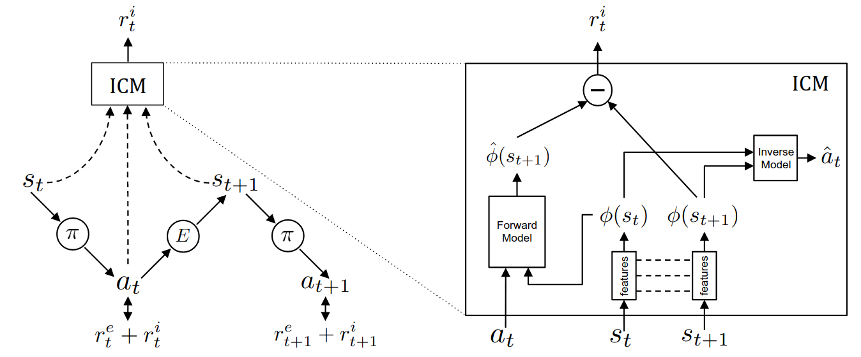
Methodology: Intrinsic Curiosity Module (ICM)
What we require?
Policy model
Forward module
Inverse module
Generalising game environments with curiosity-driven agents - Andrea Giuseppe Di Francesco

Slide 7
Methodology: Intrinsic Curiosity Module (ICM)
What we require?
Policy model
Forward module
Inverse module
They are:
Proximal Policy Optimization (PPO)
Multi-layer perceptron (MLP)
CNN + MLP
Generalising game environments with curiosity-driven agents - Andrea Giuseppe Di Francesco

Slide 8
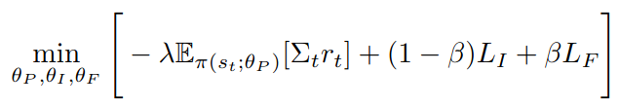
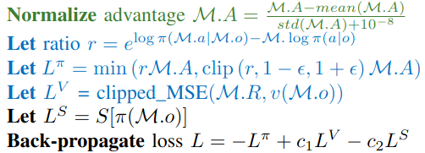
Methodology: PPO
PPO + Curiosity agent requires a particular loss.
Curiosity-Agent loss:
PPO loss:
Generalising game environments with curiosity-driven agents - Andrea Giuseppe Di Francesco

Slide 9
Methodology: PPO
PPO + Curiosity agent requires a particular loss.
Curiosity-Agent loss [1]:
PPO loss [8]:
Inverse model loss
Forward model loss
Generalising game environments with curiosity-driven agents - Andrea Giuseppe Di Francesco

Slide 10

Methodology: 3 configurations
To establish the efficacy of the intrinsic reward method, the experiments accounted 3 different settings:
Only Intrinsic agent
Only Extrinsic agent
Intrinsic + Extrinsic agent
PPO and experiment hyperparameters:
first batch of experiments
second batch of experiments
Generalising game environments with curiosity-driven agents - Andrea Giuseppe Di Francesco

Slide 11
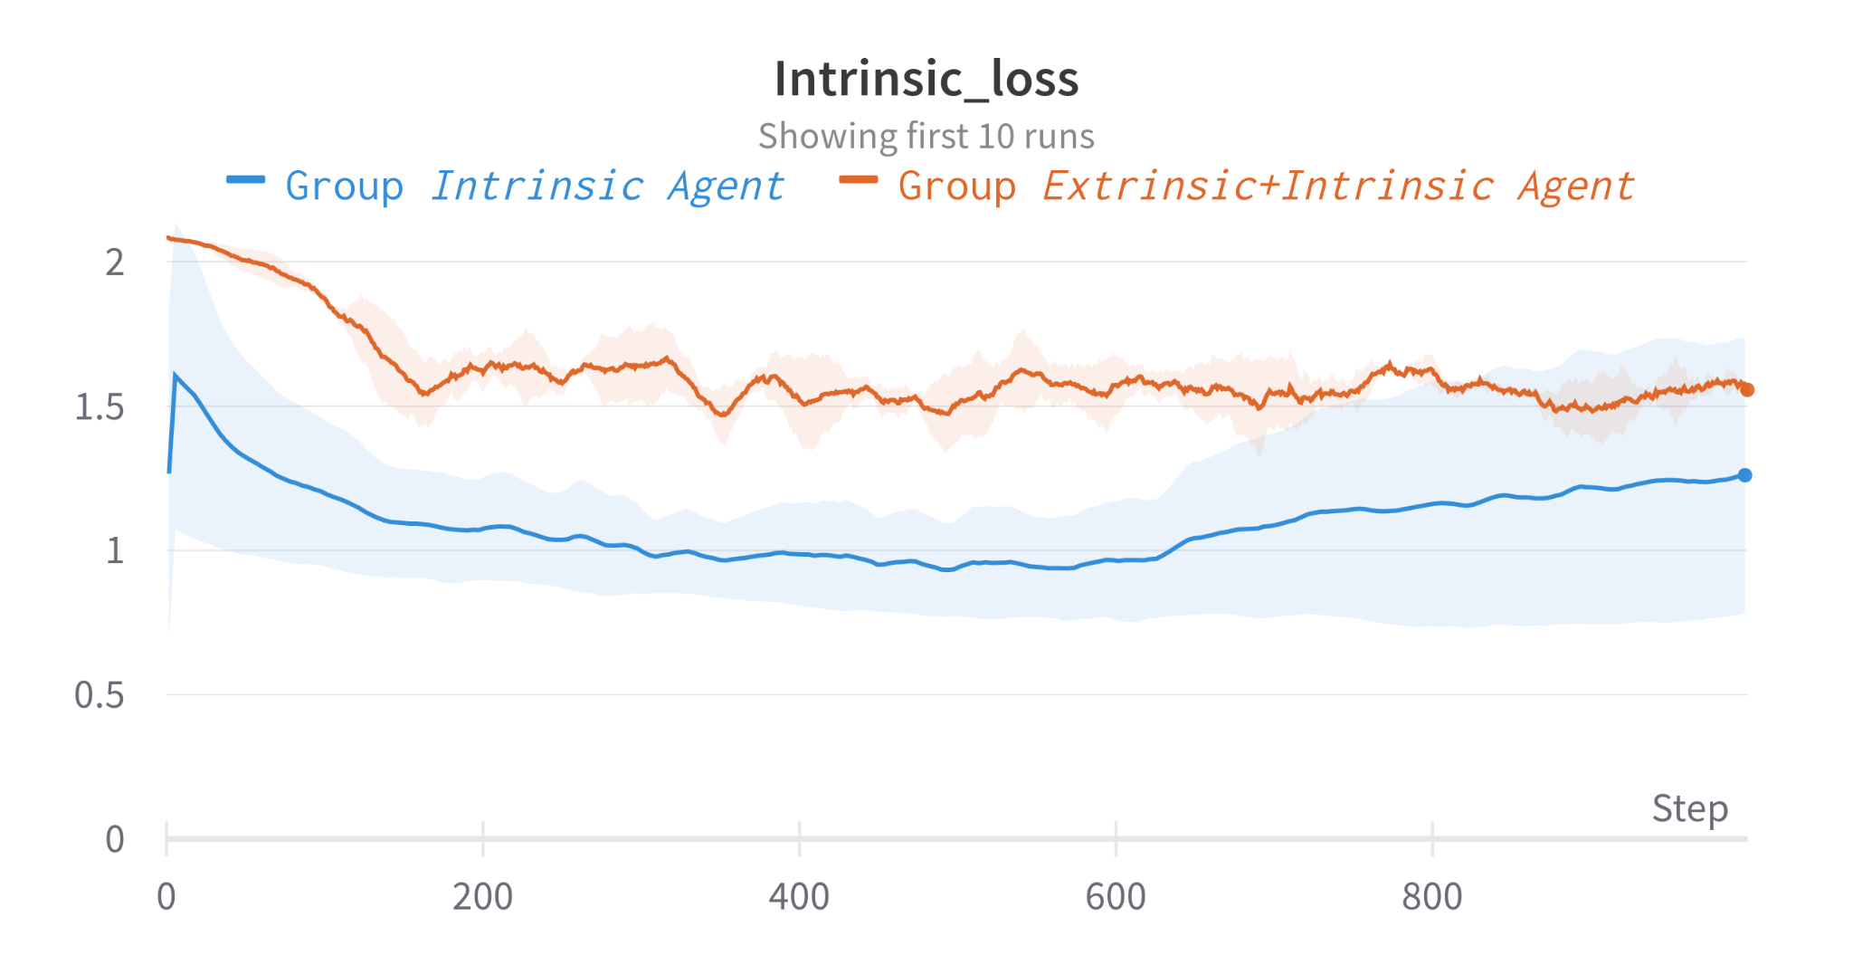
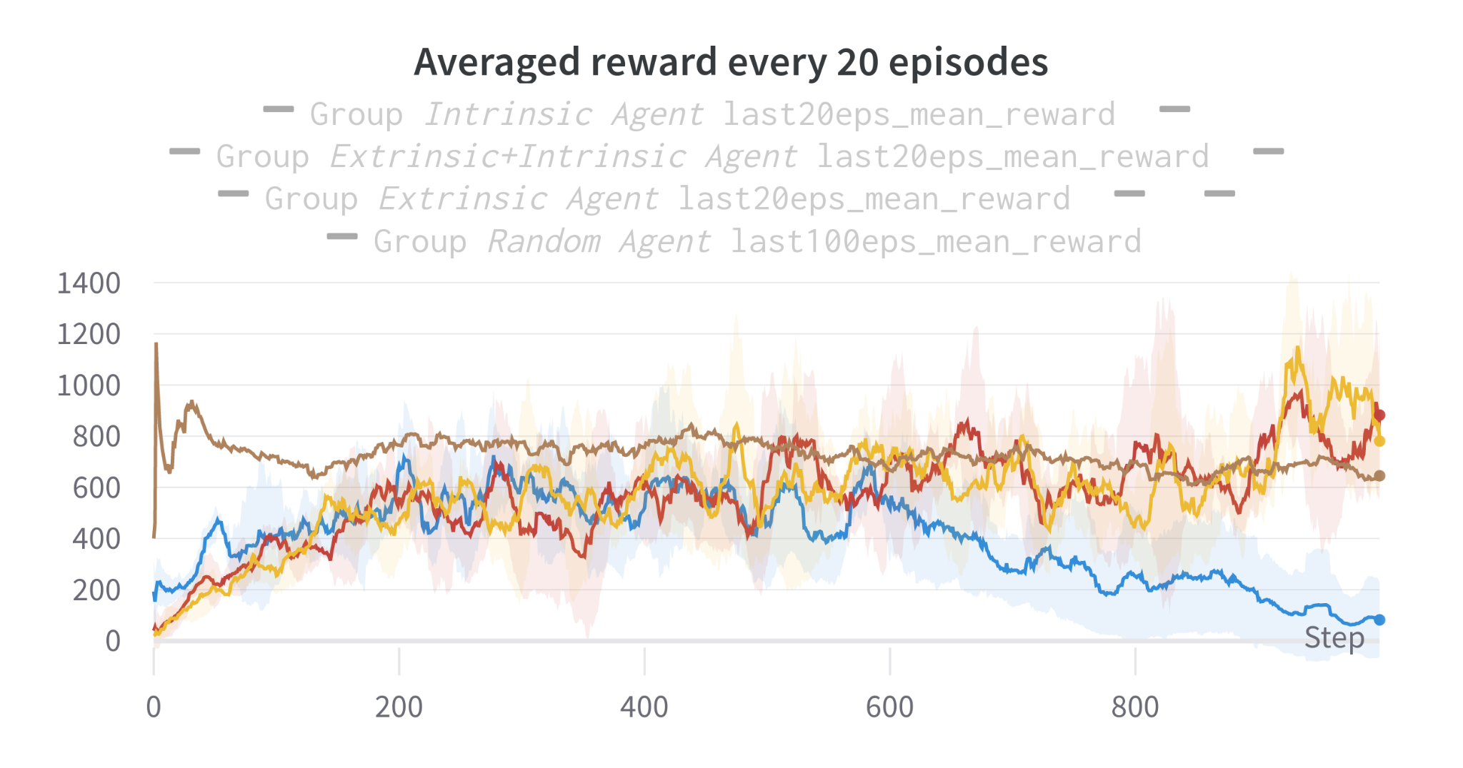
Quantitative results: Phoenix
First batch of experiments:
Intrinsic, Extrinsic, Intrinsic+Extrinsic
No Negative rewards. Only positives.
The game ends when the agent loses all of its life points.
Television white noise issue [7]/ The agent get stuck during the game runs.
Generalising game environments with curiosity-driven agents - Andrea Giuseppe Di Francesco

Slide 12
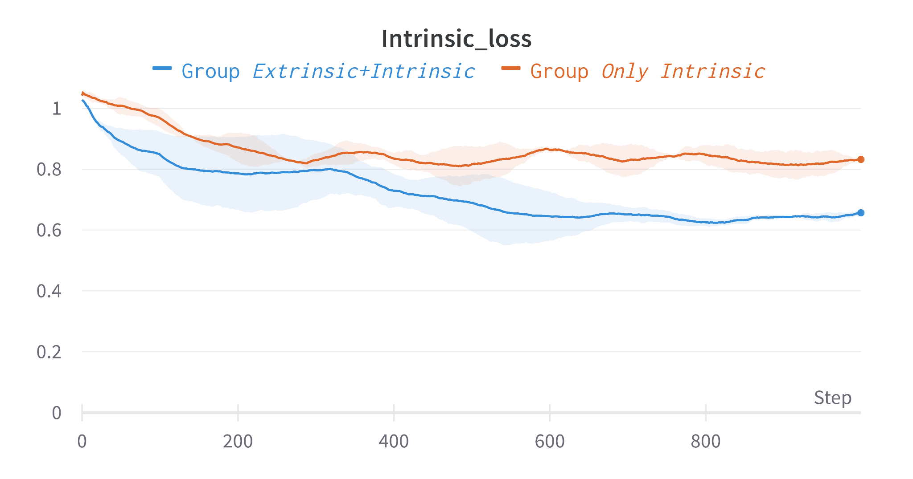
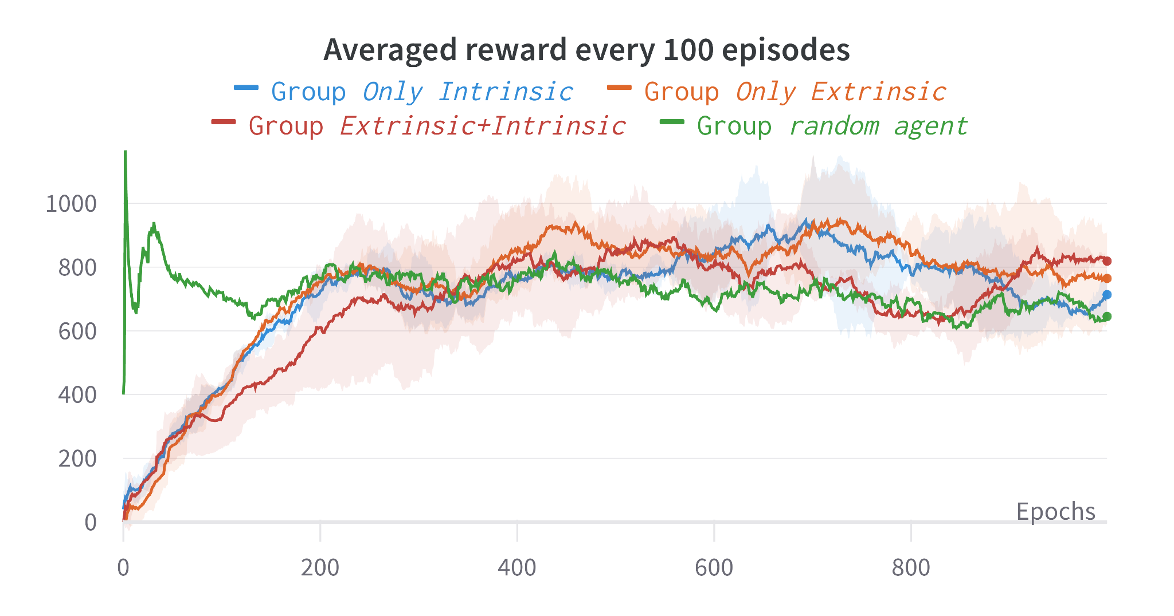
Quantitative results: Phoenix
Second batch of experiments:
Intrinsic, Extrinsic, Intrinsic+Extrinsic
Negative rewards are collected when the agent do not get positives rewards for a while.
The game ends when the agent loses all of its life points.
Television white noise issue solved for the most of the configurations.
Generalising game environments with curiosity-driven agents - Andrea Giuseppe Di Francesco

Slide 13

Qualitative Results: Main issues
Link
Generalising game environments with curiosity-driven agents - Andrea Giuseppe Di Francesco

Slide 14
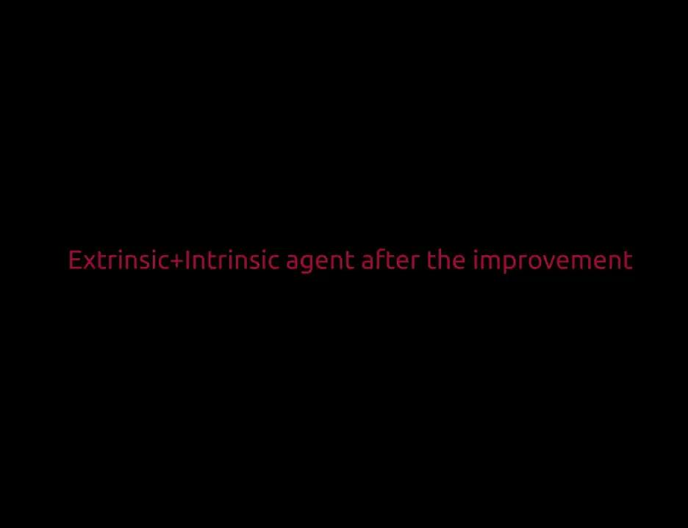
Qualitative Results: Nice practices
Link
Generalising game environments with curiosity-driven agents - Andrea Giuseppe Di Francesco

Slide 15
Conclusions
Not always the Extrinsic+Intrinsic outperforms the only Extrinsic agent [2].
Intrinsic agent is able to collect reward valuable reward from the environment, even though it acts in a goal-less fashion.
As proved in [1], the agent succeed into generalize different levels with different enemies.
The absence of negative rewards affect significantly the agent performance. It would be interesting to investigate agent performances, when having negative rewards for each death.
Bonus (few-shots learning, optional task)
Generalising game environments with curiosity-driven agents - Andrea Giuseppe Di Francesco

Slide 16
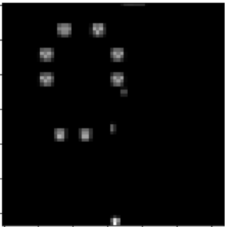
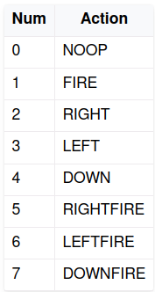
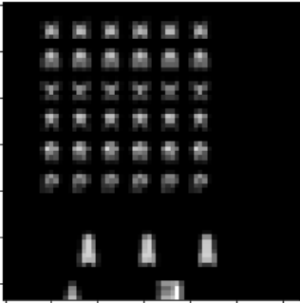
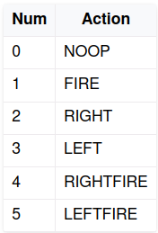
Bonus (few-shots learning):
Target game: Space Invaders
(0, 1, 10, 50, 100)-shots learning
As before we apply some preprocessing to the images:
Deleted the point bar
Converted to Grayscale
Resized to 64x64
Normalization
Actions’ names semantic is similar.
Phoenix
Space Invaders
Generalising game environments with curiosity-driven agents - Andrea Giuseppe Di Francesco

Slide 17
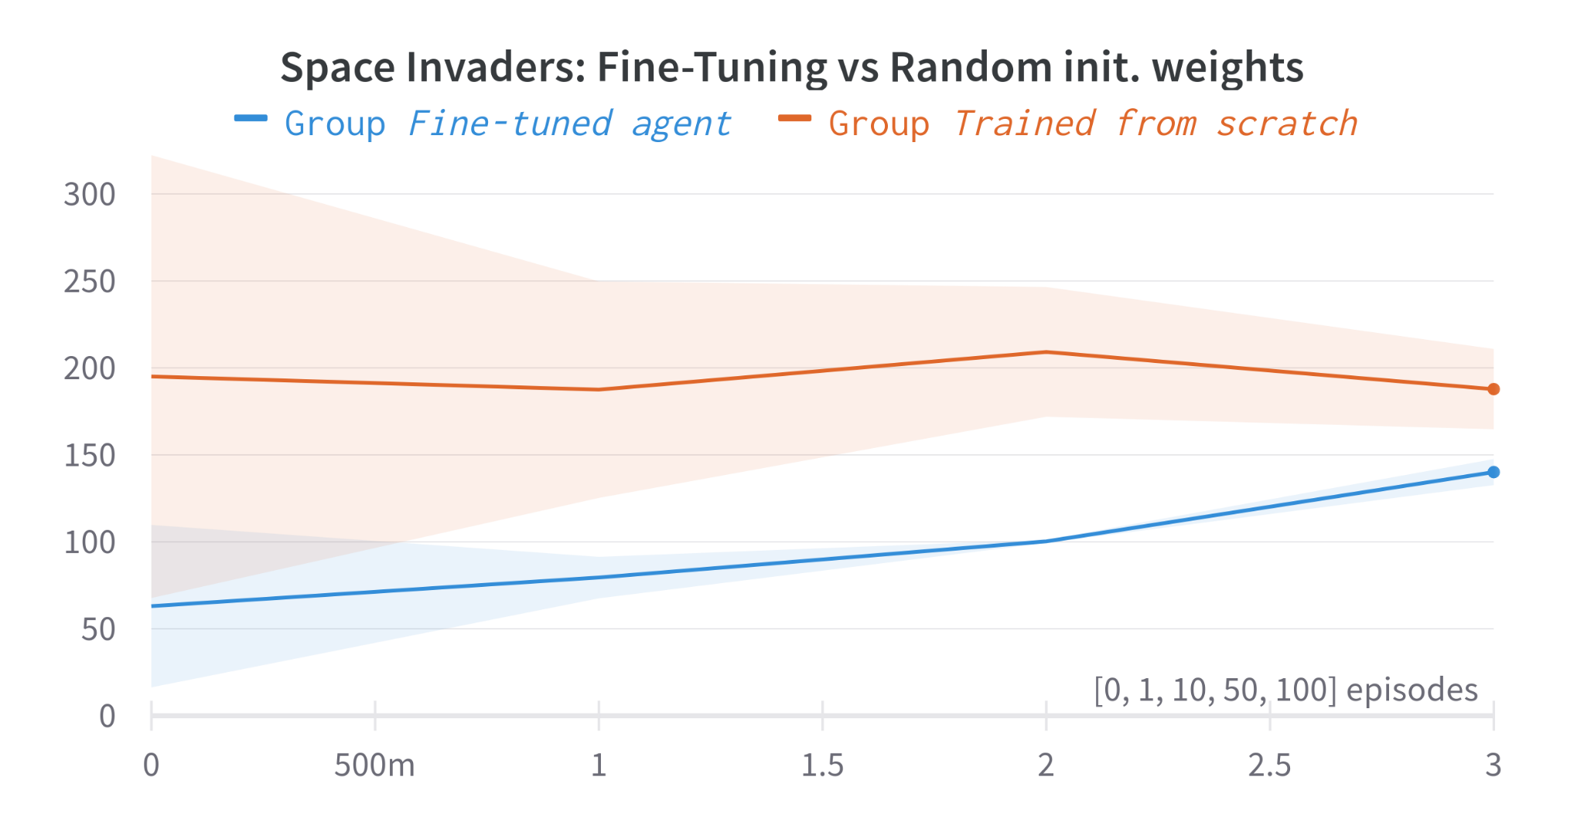
Bonus (few-shots learning): Quantitative results
Generalising game environments with curiosity-driven agents - Andrea Giuseppe Di Francesco

Slide 18
Bonus (few-shots learning): Issues
Fine-tuned network training seem to perform worse than the random initialized network.
Possible reasons:
Phoenix weights were all trainable, and maybe they were too specific for the game. Even the ICM.
Phoenix has 8 discrete actions, so when decoding the action to just 6 actions there were introduced some limitations.
Hyperparameters are the same for the second batch of experiments for Phoenix, which differs from those recommended by [9] (Here are Space Invaders typical hyperparameters).
Later on the demonstration of what is happening….
Generalising game environments with curiosity-driven agents - Andrea Giuseppe Di Francesco

Slide 19
Bonus (few-shots learning): Qualitative results (trained from scratch agent)
Link
Generalising game environments with curiosity-driven agents - Andrea Giuseppe Di Francesco

Slide 20
Bonus (few-shots learning): Qualitative results (Fine-Tuned agent)
Link
Generalising game environments with curiosity-driven agents - Andrea Giuseppe Di Francesco

Slide 21
Further Conclusions
After the fine-tuning can be drawn further conclusions.
We experience better quantitative results in the no-fine-tune scenario, because spamming the actions was effective in terms of goal-achievements.
In the fine-tuning scenario the agent already knows how to move, it displays a better knowledge of the environment.
Generalising game environments with curiosity-driven agents - Andrea Giuseppe Di Francesco

Slide 22
References
Papers:
[1]: https://arxiv.org/abs/1705.05363
[2]: https://arxiv.org/pdf/1808.04355.pdf
[3]: https://people.idsia.ch/~juergen/ieeecreative.pdf
[4]: https://arxiv.org/pdf/1509.08731.pdf
[5]: https://deepai.org/publication/incentivizing-exploration-in-reinforcement-learning-with-deep-predictive-models
[6]: https://proceedings.neurips.cc/paper/2016/file/afda332245e2af431fb7b672a68b659d-Paper.pdf
[7]: https://people.idsia.ch/~juergen/ieeecreative.pdf
[8]: https://arxiv.org/pdf/2205.09123.pdf
[9]: https://arxiv.org/abs/1707.06347
Presentation Title - Name Surname

Slide 23
Thank you for the attention!

