Slide 1
SAESum: Simultaneous Abstractive and Extractive Summarization.
Andrea Giuseppe Di Francesco – 1836928
Antonio Scardino - 2020613
NUANS – Narrative Understanding ANd Storytelling
Sapienza University of Rome

Slide 2
Table of contents
Task Introduction
Related works
Baseline approach
Challenges
Dataset & Metrics
Novelties

Slide 3
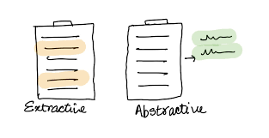
Task Introduction
In this work we aim to develop a system that performs both the extractive and abstractive summarization task.
Another one of our objectives is to construct a framework capable of exploiting the flow of information within the network, in order to obtain more fllexible and accurate summaries.
Our experiments involve SoTA architectures for each single task.
SAESum: Simultaneous Abstractive and Extractive Summarization - Di Francesco , Scardino

Slide 4
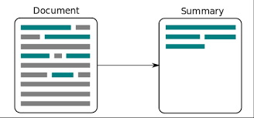
Related Works – Extractive Summarization
Given a document consisting of an ordered list of N sentences, extractive summarization aims to pick up M (M≪N) sentences as the summary of the document.
“Extracted summaries tend to be both grammatically and semantically more reliable than abstractive summaries.”[1]
In this project, we focus on MemSum [1], a recent algorithm to perform this task.
SEASum: Simultaneous Abstractive and Extractive Summarization - Di Francesco , Scardino
SAESum: Simultaneous Abstractive and Extractive Summarization - Di Francesco , Scardino
Notes:
Over the years, several extractive summarization systems have been developed.
….

Slide 5
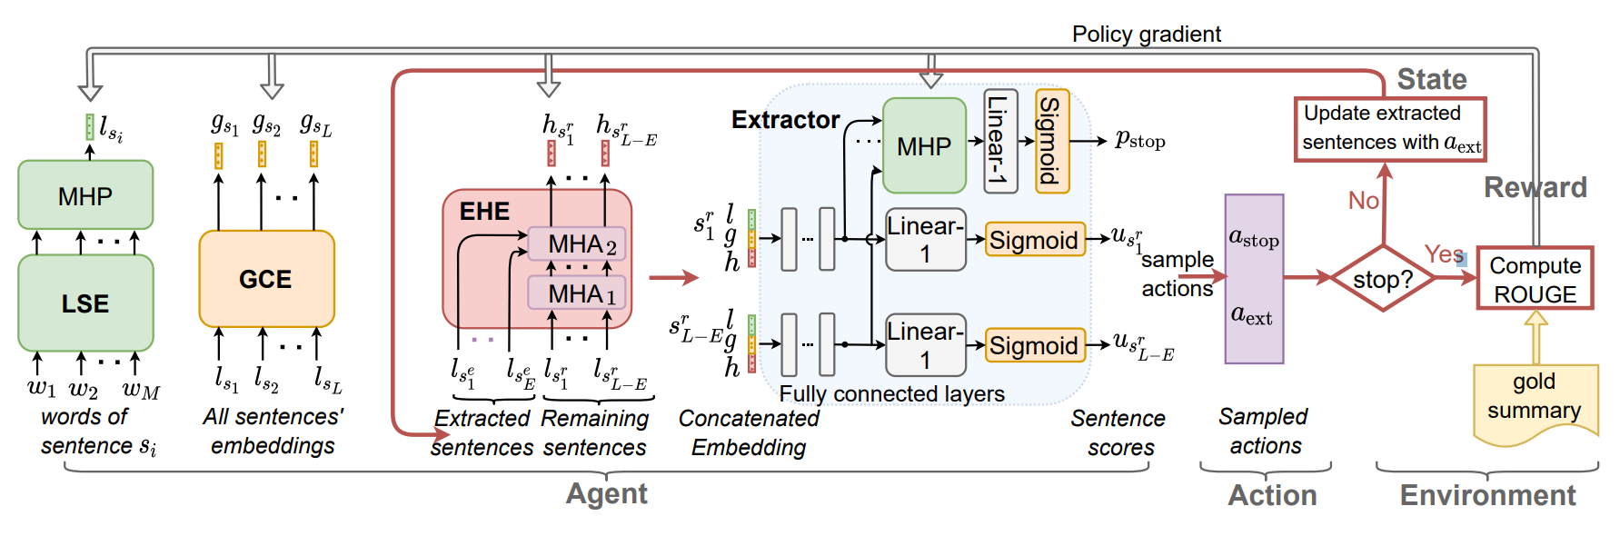
Related Works – MemSum
In a Reinforcement Learning regime, an agent is trained to select salient sentences from the document. The reward of the agent is computed according to the ROUGE score.
The novelty of MemSum is characterized by the mixing of Local and Global context for each sentence, together with the agent Extraction history. Extraction history addresses the risk of redundancy for the extractive summarization.
SAESum: Simultaneous Abstractive and Extractive Summarization - Di Francesco , Scardino

Slide 6
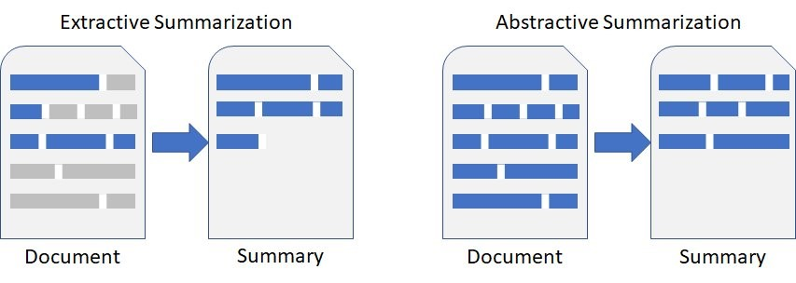
Related Works – Abstractive Summarization
Abstractive Text Summarization is the task of generating a concise summary, potentially containing new phrases, not in the source text.
PEGASUS [2] is a SoTA encoder-decoder architecture specifically pre-trained in a self-supervised setting.
It was designed to be fine-tuned for the abstractive summarization task.
Notes:
Over the years, also abstractive summarization systems have covered a role of importance.

Slide 7
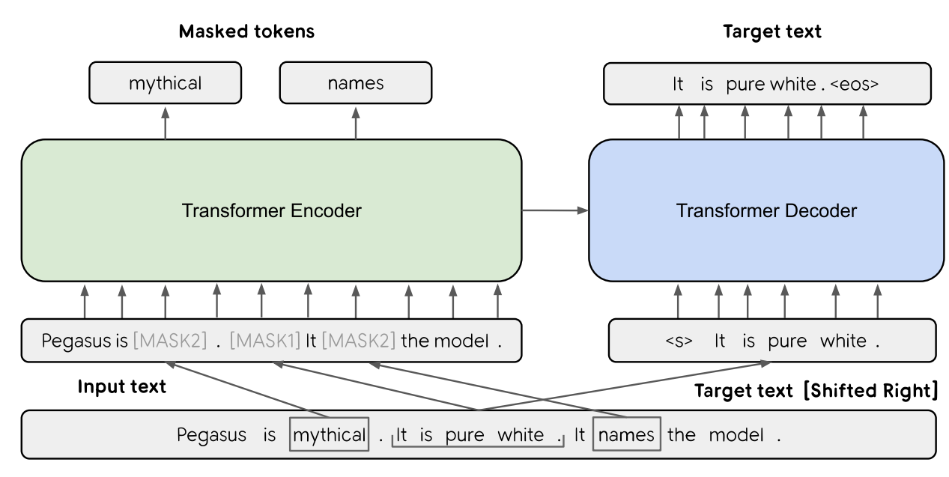
Related Works - PEGASUS
Two configurations: PEGASUS base or large (about 568M parameters),
High performances with little supervision by fine-tuning (1000 examples),
Human-level summarization performance.
SAESum: Simultaneous Abstractive and Extractive Summarization - Di Francesco , Scardino

Slide 8
Our Approach - Motivations
MemSum is trained without relying on any transformer architecture and the word embeddings are not contextualized. (GloVE 200 dim. Embeddings [3])
Firstly, we want to exploit PEGASUS encoder to obtain a semantic representation, to eventually reach better performances in the extractive summarization task.
Secondly, we plan to fine-tune PEGASUS architecture (no few-shot learning), to assess its full capabilities.
Lastly, we will try to exploit it in order to improve the extractive summarization task.
SAESum: Simultaneous Abstractive and Extractive Summarization - Di Francesco , Scardino
Notes:
Standalone network means has never been used withouth the decoder…
PEGASUS encoder has not been used as a standalone network for any specific task, except during its pre-training objectives.

Slide 9
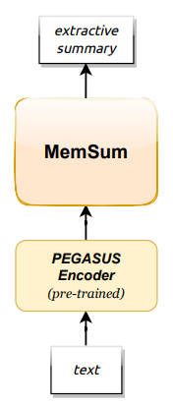
Our Approach - Baseline
We will start by substituting the GloVe embeddings with the PEGASUS encoding as input to the MemSum system.
We assume that PEGASUS word representation would be a better and more performative fit for MemSum.
We aim to assess the performances, leaving unchanged the rest of the training procedure.
SAESum: Simultaneous Abstractive and Extractive Summarization - Di Francesco , Scardino

Slide 10
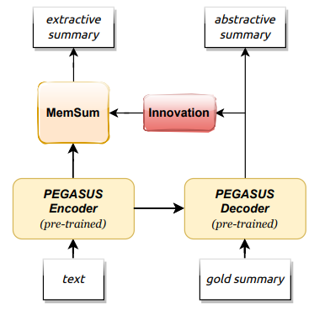
Our Approach - Challenges
While keeping the PEGASUS encoder frozen, we train only the decoder to produce abstractive summaries.
In this project, we add an additional branch: ‘Innovation’. This resembles a sort of ‘neck’ for our two-headed network.
The Innovation block carries the abstractive summary information with the purpose of improving the MemSum performances.
SAESum: Simultaneous Abstractive and Extractive Summarization - Di Francesco , Scardino

Slide 11
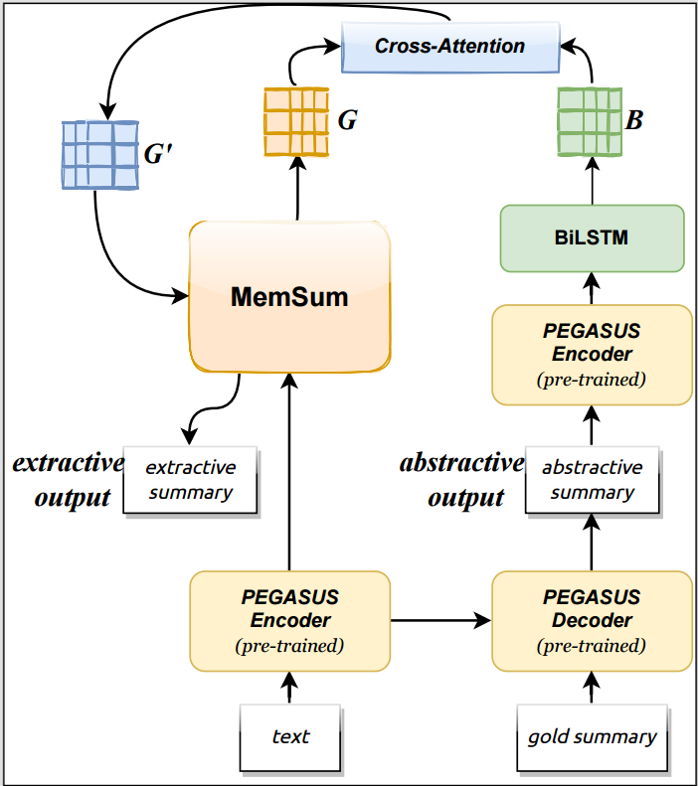
Our Approach - Challenges
In the Innovation block there is a cross-attention mechanism between the MemSum global context vectors G and the abstractive summarization encodings B.
The new G’ is fedback into the MemSum block, continuining on the standard procedure of the original algorithm.
At trainig time, the abstractive summarization is provided through a teacher-forcing mechanism.
At inference time, the abstractive summarization is obtained through the decoder prediction.
SAESum: Simultaneous Abstractive and Extractive Summarization - Di Francesco , Scardino

Slide 12
Dataset & Metrics
Gov-report dataset : consists of reports written by the U.S. government research agencies. It has longer summaries and documents w.r.t. other benchmark datasets.
ROUGE : standard summarization metric.
QuestEval [4] : question and answering based metric, ground-truth referenceless. It has better correlation with human judgement.
SAESum: Simultaneous Abstractive and Extractive Summarization - Di Francesco , Scardino

Slide 13
Novelties
Abstractive & Extractive summarization tasks are performed together. The encoder parameters are shared.
The training of the 2 networks are well separated, indeed the gradient loss of the PEGASUS decoder does not flow up to the ‘neck’. The gradient is back-propagated to the neck only from the extractive reward.
The abstractive summary is exploited to augment the global context information in MemSum.
SAESum: Simultaneous Abstractive and Extractive Summarization - Di Francesco , Scardino

Slide 14
References
Papers:
[1] : https://aclanthology.org/2022.acl-long.450.pdf
[2] : https://arxiv.org/pdf/1912.08777.pdf
[3] : https://nlp.stanford.edu/pubs/glove.pdf
[4] : https://arxiv.org/abs/2103.12693
Presentation Title - Name Surname

Slide 15
Thank you for the attention!

