Slide 1
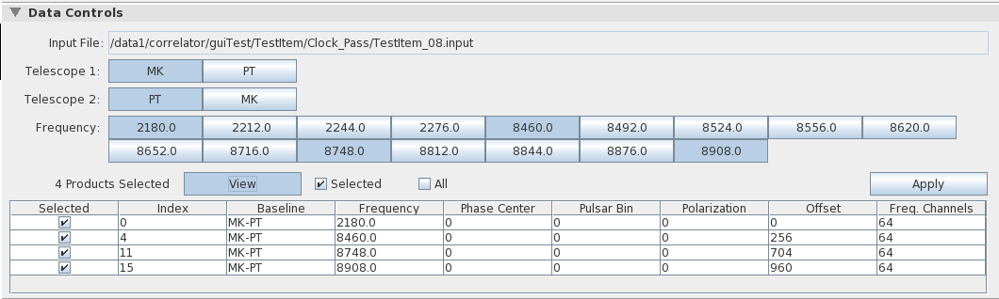
Individual Selection Check Boxes

Slide 2
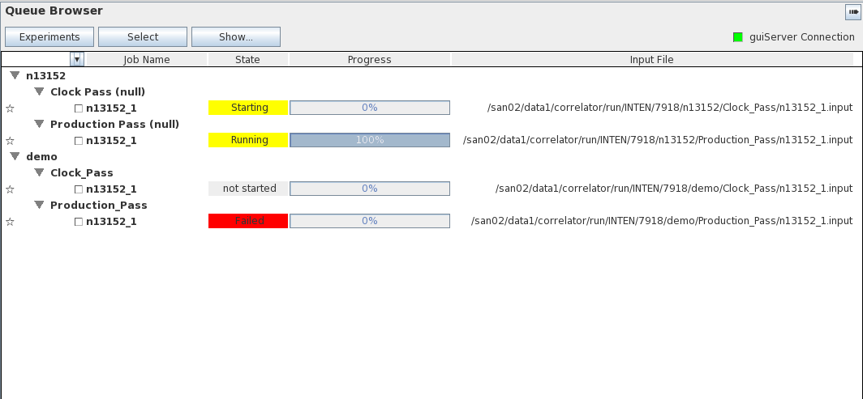
Experiment “n13152”
Experiment “demo”
“Clock” and “Production” Passes
under job “Demo”
Job “n13152” in
“demo Production Pass”

