Slide 1
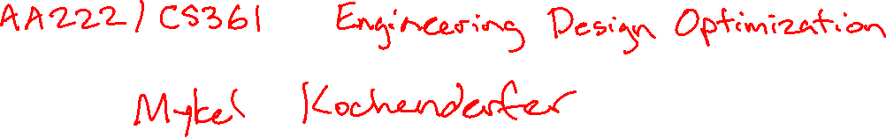

Slide 2


Slide 3
Students
Aeronautics and Astronautics
Mechanical Engineering
Computer Science
Electrical Engineering
Energy Resource Engineering
Civil and Environmental Engineering
Mathematics
Management Science and Engineering

Slide 4
Agenda
What is optimization?
Logistics
Mathematical formulation
Overview of course
Derivatives (?)

Slide 5
Introduction

Slide 6
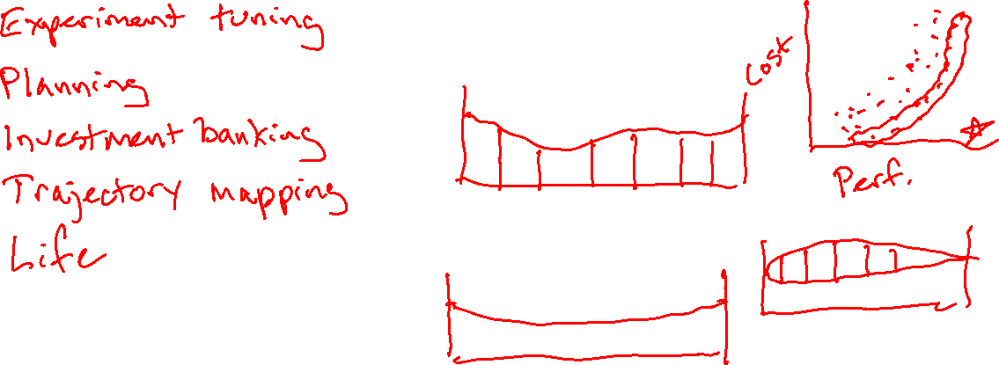

Slide 7
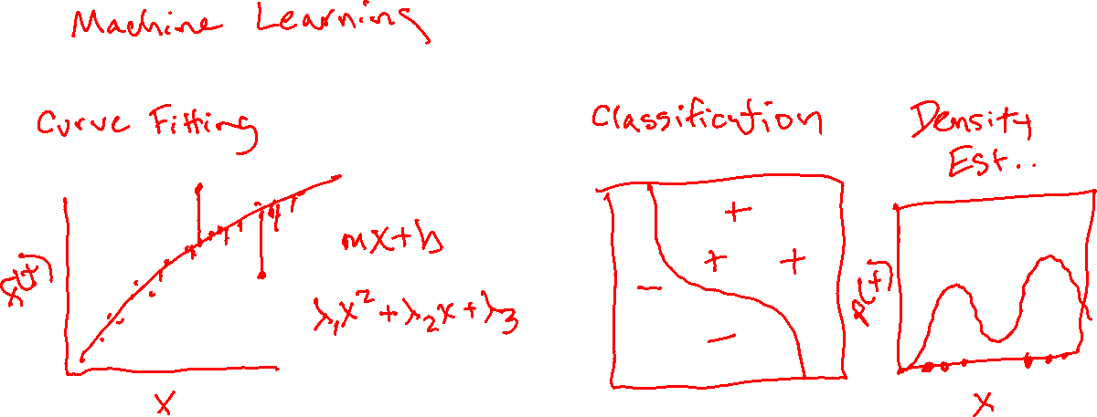

Slide 8
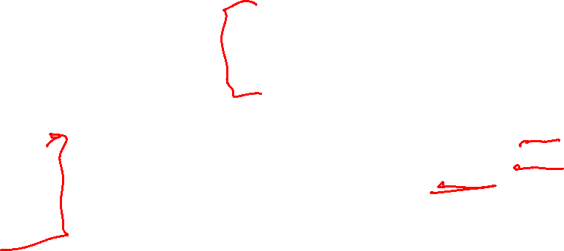
Introduction
Applications of Optimization
Physics
Business
Biology
Engineering
Objectives to Optimize
Efficiency
Safety
Accuracy
Constraints
Cost
Weight
Structural Integrity
Challenges
High-Dimensional Search Spaces
Multiple Competing Objectives
Model Uncertainty

Slide 9
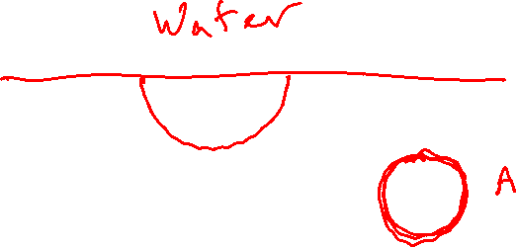
A History
Queen Dido’s Optimization Problem

Slide 10
A History
Calculus
Numerical Algorithms
Artificial Intelligence

Slide 11
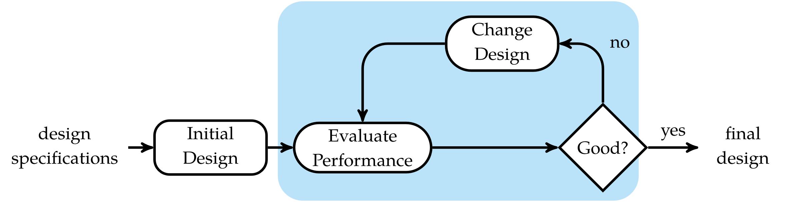

Optimization Process

Slide 12
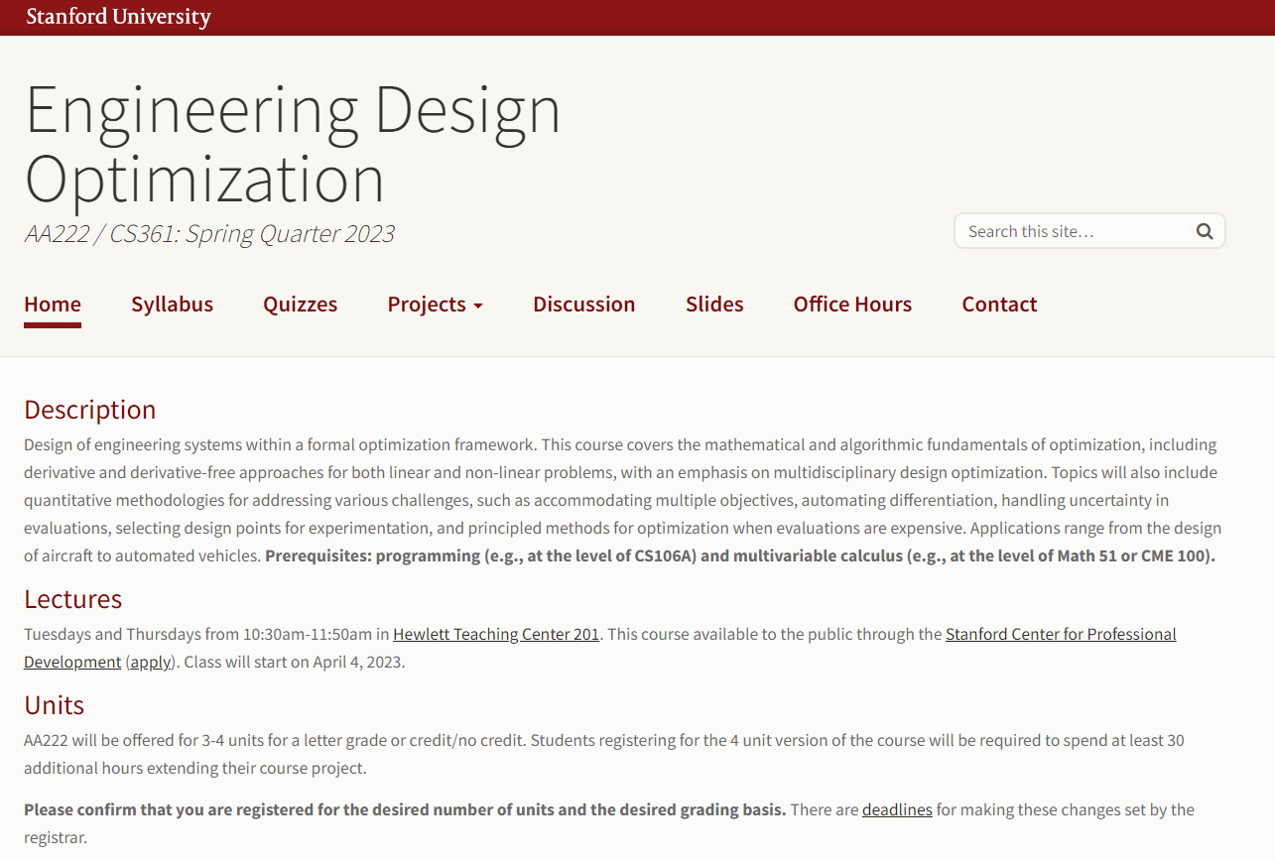


Slide 13



Slide 14


Slide 15
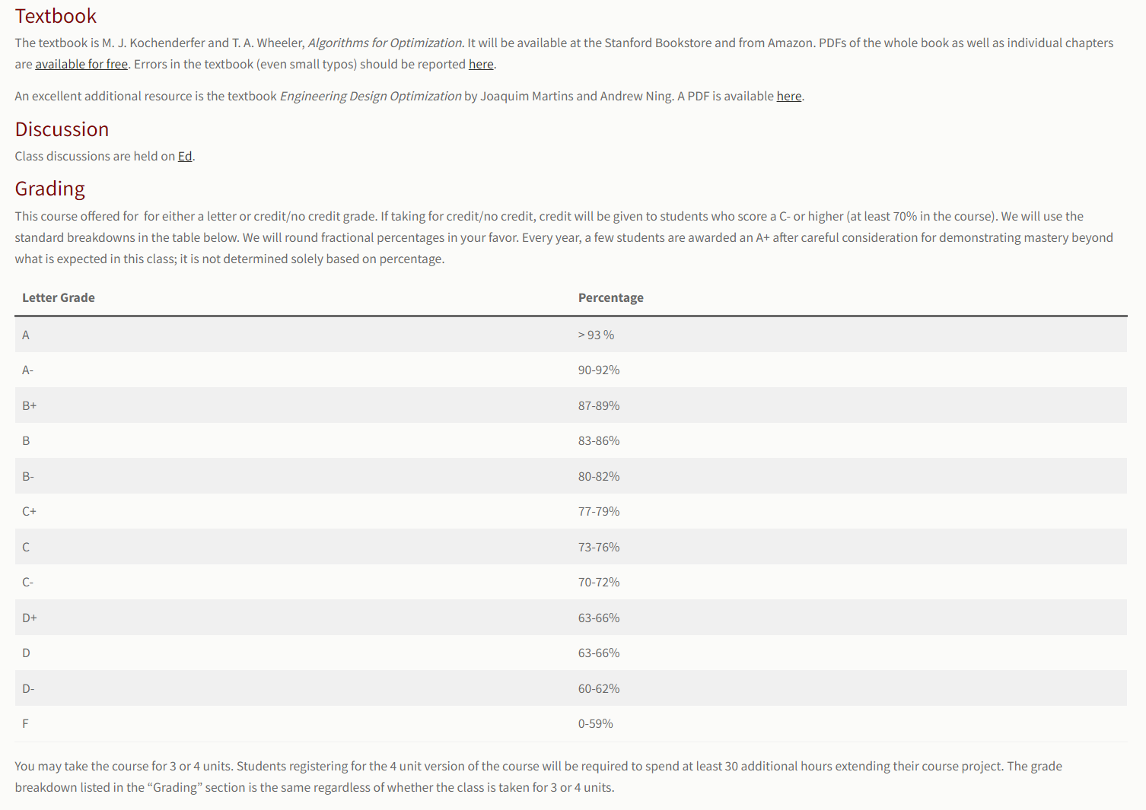


Slide 16
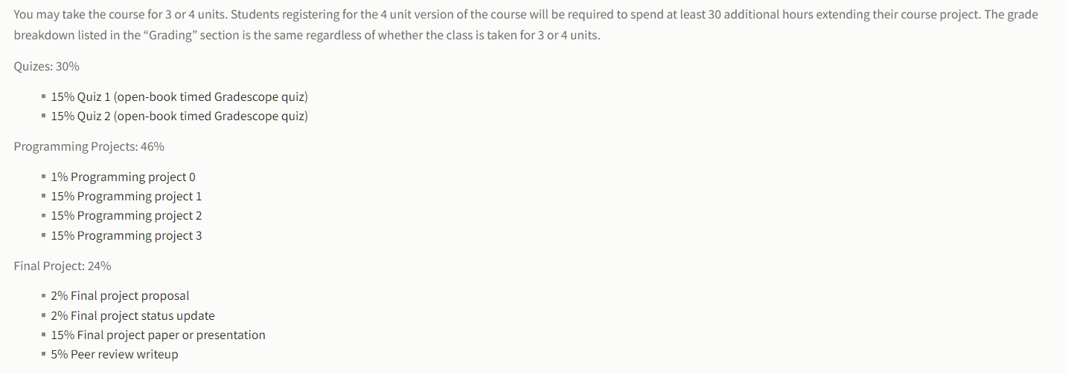


Slide 17
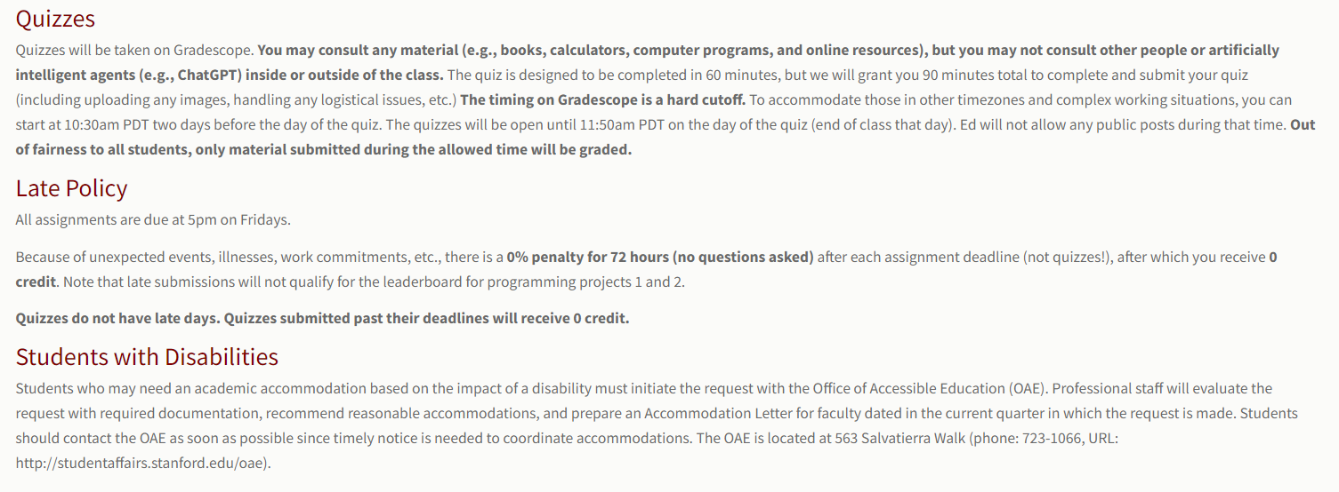

Slide 18
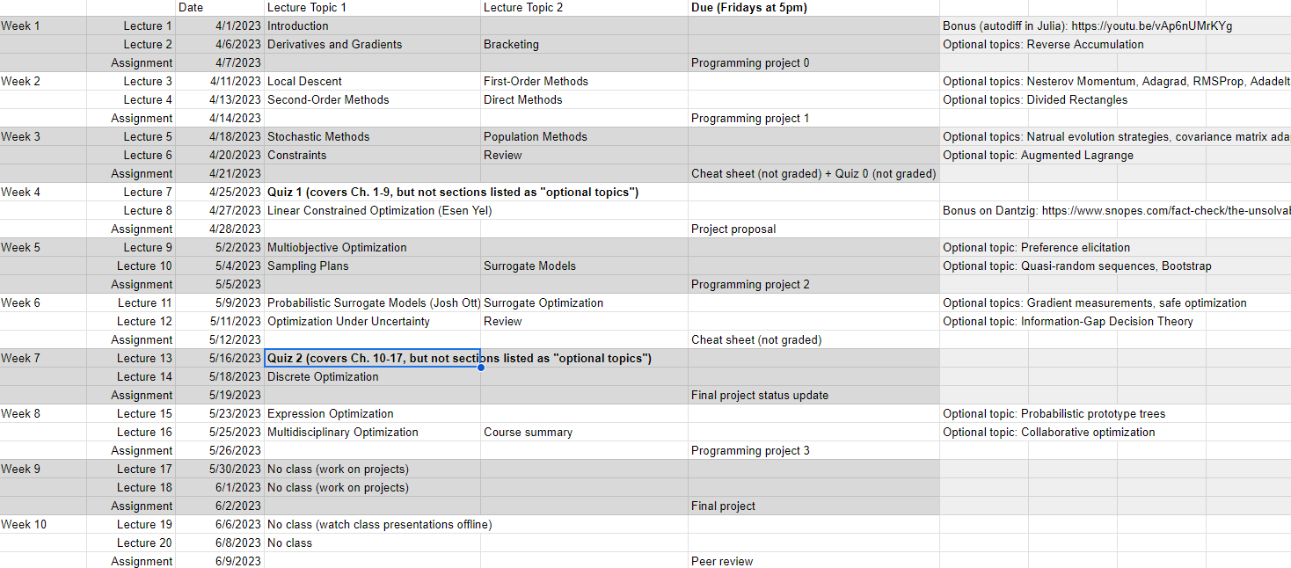


Slide 19

Tips from past students
As always with Mykel's classes, you will learn what you put into the class. He is a wonderful lecturer and makes the abstract concepts easier to grasp but its up to you to master the concepts through projects and quizzes.
Good high level overview of optimization methods to get you familiar with the different methods and how to approach a problem. This course does not go that deep into any particular type, though. I'd recommend taking this course before other optimization courses.
Definitely stay up to date on the readings.
Good overview of techniques in class, but in-depth self-study needed to actually understand algorithms
This course offers an interesting perspective on optimization with emphasis on real-world constraints instead of theory applied to nicely-behaving functions. You will not come away with a deep, theoretical background to apply towards NeurIPS-level ML research, but you will have a useful toolkit of optimization techniques to apply to engineering design problems.
A breadth of optimization techniques. This class is very well structured to equip students with a lot of tools that they can choose from whenever faced with an optimization problem in the future.
Mykel is awesome and genuinely cares about his students, which is refreshing!

Slide 20
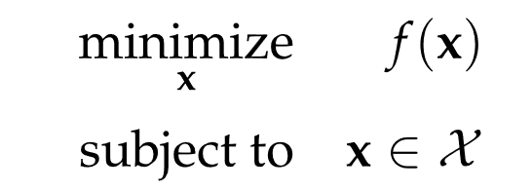
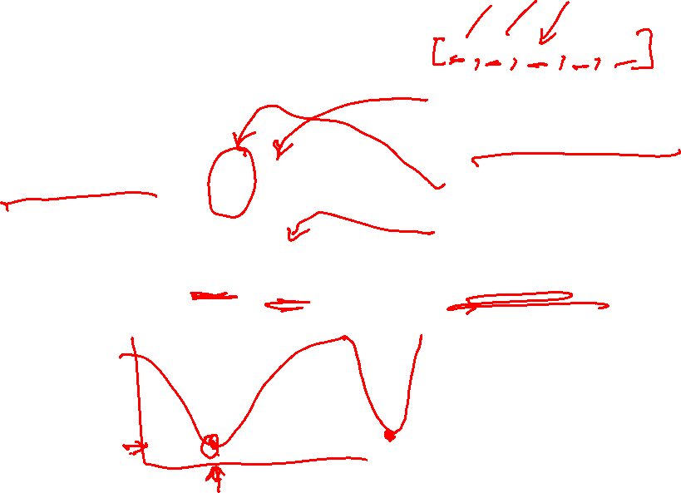
Basic Optimization Problem
Design Point
Design Variables
Objective Function
Feasible Set
Minimizer

Slide 21
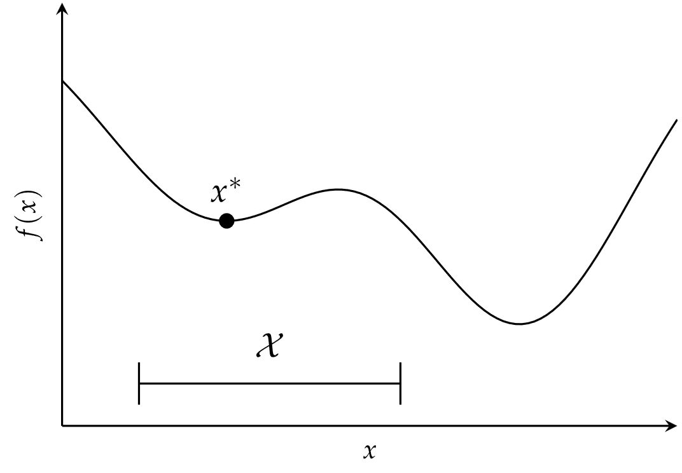
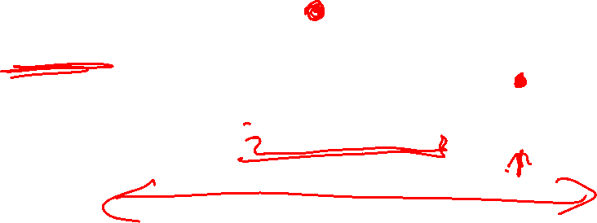
Basic Optimization Problem

Slide 22
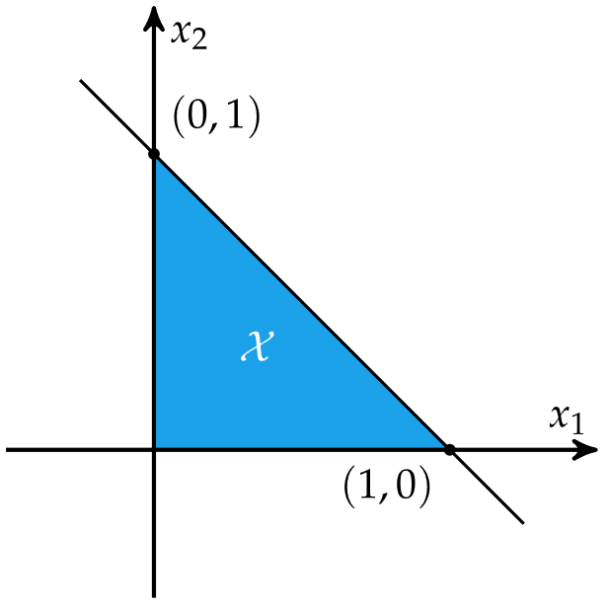
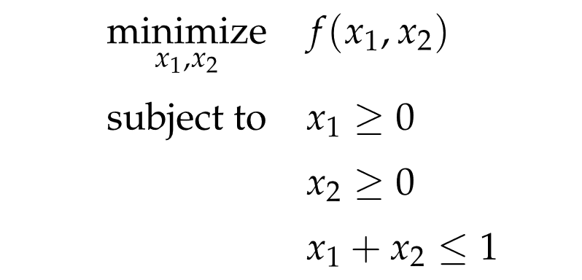

Constraints

Slide 23
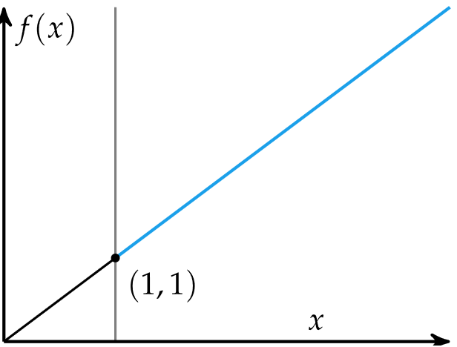
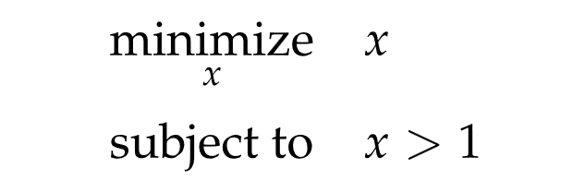
Constraints

Slide 24
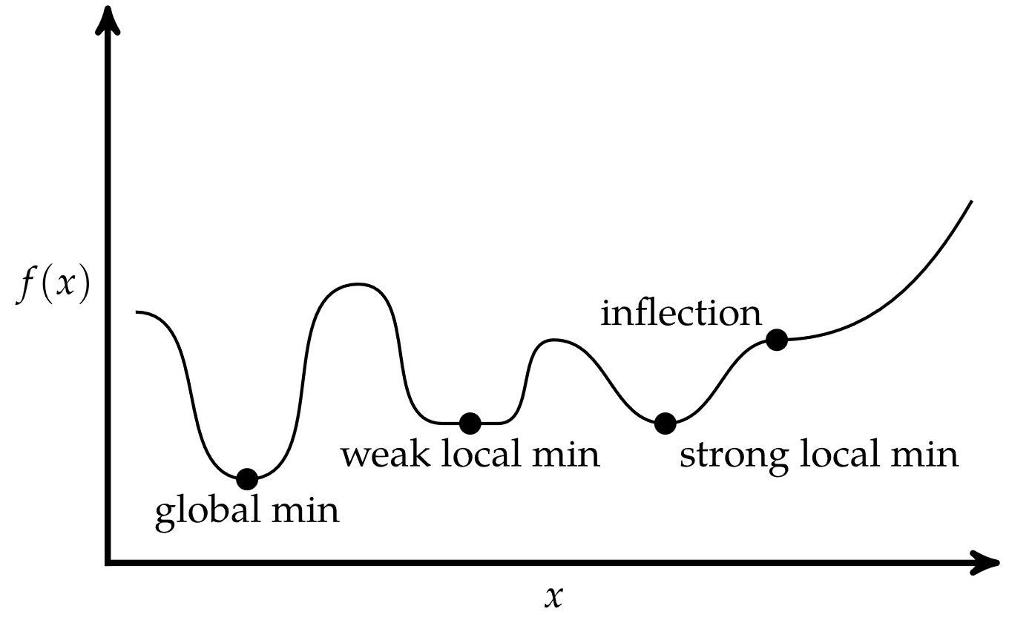

Critical Points
Univariate Function

Slide 25
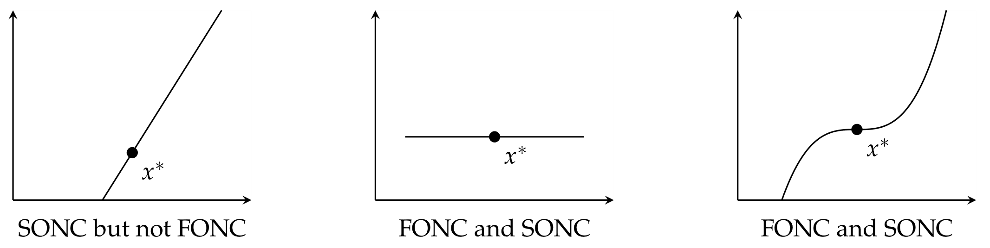


Conditions for Local Minima
Univariate Function
$=0,$ the first-order necessary condition (FONC)
$,$ the second-order necessary condition (SONC)

Slide 26


Conditions for Local Minima
Multivariate Functions
$=0,$ the first-order necessary condition (FONC)
$≥0,$ the second-order necessary condition (SONC)

Slide 27
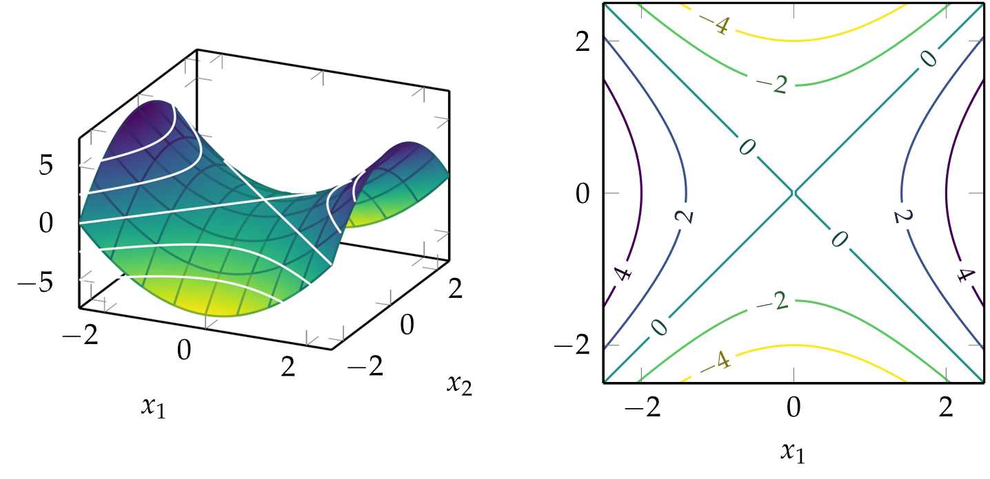


Contour Plots
$f\left(x_{1},x_{2}\right)={x_{1}}^{2}−{x_{2}}^{2}$

Slide 28
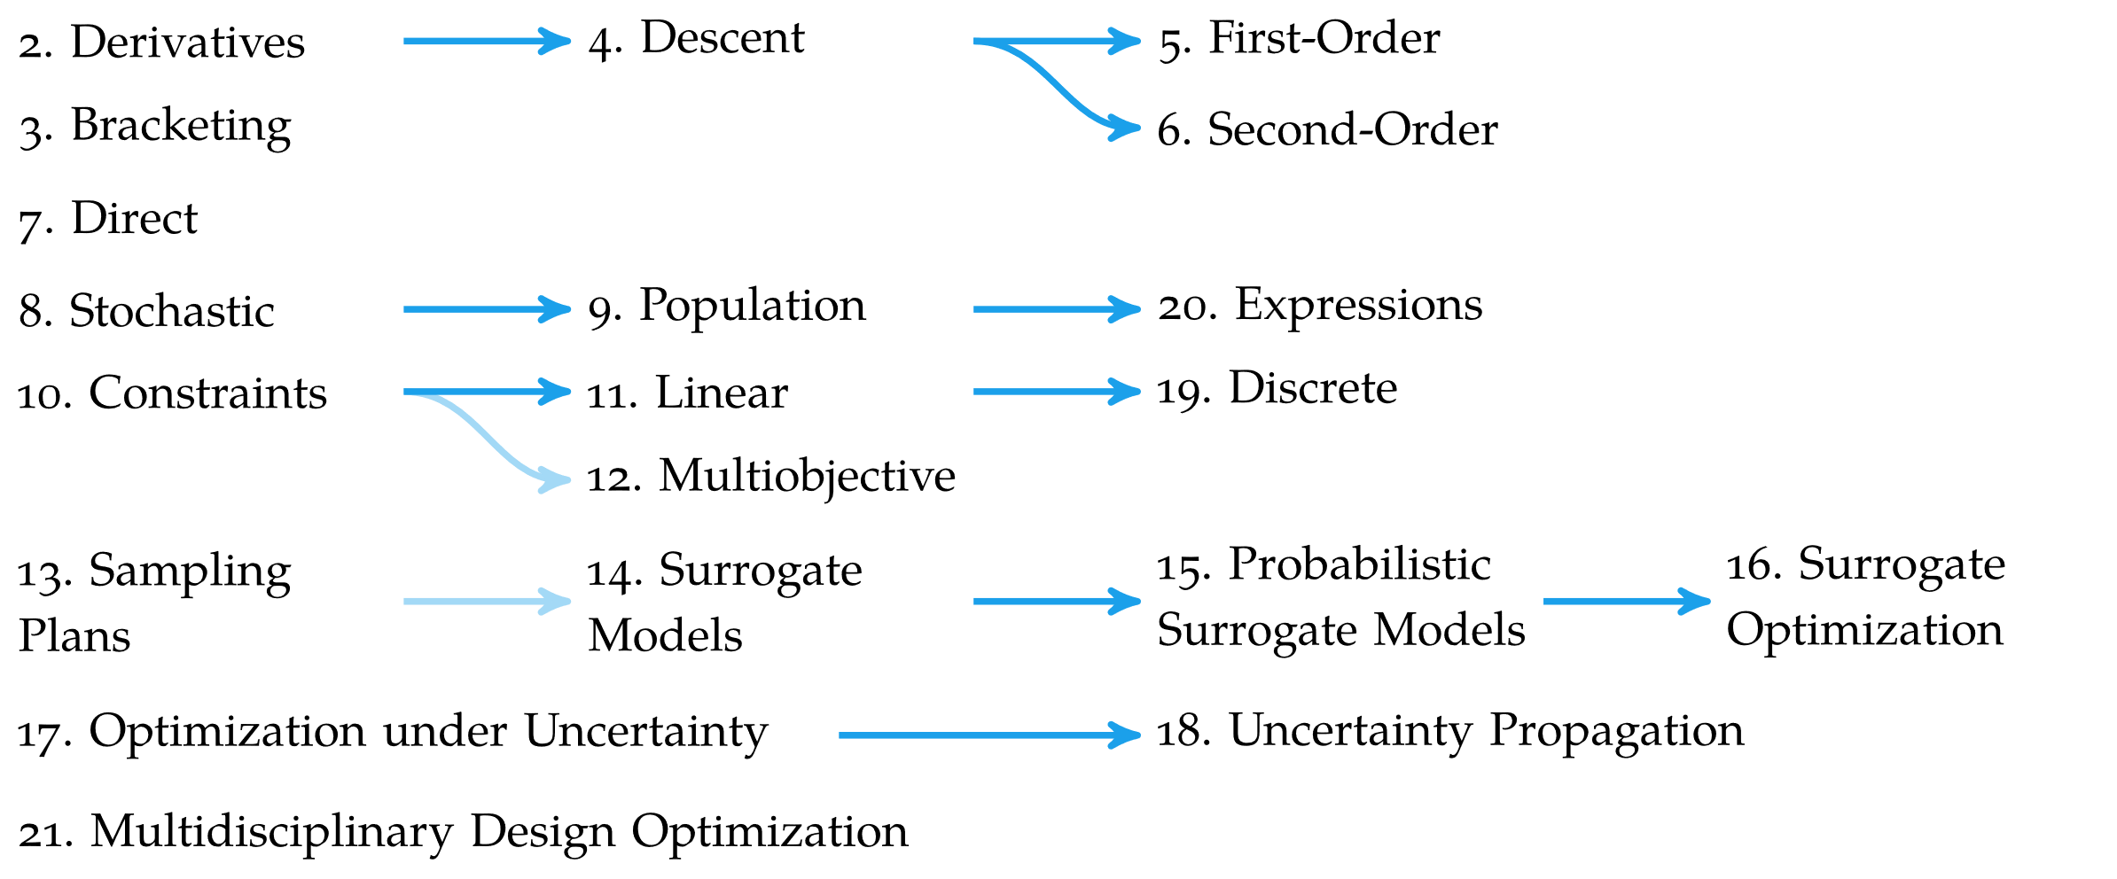
Overview

Slide 29
Summary
Optimization in engineering is the process of finding the best system design subject to a set of constraints
Optimization is concerned with finding global minima of a function
Minima can occur where the gradient is zero, but zero-gradient does not imply optimality

