Slide 1
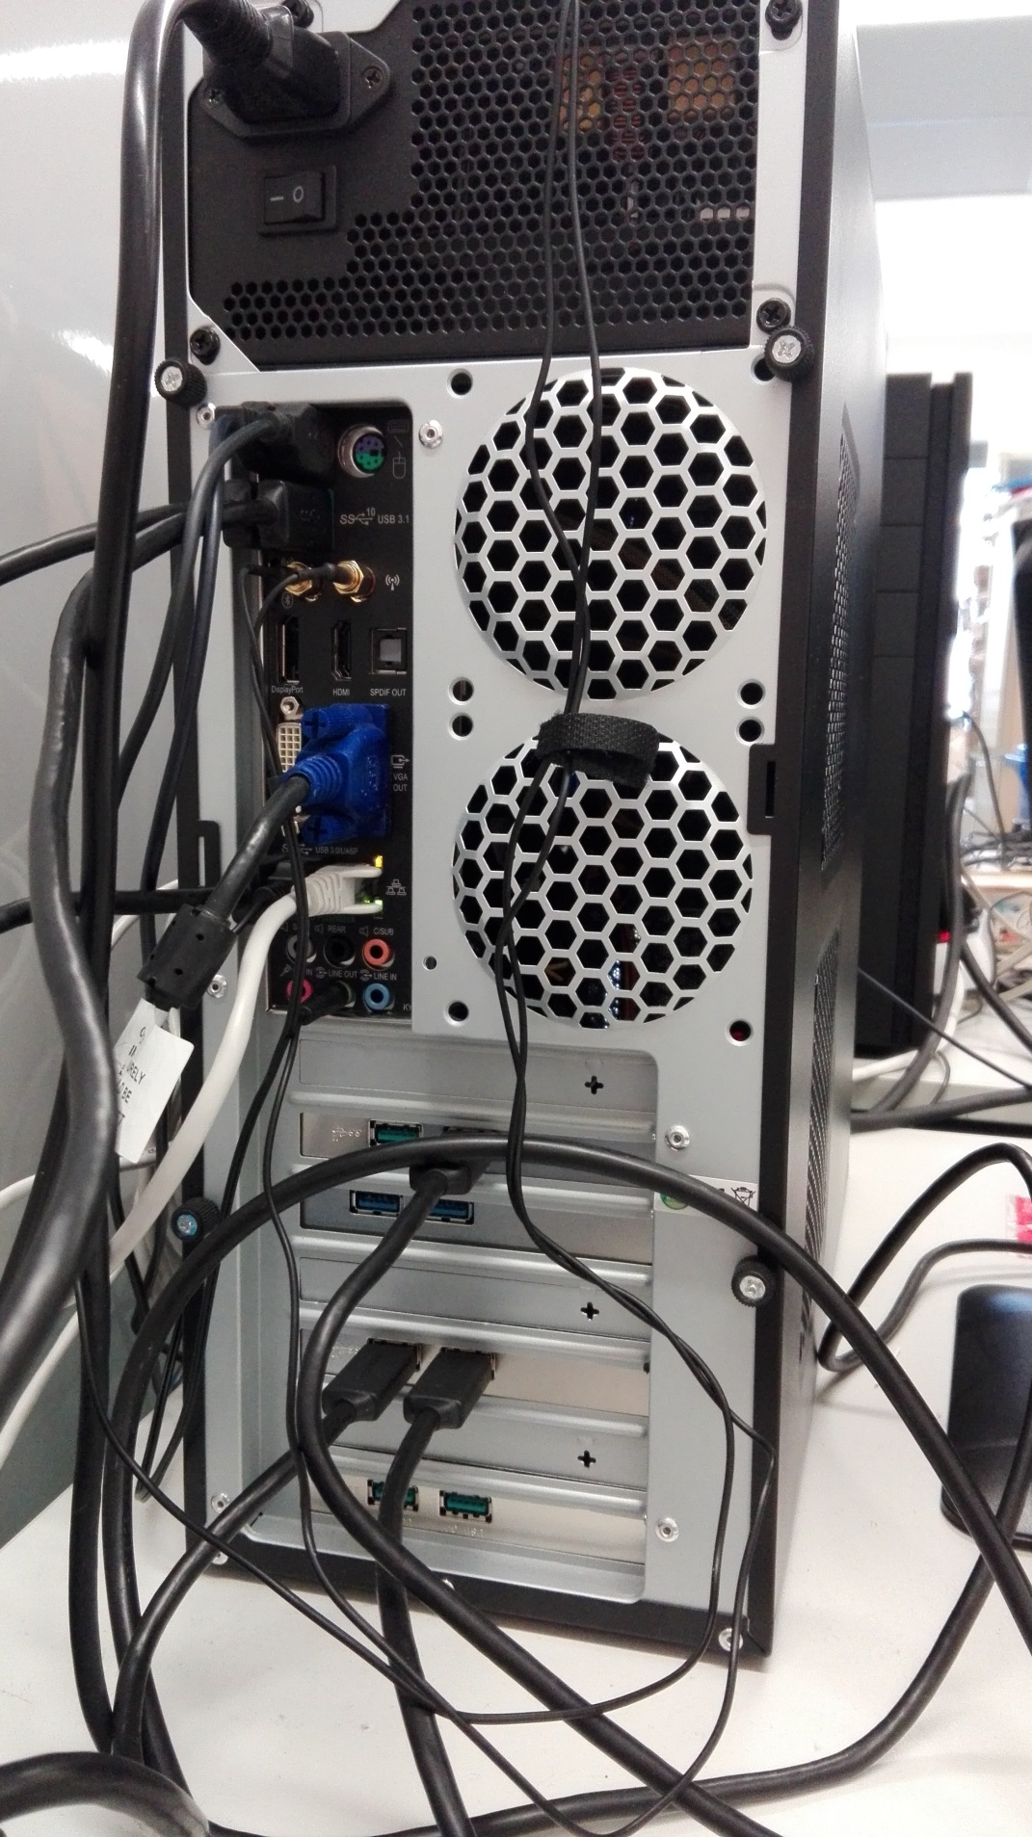
USB-monster #1
3
2
1
6
4
5

Slide 2
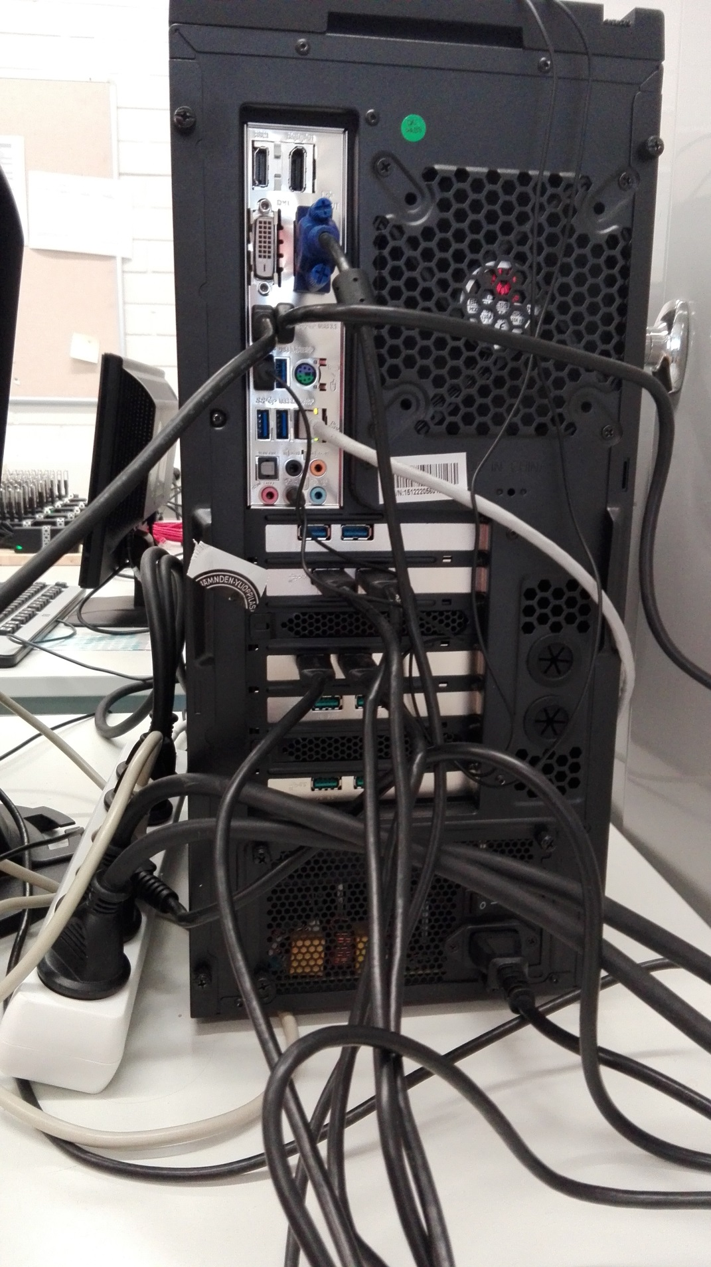
USB-monster #2
1
2
5
6
3
4

