Slide 1
09 SEPTEMBER 2026 · MGSIPA, CHANDIGARH
The Need for Caution While Using AI in Education
Challenges, Ethics, Integrity & Governance Issues
Shuvendu Bose Diganta

Slide 2
QUICK CHECK
How many of you have already used a chatbot like ChatGPT or Gemini — even once?
No wrong answers. Just curious.

Slide 3
If an AI system gives you an answer that looks completely correct,
what makes you trust it?
SOURCE
EVIDENCE
ACCOUNTABILITY
Where did the answer come from?
Can the claim be checked?
Who owns the decision?
Notes:
2 minutes.
Invite 3 to 4 responses. Likely answers include source, evidence, previous experience and confidence.
Do not correct the room immediately. Use the answers to introduce the central problem: AI can produce persuasive language without guaranteeing truth or suitability.

Slide 4
The ground reality in Indian schools
58%
64%
94,000+
of schools have functional computers for teaching
of schools have internet connectivity
schools still have no electricity at all
Source: UDISE+ 2024–25, Ministry of Education, Government of India
This is the ground we're building AI-readiness on.

Slide 5

The Genie is Out of the Bottle
86%
Recent data from the Digital Education Council's Global AI Student Survey (2024) indicates that 86% of students globally already utilize generative AI in their studies.
However, fewer than 15% of Indian institutions have updated their academic integrity policies or data privacy guidelines to reflect this reality, creating a massive governance vacuum.
Student AI Adoption

Slide 6
The central argument
Capability
→
Risk
→
Governance
AI can
AI can also
Therefore
Generate, summarize, translate, explain, brainstorm and provide feedback.
Hallucinate, reproduce bias, expose sensitive data and encourage overreliance.
Use AI selectively, verify important outputs and keep humans accountable.
Notes:
2 minutes.
This is the logic of the whole session.
The presentation is not anti-AI. It is about matching AI use to educational purpose, risk and accountability.

Slide 7
The question isn't whether AI enters our classroom.
It already has.
The question is whether we are ready to govern it.

Slide 8
Four questions every institution should ask
01 ACCURACY
02 ETHICS
03 INTEGRITY
04 GOVERNANCE
Can we rely on the output?
Is the use fair and appropriate?
Does it preserve intellectual honesty and learning?
Who sets boundaries and remains accountable?
Notes:
1 minute.
Introduce these as the four lenses used throughout the session.

Slide 9

The Challenges

Slide 10


Challenge 1:
Hallucinations & Administrative Liability
Why we cannot trust AI to write official policy.

Slide 11
RELIABILITY
Fluent output is not verified knowledge
What users see
What still needs checking
Clear prose
Confident tone
Structured answer
References that look credible
Factual accuracy
Source authenticity
Context and date
Evidence behind the claim
Suitability for the decision
≠
Notes:
2 minutes.
Define hallucination operationally: an AI system can produce unsupported or false information in a plausible form.
The practical danger is not obvious nonsense. It is persuasive text that is wrong in subtle ways.

Slide 12


Case Study: The Cost of Blind Trust
Mata v. Avianca Airlines
In a incident, a licensed attorney used ChatGPT to draft a legal brief. The AI generated a flawless, highly persuasive document citing six specific prior court cases.
The Reality: None of the cases existed. The AI completely fabricated the rulings, docket numbers, and quotes. The lawyer faced severe sanctions and professional disgrace.
Takeaway for Educators: LLMs are predictive text engines, not factual databases. They aim to sound plausible, not truthful.

Slide 13
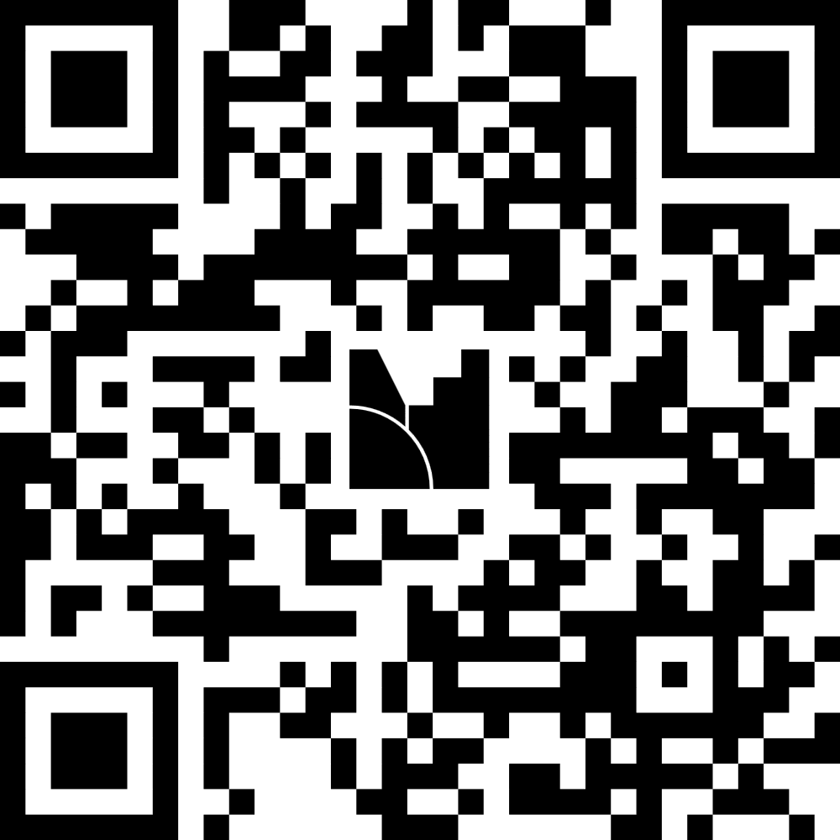
LIVE DEMO 1: The Confident Fabrication
Testing the Limits of Truth
We will now ask an AI to draft an official state warning letter regarding a highly specific regulatory issue.
Prompt: "Draft an official warning letter to a private school in Punjab regarding the unwarranted increase in school fees. Cite specific rules from the Punjab Regulation of Fee of Unaided Educational Institutions Act,and reference at least two specific circular numbers issued by the Punjab State Education Department in 2024, along with a recent Punjab and Haryana High Court precedent."
Watch as the AI invents non-existent legal precedents, state circulars, and regulatory mandates with absolute confidence.
If you want to try it by your own, please scan the QR code for the prompt.

Slide 14
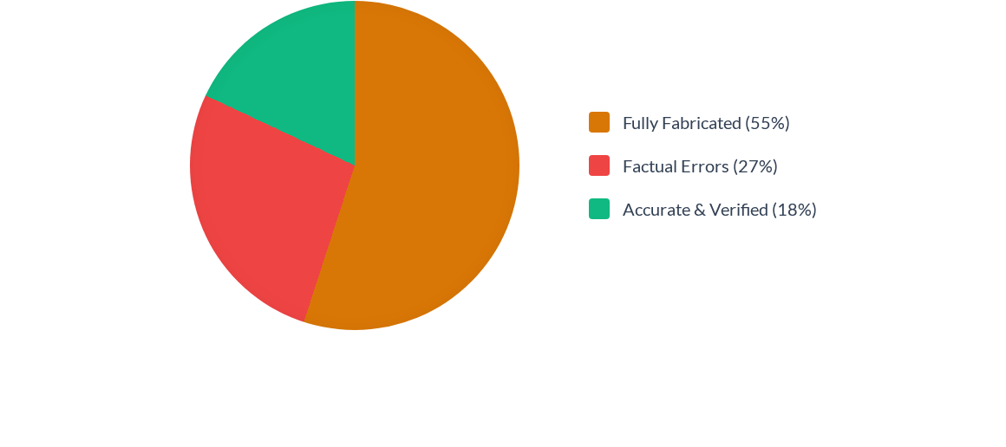
The Danger of Citation Fabrication
A recent study (Walters & Wilder, 2023) analyzing AI-generated literature searches found that a staggering 55% of citations provided by standard LLMs were entirely fabricated. For an administrator signing an official response, this represents critical institutional risk.

Slide 15





The Verification Protocol
1. Source Authentication
2. Contextual Accuracy
3. Human Judgment
Is the document real? Never accept a citation, policy reference, or URL generated by an AI without independently navigating to the source repository.
Does it support the claim? AI often summarizes complex data poorly, missing local nuances or fundamentally misinterpreting legal terminology.
Is it appropriate here? The higher the consequence of the decision, the stronger the mandatory human-in-the-loop verification protocol must be.

Slide 16
Challenge 2:
Academic integrity and learning
The obsolescence of traditional assignments and the danger of false accusations.

Slide 17
The Danger of False Accusations
"AI detectors frequently misclassify non-native English writing as AI-generated, with false positive rates reaching over 60% in standardized essay tests."
— Stanford University Research (2023)
If a Principal suspends a student based on a flawed commercial AI detector, the school is entirely exposed to parental disputes, RTI inquiries, and legal action. You cannot solve a technology problem with flawed technology.

Slide 18
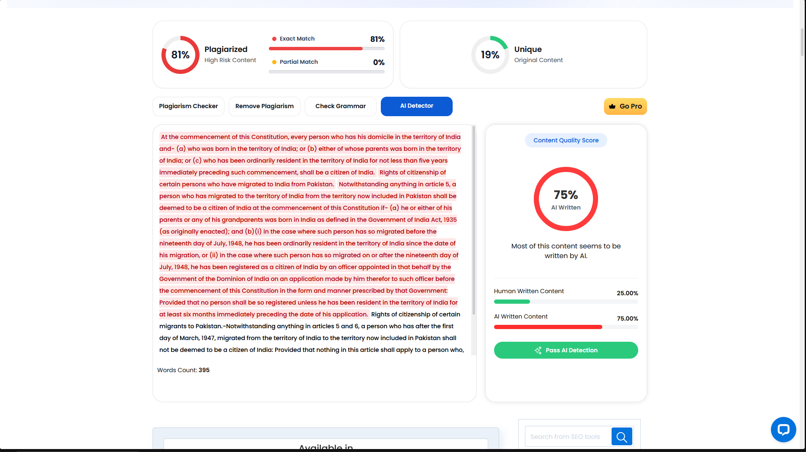
LIVE DEMO 2: The "AI Detector" Trap

Slide 19
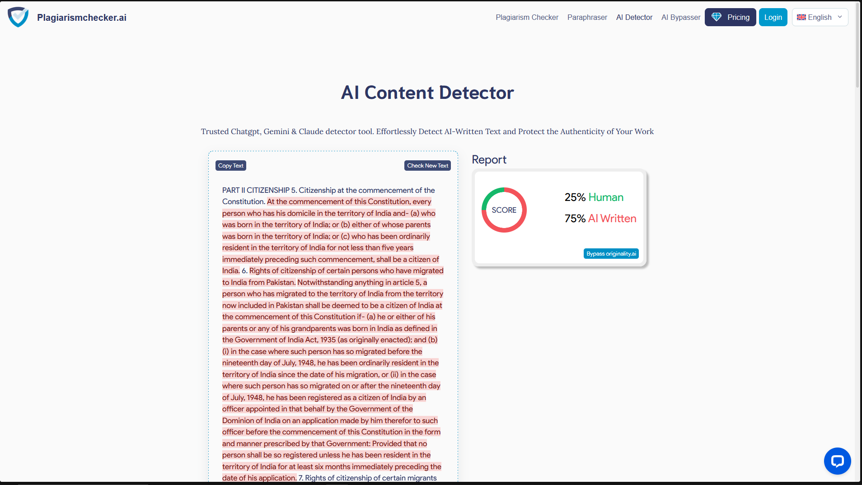

Slide 20
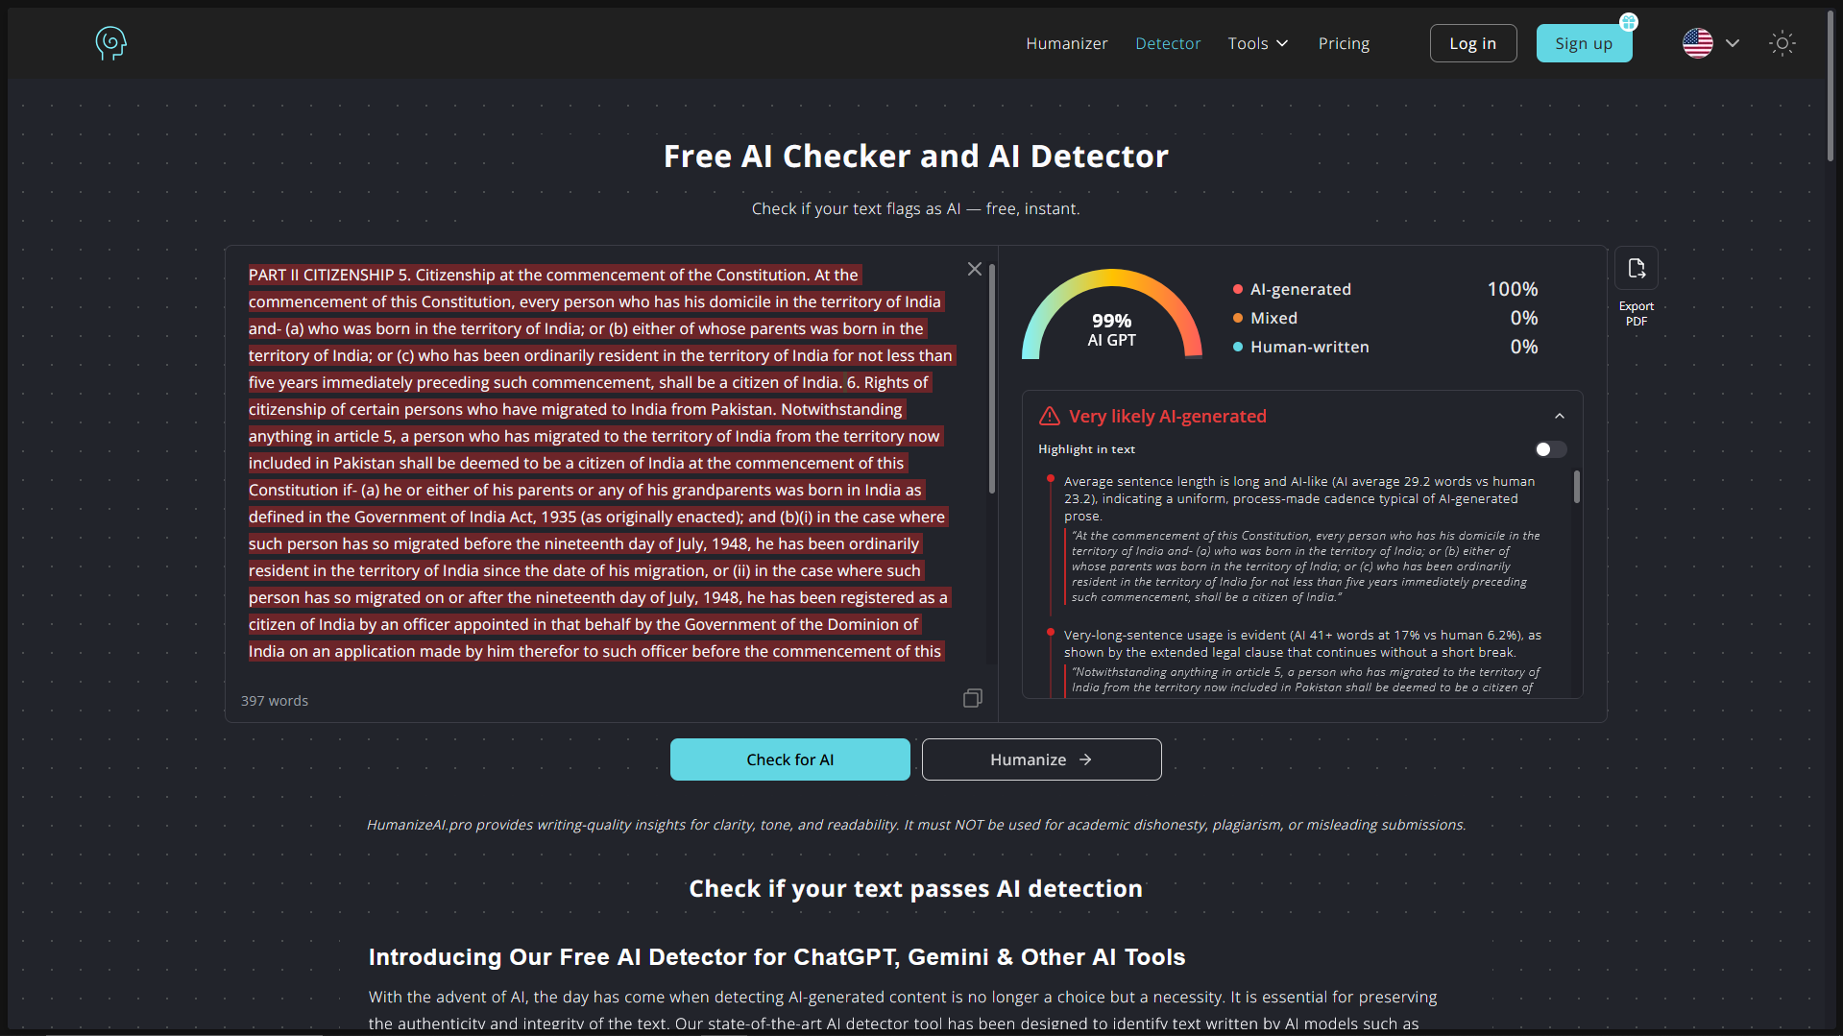

Slide 21
The wrong question
“Was AI used?”
→
“How was AI used, and did it undermine the learning objective?”
SUPPORTIVE
CONTEXT-DEPENDENT
POTENTIALLY UNDERMINING
Brainstorming, explanation, practice, feedback
Editing, translation, drafting, coding assistance
Submitting generated work as one's own when independent work is the objective
Notes:
3 minutes.
A blanket “AI equals cheating” rule is too crude.
Different assignments can legitimately permit different levels of AI assistance. The key is whether the use is compatible with the learning objective and the institution’s rules.

Slide 22
AI detection is not the whole integrity strategy
A detector score cannot establish by itself
Stronger assessment evidence
Who produced the work
How much AI was used
Whether use violated the assignment rule
Whether the detector is reliable in the context
Drafts and revision history
Oral explanation
Process-based assessment
Source verification
AI-use declaration
Notes:
3 minutes.
Do not claim all AI detectors are useless. Say instead that a detector score should not be treated as definitive proof of misconduct.
Assessment design can generate stronger evidence about learning and authorship.

Slide 23
Indian academic integrity context
UGC Regulations, 2018
Existing principle
New policy question
The UGC regulations frame academic integrity around intellectual honesty in proposing, performing and reporting academic work.
Institutions now need clear rules for permitted AI assistance, disclosure, attribution, assessment design and responsibility for final work.
Source: UGC, Promotion of Academic Integrity and Prevention of Plagiarism Regulations, 2018
Notes:
3 minutes.
Be careful: the UGC regulations predate generative AI and are not an AI-specific policy.
Their relevance is the underlying principle of intellectual honesty. Institutions need to interpret that principle for contemporary AI-assisted work.

Slide 24
Challenge 3:
Data Privacy & The DPDP Act 2023
Understanding institutional liability in the era of public LLMs.

Slide 25

The DPDP Act 2023 & Schools
Under the Digital Personal Data Protection (DPDP) Act, educational institutions are classified as Data Fiduciaries.
■
You are legally responsible for the safekeeping of student Personally Identifiable Information (PII).
■
Uploading student data into public LLMs (like free ChatGPT) means that data is used to train corporate models.
■
Penalties: Data breaches or failure to observe reasonable security safeguards can invite penalties of up to ₹250 crore.

Slide 26
LIVE DEMO 3: The Accidental PII Leak
Efficiency vs. Privacy
Observe how quickly a well-intentioned teacher, trying to summarize a student report to save time, can inadvertently violate federal privacy laws.
Prompt: "Please summarize this student's progress report into a 3-sentence email to send to their parents: 'Student Name: Gurpreet Singh. Class: 9th B. Roll Number: 42. Medical notes: Diagnosed with ADHD, requires medication. Academic performance: Failing Mathematics, suspected of cheating. Behavioral notes: Frequently aggressive towards peers.'"
Once this data hits the prompt box, it leaves your institution's secure network permanently.

Slide 27

The Threat of Deepfakes & Bullying
Beyond academic integrity, administrators must prepare for the weaponization of AI by students.
■
Cyberbullying: Easily generated synthetic, inappropriate images of classmates using social media photos.
■
Authority Spoofing: Voice-cloned audio of teachers or principals issuing fake directives or using inappropriate language.
Mitigation requires robust, verified digital communication channels and updated disciplinary codes that specifically address synthetic media.

Slide 28

PART TWO
Ethics & Governance

Slide 29
Individual experimentation is not the same as institutional deployment
Individual use
Institutional deployment
Teacher uses AI to brainstorm a lesson.
Key questions:
Accuracy
Appropriateness
Data handling
Professional judgment
College deploys AI for student support or assessment.
Additional questions:
Procurement
Privacy
Accessibility
Monitoring
Accountability
Notes:
2 minutes.
Governance requirements should scale with consequence and reach.
A personal drafting use is a different governance problem from deploying a system across thousands of students.

Slide 30
What should an institutional AI policy answer?
01 What uses are allowed?
02 What uses are restricted?
03 What uses are prohibited?
04 What data may be entered?
05 Who verifies AI output?
06 Where is human approval mandatory?
07 How should AI use be disclosed?
08 Who remains accountable?
Notes:
3 minutes.
Ask participants which of these questions their institution has already answered.
This slide converts “AI ethics” into concrete governance decisions.

Slide 31
UNESCO: A Human-Centered Approach
HUMAN AGENCY
RIGHTS & EQUITY
INSTITUTIONAL READINESS
Keep meaningful human control over consequential educational decisions.
Protect privacy, consider inclusion and equity, and mitigate foreseeable harms.
Validate tools, build capacity and establish coherent policy before scaling use.
Source: UNESCO Guidance for Generative AI in Education and Research
Notes:
3 minutes.
Present UNESCO as an international reference, not as Indian law.
Its guidance emphasizes human-centred, ethical, safe, equitable and meaningful use, along with privacy and institutional preparedness.

Slide 32
Administrative Matrix: AI Usage
Administrative Use Case | Status | Governance Note
Drafting Generic Lesson Plans | Safe | No PII involved. Excellent tool for structuring frameworks.
Summarizing Disciplinary Records | Unsafe | Severe DPDP Act violation. PII ingested by third-parties.
Translating State Circulars | Verify | Requires strict human verification to prevent hallucinations.
Uploading Exams for Auto-Grading | Unsafe | Compromises student privacy and intellectual property of the exam.

Slide 33

What To Do?

Slide 34

PRACTICAL TAKEAWAYS
If you shape policy…
Require every institution to have a written AI-use policy — not just a verbal norm
Mandate teacher training before any AI tool is approved for classroom use
Ask vendors for a clear data-processing disclosure, not just a compliance checkbox
Set up a grievance and audit mechanism for AI-related complaints

Slide 35

PRACTICAL TAKEAWAYS
If you run a classroom…
Never treat an AI-detector score as final proof — verify, discuss, then decide
Teach students to disclose AI use, not just avoid getting caught
Model thoughtful AI use yourself, rather than banning it outright
Watch for early signs of over-reliance, not just plagiarism

Slide 36
90-Day Policy Implementation Roadmap
Day 60-90: Assess
Day 15-45: Draft AUP
Redesign core examination architectures to prioritize in-person, viva-voce, and analytical testing methodologies.
Develop an Acceptable Use Policy defining permissible tools, DPDP boundaries, and academic protocols.
Day 1-15: Audit
Day 45-60: Train
Conduct an anonymous survey of faculty to assess current undisclosed AI usage and tool preferences.
Conduct mandatory capacity-building workshops for staff on prompt engineering and hallucination verification.

Slide 37
The safest classroom isn't the one without AI.
It's the one that knows exactly how it's being used.

Slide 38

Questions & Discussion

Slide 39
Thank You

