Slide 1

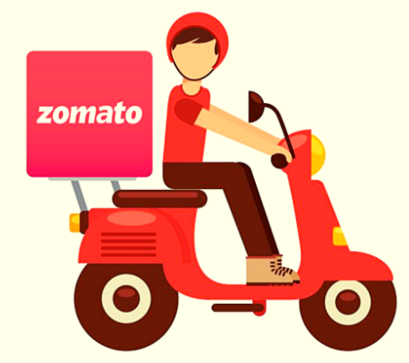
A Global Exploration with Zomato Data Analysis
Presented by
DIGANTA DIASI
234161004
Instructor: Niraj Kumar Sharma
M.Tech - Data Science
Indian Institute of Technology Guwahati
16 Nov 2023

Slide 2
OUTLINE
Introduction & Motivation
About Dataset
Objective
Block Diagram
Data visualization using Diagram
Conclusion
References

Slide 3
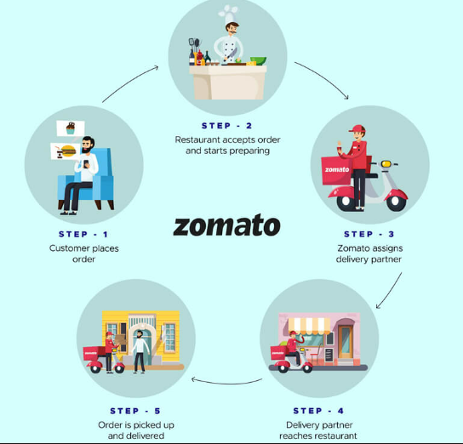
INTRODUCTION & MOTIVATION
Zomato is an Indian multinational restaurant aggregator and online food delivery company founded by Pankaj Chaddah and Deepinder Goyal in 2008.
Zomato is right now available in 20 plus countries. Zomato receive approx. 8 order per second.
Zomato is one of the most useful apps for foodies who want to taste the best cuisines of every part of the world. Zomato serves as the digital platform that bridges users with cloud kitchens, facilitating the entire process from menu exploration and order placement to delivery.

Slide 4
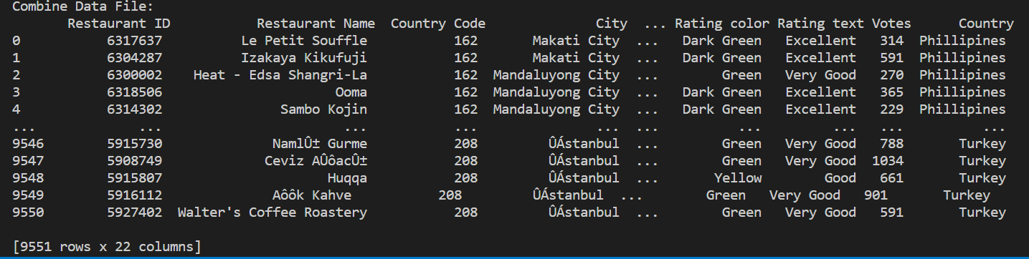
ABOUT DATASET
Zomato dataset is real time data set which gives information about restaurant , its cuisines , locality , ratings etc.
The data is taken from url: https://www.kaggle.com/datasets/shrutimehta/zomato-restaurants-data
Dataset contain two file one is csv file which contain information about restaurant and another is xlsx file which contain country code
The dataset contains the following features
Restaurant Id
Restaurant Name
Country Code
City
Address
Locality
Locality Verbose
Longitude
Latitude
Cuisines
Average Cost for Two
Currency
Has online order
Switch to Order Menu
Has Table Booking
Aggregate Rating
Votes
City
Price Range
Has Online Delivery
Rating Colour
Rating Text
Country

Slide 5
BLOCK DIAGRAM
Collect Zomato Dataset
Cleaning Dataset
Data Exploration
Conclusion
Data Visualization

Slide 6
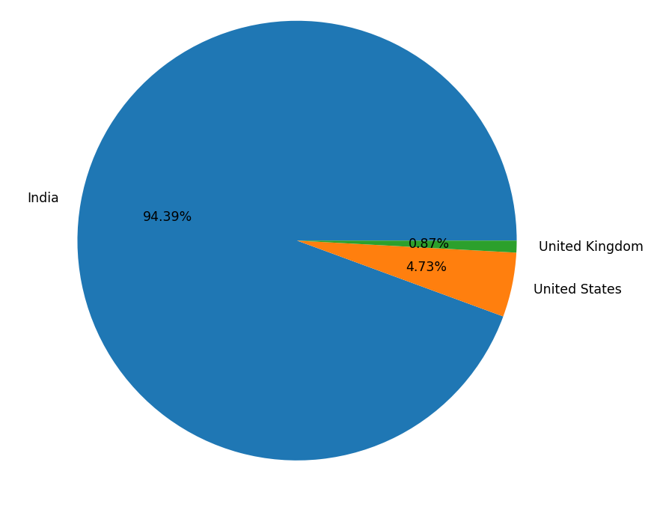
Visualization through chart
Country All over World
India 8652
United States 434
United Kingdom 80
Brazil 60
UAE 60
South Africa 60
New Zealand 40
Turkey 34
Australia 24
Phillipines 22
Indonesia 21
Singapore 20
Qatar 20
Sri Lanka 20
Canada 4
2-D Region wise splitting of Data
* All over world India has more number of restaurant under Zomato and Zomato receive maximum transection from India after that USA and UK

Slide 7
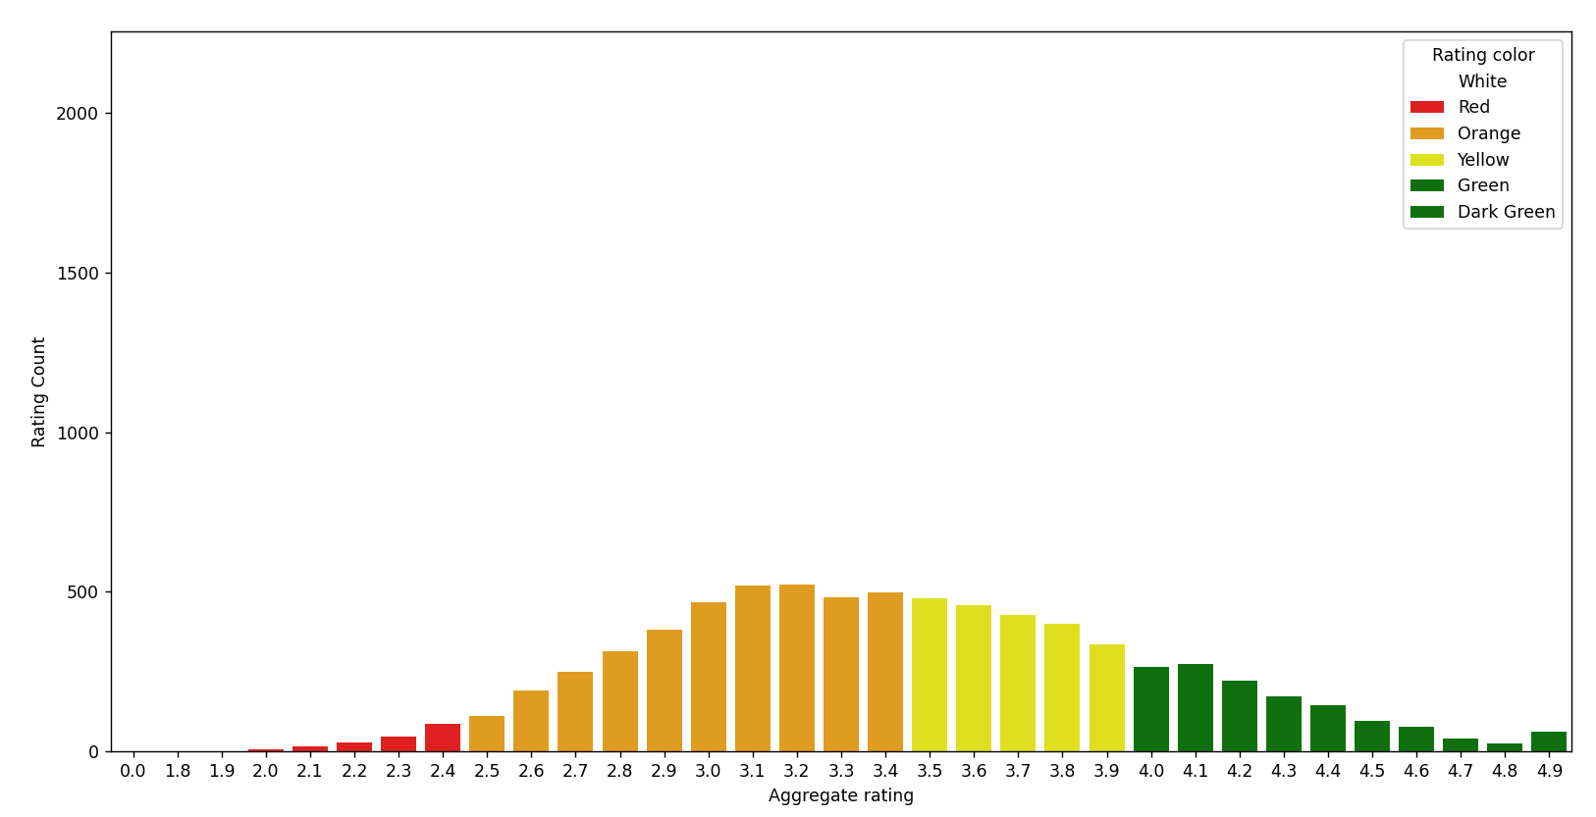
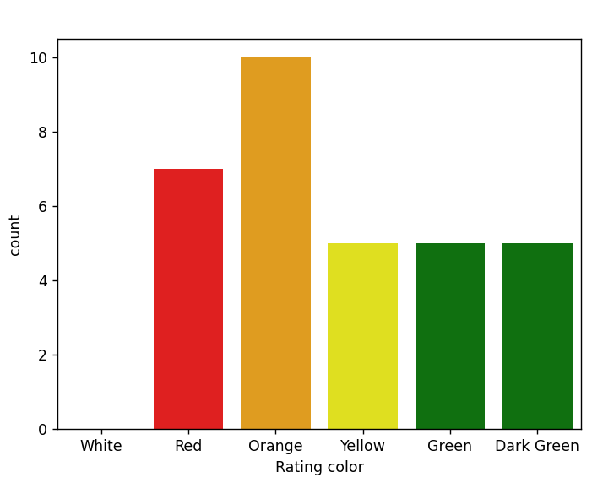
Data Visualization
Aggregate rating Country Coutnt
0 0.0 Brazil 5
1 0.0 India 2139
2 0.0 United Kingdom 1
3 0.0 United States 3
4 1.8 India 1
*bservation:
Not rated count is very high
maximum number of rating are between 2.5 to 3.4

Slide 8
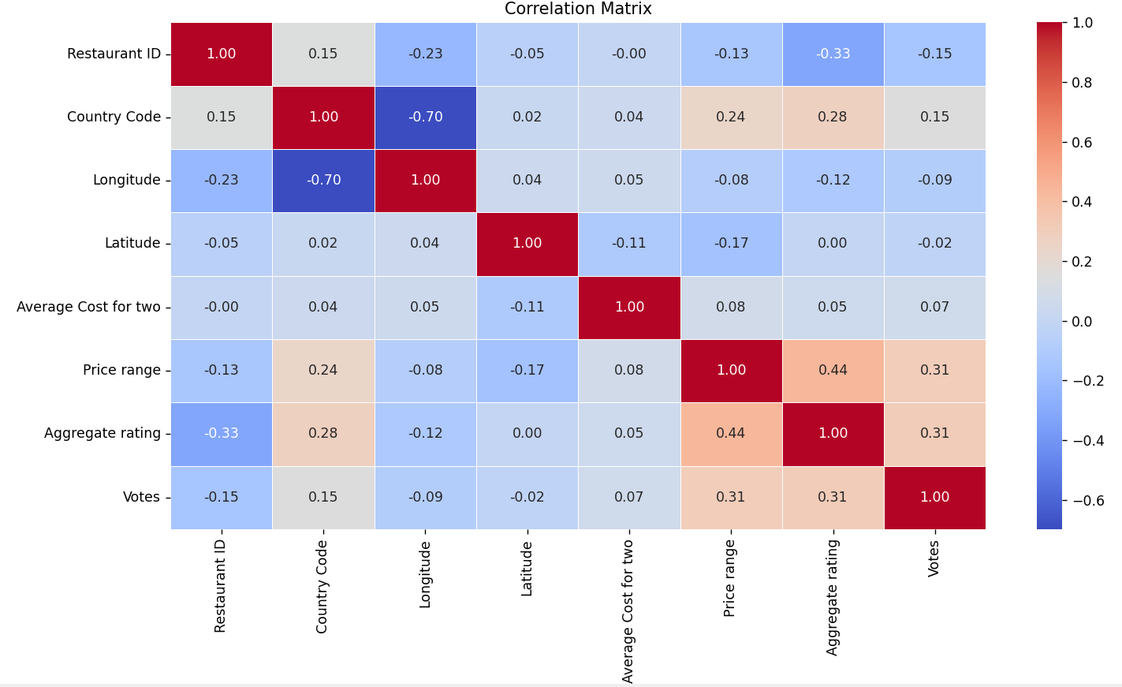
Visualization through Correlation matrix

Slide 9
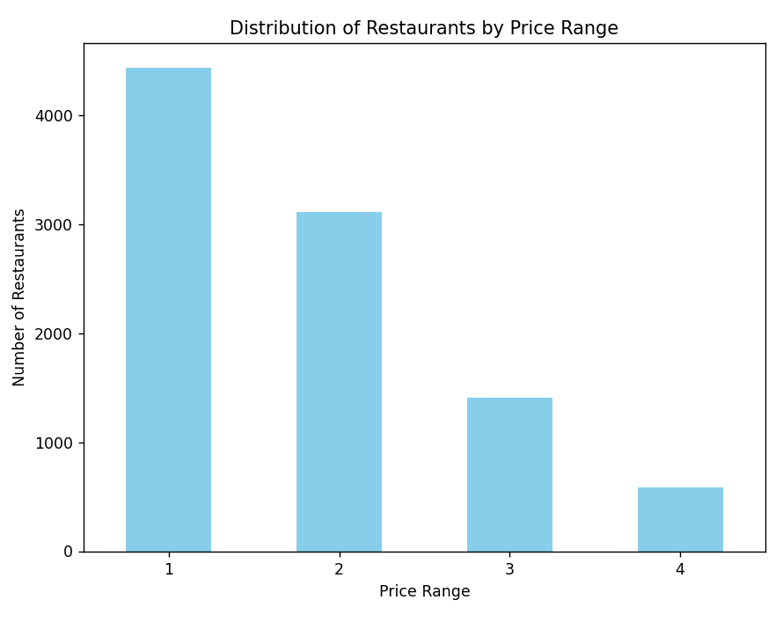
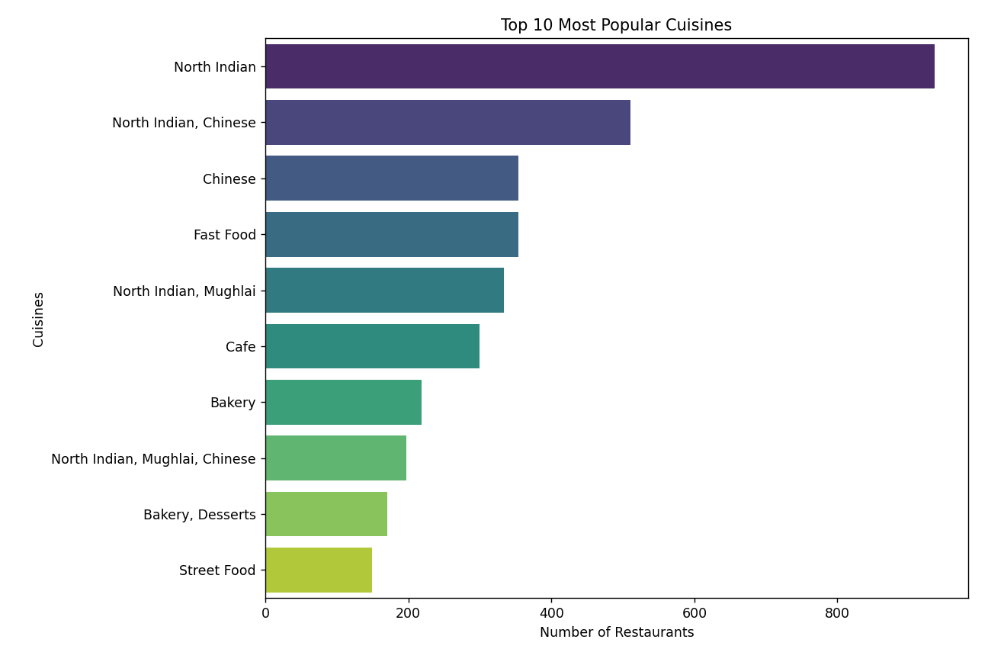
Data Visualization

Slide 10
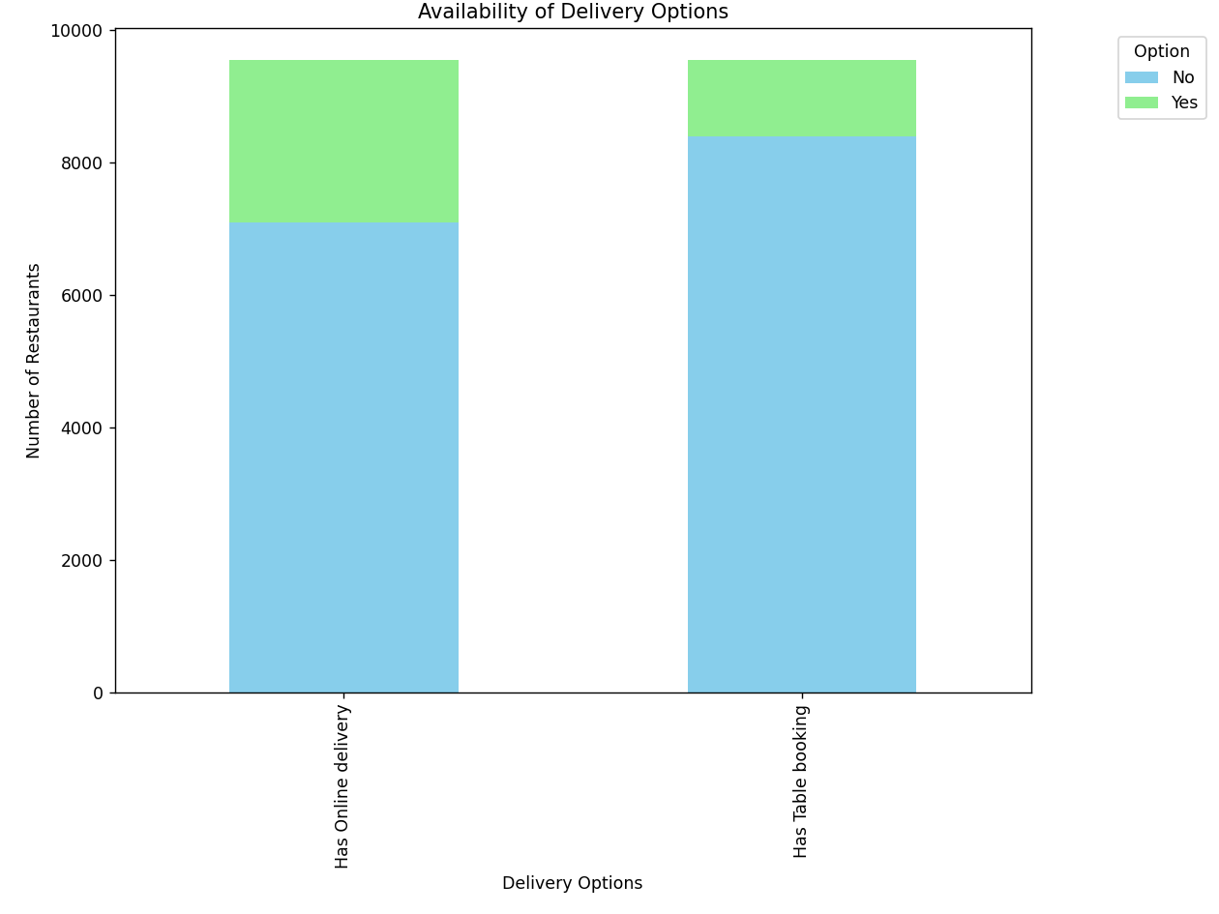
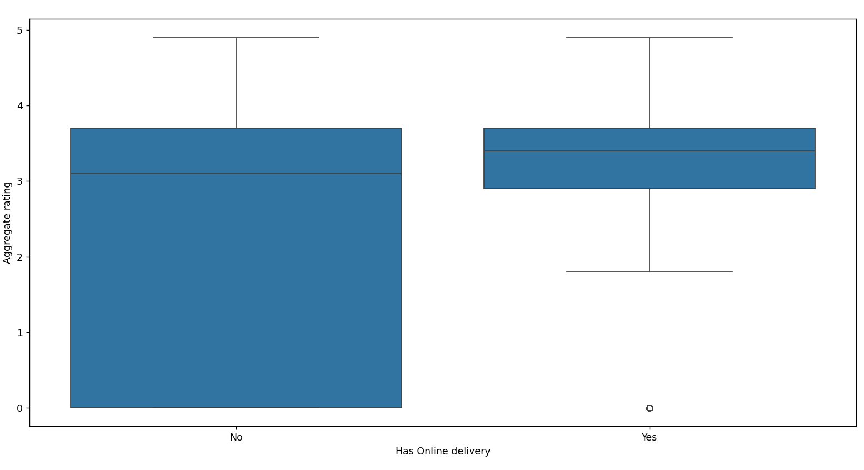
Visualization

Slide 11
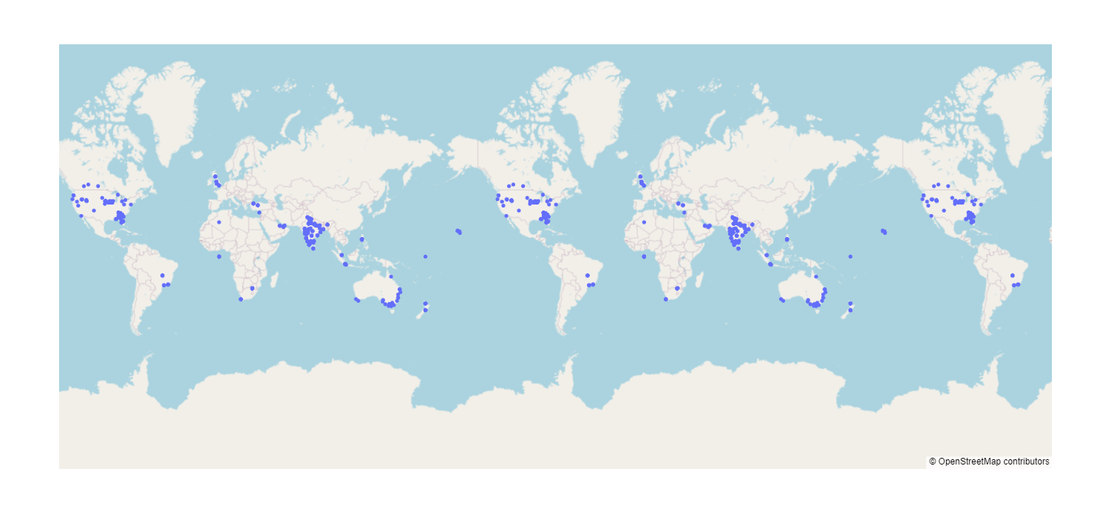
Scatter map of location Zomato restaurants

Slide 12
CONCLUSIONS
USA has higher ratings than India and a majority of Indian restaurants have 0 ratings.
Popular Indian cuisine is North Indian
Outside of India customers provide ratings more frequently and consistently than Indians.
Zomato maximum records or transaction are from India After that USA and then United Kingdoms

Slide 13
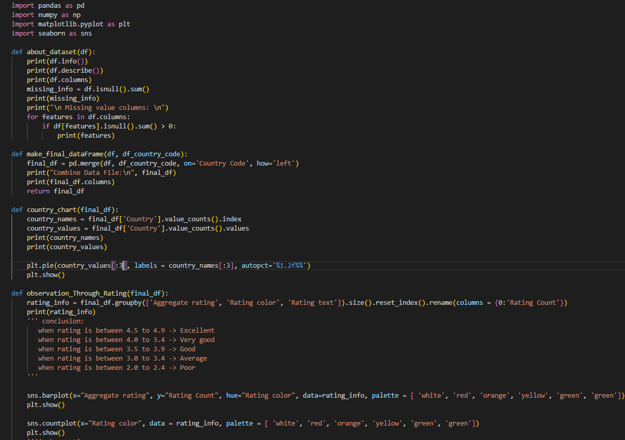
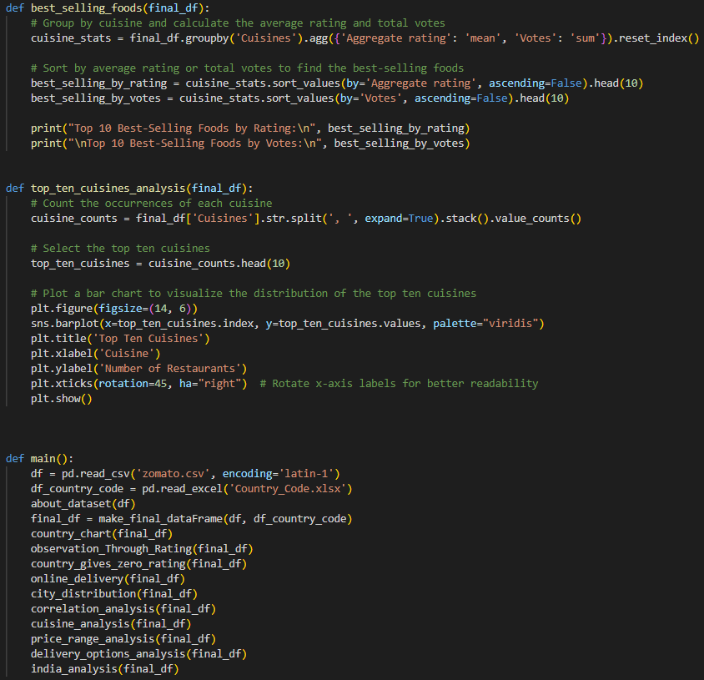
Code

Slide 14
REFERENCES
https://www.kaggle.com/datasets/shrutimehta/zomato-restaurants-data
http://www.zomato.com/
Python Software Foundation. Archived from the original on 20 April 2012. Retrieved 24 April 2012., second section \"Fans of Python use the phrase \"batteries included\" to describe the standard library, which covers everything from asynchronous processing to zip files.\“
\"Installing – Matplotlib 2.0.2 documentation\". Retrieved 2017-06-23.
https://www.geeksforgeeks.org/zomato-data-analysis-using-python/

Slide 15
THANK YOU

