Slide 1

AI Based Healthcare Chatbot System
Diganta Diasi (234161004)
Tapan Mahata (234161010)
Tarun Kumar (2341610011)
Instructor Prof. Chiranjib Sur

Slide 2
OUTLINE
Introduction
Problem Statement
Related Work
Description of Dataset
Methodology : Lora, QLora
Experiments & Results
Conclusion

Slide 3
Introduction
Natural Language Processing (NLP) advancements enable programs to converse like humans.
Chatbots have become pervasive from few past decades, enhancing user experiences.
NLP-driven chatbots are reshaping industries beyond healthcare.
Health and fitness chatbots, like Health Tap's Messenger bot, facilitate convenient medical advice.
NLP's expansion into healthcare promises transformative impacts on health management.
AI Based Healthcare chatbot system using Natural Language Processing, is easy to use and more secure than the other system it will helps to maintain proper health in the current system

Slide 4
Problem Statement
Information Accuracy and Accessibility: People often struggle to find trustworthy health information online. Medical jargon and complex language can create barriers to understanding. The chatbot aims to address this by providing a user-friendly platform with accurate and clear medical explanations.
Interactive Healthcare Resources: Traditional methods of accessing healthcare information can be passive. The chatbot addresses this by offering an interactive platform where users can ask questions in natural language and receive clear, concise answers.
Limitations of Current Chatbots: Existing healthcare chatbots might have limitations in information retrieval, natural language understanding, or inability to summarize complex medical texts. The LLM-powered chatbot aims to overcome these limitations by leveraging the strengths of large language models to deliver a more comprehensive and informative user experience

Slide 5
Related Work
The research paper "The Typing Cure: Experiences with Large Language Model Chatbots for Mental Health Support" investigates how people use large language models (LLMs) for mental health support, and the potential implications of this use.
LLMs show promise in assisting patients with chronic conditions by providing medication reminders, offering educational resources, and facilitating communication with healthcare providers.
Studies explore using LLMs to develop chatbots that assess user symptoms and suggest suitable actions. This could involve directing users to self-care options, scheduling appointments, or recommending further evaluation by a medical professional.

Slide 6
Dataset Description
The Gale Encyclopedia of Alternative Medicine is a comprehensive resource that covers various aspects of complementary and alternative medicine.
It aims to inform about prevalent conditions and diseases, offering comprehensive but not definitive information.
It covers a wide range of topics, such as Bach flower essences, cancer, depression, stress, vitamins, osteopathy.
The encyclopedia includes information on therapies, conditions/diseases, herbs/plants, foods, and people in the field
The encyclopedia offers a vast amount of data points on various alternative medical practices, conditions, and terminology. This variety can be useful for training the chatbot to understand a broad spectrum of user queries related to alternative medicine.

Slide 7
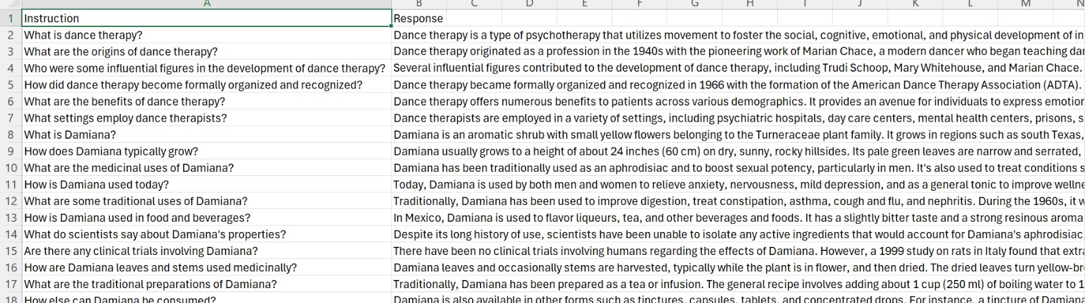
Dataset
From "the Gale Encyclopedia of Alternative Medicine" We have created a custom dataset which consists of two columns: 'Instructions' and 'Response'."
The dataset comprises
Instructions: This column contains the questions that need to be asked.
Response: This column provides the corresponding answers to the questions.

Slide 8
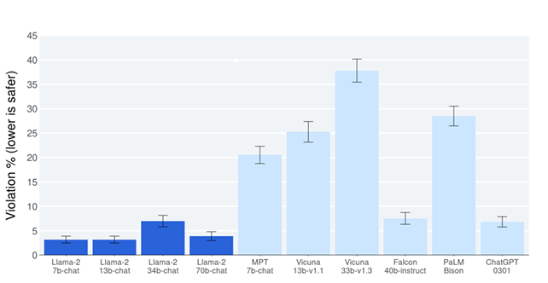
Methodology : Llama 2
Llama-2 model is a collection of pretrained and fine-tuned generative text models ranging in scale from 7 billion to 70 billion parameters.
The Llama-2-7B-Chat model is optimized for dialogue use cases
It uses an auto-regressive language model with an optimized transformer architecture and is trained on a new mix of publicly available online data.
The tuned versions of the model use supervised fine-tuning and reinforcement learning with human feedback to align to human preferences for helpfulness and safety.

Slide 9
Methodology :LoRA
LoRA is a technique for efficiently fine-tuning LLMs on specific tasks or domains. Traditional fine-tuning involves adjusting a large number of parameters within the LLM, which can be computationally expensive.
Instead of modifying all parameters, LoRA introduces a smaller set of additional parameters called "adapter modules."
Requires training fewer parameters compared to traditional fine-tuning, making it faster and resource-friendly, especially beneficial for massive LLMs.
Smaller adapter modules lead to a smaller overall model size, crucial for deploying LLMs on devices with limited memory.

Slide 10
Quantization
Quantization reduces the number of bits needed to represent weights and activations in a model. This can significantly lower memory requirements and potentially speed up computations.
By converting from high-precision data types (like 32-bit floats) to lower-precision ones (like 8-bit integers), the model becomes more compact and efficient.
BitsAndBytesConfig is a Python library specifically designed for quantization workflows in machine learning models. It provides tools and functionalities to:
Define quantization configurations: Specify the target precision for weights and activations (e.g., 8-bit integers).
Quantize models: Apply the defined configuration to convert a model's weights and activations to the lower precision data type.

Slide 11
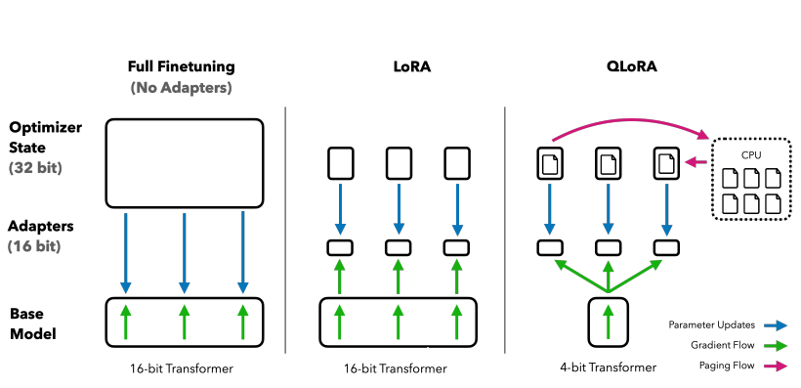
Methodology : QLora
Efficient Finetuning of Quantized LLMs
It's a technique used to fine-tune large language models on specific tasks by reducing memory. .
QLORA introduces multiple innovations designed to reduce memory use without sacrificing performance
i) 4-bit NormalFloat
ii) Double Quantization
Iii) Paged Optimizers

Slide 12
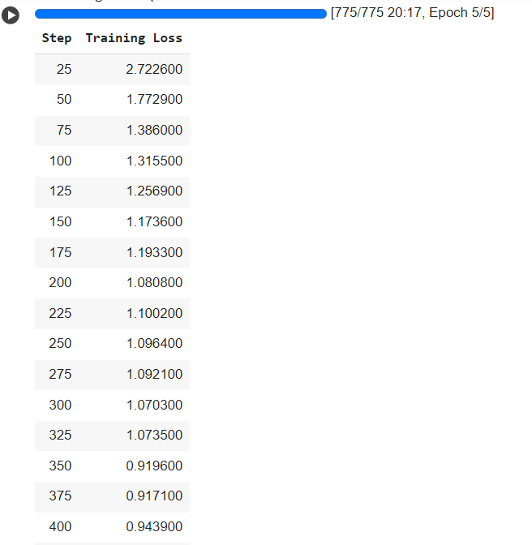
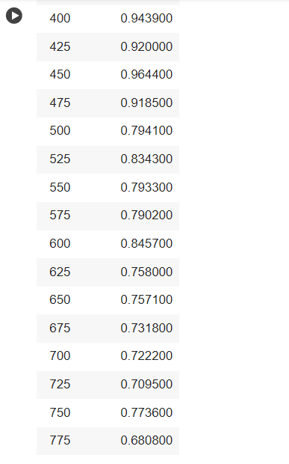
Training
12

Slide 13
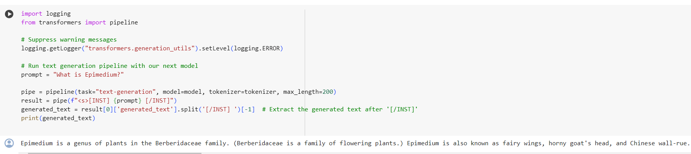
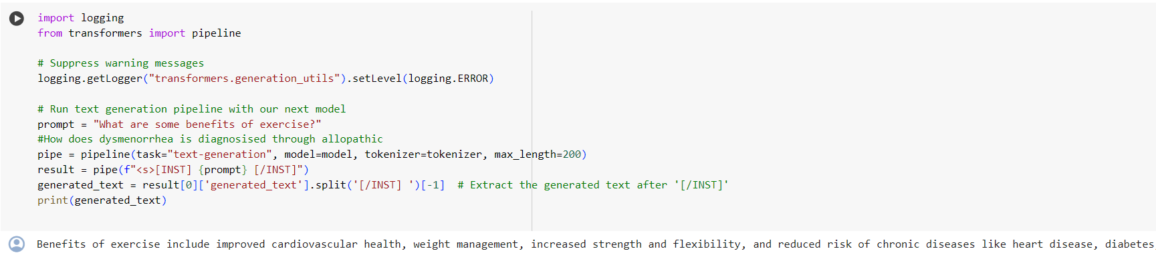
Results
13

Slide 14
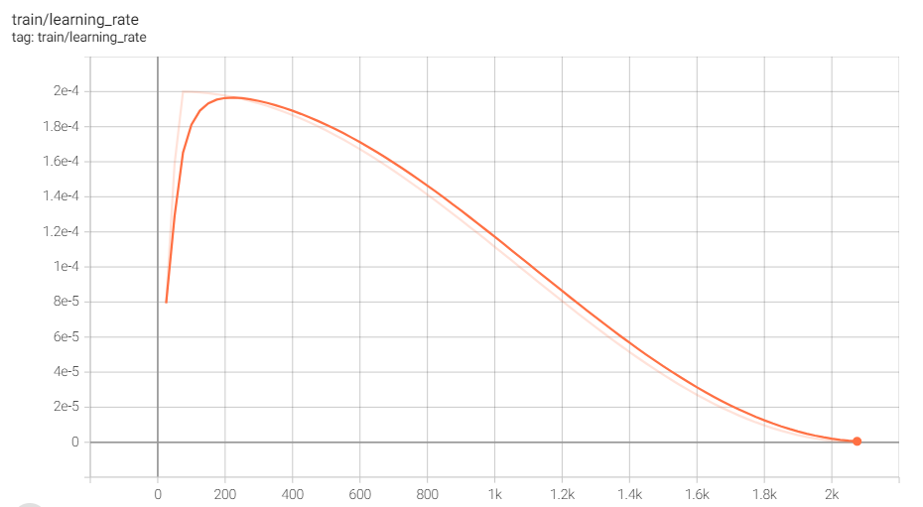
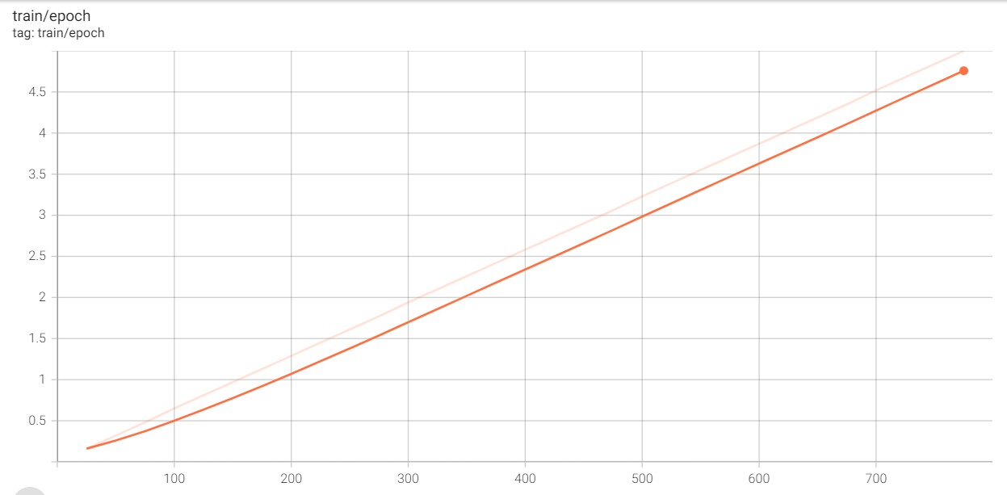
Experiments & Results
14

Slide 15
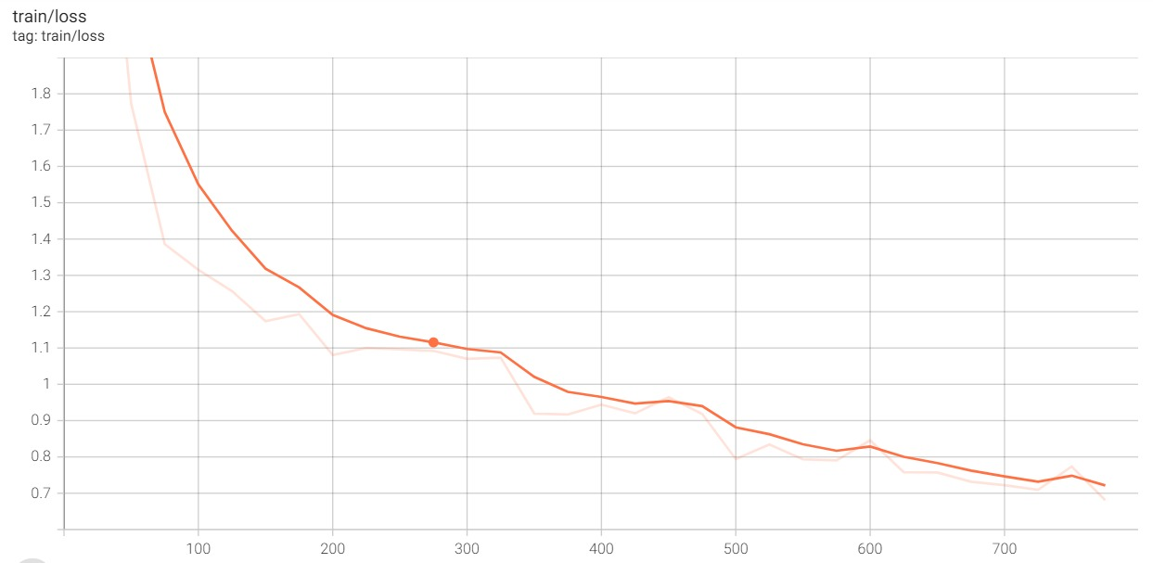
Experiments & Results
15

Slide 16
CONCLUSION
Accurate information delivery: The main aim of the project AI Based Healthcare chatbot system using Natural Language Processing, which is easy to use.
Enhanced usability and security: The AI-based Healthcare chatbot system employing Natural Language Processing ensures a user-friendly experience while maintaining robust security measures.
Fine-tuned-model link : Model Hugging FACE

Slide 17
THANK YOU

