Slide 1
Home Automation

Slide 2
1.
Project Overview
To demonstrate the use of transistor’s to switch on a lamp when dark, fan when temperature is high, when there a user detected in a room!

Slide 3
Objectives
To design a circuit to control the light, fan and door.
To implement a logic circuit so that the switching works in coordination.
To not use any microcontroller.
Interfacing the sensors.

Slide 4
Challenges Faced
Exploring ways to design the logic circuit
Getting enough voltage from the sensors which are a few millivolts to drive the relay
Bypassing the problem of relay draining the battery
Effective switching of devices when object is detected
Heating problem of transistors

Slide 5
Different types of sensors used
Temperature Sensor
Gives different voltage outputs for different temperatures. This voltage output will turn the mosfet on, when a threshold temperature is reached.
Proximity Sensor
Emits infrared rays and looks for changes in signal and determines the distance between the object and itself.
Light dependent resistor
The resistance of this device decreases with the increase in the amount of light falling on it. This will basically act as a switch turning the mosfet off and on, inturn turning the light on and off.

Slide 6
Truth table for lamp
Lamp | Temp | Light | User
0 | 0 | 0 | 0
0 | 0 | 0 | 1
0 | 0 | 1 | 0
1 | 0 | 1 | 1
0 | 1 | 0 | 0
0 | 1 | 0 | 1
0 | 1 | 1 | 0
1 | 1 | 1 | 1
Solving this the output will be :
Y = LU
This is correct when we think logically! Output depends on presence of sunlight and if the user is present in the room!

Slide 7
Similarly other outputs….
For fan :
Y = TU
An AND logic gate between the outputs of door and fan circuits.
For door:
Y = U
Ouput depends on the presence of user.
Where T – temperature, U – user and L - light

Slide 8
Flow Chart
LDR
Circuit and Temp circuit
Output
Object
Sensor
Relay
Op-amp LM741
comparator
Calibration
to get 6V

Slide 9
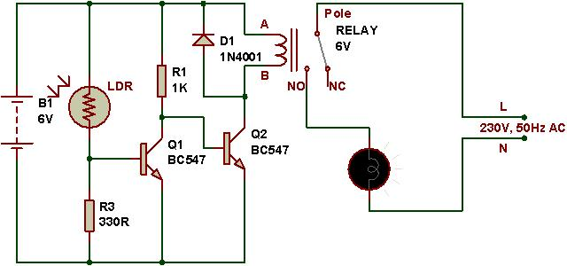
LDR Circuit

Slide 10
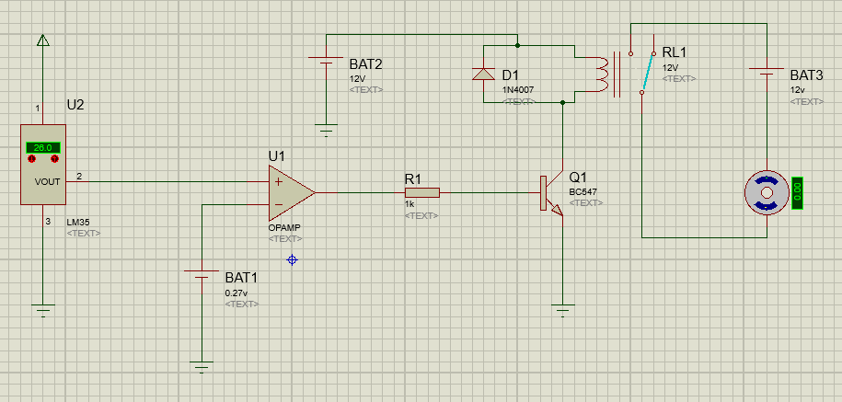
Temperature regulation Circuit

Slide 11
Area of Application
Lighting – This can be set as per our own required settings for dim and bright light.
Drapes – With the help of the home automation system, the drapes of the room can be opened and closed during the night time.
Lawn sprinklers – The sprinkler system can be activated as per the schedule settings.
The list goes on…

Slide 12
Thank You
The team:
Date:
03/11/2015
Jahnavi Reddy
B Vandana
Diganth P
Dheeraj Kamath

