Slide 1
Covid 19: The United States VS. Italy
Group 11
Group members: Asim Syed, Connor Scherer, Digiant Patel, Stephany Obakpolor, Jessica Doanes, John Timmers

Slide 2
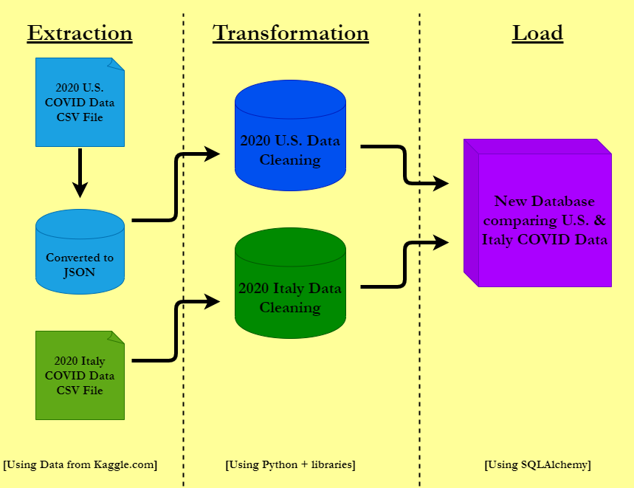

Slide 3
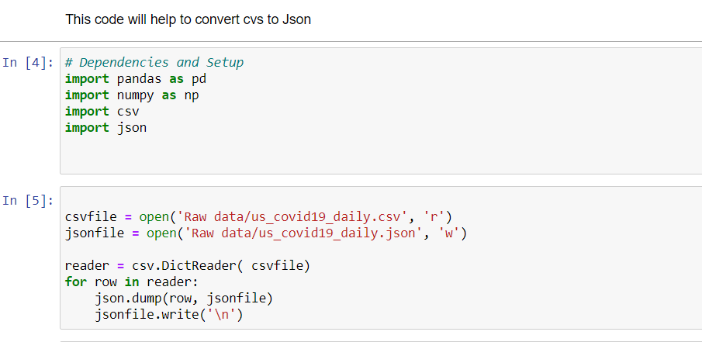
Extraction
We retrieved data from COVID-19 in USA and COVID-19 in Italy from Kaggle.
• The assignment required that we use diverse data sources. To meet this requirement, we converted the USA data set from a CSV to JSON file.
• Then, we used Python to extract data from JSON and CSV.

Slide 4
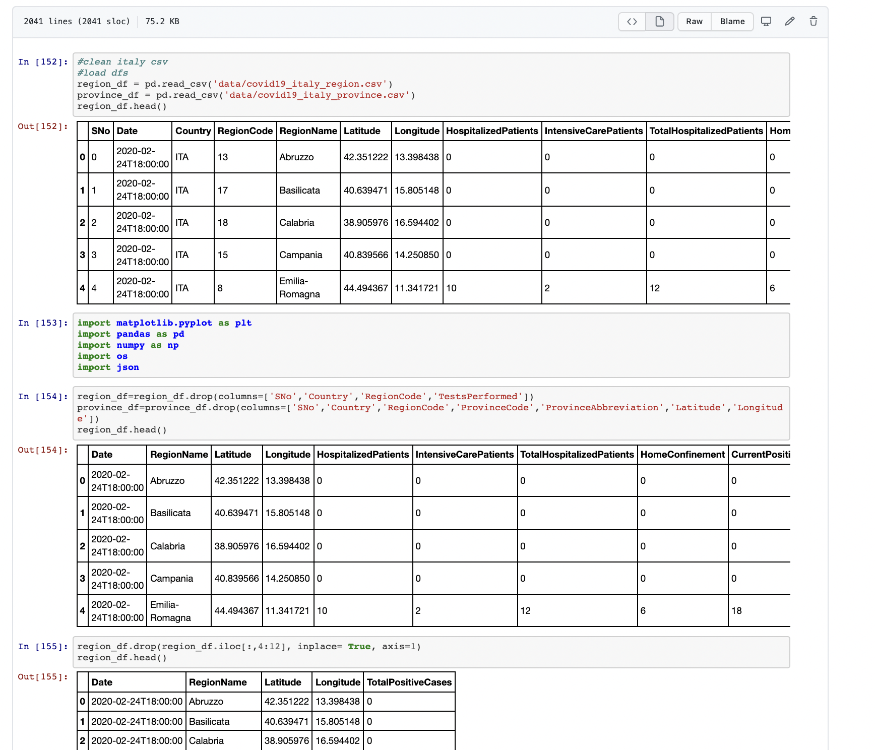
Transformation
• Following successful conversion of the USA data set, we cleaned our data for USA and Italy.

Slide 5
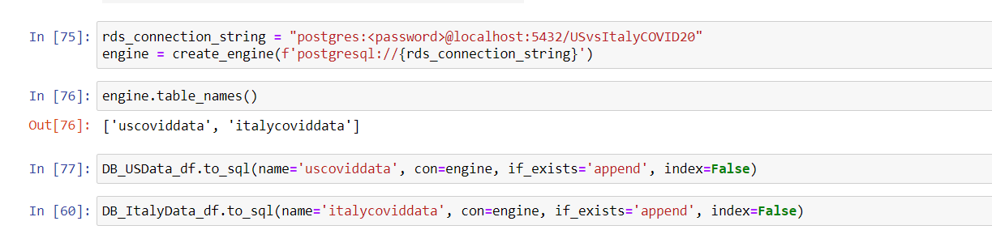
Load
Finally loaded data into Database

Slide 6
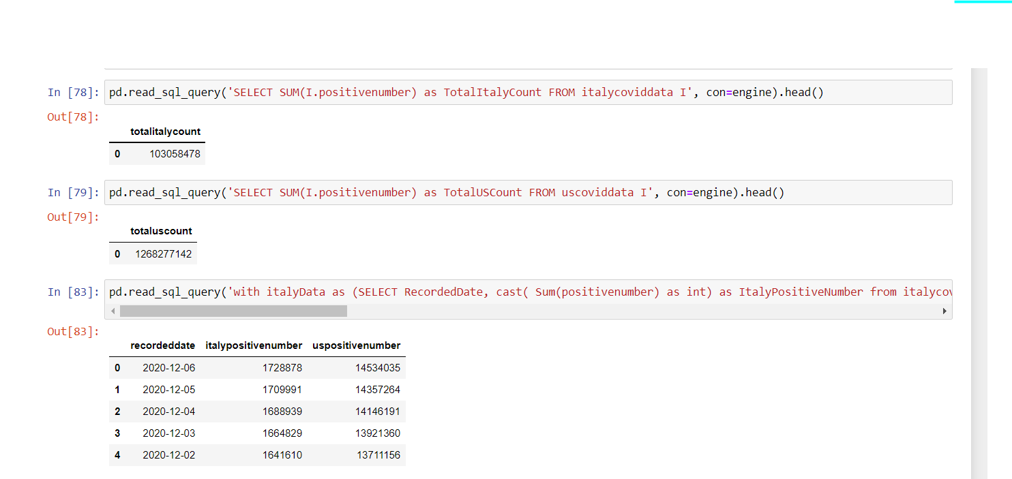
Final result: Comparing US vs Italy

