Slide 1
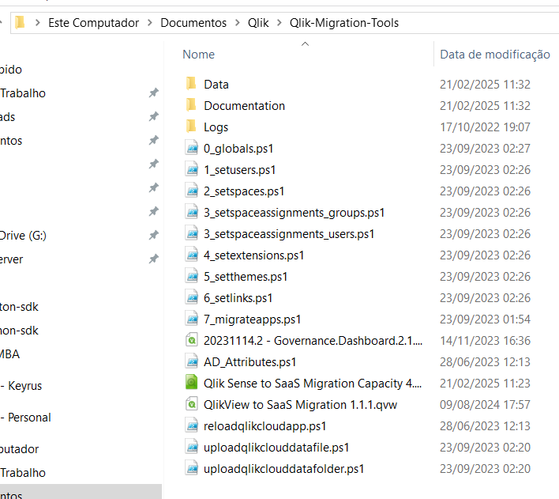
https://help.qlik.com/en-US/migration/Content/Migration/Qlik-migration-playbook.htm

Slide 2
