Slide 1
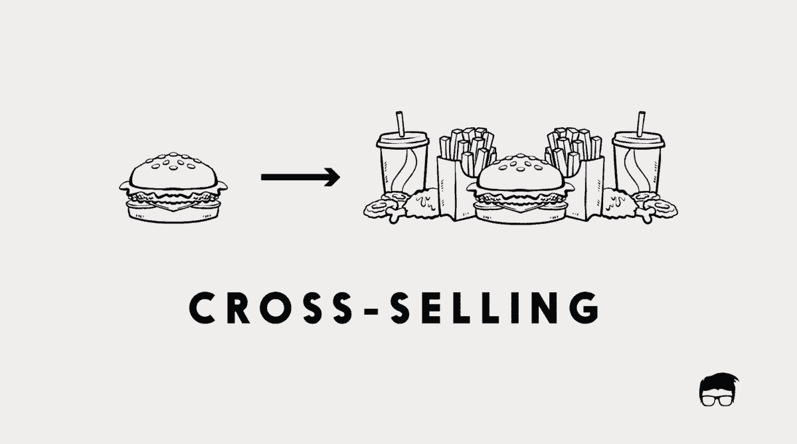

Cross selling
CO R&A
Aragon Li CW

Slide 2
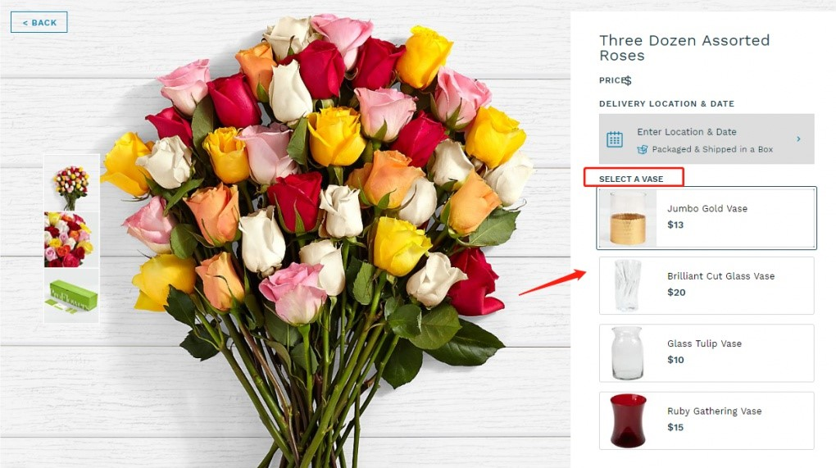
What is cross selling?
Cross-selling is the action or practice of selling among or between clients, markets, traders, etc. or the action or practice of selling an additional product or service to an existing customer.

Slide 3
Collaborative Filtering Recommendation
基于用户的(User-Based)的协同过滤算法
基于启发式
基于物品的(Item-Based)的协同过滤算法
协同过滤算法
基于模型式
基于模型的(Model-Based)的协同过滤算法

Slide 4
Item-based collaborative filtering
According to the users’ historical behavior of selecting items, recommend other items to the users through the similarity between items.
Step one: calculate the similarity between items
Step two: generate a recommendation list for users based on
similarity of items and their historical behavior

Slide 5

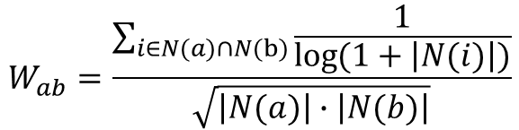
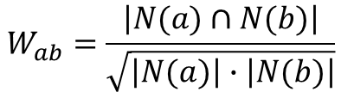
Similarity calculation between items
ItemCF并不是直接根据物品本身的特征计算相似度，而是通过分析用户的行为计算物品之间的相似度
$$W_{ab}=\frac{\left|N(a)∩N(b)\right|}{\left|N(a)\right|}$$
$$W_{ab}=\frac{\left|N(a)∩N(b)\right|}{\sqrt{\left|N(a)\right|∙\left|N(b)\right|}}$$
$$W_{ab}=\frac{\sum_{i∈N(a)∩N(b)}{\frac{1}{\log{(1+\left|N(i)\right|)}}}}{\sqrt{\left|N(a)\right|∙\left|N(b)\right|}}$$
惩罚b的权重
惩罚活跃用户
余弦相似度
余弦相似度改进
N(i)表示喜欢物品i的用户的集合

Slide 6

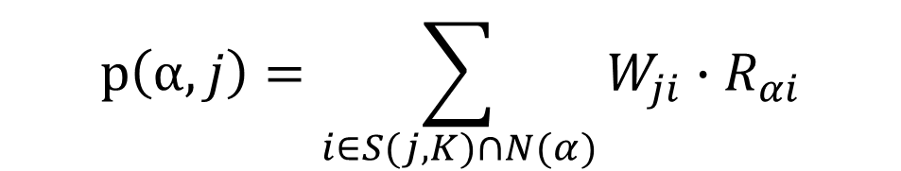




Calculation of the users’ interest in the item
$$p\left(α,j\right)=\sum_{i∈S(j,K)∩N(α)}{W_{ji}∙R_{αi}}$$
用户$α$对于物品j的兴趣程度
$N\left(α\right) 用户α$喜欢的物品的集合
$S\left(j,K\right) 与$物品j最相似的K个物品的集合
$W_{ji} 物品$j与物品i的相似度
$R_{αi}$ 用户$α$对于物品i的兴趣

Slide 7
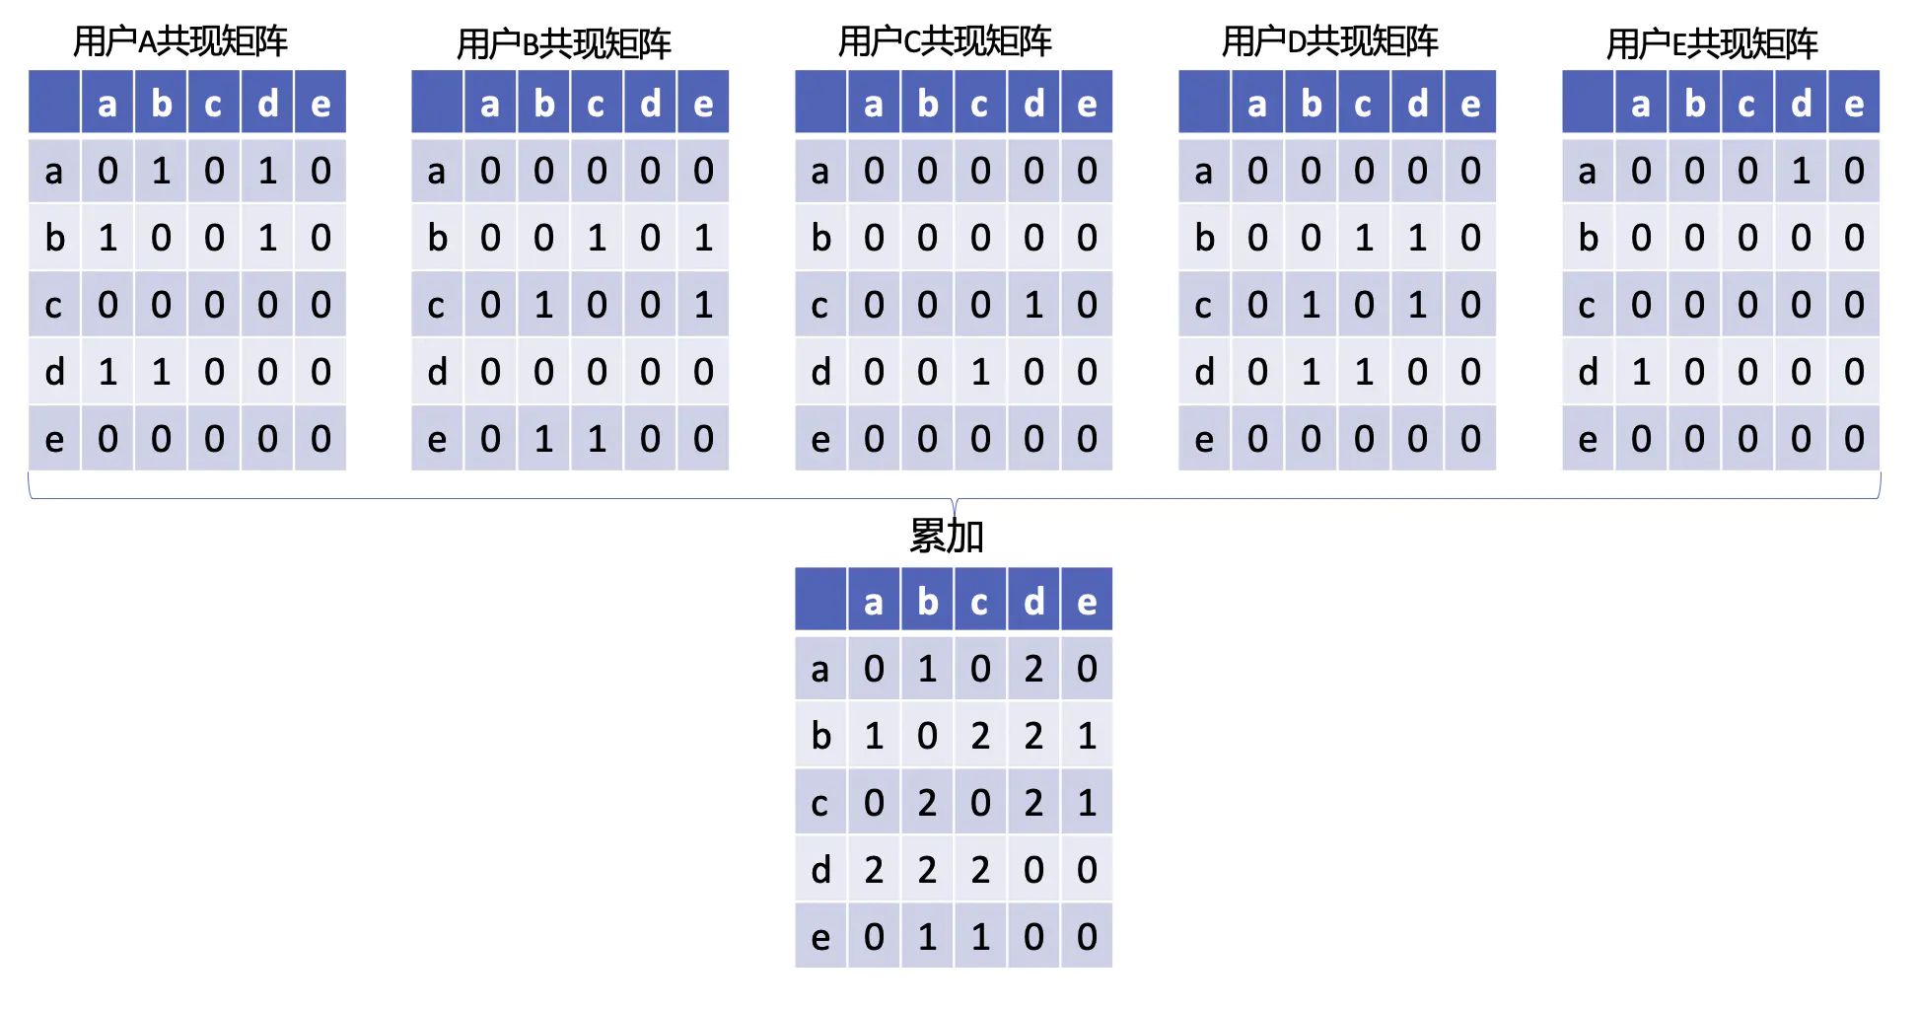

ItemCF example process
用户 | 喜欢的物品
A | {a,b,d}
B | {b,c,e}
C | {c,d}
D | {b,c,d}
E | {a,d}
Users和items的倒排表
$C_{\left[i\right]\left[j\right]}$ 同时喜欢物品i和物品j的用户数量
建立共现矩阵

Slide 8


Establish the similarity matrix
 | a | b | c | d | e
a | 0 | 1 | 0 | 2 | 0
b | 1 | 0 | 2 | 2 | 1
c | 0 | 2 | 0 | 2 | 1
d | 2 | 2 | 2 | 0 | 0
e | 0 | 1 | 1 | 0 | 0
 | a | b | c | d | e
a | 0 | 0.41 | 0 | 0.71 | 0
b | 0.41 | 0 | 0.67 | 0.58 | 0.58
c | 0 | 0.67 | 0 | 0.58 | 0.58
d | 0.71 | 0.58 | 0.67 | 0 | 0
e | 0 | 0.58 | 0.58 | 0 | 0
$$W_{ab}=\frac{C_{\left[a\right]\left[b\right]}}{\sqrt{\left|N(a)\right|∙\left|N(b)\right|}}=\frac{1}{\sqrt{2∗3}}≈0.41$$
$$W_{ad}=\frac{C_{\left[a\right]\left[d\right]}}{\sqrt{\left|N(a)\right|∙\left|N(d)\right|}}=\frac{2}{\sqrt{2∗4}}≈0.71$$
…
共现矩阵
相似度矩阵

Slide 9


Example: form user C’s recommendation list
用户 | 喜欢的物品
C | {c,d}
 | a | b | c | d | e
a | 0 | 0.41 | 0 | 0.71 | 0
b | 0.41 | 0 | 0.67 | 0.58 | 0.58
c | 0 | 0.67 | 0 | 0.58 | 0.58
d | 0.71 | 0.58 | 0.67 | 0 | 0
e | 0 | 0.58 | 0.58 | 0 | 0
$$p\left(C,a\right)=W_{ca}+W_{da}=0.71$$
$$p\left(C,b\right)=W_{cb}+W_{db}=0.67+0.58=1.25$$
$$p\left(C,e\right)=W_{ce}+W_{de}=0.58$$
Recommendation list {b:1.25, a:0.71, e:0.58}

Slide 10
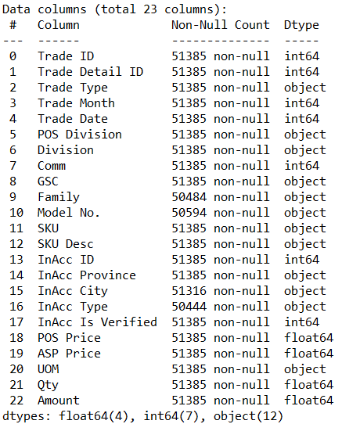
Application
POS – 2020 - EMD
Feature used in the dataset(Comm, GSC, SKU Desc, InAcc ID, Amount)

Slide 11
Confirm target Item
Feature used in the dataset(Comm, GSC, SKU Desc, InAcc ID, Amount)
InAcc ID | 3720
Features can be selected as target Item(Comm, GSC, SKU Desc, the result of SKU Desc after clustering)
Feature | Data size
Comm | 8
GSC | 65
SKU Desc | 705

Slide 12
Compare the effects of classification
BQD - DIELECTRIC AND COSMETIC FILM
EPE D300 白色复合膜980 MM × 103 M
EPE D300 白色复合膜尺寸：620 MM × 80 MM（小片）
EPE D500X 白色复合膜
EPE9131 白色复合膜980MM X 103M
高效抗紫外复合膜D300980MM*103M
EPE D500X 白色复合膜
导光膜LRF-1.2MM1.2MM
EPE D300 白色复合膜980 MM × 103 M
EPE9131 白色复合膜980MM X 103M
EPE D300 白色复合膜尺寸：620 MM × 80 MM（小片）
3M风能保护胶带W8750尺寸：254mm x 21m
GSC本身分类效果
Kmeans聚类效果

Slide 13


BASKET ANALYSIS
Two baskets
FJF - QSIII & QS-2000 SPLICES and FJL - QTII,RUBBER, PORCELAIN TERMI | 9.1667%
FJF - QSIII & QS-2000 SPLICES and FJM - QTIII RUBBER TERMINATIONS | 8.6559%
FJL - QTII,RUBBER, PORCELAIN TERMI and FJM - QTIII RUBBER TERMINATIONS | 6.129%
$$P\left(a,b\right)=\frac{\left|N(a)∩N(b)\right|}{N}$$
Three baskets
$$P\left(a,b,c\right)=\frac{\left|N(a)∩N(b)∩N(c)\right|}{N}$$
FJF - QSIII & QS-2000 SPLICES and FJM - QTIII RUBBER TERMINATIONS and FJL - QTII,RUBBER, PORCELAIN TERMI 3.978%

Slide 14
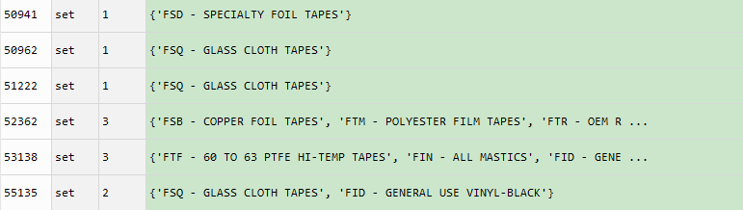
Establish the inverted list of User-Item
InAcc ID
GSC

Slide 15
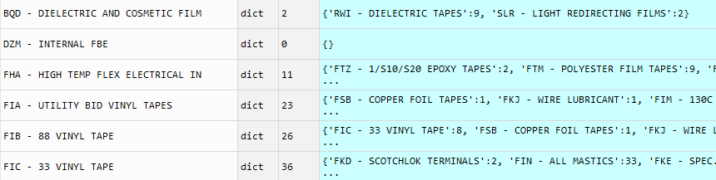
Establish the co-occurrence matrix of Item-Item
GSC
GSC
establish
traversal

Slide 16
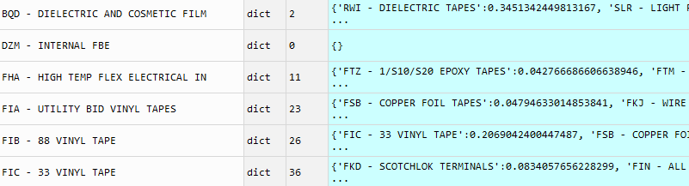
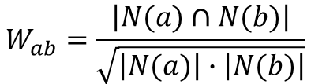
Establish the similarity matrix of GSC
GSC
GSC
$$W_{ab}=\frac{\left|N(a)∩N(b)\right|}{\sqrt{\left|N(a)\right|∙\left|N(b)\right|}}$$

Slide 17
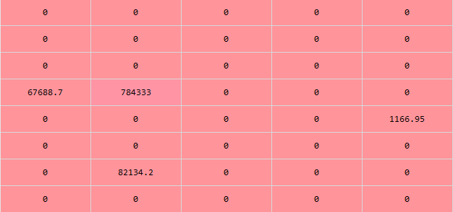
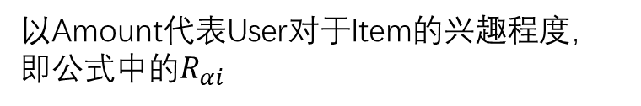

Establish the Interest level
$$p\left(α,j\right)=\sum_{i∈S(j,K)∩N(α)}{W_{ji}∙R_{αi}}$$
以Amount代表User对于Item的兴趣程度，即公式中的$R_{αi}$
Amount
InAcc ID

Slide 18
Form recommendation lists and organize data
InAcc ID | 2020 total amount | GSC Top3 | GSC Top3 pct | GSC Recommendation Top3
71488 | 33,750,937 | FIQ - TAPE TERM/SPLICING KITS,FIL - 23 RUBBER TAPE,FIR - 13 SEMI-CONDUCTING TAPE | 0.932540775 | ('FIC - 33 VINYL TAPE', 3193839.64) ('FIN - ALL MASTICS', 3020771.33) ('FIE - 35 VINYL TAPE', 2355333.08)
215051 | 13,308,399 | SLR - LIGHT REDIRECTING FILMS,FJM - QTIII RUBBER TERMINATIONS | 1 | ('RWI - DIELECTRIC TAPES', 1976106.74) ('BQD - DIELECTRIC AND COSMETIC FILM', 1717685.31) ('FJF - QSIII & QS-2000 SPLICES', 1554.76)
156337 | 10,636,447 | FTM - POLYESTER FILM TAPES | 1 | ('FTB - COMPOSITE, ACETATE & PAPER', 4480055.58) ('FTU - 92/1205 & OTH HI-TEMP', 3383480.23) ('FTZ - 1/S10/S20 EPOXY TAPES', 3277799.61)

Slide 19
Thanks for listening

