Slide 1
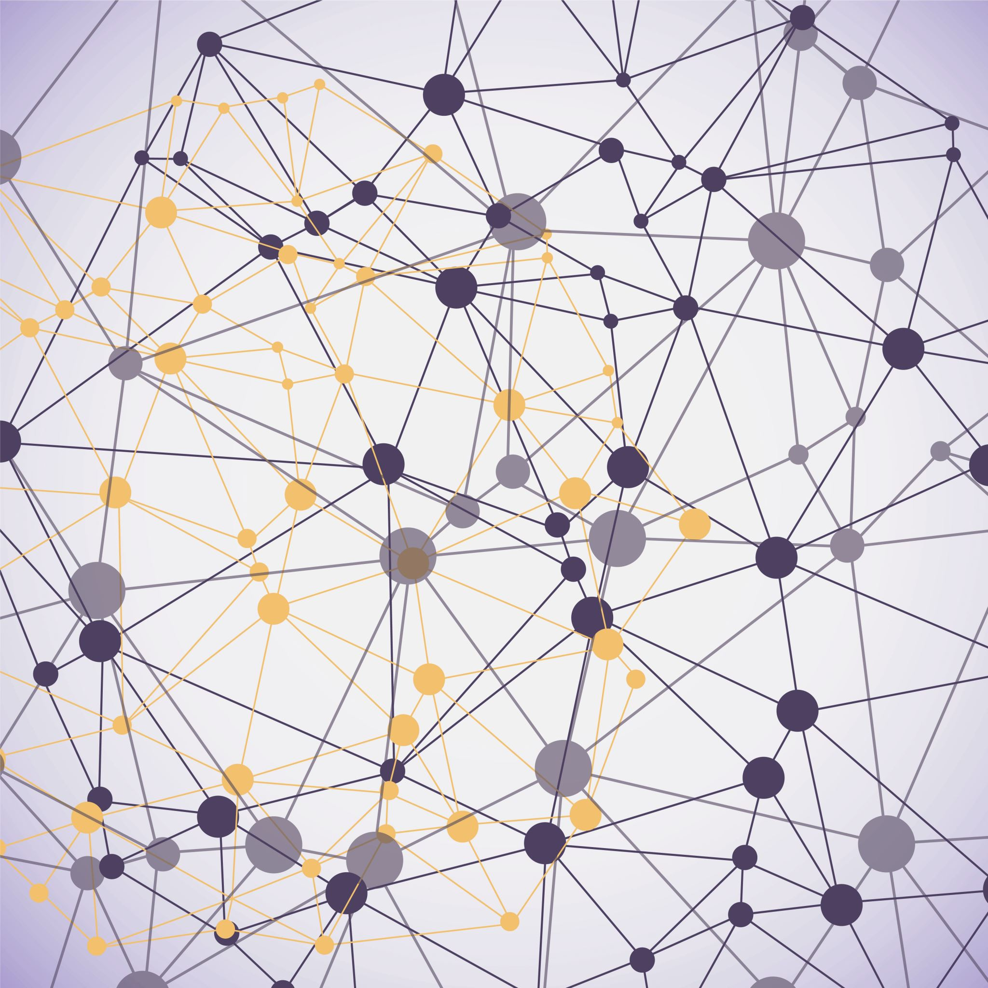
Metadata and Digital Collections
Jessica Bright (she/her)
Digital Collections & Metadata Librarian
jbright1@brynmawr.edu

Slide 2
What are we talking about today?
What is metadata?
Standards that make up metadata (structure, value, content, and format standards)
Where things like Dublin Core and Library of Congress Subject Headings fit in
How is an online archival collection organized?
How do you navigate an online archival collection?
What to do if pieces of metadata are missing

Slide 3
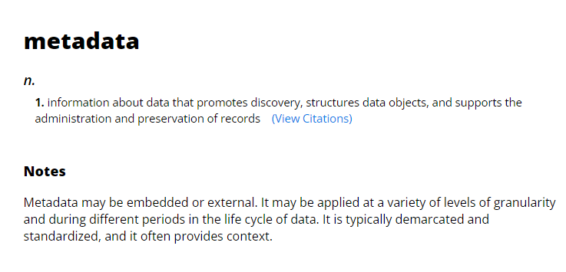
What is metadata?
Metadata is most simply data about data
To be most useful, metadata is structured information
Society of American Archivists, Dictionary of Archives Terminology https://dictionary.archivists.org/entry/metadata.html

Slide 4
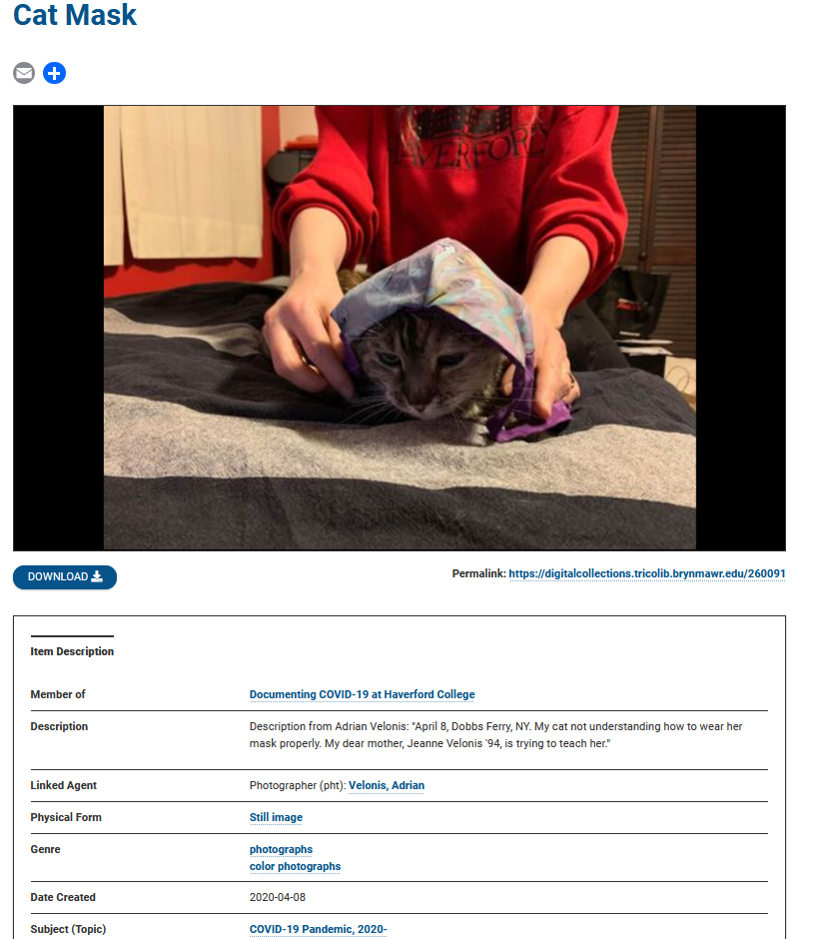
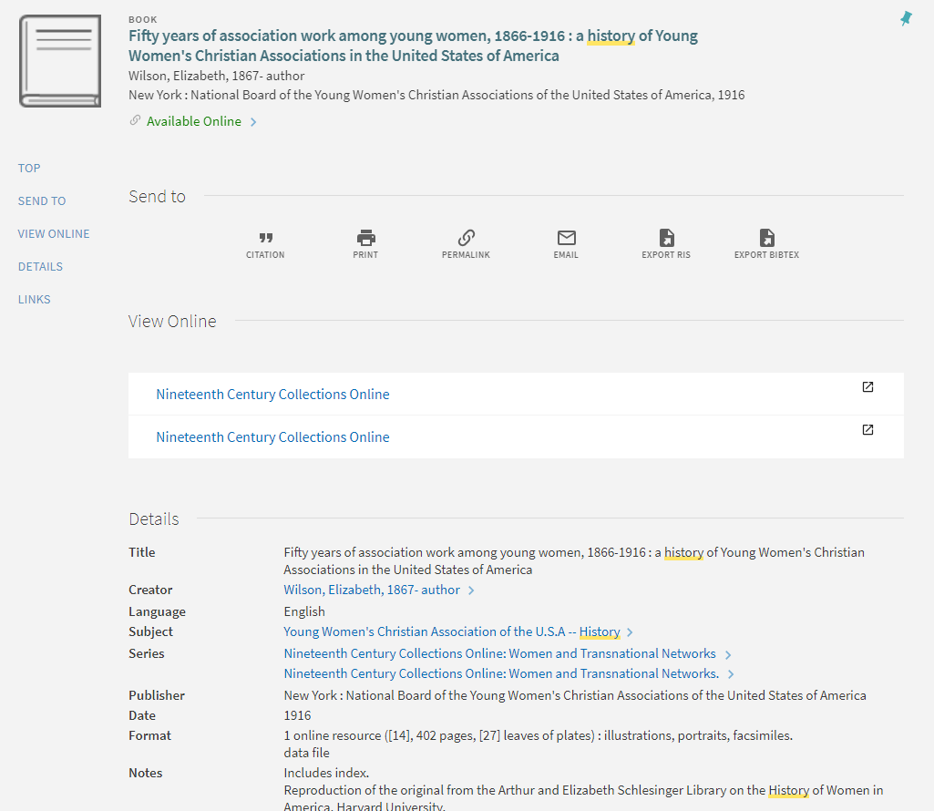
What does metadata look like?
Tripod library catalog book record
https://tripod.brynmawr.edu/permalink/01TRI_INST/1ijd0uu/alma991019256706004921
Digital Collections image record https://digitalcollections.tricolib.brynmawr.edu/260091

Slide 5
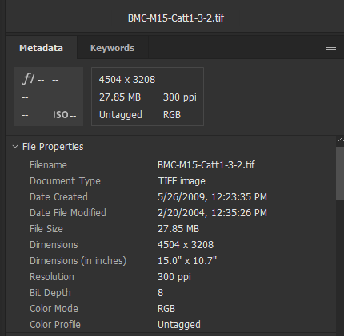
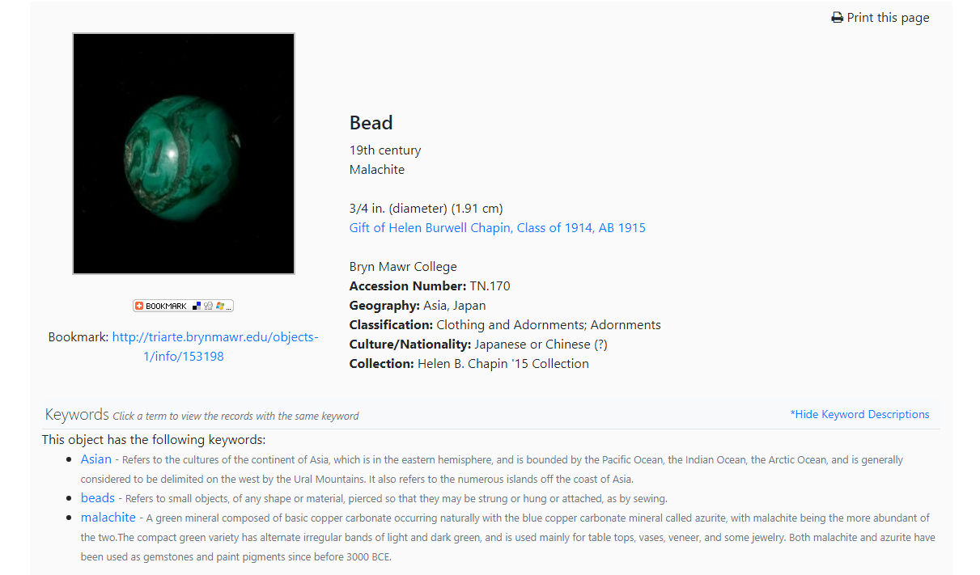
What does metadata look like?
Embedded technical metadata in Adobe Bridge for a digital image
Metadata record from TriArte http://triarte.brynmawr.edu/objects-1/info/153198

Slide 6
Why is metadata important?
“Certifies the authenticity and degree of completeness of the content”
Was the entire letter digitized and who is the creator?
“Establishes and documents the context of the content”
Provenance information, who/how was it acquired?
What collection is it from?
“Identifies and exploits the structural relationships that exist within and between information objects”
Filenames/identifiers can track the page numbers of a digitized book
“Provides a range of intellectual access points for an increasingly diverse range of users”
Different search terms like subject headings, descriptions, creator, and general keywords are available in a robust metadata record
Baca, Murtha, ed. Introduction to Metadata: Setting the Stage 3rd ed. Los Angeles: Getty Publications, 2016. http://www.getty.edu/publications/intrometadata

Slide 7
What does this really mean?
Searching!
Structured data allows us to query information in a (human and machine) predictable way
This allows us to search more effectively and efficiently
Example: Think of how difficult it is to search on Instagram for things that aren’t an account or place name and don’t fit neatly into a hashtag.

Slide 8
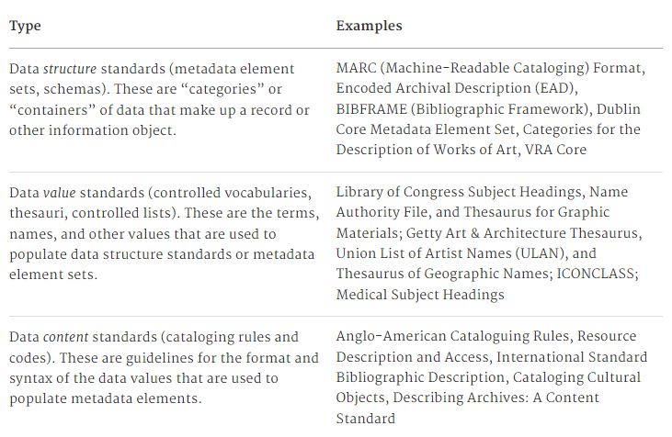


What makes up metadata?
Baca, Murtha, ed. Introduction to Metadata: Setting the Stage 3rd ed. Los Angeles: Getty Publications, 2016. http://www.getty.edu/publications/intrometadata

Slide 9
Pause and consider
Of the different types of standards, which seem the most accessible/inaccessible?
What kinds of guidelines would you anticipate seeing in a content standard that governs how you format data?
Date encoding
Name structures (direct order, inverse, etc.)

Slide 10
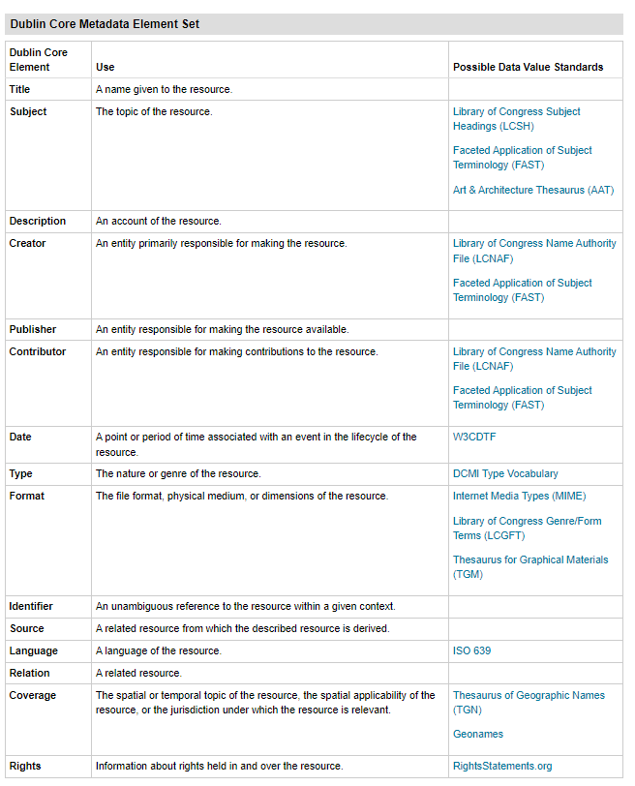
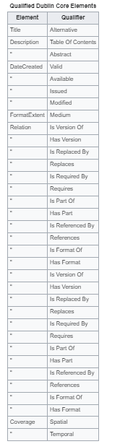
Dublin Core
Originally created to describe web resources
Designed in 1998 in Dublin, Ohio
It is a basic element set with 15 terms, each are optional and repeatable
Qualified Dublin Core expanded these 15 terms
https://guides.library.ucsc.edu/c.php?g=618773&p=4306386#:~:text=Originally%20developed%20to%20describe%20web,for%20greater%20specificity%20and%20granularity.
https://en.wikipedia.org/wiki/Dublin_Core

Slide 11
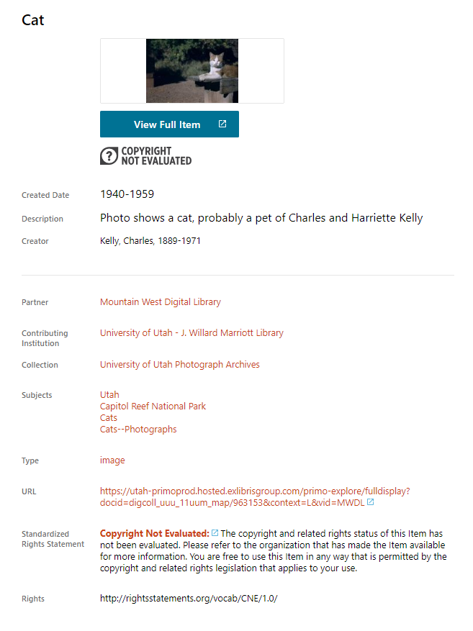
Example of a DC type record from DPLA
This isn’t exactly DC, but it is based on DC
The beauty of standardization is that you can aggregate mass amounts of data for searching
Many libraries digitize their materials and DPLA will harvest their metadata records for greater visibility
Libraries can use different metadata schemas and then map the elements to Dublin Core, which is more basic and flexible
End users then search on DPLA and find more materials than just searching their local institution
https://dp.la/item/3f1ac38f0baeaa66d3c57e5dbb633b8f?q=cat&page=2

Slide 12
LCSH and LCNAF
LCSH = Library of Congress Subject Headings
LCNAF= Library of Congress Name Authority File
Controlled vocabularies of subject headings and names maintained by the US Library of Congress for use in bibliographic records
Since they’re so robust, many libraries use them for cataloging books, describing digital collection materials, and more
They’re controlled by LC, so they are not perfect, but they help with standardization and searching

Slide 13
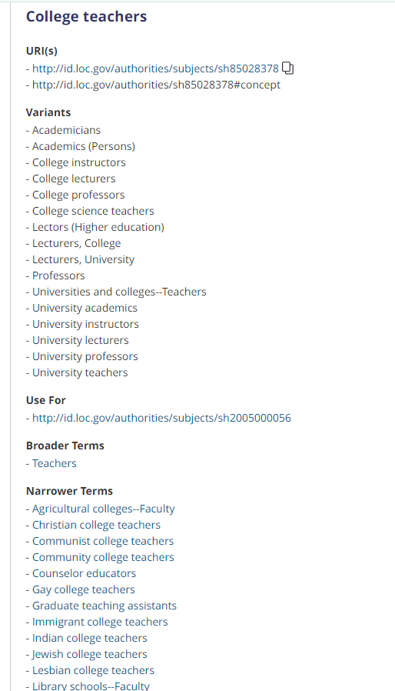
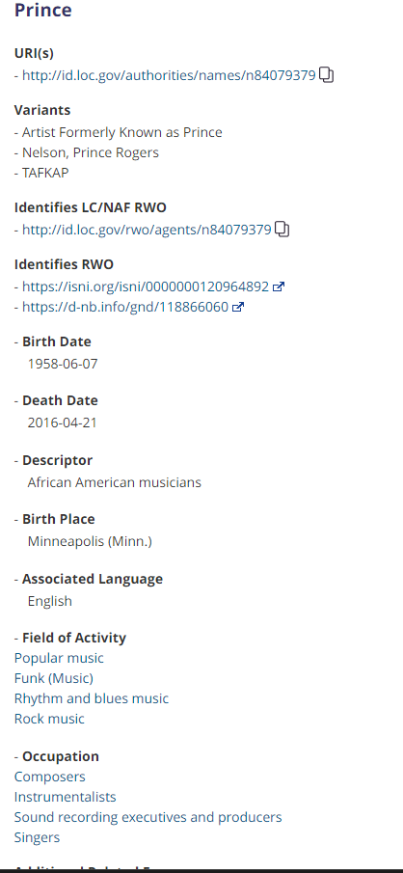
LCSH
LCNAF
https://id.loc.gov/authorities/subjects/sh85028378.html
https://id.loc.gov/authorities/names/n84079379.html

Slide 14
How collections are organized physically/digitally
Collections can be organized in a number of ways, but generally you will always see a link between the physical and digital
Generally, this refers to the filename/identifier linking back to where the item came from within the collection
E.g. filename: BMC-M124_b2f02
BMC, Manuscript Collection 124, box 2, folder 2
When you have a digital collection, there is no one perfect way to organize things because you don’t know how people are coming in and searching your site
They can sort it and organize it themselves in any number of ways

Slide 15
How to navigate a collection
https://digitalcollections.tricolib.brynmawr.edu/collections/college-women
https://digitalcollections.tricolib.brynmawr.edu/collections/her-own-right
https://digitalcollections.tricolib.brynmawr.edu/collections/1918-pandemic-bryn-mawr-college?items_per_page=50
https://digitalcollections.tricolib.brynmawr.edu/collections/summer-school-women-workers-industry
Facets/filters are your friend
Visual review
Keyword search is most helpful

Slide 16
What to do if metadata is missing?
Oftentimes there are missing pieces of metadata. You might not know:
Who is in the photo (description) or who took it (creator)
The year a digitized photographic print was originally taken (date)
This doesn’t necessarily mean that you can’t use the material! (You do need to have the required permissions to use it).
Note in the metadata any unknown information (in a standard way, so you can retrieve it via search)
Crowdsourcing, especially with community-based projects, can be a powerful way to solve some of these unknowns.

Slide 17
Wrap-up
Metadata can seem confusing, but we all use and interact with metadata more than you might think
Standardization and clarity is key!
There are lots of helpful resources out there to help create metadata

Slide 18
Any questions?
Please feel free to reach out!
Jessica Bright (she/her)
Digital Collections and Metadata Librarian
Special Collections, Canaday Library 2nd Floor
jbright1@brynmawr.edu

