Slide 1
Using your Bugs to prevent Bugs and Fund Technical Debt Fixes
Arlo Belshee, Principal Technical & Leadership Coach @ArloBelshee @DigDeepRoots

Slide 2
Reality
Bugs aren’t random …
AND
… they are preventable.
Notes:
Story: formatting team had lots of bugs. May related to inconsistencies – code & UI - between teams.
Cross team pairing reduced bugs by about 50%

Slide 3
Our Pain
We need to fund tech debt. with agreement
We need deterministic ROI.
Notes:
Tell story: ratio of desired spend, by role

Slide 4
What do I do?
Safeguarding™

Slide 5


Why Safeguarding™ ?
Team: Get funding to fix the problems - with support!
Exec: Get to optimize ROI even with uncertainty.

Slide 6
This Won’t Hurt
You are already doing agile.
No need to reinvent your framework.

Slide 7
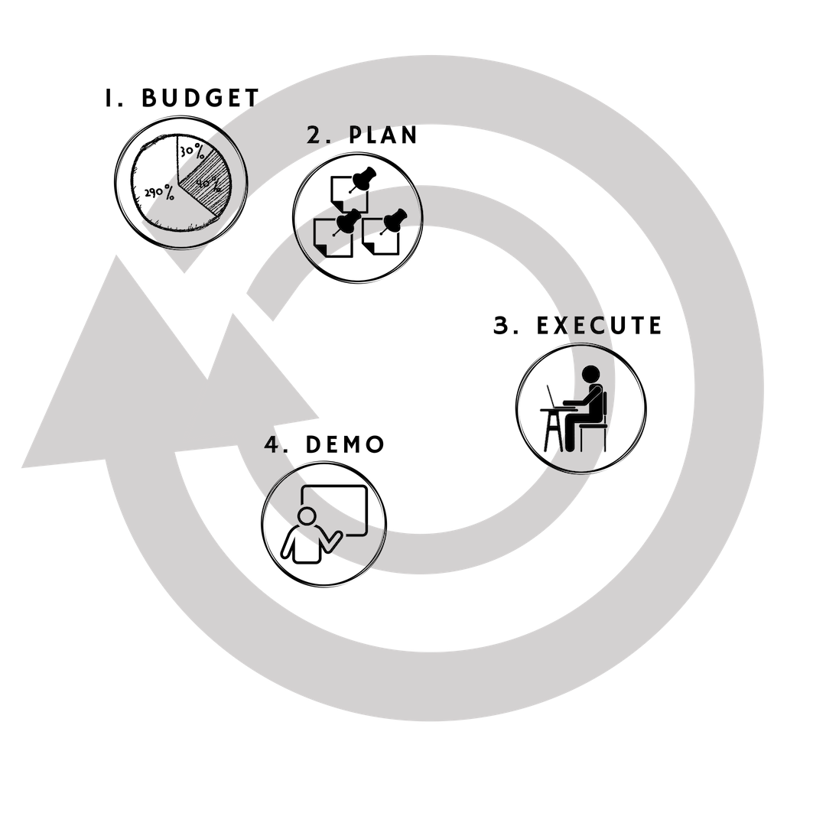
Notes:
Regardless of the framework, there is always a budget step, a planning step, an execute step, and a demo step.

Slide 8




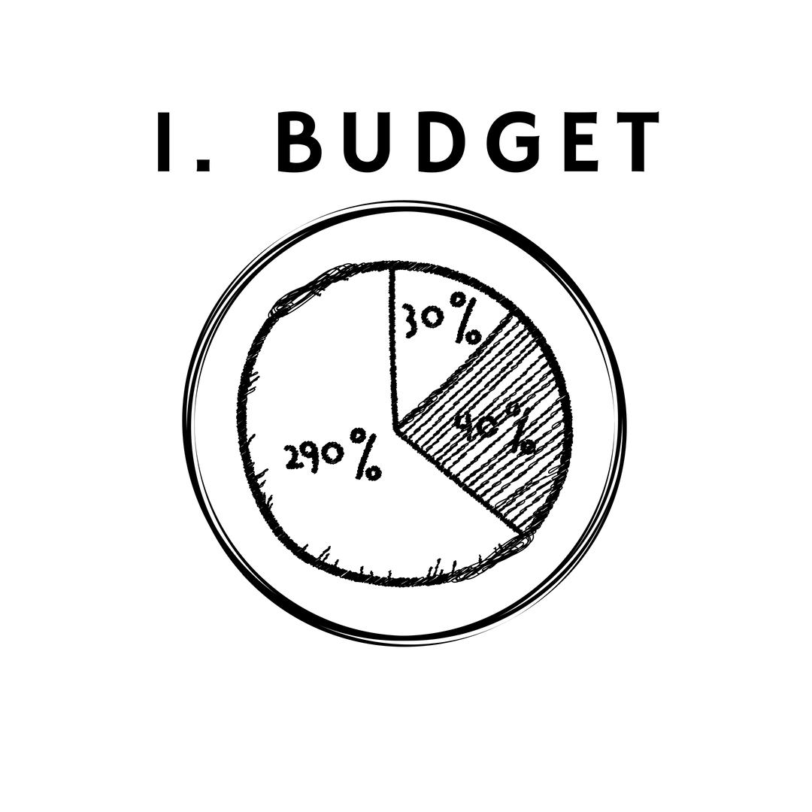
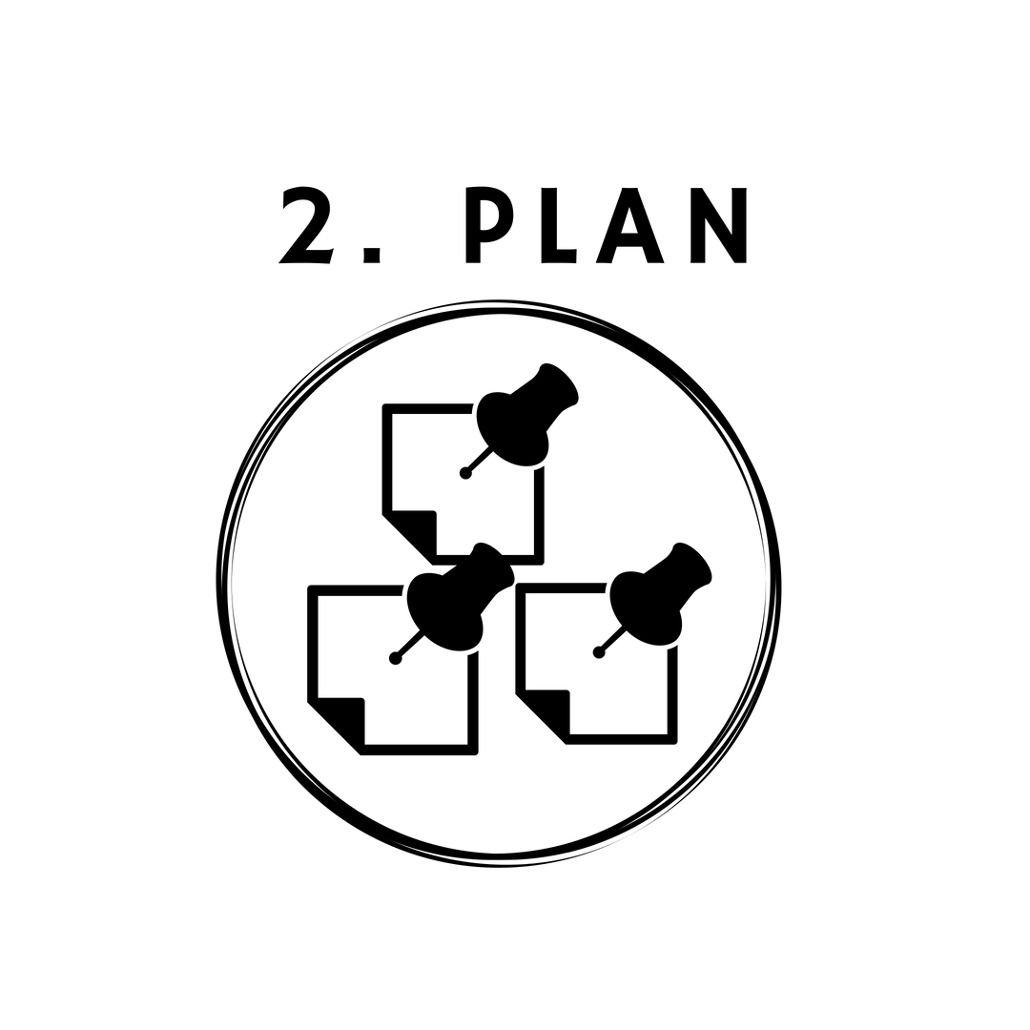
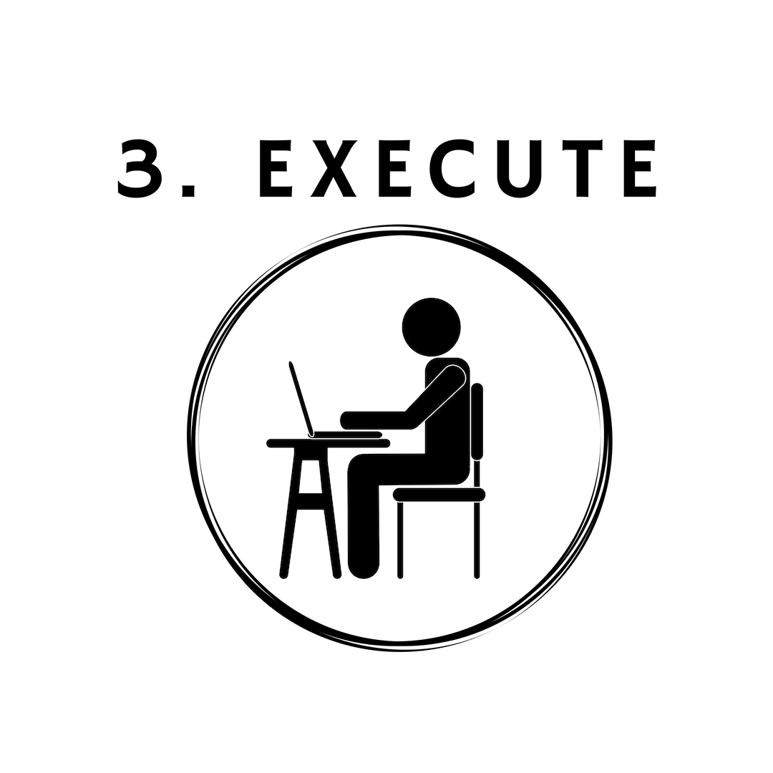
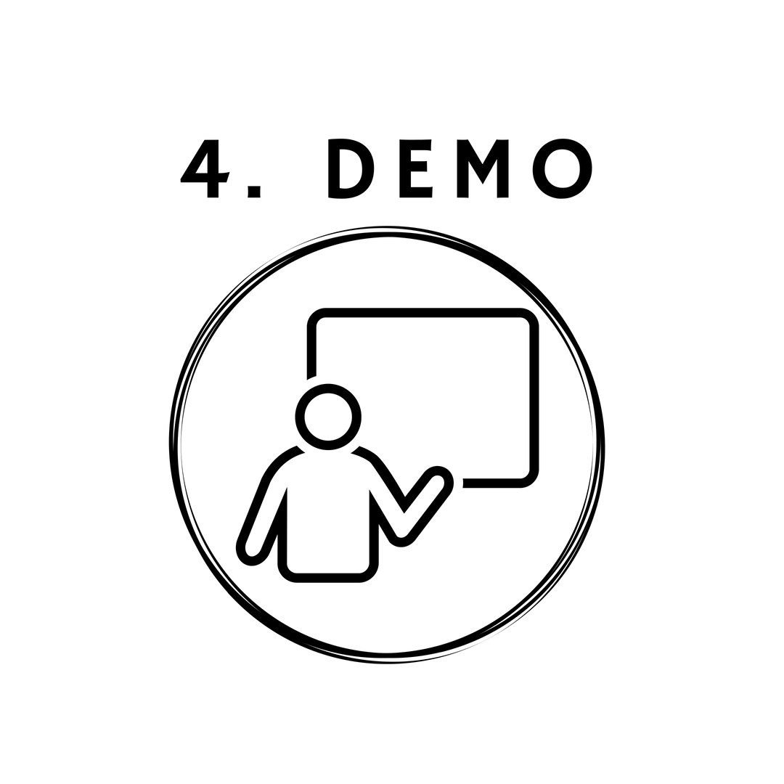
PI Planning | Quarterly Budgeting | Requirement Areas | [Budget from Customer]
Sprint Planning | Sprint Planning | Sprint Planning | Planning Game
Sprint | Sprint | Sprint | Iteration
Sprint Review | Sprint Review | Sprint Review | AB Testing
Notes:
And these four steps apply whether you’re practicing Scrum, XP, SAFe, LeSS

Slide 9

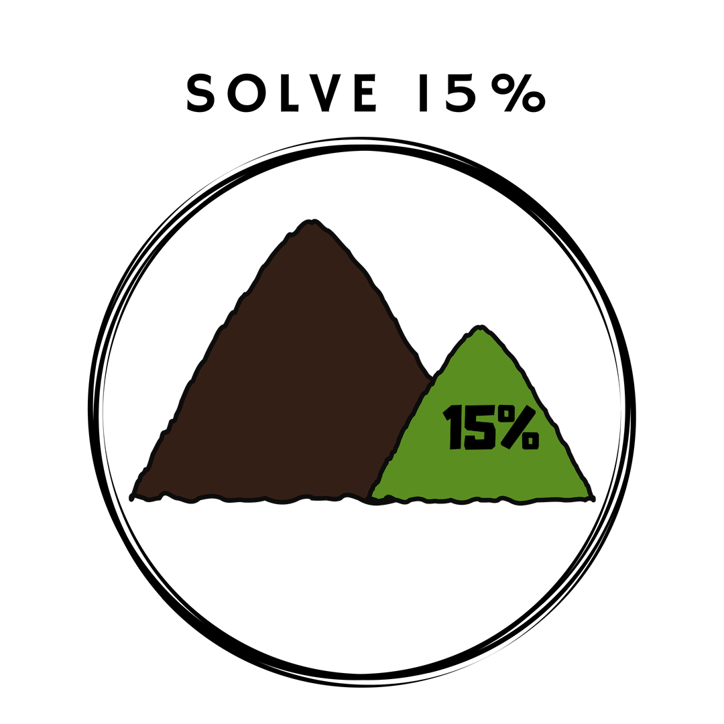



Notes:
Budget, Execute, and Demo each have one simple action to additionally do in order to safeguard successfully.

Slide 10



Notes:
Planning, however, is where our mind and behavioural shift really occurs. So we will start with what happens in planning, and then you will easily see the value of the single extra action in the other 3 steps you already have well practiced.

Slide 11

Planning Step
Where the real shift happens!

Slide 12
Hazards Exercise
Remember the last bug you wrote
Use the Hazards Exercise sheet on your table
Based on your bug, build a question and answer tree under each question
Our biggest mind shift …
… turning expenses into investment by taking a single bug fix and preventing a category of future bugs.

Slide 13

Hazard Exercise Debrief
Who identified a person who made a mistake?
Who feels that person made the mistake as a legitimate choice?

Slide 14

Hazard Exercise Debrief
That legitimate choice is a result of the system around them.
Who explored that?

Slide 15
Hazards repeat…
…except when they don’t.
Notes:
All of you had different bugs, yet group collaboration worked without knowing the detail of each bug. You found some hazards that were unique to a particular bug, and others that showed up repeatedly.
In the same way, you will find that taking it one bug at a time in the workplace will become a similar pattern. This allows you to not worry about which hazards are worst – just fix some for each bug, and you will tend to get the repeating ones more often.

Slide 16
Parallel Writing Exercise
Remember the last bug you were a part of that impacted multiple teams
Use the Parallel Writing sheet on your table
Based on your bug, build a question and answer tree under each question without speaking
Work on all 3 questions at once
Our first behavioural shift …
… getting all the voices represented effectively and ideas explored in parallel.
Just like the Hazards exercise, but silently.

Slide 17
Parallel Writing Exercise Debrief
With the silent mode, who saw more ideas being explored at once?
Which ones of you felt you contributed more? Which ones of you felt you contributed less?

Slide 18
Parallel Writing Exercise Debrief
Speaking makes conversation linear, and that’s fragile.
For those who felt they contributed LESS, please share how it felt.
For those who felt they contributed MORE, please share how it felt.

Slide 19
15% Solution Exercise
Pick just one hazard you experienced that is a spooky action at a distance
Use the 15% Solution Exercise sheet on your table
Based on your selected hazard, build a tree under each question
Select some solutions you would put into the current Sprint.
Another important mind shift …
… making many small bets to accumulate returns on the most important things.
NO BIG, BOLD BETS!

Slide 20
15% Solution Exercise Debrief
Did you have multiple solutions?
Did you choose partial progress on each of those solutions?

Slide 21
15% Solution Exercise Debrief
It’s better to make partial progress in many directions and leave work undone.
How would you make that work?

Slide 22
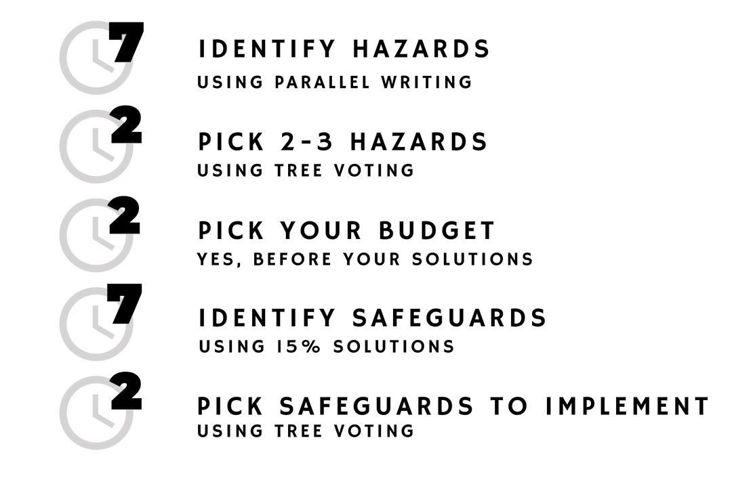
Agenda Exercise
Consider the common hazards you’ll experience getting the agenda to stick
Write on post-it notes ways you would safeguard against the highest threat hazards
Place those post-it notes on the flip chart station for the relevant hazard
Our biggest dread …
… the meeting.

Slide 23







Agenda Hazards

Slide 24
Agenda Exercise Debrief
The rigidity of this structure saves an hour or more of meeting… …each time.
Who saw an idea that would unlock their ability to implement this practice?

Slide 25


Slide 26
Budgeting Step
Get permission to do the Right Thing

Slide 27
Budgeting Strategies
This is where we allocate a spending pool during the quarter so that when bugs are identified, they can invest in preventing that category of future bugs.
Overall: A ratio
1/3 on Safeguarding™
2/3 on prod dev
Per-incident: Classify
Categorize by impact: small, medium, or large.
Small = ½ pair-day
Medium = 2 pair-days
Large = ½ pair-sprint

Slide 28
Budgeting Exercise
Discuss quarterly and per-incident budgets
What are reasons at your company that the budgets should be larger or smaller?

Slide 29
Executing Step
Keep on chunking!

Slide 30
Executing Strategies
We now do the 15% solution … this represents the mind shift of doing only what was planned rather than continuing to improve.
Timeboxing
Use it
Commit
Make it safe
Early and Often
Make it safe to abandon WIP!
Notes:
[Show Jay’s commit graph?]

Slide 31
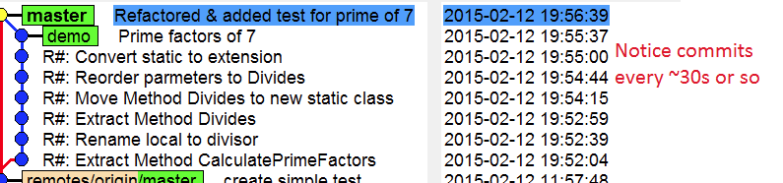

Slide 32
Demo Step
Show that ROI!

Slide 33
Demo Strategies
This is where we show ROI by describing the investment and the return in terms that the business cares about.
Quantify Hazard
Show the hazard as a risk
Show how you changed that
Align to Big Picture
Remind everybody that this is a small bet, designed to accumulate over time.
If possible, tie with previous investments that have already been done
Notes:
[also: demo that have completed some value & not started more – can do with next bug if important]

Slide 34
Remember Our Pain…
Cost NOW each instance has a small cost (and we agree to spend it)
Return NOW we have made return deterministic by accumulating many small bets. No BIG bets.

Slide 35
Specific Actions
Apply one practice …such as parallel writing or solving 15%
Take our self-assessment …a diagnostic of which specific pains your team has most – and which practices to start with.
http://www.DigDeepRoots.com/Safeguarding/

Slide 36
Remember Why…
Big change at once is very hard. First fix what hurts.
The diagnostic will help you find what is specifically hard for your team.

Slide 37
After all, you’re doing Agile. Now you can do it well and iteratively.

