Slide 1
Code by Refactoring
Habit Catalog

Slide 2

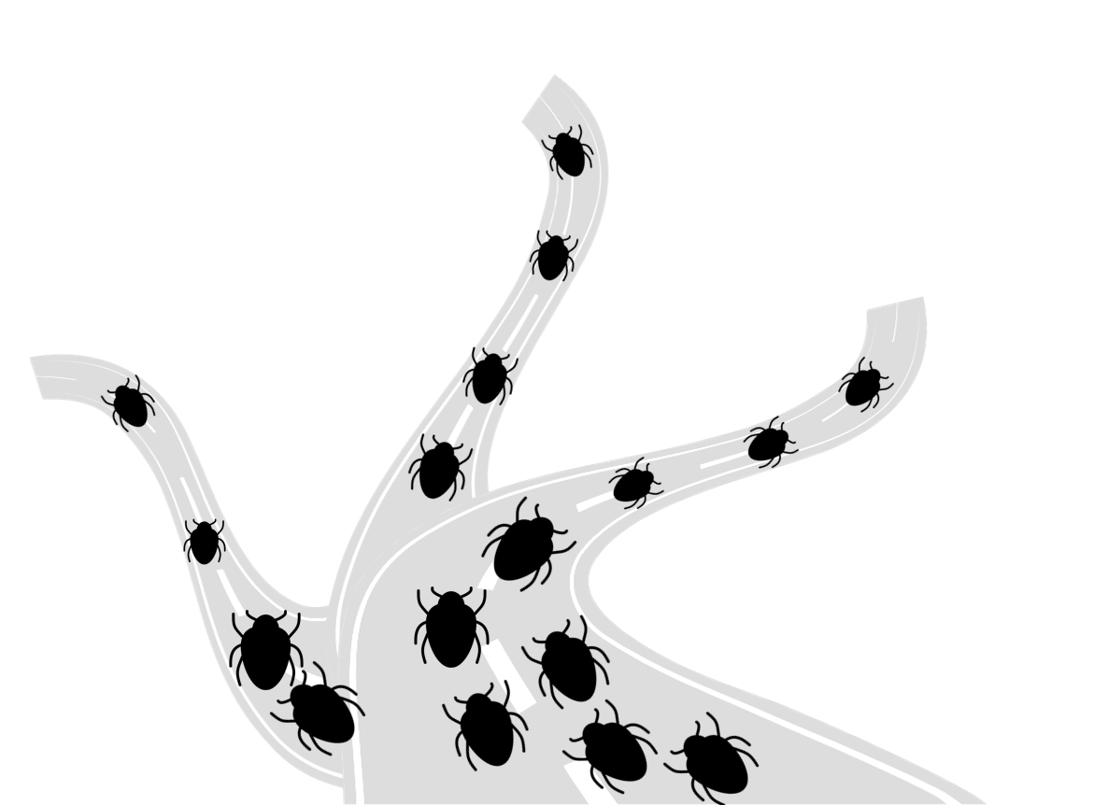

Choose your Pathway
The Insight Loop
The Foundation to All Pathways
Improving Quality
Rewriting Legacy Systems
Shipping Faster (CD)

Slide 3
Change Series:
The Insight Loop
Return on Investment
This change series will decrease time spent on reading code, increase the safety in changing code, and reduce the most common sources of future bugs.
Habit: Structured Editing
Code changes become easier, less bug-prone, and less vulnerable to interruption
Habit: Disciplined Refactoring
Reduces cost and increases safety for any story that touches existing code

Slide 4
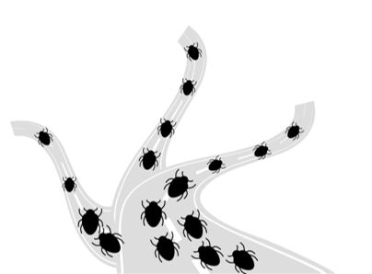
Improving Quality
Bugs are hurting your entire organization, but they are hurting each part differently. While bugs are preventable, the solution is different for each team.
Quality Issue Habits

Slide 5
Improving Quality
There are change series to prevent each of the common bug categories. Each change series contains several habits that individually address one hazard and together prevent that bug category. The Hazard Thinking change series extends your team’s thinking to address whatever additional bug categories they see.
Prevent Code Misunderstanding Bugs
Prevent Duplication Bugs
Prevent Non-local Interaction Bugs
Test Untestable Code
Hazard Thinking

Slide 6
RETURN
Change Series:
Prevent Code Misunderstanding Bugs
Return on Investment
Difficult-to-understand code is the #1 leading reason that developers write bugs. This change series prevents those bugs by making code easy to understand without making stories take longer.
Habit: Naming is Easy
Habit: Read Fragmented Code
Prevent bugs that happen when code is difficult to understand.
Apply Insight Loop change series from fragmented code.
Habit: Naming is a Process
Habit: Power Combos
Eliminate the story cost you spend working around bad design.
Make arbitrary design changes in a disciplined way without bugs.

Slide 7
RETURN
Change Series:
Prevent Duplication Bugs
Return on Investment
Duplicated code is one of the leading reasons that developers write bugs. This change series prevents those bugs by fixing the existing duplication without making stories take longer.
Habit: Explicit Data
Habit: Relaxing into Whole Values
Prevent bugs due to hidden data dependencies.
Reduce bugs that arise from duplication in complex methods.
Habit: Primitive Whole Values
Habit: Pulling from God Classes
Reduce bugs due to miscommunication between developers and Product Owners.
Reduce bugs that arise from multiple pieces of code sharing a God class.
Habit: Make Whole Values Smart
Reduce bugs that arise to simple duplicate code.

Slide 8
RETURN
Change Series:
Prevent Non-local Interaction Bugs
Return on Investment
Non-local interactions cause few bugs, but those bugs are particularly hard to find and fix. This change series prevents those bugs by eliminating existing non-local interactions without making stories take longer.
Habit: Breaking God Dependencies
Habit: Extract One Purpose from God
Prevent bugs due to do data sharing between remote parts of the code.
Prevent bugs due to do data sharing between adjacent parts of the code.
Habit: Eliminate Utility Classes
Habit: Make Methods Simple
Prevent bugs from code that is operating on wrong or inconsistent data.
Prevent bugs that come from unexpected interactions within a single method.
Habit: Untying the Knots
Apply unique techniques that disentangle the less common coupling issues.

Slide 9
RETURN
Change Series:
Test Untestable Code
Return on Investment
This change series allows you to make untestable code become easy to test. This will not prevent any bugs, but it will speed up release validation, find bugs earlier, and reduce the cost of sharing code between teams.
Habit: Decoupling & Micro-Testing
Habit: Readable Tests
Tests speed up, have fewer false positives, and cover more of the code.
Communication between developers and product owners become easier.
Habit: Stop Testing Internals
Habit: No More Mocking
Tests tell you where you will pay costs on future stories.
Tests tell you where stories will cause non-local interaction bugs.

Slide 10
RETURN
Hazard Thinking
Return on Investment
90% of a team’s bugs are addressed by the other change series. The other 10% are different for every team. This change series teaches a team how to identify and fix whatever causes their other 10%.
Engage with all stakeholders for how each role contributes to safeguarding the code.
Safeguarding Your Code

Slide 11
Rewriting Legacy Systems
Copying the system will not be easy. Even harder will be copying the bunny while leaving the cancer behind.
Legacy Systems Habits

Slide 12
Rewriting Legacy Systems
These change series take you through the safest and fastest way to replace a legacy system: by using a crossover system during transition. The first change series creates the crossover system and makes it easy to cleanly share code between old and new systems. Each of the others addresses one common design flaw, showing how to migrate the functionality without the flaw.
1. Set Your System Up Right
Ship from a crossover system
2. Address Your System’s Specific Needs
Select habits based on your code design

Slide 13
Rewriting Legacy Systems
Select habits based on your code design
Fix Procedural Utility Classes
Break a Service Out of the Monolith
Fix God Classes
Fix Complex Methods
Fix Remotely Coupled Code
Fix Arcane Architecture Choices
Fix Duplication
Test Challenging Dependencies
Fix Untestable Code
Advanced Testing
Change Data Backend

Slide 14
RETURN
Change Series:
Ship from a Crossover System
Return on Investment
This change series enables features to be implemented in the new and old system without additional cost. This additionally reduces the risk of replacement project never finishing.
Habit: Shell System
Habit: Explicit Dependencies
Make new system always shippable and increase viability as features are added.
Modify old code so that it can be re-used for the new system.
Habit: Dual-Home Features
Habit: Cross-system Sharing
Implement the feature once works in both old and new systems.
Re-use code between old and new systems.

Slide 15
RETURN
Change Series:
Fix Procedural Utility Classes
Return on Investment
This change series puts together the pieces in the old system that need to be together in the new system. Procedural utility classes tie together unrelated functionality and makes it hard to build a new system.
Habit: Explicit Data
Habit: Breaking God Dependencies
Disentangles multiple pieces of code that are intertwined by the same data.
Break apart the catch-22 dependency between god and utility classes.
Habit: Primitive Whole Values
Habit: Migrating New Objects
Create the missing classes using the utility class methods as a guide.
Change the code base to use the objects that have been extracted from the utility class.
Habit: Make Whole Values Smart
Incrementally move methods out of the utility class with a high degree of safety.

Slide 16
RETURN
Change Series:
Fix God Classes
Return on Investment
This change series guides fixing god classes in the old system to make the relevant code movable to the new system, since they tie together data that will end up in different parts of the new system.
Habit Sequence: Whole Values
Habit Sequence: Breaking God Classes
This 3-habit series creates the missing classes that take responsibilities from the god classes.
This 3-habit series incrementally splits up a god class into interacting, simple classes.
Habit: Primitive Whole Values
Habit: Extract One Purpose from God
Habit: Make Whole Values Smart
Habit: Pulling from God Classes
Habit: Relaxing into Whole Values
Habit: Breaking God Dependencies
Habit: Explicit Data
Habit: Power Combos
Disentangles multiple pieces of code that are intertwined by the same data.
Make arbitrary design changes in a disciplined way without bugs.

Slide 17
RETURN
Change Series:
Fix Remotely Coupled Code
Return on Investment
This change series will allow parts you want of the old system to be moved to the new system, leaving behind the parts you don’t want.
Habit: Breaking God Dependencies
Habit: Make Methods Simple
Break code’s dependency on a god class so you can move it to the new system.
Separate parts of a method so they can be each used appropriately in the new system.
Habit: Extract One Purpose from God
Habit: Untying the Knots
Break off a piece of the god class so that you can move it to the new system.
Apply unique techniques that disentangle the less common coupling issues.

Slide 18
RETURN
Change Series:
Fix Duplication
Return on Investment
This change series fixes duplication and semi-duplication in the old system, making it easy to understand what to move to the new system.
Habit: Breaking God Dependencies
Habit: Primitive Whole Values
Break code’s dependency on a god class so you can move it to the new system.
Create the missing classes using the duplication as a guide.
Habit: Naming is Easy
Habit: Make Whole Values Smart
Use the honest name technique to tell you what design will minimize duplication.
Incrementally move duplicate code to the new classes with a high degree of safety.

Slide 19
RETURN
Change Series:
Fix Untestable Code
Return on Investment
This change series allows you to make untestable code become easy to test, by decreasing coupling. Low-coupling code is easier to move incrementally between systems and share between teams.
Habit: Decoupling & Micro-Testing
Habit: Readable Tests
Tests speed up, have fewer false positives, and cover more of the code.
Communication between developers and product owners become easier.
Habit: Stop Testing Internals
Habit: No More Mocking
Tests tell you where you will pay costs on future stories.
Tests tell you where the system will be hard to decompose and move to the new system.

Slide 20
RETURN
Change Series:
Break a Service Out of the Monolith
Return on Investment
This change series will extract chunks of the old system into a new service for the new system
without disrupting the company.
Habit: Ports and Adapters
Habit: Independent Data
Allows clean separation of new service from other parts of the monolith.
Reduces unintended reactions with the rest of the system.
Habit: Incremental Isolation
Habit: Backwards Compatibility
Service gets incrementally pulled out to avoid lockdown during initial extraction.
Allows independent updating between the new service and the monolith.
Habit: Feature Flag Migration
Bugs can be released and rolled back without disruption to others.

Slide 21
RETURN
Change Series:
Fix Complex Methods
Return on Investment
This change series will ensure that the new system gets the behavior of the complex method
in a tidy readable way.
Habit: Naming is Easy
Habit: Make Methods Simple
Apply the honest name technique to expose exactly what the complex method does.
Separate parts of a method so they can be each used appropriately in the new system.
Habit: Naming is a Process
Habit: Power Combos
Use the honest names to tell you what design will be easiest for your new system.
Make arbitrary design changes in a disciplined way without bugs.

Slide 22
RETURN
Change Series:
Fix Arcane Architecture Choices
Return on Investment
This change series will guide undoing various architecture choices that turned out to be bad ideas but are universal in the old system. This allows re-using code into a new system with a different architecture.
Habit: Read Fragmented Code
Gain insights about related code chunks that are scattered across the old system.
Habit: Undoing Layers
Allows teams to code and ship more independently.
Habit: Stop Inheriting
Unexpected features become cheaper to add.

Slide 23
RETURN
Change Series:
Test Challenging Dependencies
Return on Investment
This change series allow automatic testing for properties that usually can only be validated manually once the whole system is put together.
Habit: Ports and Adapters
Habit: Complex Adapters
Micro-test interactions with services and get notified when they change in production.
Adapt and test services that do what you need but are hard to work with.
Habit: Testable Services
Habit: Testing User Interactions
Each team knows when its changes would impact others without running full system tests.
UI appearance and behavior can be tested without running it.
Habit: Testing Temporal Dependencies
Know when the code will behave differently under timeouts, delays, and parallelism.

Slide 24
RETURN
Change Series:
Advanced Testing
Return on Investment
This change series makes software testing provide useful feedback on company decisions not directly related to software implementation.
Habit: Make Methods Simple
Habit: Separate Commands & Queries
Separate parts of a method so they can be each be tested separately.
Code becomes much easier to test.
Habit: Test as Design Preview
Habit: Test as Spec
Tests indicate design flaws before you
write the code.
Eliminates the disagreements between coders and non-coders for what the system should do.
Habit: Acceptance Micro-testing
Guarantee each feature can be changed without interactions with other features.

Slide 25
RETURN
Change Series:
Change Data Backend
Return on Investment
This change series allows data to be shared between the old and new systems even while you are making the backend optimal for the new system.
Habit: Ports and Adapters
Habit: In-storage Data Adapters
Isolate interactions between the service and data storage.
Support multiple applications with different data expectations off the same data source.
Habit: Deterministic Schema Migrations
Habit: Multi-Phase Schema Migrations
Prevent bugs that occur due to subtle differences between databases.
Upgrade applications independently even if they share the same database.

Slide 26
Shipping Faster (Continuous Delivery)
Each business opportunity requires a small change in direction. Would you rather turn a container ship or a speedboat?
Continuous Delivery Habits

Slide 27
Shipping Faster (CD)
There are a series of mind shifts necessary to achieve the coding habits to ensure a near zero bug quality. Each mind shift contains a series of habits that individually improve capability and together create the mind shift.
Coming Soon!

