Slide 1

Using Empathy to Make Tests Easy and Code Safe
Marian Hartman, PhD
@DigDeepRoots
Notes:
Hello everybody! I’m so honoured join you here at CRAFT, and I’m very excited to talk to you about how using empathy can make tests easy and code safe. I’m Marian Hartman learning designer and partner to Arlo Belshee at Deep Roots.

Slide 2
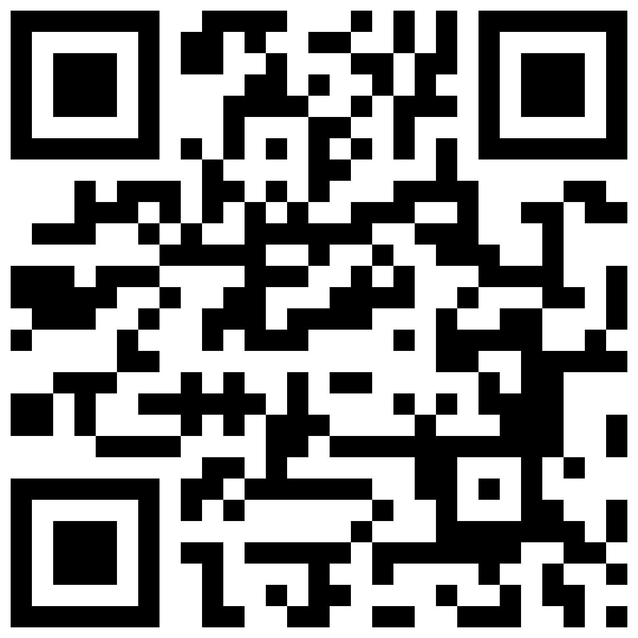
Notes:
Before getting started though, I wanted to let you know that all resources from this talk are in a webpage linked to this QR code. No worries right now, I’ll show it again at the end of the talk during the questions where you’ll have time to scan it. I just wanted to give you a heads up so that you can sit back and relax. Although, active tweeting is encouraged ☺

Slide 3


Business Problem
Being productive requires making code changes.
Any change adds risk.
Notes:
Empathy is awesome. You already recognize it’s value, otherwise you might choose another session.
However, we all know from our experience in companies that the business problem drives behavior. This means that something like empathy will only be used if convenient to the business problem.
So let’s start with the business problem! [STICKIES]
Productive = features, process

Slide 4
I can’t change it without tests
I can’t test it without changing it
Notes:
Welcome to every developer’s least favourite catch-22.
The most common technique to reduce risk is automated testing, but some code can’t be tested. The safest strategy is to not change untestable code. When we want to avoid a codebase or feature, we’re already trying to minimise risk – even if that isn’t a sustainable strategy.

Slide 5

ONLY purpose:
Document can’t be changed.
Notes:
As somebody who doesn’t code, but makes a living in metaphors, I couldn’t help but compare this to PDFs.
We want PDFs because we don’t want a perfectly “good enough” document that we already understand to be changed.

Slide 6

Notes:
But we do have to make changes. That’s the reality of business. Not only do developers need to add features, but they also want to improve the design.
Both features and design improvement mean change to our proverbial PDF.

Slide 7

Notes:
There’s nothing so terrifying as receiving an edited document without Track Changes. For the developer, these “changes” brings not only the possibility of bugs, but an unknown amount of hours finding them when they cause problems somewhere completely unrelated. After all, it’s not like we can test this untestable code before integration. Cycle of panic complete.

Slide 8

Illusion of Control
Notes:
We work very hard to avoid this cycle of panic.
The first knee jerk response is to maintain an illusion of control.
I can make changes, but you can’t.

Slide 9
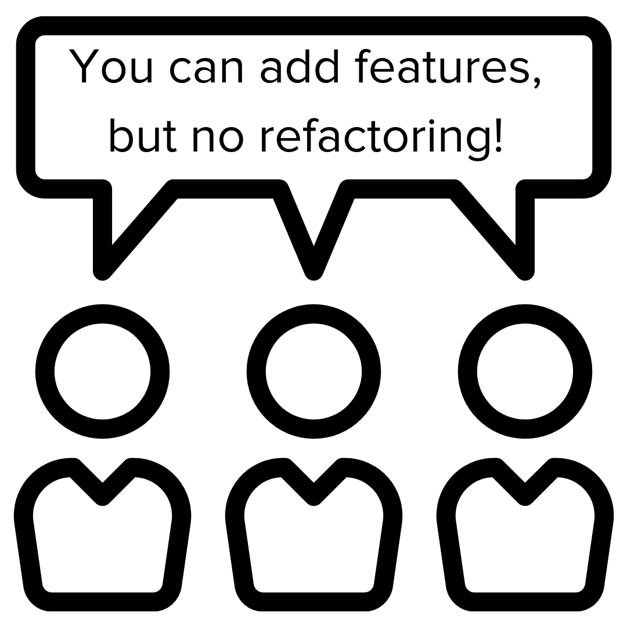
Notes:
In my words, you can create your own PDF, but don’t mess with mine.
In development speak, this means you can add features, but you aren’t allowed to refactor.

Slide 10
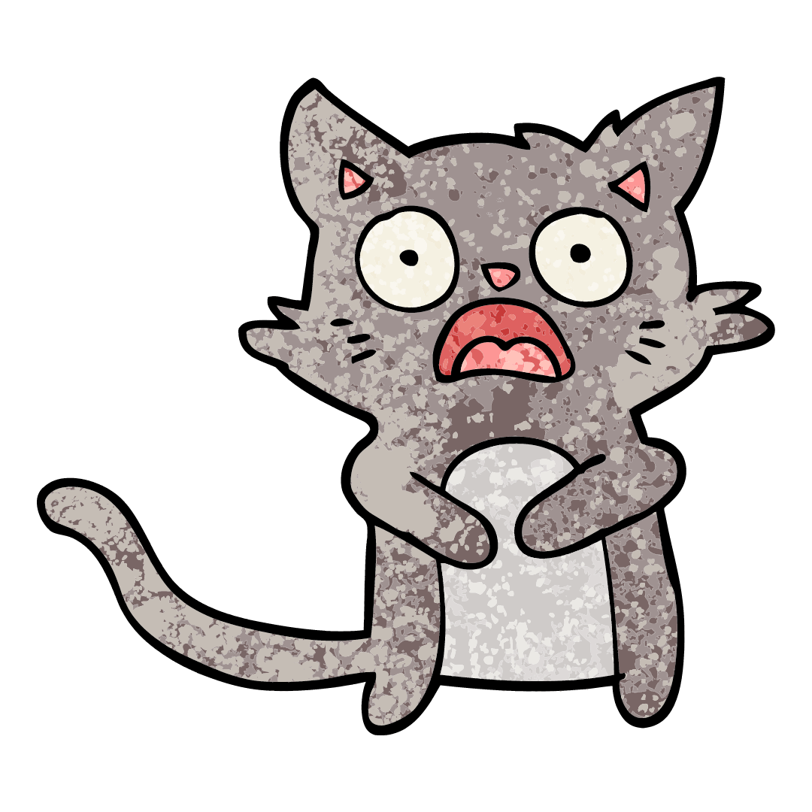

Notes:
But then, of course, came the PDF editor. It breaks our illusion of control, which is the same thing as developers refactoring without permission. Managers really dislike code changing without permission.

Slide 11




Notes:
So here’s a classic solution to finally realizing the code needs to change:
Call a meeting and we work on it together.
Achieve consensus (if very lucky).
Lock it back down to keep my illusion of control over the risk.
Expensive. Painful. Last resort. Like I said, we’ll do anything to avoid a cycle of panic.

Slide 12



Notes:
The obvious solution is to make our code testable so every detail doesn’t need controlled. [CLICK]
They SAY that refactoring makes the code testable and reduces future bugs! [CLICK]
BUT that is a change. Is it worth making that first change?? [CLICK]
In other words, is it worth risking a bug now to reduce the risk of adding bugs when I add the feature later?

Slide 13
Global Term: “Licences”
EU Context:
“Licence” adds responsibility
Solution:
Change to “Access Grants”
Notes:
Let’s say that my PDF is one of 50 nearly identical contracts we use worldwide.
[CLICK] The contracts reference “licences”.
[CLICK] But using that term adds legal responsibilities in the EU, so it adds a risk of lawsuit.
[CLICK] The fix is to change all contracts to reference “access grants” because it doesn’t have any specific legal meaning.
[CLICK] Is it worth the risk to change all the contracts to avoid future lawsuits? Or is it better to leave it working as is and hope the lawsuit never shows up?

Slide 14



Exposure’s Known Risk
The Fix!
Maybe….
Unknown Risk
Notes:
So we have this exposure. We know what it is.
[CLICK] We could fix it by adding “access grants] to the contracts … it should fix it….
[CLICK] But now we have an unknown risk. They don’t know what else gets changed in the contract if they simply switch out the terms.
And to bring it right into the world of every tired tech lead’s nightmare, the org doesn’t know which customer depends on that exact language. [CLICK] So every manager who values their job is going to accept known risk.
So it’s our to reduce that risk and to make the risk knowable.

Slide 15
Existing Solutions
Refactoring
Automated Tests
Tools
System Empathy
Notes:
To be clear, reducing risk and making the risk knowable has been solved since the 80s.
We have refactoring that doesn’t change behavior, automated tests, and tools.
However, change causing risk is still showing up as a problem.
I’m adding one more … system empathy.

Slide 16
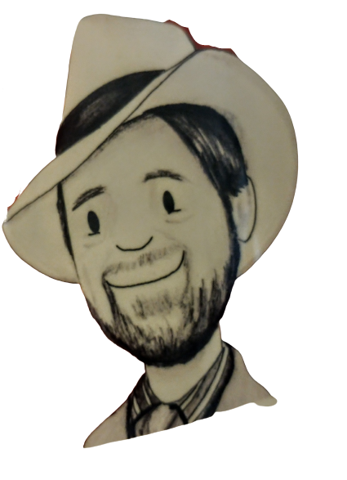
@ArloBelshee
Notes:
When Arlo and I started working together to make Deep Roots, one of the more powerful effects I saw of his refactoring processes is the amount of system level empathy that was naturally involved. I’m going to give you a close look at it, through the lens of my brain.

Slide 17
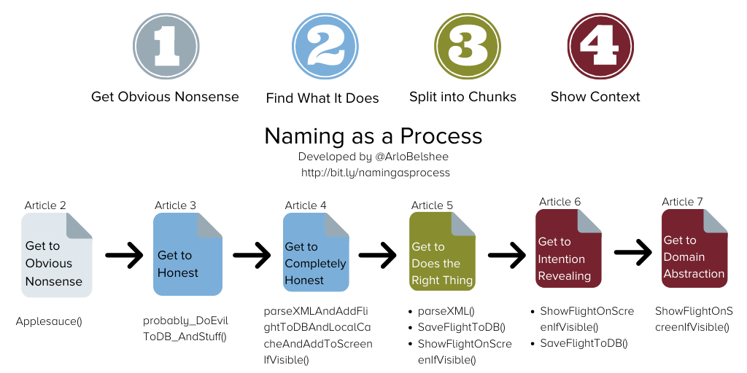
Notes:
This is the big picture of his Naming as a Process, one of the early processes that we teach at Deep Roots. Each naming stage makes the contract one increment more testable, giving trust to the names and dropping off hours of reading.

Slide 18
The Contract
We all want to work together with clients to help them learn the X set of skills.
The customer has too many employees for us to teach them all at once, so we will break them into groups. Similarly, the curriculum breaks the total set of knowledge and skills into several chunks that can be learned separately. When we interact with a customer, we will help them develop a strategy for dividing their employees into learning groups and providing separate pieces of the content and all related instruction and support for that content to each group. We agree to share all money equally between the partners involved in the interaction. We will define the overall strategy for spreading the skills across the client based on the customer’s measures of success, which the person signing the contract will determine with the company and then tell to everyone else involved. The skills and ways of learning them are valuable IP, and the curriculum is owned by the people that created it. No one else can teach these skills except as specified in this agreement. The person doing the measuring will also make sure that we record those measures and report them to the right stakeholders, though the person signing the contract will manage the relationship and ensure stakeholders are happy and that the roadmap is followed. Each time we help a single set of employees learn a particular set of skills, we will be able to assess that those skills have been learned, that they are being applied on real work, and the business impacts of that application (in terms of the measures agreed to for the total interaction between the customer and the person who signed the contract), and it is the responsibility of the person who created the curriculum to define the assessment, and the person who teaches it to run the assessment and share the data.
Too much unknown
So much reading time to understand intent
Misunderstanding intent
Changing one thing but not seeing another thing
Changing more than you intended
Notes:
Here’s how Arlo’s explanation struck me. Not having put fingers to code before, it sounded like the contract migraines of my past life.
How many of us, whether professionally or personally, have seen this wall of text for a contract? There are a slew of problems that make this high risk to change.

Slide 19
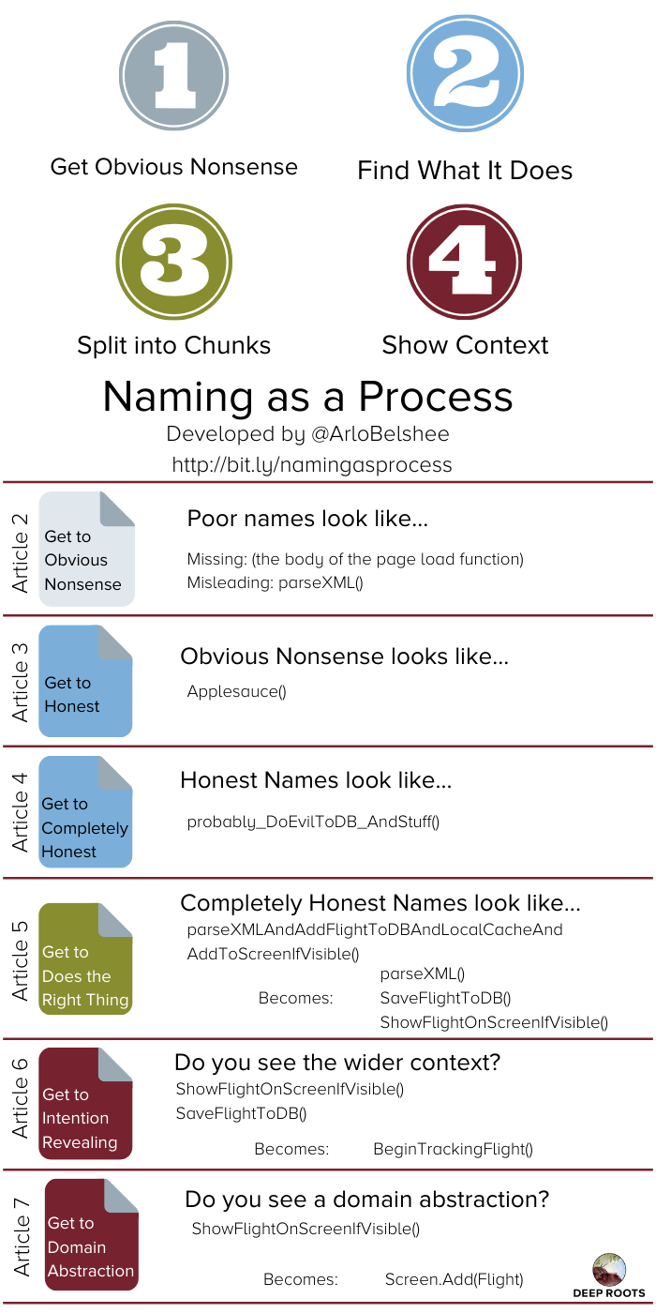
Missing Names
Consultant hereby irrevocably transfers and assigns to Company any and all of its right, title, and interest in and to all designs, discoveries, inventions, products, computer programs, procedures, business plans, revenue models, customer lists, marketing approaches or any similar business information, improvements, developments, drawings, notes, documents, information and materials made, conceived or developed by Consultant alone or with others which result from, relate to, or are used while providing the Services, including, but not limited to, any copyrights, patent rights, trade secrets and trademarks. all designs, discoveries, inventions, products, computer programs, procedures, business plans, revenue models, customer lists, marketing approaches or any similar business information, improvements, developments, drawings, notes, documents, information and materials made, conceived or developed by Consultant alone or with others which result from, relate to, or are used while providing the Services will be the sole and exclusive property of Company, and Company shall have the sole right to determine the treatment of any all designs, discoveries, inventions, products, computer programs, procedures, business plans, revenue models, customer lists, marketing approaches or any similar business information, improvements, developments, drawings, notes, documents, information and materials made, conceived or developed by Consultant alone or with others which result from, relate to, or are used while providing the Services, including the right to keep them as trade secrets, to file and execute patent applications on them, to use and disclose them without prior patent application, to file registrations for copyright or trademark on them in its own name, or to follow any other procedure that Company deems appropriate.
Consultant agrees: (a) to disclose promptly in writing to Company all all designs, discoveries, inventions, products, computer programs, procedures, business plans, revenue models, customer lists, marketing approaches or any similar business information, improvements, developments, drawings, notes, documents, information and materials made, conceived or developed by Consultant alone or with others which result from or relate to the Services; (b) to cooperate with and assist Company to apply for, and to execute any applications and/or assignments reasonably necessary to obtain, any patent, copyright, trademark or other statutory protection for all designs, discoveries, inventions, products, computer programs, procedures, business plans, revenue models, customer lists, marketing approaches or any similar business information, improvements, developments, drawings, notes, documents, information and materials made, conceived or developed by Consultant alone or with others which result from or relate to the Services in Company' name as Company deems appropriate; and (c) to otherwise treat all all designs, discoveries, inventions, products, computer programs, procedures, business plans, revenue models, customer lists, marketing approaches or any similar business information, improvements, developments, drawings, notes, documents, information and materials made, conceived or developed by Consultant alone or with others which result from or relate to the Services as Confidential Information, as defined below. These obligations to disclose, assist and assign the termination of this Agreement.
Notes:
So we are going to start the refactoring process. The starting point is that we see missing names. As we can see with this contract, there are officially missing names. Our goal is to get to the next stage: obvious nonsense.

Slide 20
Identifying Obvious Nonsense – Extract Definition
Before
After
Consultant hereby irrevocably transfers and assigns to Company any and all of its right, title, and interest in and to all designs, discoveries, inventions, products, computer programs, procedures, business plans, revenue models, customer lists, marketing approaches or any similar business information, improvements, developments, drawings, notes, documents, information and materials made, conceived or developed by Consultant alone or with others which result from, relate to, or are used while providing the Services, including, but not limited to, any copyrights, patent rights, trade secrets and trademarks. All designs, discoveries, inventions, products, computer programs, procedures, business plans, revenue models, customer lists, marketing approaches or any similar business information, improvements, developments, drawings, notes, documents, information and materials made, conceived or developed by Consultant alone or with others which result from, relate to, or are used while providing the Services will be the sole and exclusive property of Company, and Company shall have the sole right to determine the treatment of all designs, discoveries, inventions, products, computer programs, procedures, business plans, revenue models, customer lists, marketing approaches or any similar business information, improvements, developments, drawings, notes, documents, information and materials made, conceived or developed by Consultant alone or with others which result from, relate to, or are used while providing the Services, including the right to keep them as trade secrets, to file and execute patent applications on them, to use and disclose them without prior patent application, to file registrations for copyright or trademark on them in its own name, or to follow any other procedure that Company deems appropriate.
[more…]
Consultant hereby irrevocably transfers and assigns to Company any and all of its right, title, and interest in and to Applesauce, including, but not limited to, any copyrights, patent rights, trade secrets and trademarks to Company. Applesauce will be the sole and exclusive property of Company, and Company shall have the sole right to determine the treatment of Applesauce, including the right to keep them as trade secrets, to file and execute patent applications on them, to use and disclose them without prior patent application, to file registrations for copyright or trademark on them in its own name, or to follow any other procedure that Company deems appropriate.
[more…]
Definitions:
“Applesauce” means all designs, discoveries, inventions, products, computer programs, procedures, business plans, revenue models, customer lists, marketing approaches or any similar business information, improvements, developments, drawings, notes, documents, information and materials made, conceived or developed by Consultant alone or with others which result from, relate to, or are used while providing the Services.
Notes:
Getting to Obvious Nonsense requires us to identify things that should be named but aren’t. We find one at a time, then do the Extract Definition refactoring. Extract Definition creates a name, and we use an obvious nonsense name.
In this contract, we see the same text repeated 3 times. That seems like something that we should extract and name. [CLICK]
Right now, we aren’t trying to get a good name – just to find the chunks that we will name later. So we extract it as Applesauce and move on. [CLICK]
Just extracting Applesauce has reduced the size of the contract by half.

Slide 21
Identifying Obvious Nonsense – Extract Definition
Before
After
Definitions:
“Applesauce” means all designs, discoveries, inventions, products, computer programs, procedures, business plans, revenue models, customer lists, marketing approaches or any similar business information, improvements, developments, drawings, notes, documents, information and materials made, conceived or developed by Consultant alone or with others which result from, relate to, or are used while providing the Services.
Definitions:
“Applesauce” means all Dinguses made, conceived or developed by Consultant alone or with others which result from, relate to, or are used while providing the Services.
“Dunguses” means designs, discoveries, inventions, products, computer programs, procedures, business plans, revenue models, customer lists, marketing approaches or any similar business information, improvements, developments, drawings, notes, documents, information and materials.
Notes:
Sometimes the definition we extracted is still too complicated. In this case, we see a long list of nouns inside the definition for Applesauce.
[CLICK] So we do the same Extract Definition to pull out all these nouns.

Slide 22
Obvious Nonsense
Consultant hereby Schlepps Applesauce, including, but not limited to, any Pearsauce to Company. The Company Powns Applesauce, including the right to Do Things.
[more…]
Definitions:
“Schlepps” a thing means irrevocably transfers and assigns any and all of its right, title, and interest in and to that thing.
“Applesauce” means all Dinguses made, conceived or developed by Consultant alone or with others which result from, relate to, or are used while providing the Services.
A Party “Powns” a thing means that the thing is the sole and exclusive property of that Party, including that the Party has the sole right to determine the treatment of the thing.
“Do Things” means keep them as trade secrets, to file and execute patent applications on them, to use and disclose them without prior patent application, to file registrations for copyright or trademark on them in its own name, or to follow any other procedure that Company deems appropriate.
“Dunguses” means designs, discoveries, inventions, products, computer programs, procedures, business plans, revenue models, customer lists, marketing approaches or any similar business information, improvements, developments, drawings, notes, documents, information and materials.
“Pearsauce” means copyrights, patent rights, trade secrets and trademarks.
[more…]
Notes:
Repeating this many more times, we have now gotten to the Obvious Nonsense stage.
[CLICK] Our contract is already much easier to read, even with nonsense names!
Our next goal is to get to the Honest stage. We want each name to be at least minimally accurate – to state one part of its definition.

Slide 23
Becoming Honest – Rename Definition
Before
After
Definitions:
“Applesauce” means all Dinguses made, conceived or developed by Consultant alone or with others which result from, relate to, or are used while providing the Services.
Definitions:
“WorkAndOtherStuff” means all CreatedThings made, conceived or developed by Consultant alone or with others which result from, relate to, or are used while providing the Services.
Notes:
Just like with Obvious Nonsense, we get to Honest incrementally. Here, in each step we look at one definition. We identify one thing that the body of the definition includes.
[CLICK] We then do the refactoring “Rename Definition” to include that one true thing. Sometimes the definition really only defines one thing. In this case, the list of nouns were all “created things” and so that name fully describes the definition.
Other times we know that the name describes only part of the definition, so we add “and other stuff” to the name to indicate that there is more.

Slide 24
Honest
Intellectual Property Ownership:
Consultant hereby ConveysAndThings WorkAndOtherStuff, including, but not limited to, any Legal Protections to Company. The Company OwnsAndStuff WorkAndOtherStuff, including the right to ProtectOrUseOrDoOtherThings.
[more…]
Definitions:
“WorkAndOtherStuff” means all CreatedThings made, conceived or developed by Consultant alone or with others which result from, relate to, or are used while providing the Services.
[more …]
Notes:
Repeating that step several times gets us to the Honest stage.
[CLICK] Here is our contract at the Honest stage. Again, it is more readable than at the prior stage, but still not completely obvious.
Our next goal is the Completely Honest stage.

Slide 25
Becoming Completely Honest – Rename Definition
Before
After
Definitions:
“WorkAndOtherStuff” means all CreatedThings made, conceived or developed by Consultant alone or with others which result from, relate to, or are used while providing the Services.
Definitions:
“AnyIntellectualPropertyMadeOrReferencedOrUsed” means all CreatedThings made, conceived or developed by Consultant alone or with others which result from, relate to, or are used while providing the Services.
Notes:
To become Completely Honest, we need each definition’s name to summarize all the content in the definition, so we have to lose the “AndStuff”. Again, we get there incrementally.
[CLICK] We pick one definition and identify one element that is not already in the name. Then we using the refactoring “Rename Definition” again to add that one fact to the name. We repeat this until the name has everything. At that point we do one final Rename Definition to eliminate the “and other stuff.”
In this case, we found that “work and other stuff” had several important facts. We extracted them one at a time and got to this final definition after 5 renames.

Slide 26
Completely Honest
Intellectual Property Ownership:
Consultant hereby TransfersAndAssigns AnyIntellectualPropertyMadeOrReferencedOrUsed, including, but not limited to, any Legal Protections to Company. The Company OwnsAndControls AnyIntellectualPropertyMadeOrReferencedOrUsed, including the right to ProtectOrUseOrDoOtherThings.
[more…]
Notes:
After performing that refactoring another 20 times or so, we get to the Completely Honest stage.
[CLICK] This stage is the first one where the contract is completely readable. We can still make more improvements – the naming process does continue. However, you can now read the contract without reading the list of definitions – and get an accurate understanding of the agreement. You are ready to fix bugs, implement features, or whatever brought you here.

Slide 27
Notes:
You just witnessed a non-coding application of half the process. There are a couple more stages to the naming process, but I believe we’ve accomplished my point.
It’s not just about naming; it’s about breaking things up so that each piece can stand on its own and be clearly noted for what it does.
It’s not fast to get through all the stages, but we’ve found there is remarkable speed in results when it becomes a process.

Slide 28
Notes:
And, as we open to questions, please take a moment to scan the QR code to get the resources provided in this deck as well as other information on Deep Roots.

