Slide 1
Promiscuous Pairing and Beginner’s Mind
Arlo Belshee
Craft Conference 2003

Slide 2
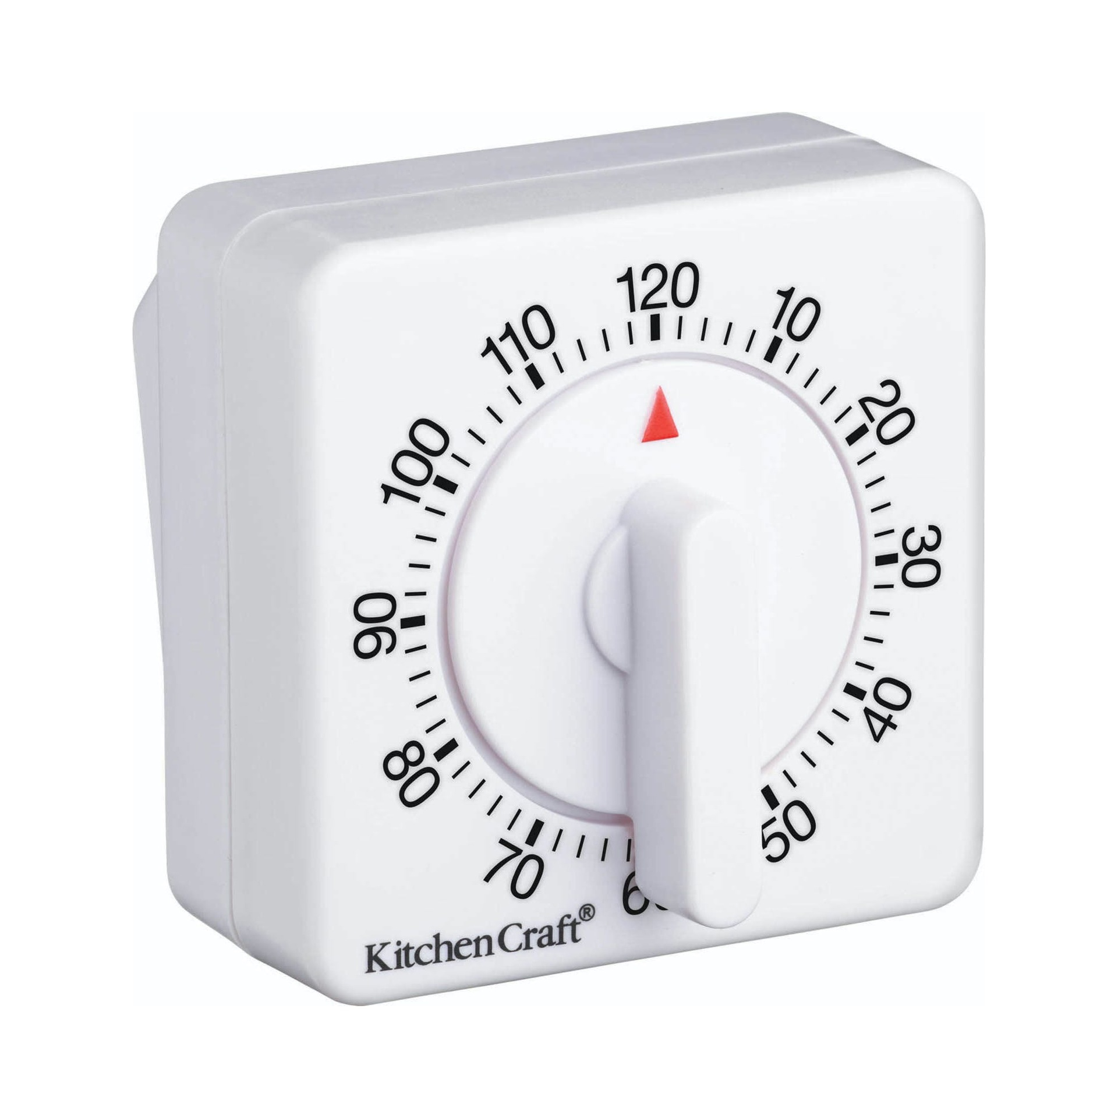
Notes:
We knew we had an excellent way to work when we were totally unable to do it without an egg timer. Let me step back.

Slide 3

Notes:
We already paired 100% of the time.
Back further: company as going to die. On May 21.
This was 2000, we had read the Extreme Programming White Book.
Did it by the book, because couldn’t mess about.
Experimental physicist. Did whatever worked.

Slide 4
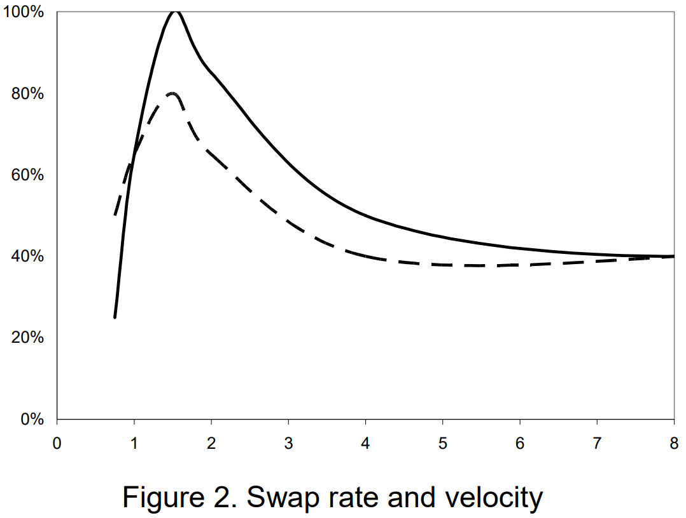
Pairing Duration (hours)
Notes:
Found some pairs were far more effective – even same people on different days.
Sought to establish why.
These were our results.

Slide 5
Notes:
But most effective was also hardest.
Team chose to use the egg timer. Not because we like pain, but because we understood the data.
Having finished Discovery, we now needed to Improve. And that means changing habits. For which we needs support, such as tools.
So, should you work like we did?

Slide 6

Resources
Ask Arlo Anything!
arlo@digdeeproots.com
@arlobelshee
In: arlobelshee
GH: arlobelshee
https://digdeeproots.github.io/talks/craft2023
Notes:
Before I answer that question,
Restate mission, offer Ask Arlo Anything
All resources are online.
This QR & URL will be available at end too.

Slide 7




How You Collaborate Matters
Most familiar or most effective?
Easiest to start or easiest in long-term?
Protect specialists or maximize growth?
Maximize innovation or minimize cost?
Solo / PR
Peer
Pair
Ensemble (Mob)
…But How You Choose Matters More
Notes:
Not necessarily.
There are many ways to collaborate. And many sub-variations! (click)
All work in different contexts. Intuition and ease may be misleading. (click)
Choose intentionally, based on data. And ease can be a valid factor!

Slide 8
Recommendation
Notes:
Here’s where I make a recommendation about how you work.
…and because this is a talk about Pairing, I’m going to recommend…

Slide 9
Recommendation
Discovery
Improvement
Question
Research
Hypothesis
Try to Disprove
Analyze
Report Conclusion
Ask
Imagine
Plan
Implement
Improve
Scientific Method
Engineering Method
Notes:
that you change your retro.
Distinguish discovery from improvement. Use the scientific method for discovery and the engineering method for improvement.
This replaces your traditional retro with a whole new set of practices.

Slide 10
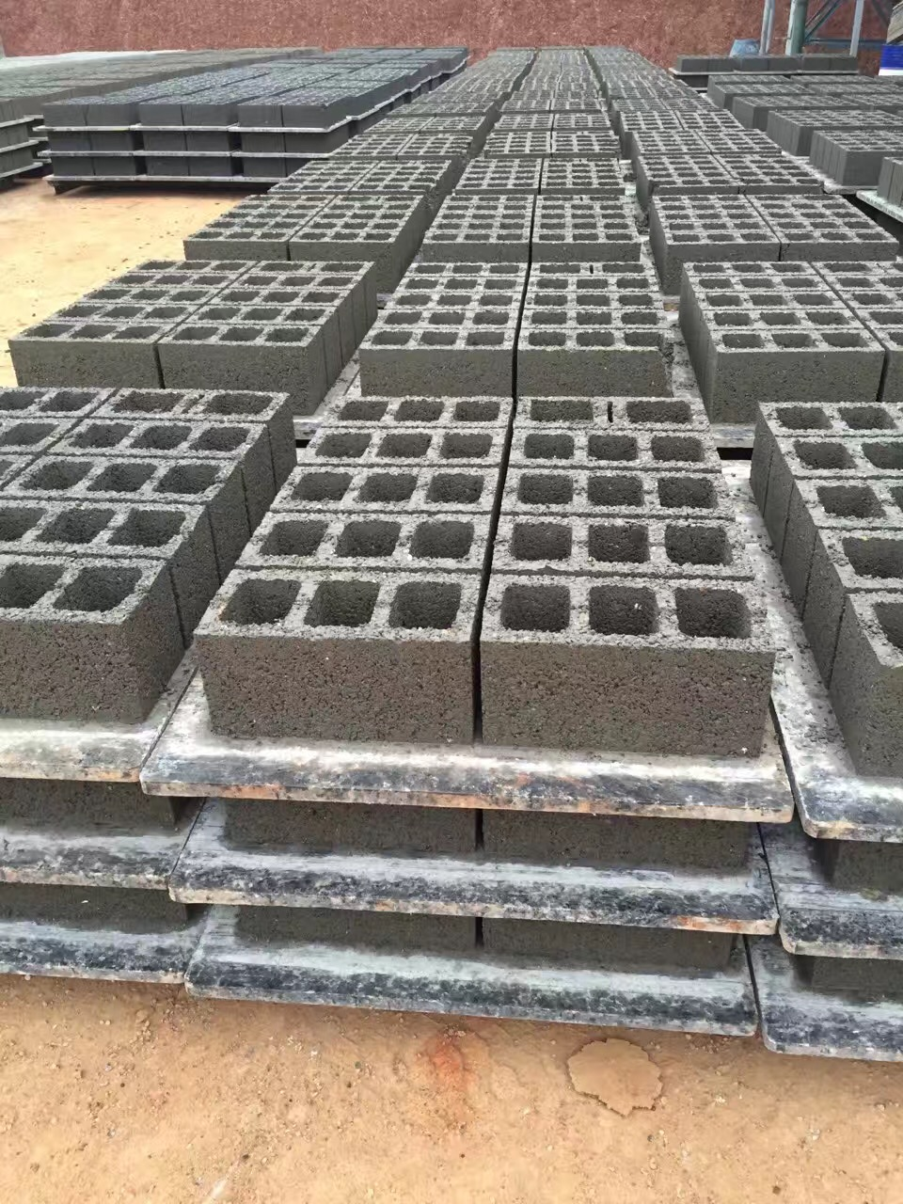
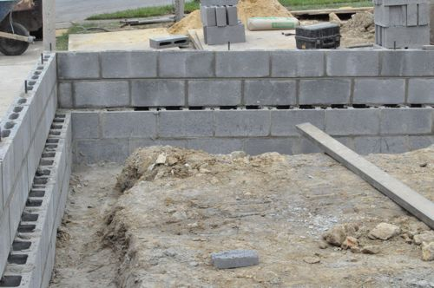
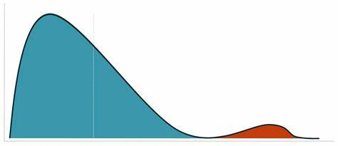
Why Bother?
The company owner doesn’t need to win. The best idea does.
- John C. Maxwell
Find the Unexpected
More Improvements
Best Idea Wins
Improvements Stick

Slide 11
Collaboration Techniques
Comparing Promiscuous Pairing to other options

Slide 12
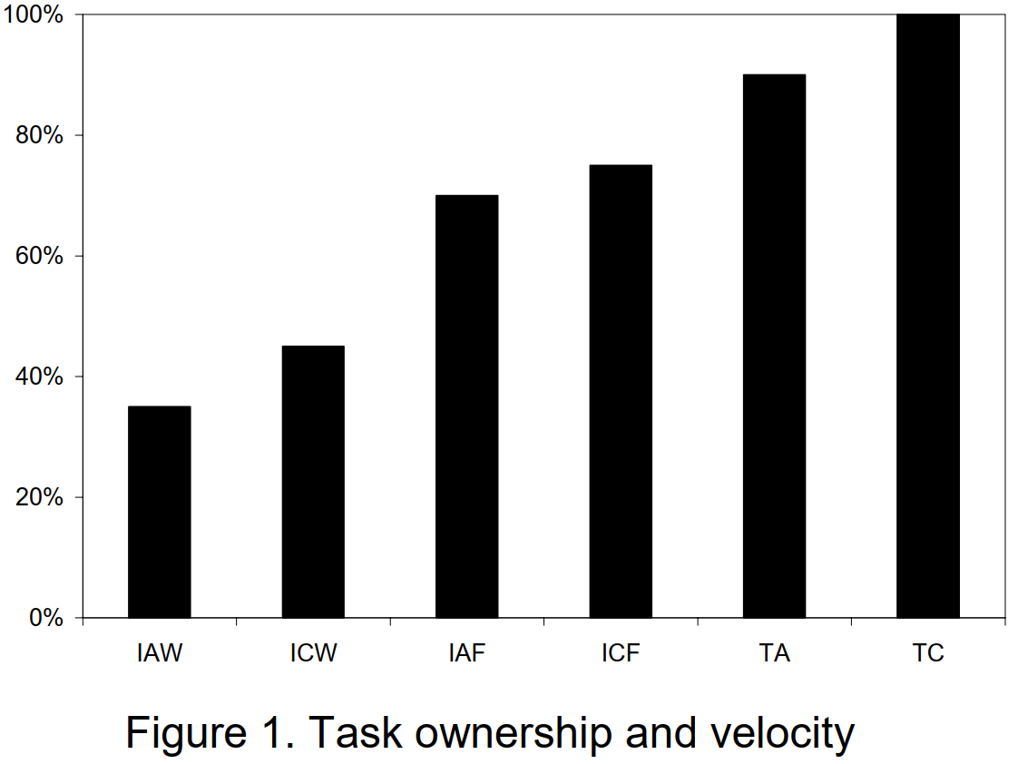
Effective Pairing – Our Data
Team Owned
Most developers do this (1x velocity)
Individual Owned
Solo (apx)
(I)ndividual- vs (T)eam- owned
(A)ssigned vs (C)hosen assignment
Chosen (W)eekly vs (F)lexibly / on-demand
Most teams that try pairing try this (apx 0.8-1.25x velocity)
We did this
(apx 5x velocity)
Pairing Duration (hours)
Notes:
But first let’s talk about pairing
Walk through our results
I didn’t report it in the paper, but we also tracked red card rate (explain).
Red rate was unaffected by swap strategy, except for one case. Sith-style with swap rate fast enough that most stories involved a complete rotation of implementors resulted in a lower rate. Step function, but only 20% or so better.

Slide 13


What is Promiscuous Pairing?
Swap every
90-120 min
Apprentice replaces master
Least-qualified
implementor
Notes:
Explain each point
This makes no sense!
But the data showed it to be optimal. We eventually found a theory to explain the data – Beginner’s Mind.
Note: the practice came first. The theory was more than a year after we had mastered the practice, and the theory didn’t change much. That’s the opposite of most instruction, most advice, blogs, etc.
That was great, until a new innovation came.

Slide 14
Mob
Programming
Notes:
Mobs beat Promiscuous Pairs.
Or do they?

Slide 15
Isn’t Pairing Obsolete?
6 Person XP-ish Team | Solo / PR | Peer | Slow Rotation Pair | Promiscuous Pair | Ensemble (Mob)
Team velocity – repetitive work | 4x | 6x (and likely to automate) | 1x | 3x (and likely to automate) | 1x (and likely to automate)
Team velocity – creative work | 1.5x | 1x | 4x | 20x | 10x
Bugs written | 12/day (~4,300x) | 12/day (~4,300x) | 1 / week (~80x) | 1 / 8 weeks (~10x) | 1 / 18 months (1x)
Time to Get Expert / Spread Technique | Requires out of band solution | Requires out of band solution | 3 days / 4 weeks | 3 hr / 1 day | 0 min / 0 min
Perseverance & Habit Change | Low | Medium | High | Unstoppable | Unstoppable
Notes:
Not really. Mob vs Promiscuous Pair vs slow Pair vs Peer vs Solo/PR feature comparison
But these are all generalizations.
Different teams see different results.
Different contexts need different things.
So run the experiments yourself and choose.

Slide 16
Other Teams
It hurts!
It always did, but I was used to it.
Notes:
MS team follow-up. One big finding. (click)
Actually… (click)
Amplified all the existing problems.
Traditional retro couldn’t solve the problems in real time.
…so if you’re going to pair promiscuously, make sure you change well!

Slide 17
Changing
How to choose an approach and change your habits

Slide 18
Ways to Change
Verify
Implement
Ideas
Problem
Choose
Notes:
Many ways to make a change. All have same parts, but different order.
Parts: identify problem, generate ideas (diverge), decide among them (converge), implement them (partially), verify them (pass or fail).
Rqt: impl before verify, and impl, choose, and verify must all be after ideas

Slide 19
Ways to Change - Governance
Problem
Ideas
Choose
Implement
Verify
Notes:
2 contexts
Usually lacks formal verify
Will succeed or fail
Only team knows result; leaders appear clueless
Breaks trust

Slide 20
Ways to Change - Retro
Problem
Ideas
Choose
Implement
Verify
Notes:
Still often missing verify
Will succeed or fail
Failures will come back in future retro

Slide 21
Ways to Change – Follow Expert Technique
Ideas
Choose
Implement
Verify
Problem
Notes:
Try stuff, see results, then decide what problem to apply it to.
Usually works, because you choose a problem that makes the verification pass!

Slide 22
Ways to Change – Stage Magician
Ideas
Implement
Verify
Choose
Notes:
Never fail! They only guess after they know the answer!
Pick among known-good solutions.

Slide 23
Ways to Change – Experiment Driven
Problem
Ideas
Implement
Verify
Choose
Notes:
Never fail!
Need to manage the divergence. Avoid analysis paralysis.

Slide 24
Data-driven Improvement
Discovery
Improvement
Question
Research
Hypothesis
Try to Disprove
Analyze
Report Conclusion
Ask
Imagine
Plan
Implement
Improve
Scientific Method
Engineering Method
Notes:
Manage divergence by alternating 2 states. Learn a little, then apply it, then repeat.
Don’t try to do both at once!

Slide 25
Change Structure: Overview
Plan (during retro)
Pick top Problem
Do (during week)
Implement small bits
Decide (during retro)
Review results
Discover or Improve?
Hypothesis or Habit
Decide
Verify & record outcomes
Record unrelated problems
Notes:
Key points:
Each problem, choose to discover or improve. Align that way for the week.
Retro: demo past, then decide, then prioritize (shorts & longs), then plan.
Optimally, gather problem data outside retro

Slide 26
Discovering
Maximize Learning
Ignore Improvement
Test multiple options
Test current state
Vary details within each option
Qualitative + Quantitative
Measure invariants
Record in real-time
Measure one level up & out
Don’t adopt promising things! Try more.

Slide 27
Improving
Maximize Improvement
Ignore Learning
Ensure the answer is known first
Apply and refine best ideas
Focus on habits and fluency
First get consistent, then fluent, then refine the habit
Change one micro-habit at a time
Seek uniformity
Avoid innovation

Slide 28
Your Collaboration Style
Your Team | Solo / PR | Peer | Slow Rotation Pair | Promiscuous Pair | Ensemble (Mob)
Criterion 1
Criterion 2
…
Notes:
Choose it intentionally, based on data. Then improve it consistently.

Slide 29
First Next Step: Swap your Retro
Plan (during retro)
Pick top Problem
Do (during week)
Implement small bits
Decide (during retro)
Review results
Discover or Improve?
Hypothesis or Habit
Decide
Verify & record outcomes
Record unrelated problems
Start
Stop
Keep
Question
Notes:
Key points:
Each problem, choose to discover or improve. Align that way for the week.
Retro: demo past, then decide, then prioritize (shorts & longs), then plan.
Optimally, gather problem data outside retro

Slide 30
Ask Arlo Anything!
arlo@digdeeproots.com
@arlobelshee
In: arlobelshee
GH: arlobelshee
https://digdeeproots.github.io/talks/craft2023
Notes:
Resources QR and URL if you need it. Ask away – even off topic!

