Slide 1
Promiscuous Pairing and Beginner’s Mind
Arlo Belshee
Craft Conference 2003

Slide 2
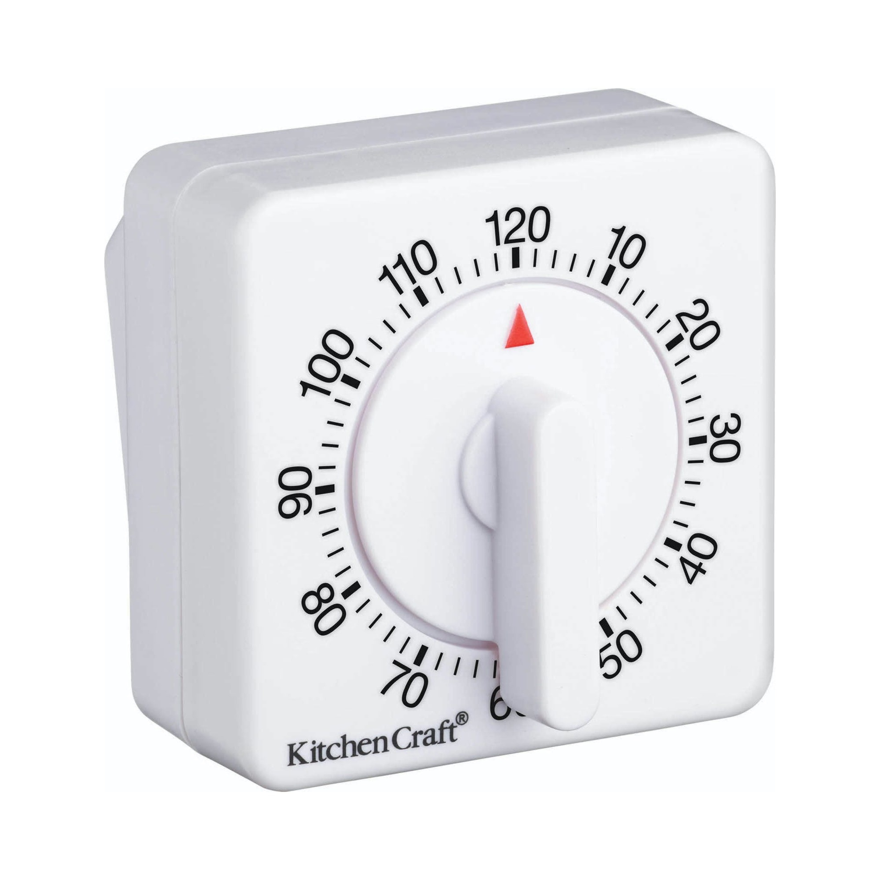
Notes:
We knew we had an excellent way to work when we were totally unable to do it without an egg timer. Let me step back.

Slide 3

Notes:
We already paired 100% of the time.
Back further: company as going to die. On May 21.
This was 2000, we had read the Extreme Programming White Book.
Did it by the book, because couldn’t mess about.
Experimental physicist. Did whatever worked.

Slide 4
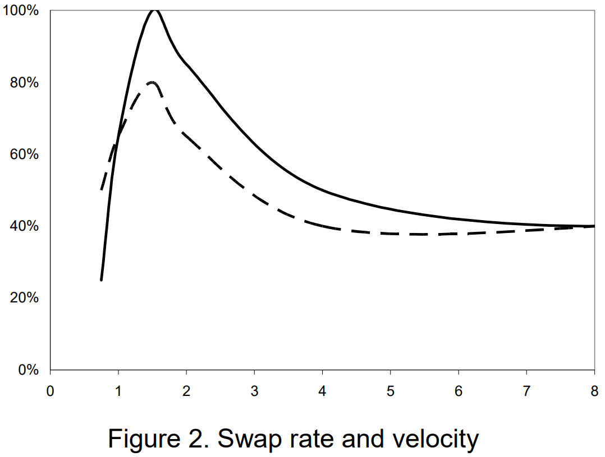
Pairing Duration (hours)
Notes:
Found some pairs were far more effective – even same people on different days.
Sought to establish why.
These were our results.
But most effective was also hardest.
Chose peak not because we like pain, but because we understood the data.

Slide 5
Notes:
Having finished Discovery, we now needed to Improve.
And that means changing habits. For which we needs support, such as tools.
Team chose to use the egg timer.
I knew we had an excellent way to work, because we chose to adopt an annoying egg timer.
So, should you work like we did?

Slide 6

Resources
Ask Arlo Anything!
arlo@digdeeproots.com
@arlobelshee
In: arlobelshee
GH: arlobelshee
https://digdeeproots.github.io/talks/craft2023
Notes:
Before I answer that question, let’s make it easier to be present.
All resources are online.
QR/URL at end of talk too.
I’m Arlo; I love legacy code; mission to end all bugs, worldwide
Ask Arlo Anything (end of talk and afterword)
So, should you work like we did?

Slide 7




How You Collaborate Matters
Most familiar or most effective?
Easiest to start or easiest in long-term?
Protect specialists or maximize growth?
Maximize innovation or minimize cost?
Solo / PR
Peer
Pair
Ensemble (Mob)
…But How You Choose Matters More
Notes:
Not necessarily.
There are many ways to collaborate. And many sub-variations! (click)
All work in different contexts. Intuition and ease may be misleading. (click)
Choose intentionally, based on data. And ease can be a valid factor!

Slide 8
Recommendation
Notes:
Here’s where I make a recommendation about how you work.
…and because this is a talk about Pairing, I’m going to recommend…

Slide 9
Recommendation – Data-driven Improvement
Discovery
Improvement
Question
Research
Hypothesis
Try to Disprove
Analyze
Report Conclusion
Ask
Imagine
Plan
Implement
Improve
Scientific Method
Engineering Method
Notes:
that you change your retro.
Distinguish discovery from improvement.
Scientific method -> discovery
Engineering method -> improvement
Immediate result:
Replaces opinion with data.
Still uses intuition, but to guide discovery, not to define improvements.
This replaces your traditional retro with a whole new set of practices.
Why bother?

Slide 10
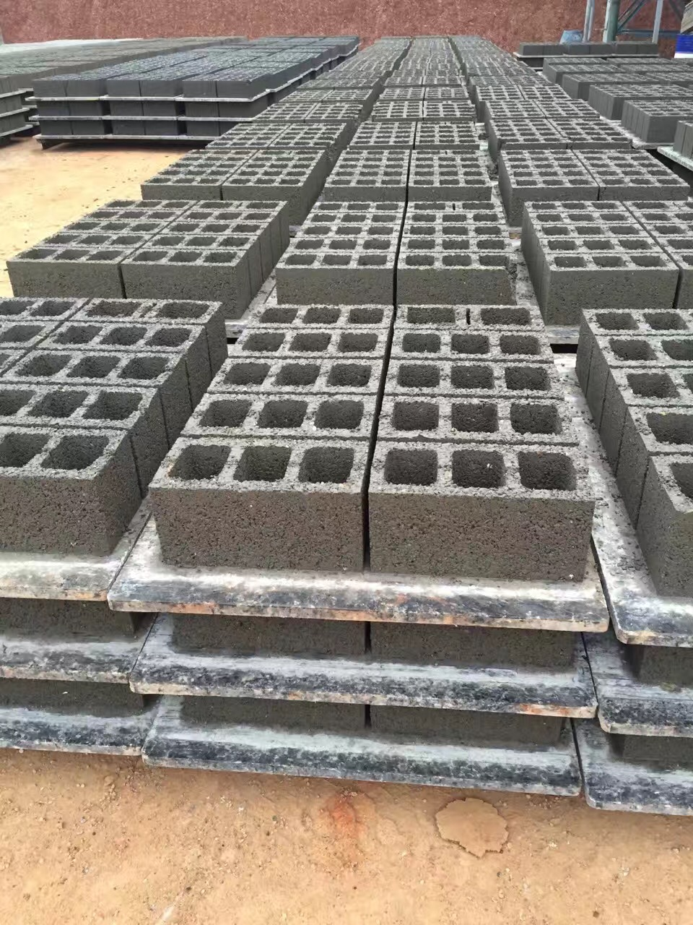
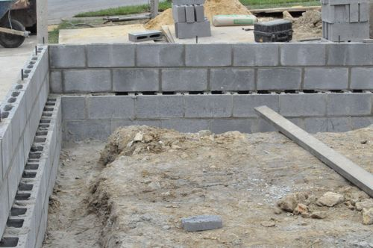
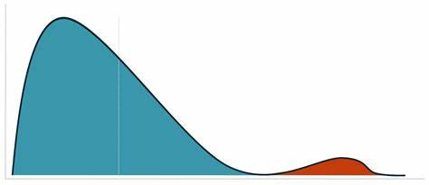
Why Bother?
The company owner doesn’t need to win. The best idea does.
- John C. Maxwell
Find the Unexpected
More Improvements
Best Idea Wins
Improvements Stick
Notes:
Improve by intuition -> many opinions. Choose based on person.
Do discovery with data -> best wins; no matter who had it.
Following intuition -> following past patterns -> left bump
Experiments -> surprises!
Opinions -> things fail -> comes up again
Opinions -> have to convince -> pain of change -> limits number of changes
Known good solution when changing -> focus on change -> disciplined, iterative adoption -> stays changed
4 reasons to change your retro. But that’s not why you’re here…

Slide 11
Collaboration Techniques
Comparing Promiscuous Pairing to other options
Notes:
Let’s discuss the benefits of promiscuity!

Slide 12
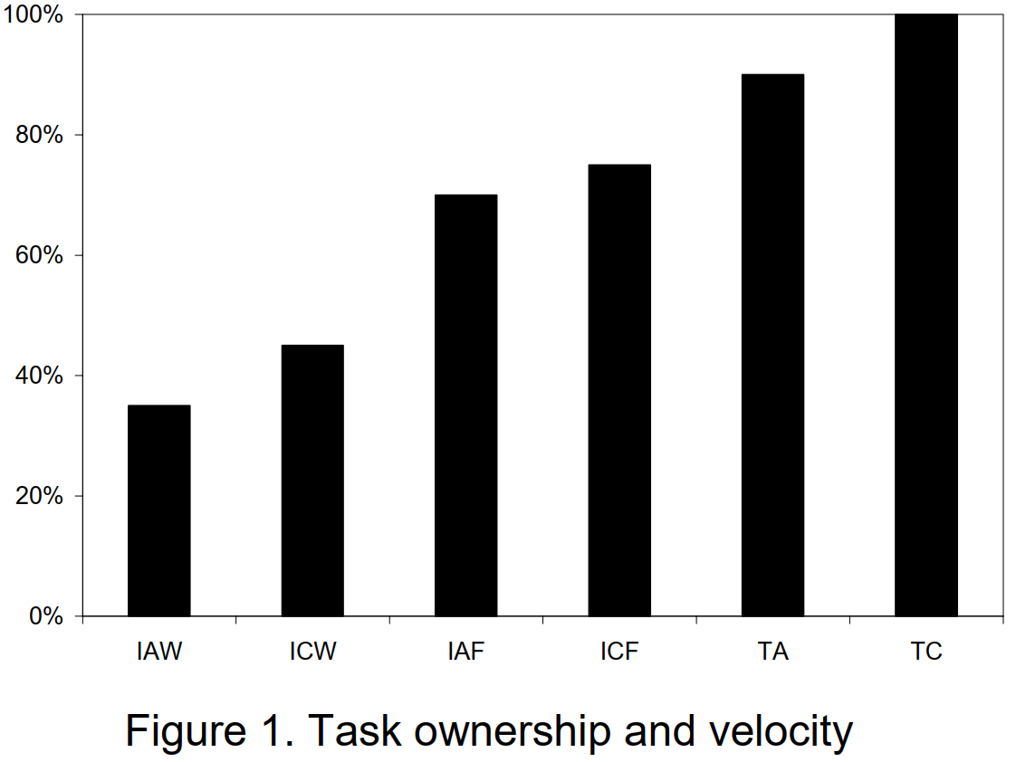
Effective Pairing – Our Data
Avoid Experts
Most developers do this (baseline velocity)
Keep Expert
Solo (apx)
(I)ndividual- vs (T)eam- owned
(A)ssigned vs (C)hosen assignment
Chosen (W)eekly vs (F)lexibly / on-demand
Most teams that try pairing try this (apx 0.8-1.25x velocity)
We did this
(apx 5x velocity)
Pairing Duration (hours)
Notes:
Lots of ways to pair. We experimented.
Walk through our results.
Surprises:
Optimal swap time was short!
Shorter than our intended experiment – added variations.
Better to avoid experts!
Surprises:
Choosing for the week allowed optimal matching task to person…and performed worst!
I didn’t report it in the paper, but we also tracked red card rate (explain).
Red rate was unaffected by swap strategy, except for one case. Avoid experts + fast swap -> complete rotation -> fewer bugs
Surprise!
Step function, but only 20% or so better.
One interesting interpretation: most pairing experiments are doomed to fail.
(red vs blue)
But we got to see all the data. So duh!
Real experiment, not just comparing 2 options.

Slide 13


What is Promiscuous Pairing?
Swap every
90-120 min
Apprentice replaces master
Least-qualified
implementor
Notes:
Explain each point
This makes no sense!
But of course. Data found surprises -> practice breaks intuition.
Found a theory a year later – Beginner’s Mind. -> didn’t change much
Practice first -> theory / mindset whatever -> opposite of most instruction, advice
That was great, until a new innovation came.

Slide 14
Mob
Programming
Notes:
Mobs beat Promiscuous Pairs.
Or do they?

Slide 15
Isn’t Pairing Obsolete?
6 Person XP-ish Team | Solo / PR | Peer | Slow Rotation Pair | Promiscuous Pair | Ensemble (Mob)
Team velocity – repetitive work | 4x | 6x (and likely to automate) | 1x | 3x (and likely to automate) | 1x (and likely to automate)
Team velocity – creative work | 1.5x | 1x | 4x | 20x | 10x
Bugs written | 12/day (~4,300x) | 12/day (~4,300x) | 1 / week (~80x) | 1 / 8 weeks (~10x) | 1 / 18 months (1x)
Time to Get Expert / Spread Technique | Requires out of band solution | Requires out of band solution | 3 days / 4 weeks | 3 hr / 1 day | 0 min / 0 min
Perseverance & Habit Change | Low | Medium | High | Unstoppable | Unstoppable
Notes:
Not really.
List many options -> compare some features -> no definitive set
I’ve observed -> green top; blue good enough
But these are all generalizations.
Different teams see different results.
Different contexts need different things.
So run the experiments yourself and choose.

Slide 16
Other Teams
It hurts!
It always did, but I was used to it.
Notes:
Team did -> One big finding. (click)
Actually… (click)
Reproduced our results, and
It amplified all the existing problems.
Traditional retro couldn’t solve the problems in real time.
…so if you’re going to pair promiscuously, make sure you change well!

Slide 17
Changing
How to choose an approach and change your habits

Slide 18
Ways to Change
Verify
Implement
Ideas
Problem
Choose
Notes:
Many ways -> same parts / different order.
identify problem
generate ideas -> (diverge),
decide among them -> (converge),
implement them -> (partially),
verify them -> (pass or fail).
Rqt:
Verify always present, even if skipped
impl before verify,
Ideas before impl, choose, and verify

Slide 19
Ways to Change - Governance
Problem
Ideas
Choose
Implement
Verify
Notes:
Mgr or architect edict
2 contexts
Usually lacks formal verify
Will succeed or fail
Only team knows result; leaders appear clueless
Breaks trust from teams to leaders

Slide 20
Ways to Change - Retro
Problem
Ideas
Choose
Implement
Verify
Notes:
Same approach / decision process, just local
Still often missing verify
Will succeed or fail
Failures will come back in future retro
Will succeed eventually
Looks wasteful / chaotic from outside
Breaks trust from leaders to teams

Slide 21
Ways to Change – Follow Expert Technique
Ideas
Choose
Implement
Verify
Problem
Notes:
Try stuff, see results, then decide what problem to apply it to.
Usually works, because you choose a problem that makes the verification pass!
Looks intentional and successful; reinforces trust
But often misses your key problem

Slide 22
Ways to Change – Stage Magician
Ideas
Implement
Verify
Choose
Notes:
Brilliant idea: Choose last!
Never fail!
Pick among known-good solutions.
Look like super-genius
Establishes trust
Only on one problem
Carefully-orchestrated illusion
How to apply this idea?

Slide 23
Ways to Change – Experiment Driven
Problem
Ideas
Implement
Verify
Choose
Notes:
Solves most important problem.
Never fail!
Look like super-genius.
Build crazy trust.
Need to manage the divergence. Avoid analysis paralysis.

Slide 24
Data-driven Improvement
Discovery
Improvement
Question
Research
Hypothesis
Try to Disprove
Analyze
Report Conclusion
Ask
Imagine
Plan
Implement
Improve
Scientific Method
Engineering Method
Notes:
Manage divergence by alternating 2 states. Learn a little, then apply it, then repeat.
Don’t try to do both at once!
How manage this complexity? -> choose last!
notice similarities -> structure week to work for either -> pick which we do after we know the problem!
Similarity: plan -> do -> decide

Slide 25
Change Structure: Overview
Plan (during retro)
Pick top Problem
Do (during week)
Implement small bits
Decide (during retro)
Review results
Discover or Improve?
Hypothesis or Habit
Decide
Verify & record outcomes
Record unrelated problems
Notes:
Key points:
Each problem, choose to discover or improve. Align that way for the week.
Retro: demo past, then decide, then prioritize (shorts & longs), then plan.
Retro lacks “gather data” step.
In Do: Gather experiment results + unrelated pain points

Slide 26
Discovering
Maximize Learning
Ignore Improvement
Test multiple options
Test current state
Vary details within each option
Qualitative + Quantitative
Measure invariants
Record in real-time
Measure one level up & out
Don’t adopt promising things! Try more.
Notes:
Key: measure wide; optimize for chance to be surprised.
Don’t read.
As reference in resources.

Slide 27
Improving
Maximize Improvement
Ignore Learning
Ensure the answer is known first
Apply and refine best ideas
Focus on habits and fluency
First get consistent, then fluent, then refine the habit
Change one micro-habit at a time
Seek uniformity
Avoid innovation
Notes:
Key: habits and fluency. Optimize for uniformity and eliminate surprises.
Don’t read.
As reference in resources.

Slide 28
Taking it Home
Making this talk useful by improving your team

Slide 29
Your Collaboration Style
Your Team | Solo / PR | Peer | Slow Rotation Pair | Promiscuous Pair | Ensemble (Mob)
Criterion 1
Criterion 2
…
Notes:
Choose it intentionally, based on data. Then improve it consistently.

Slide 30
First Next Step: Swap your Retro
Plan (during retro)
Pick top Problem
Do (during week)
Implement small bits
Decide (during retro)
Review results
Discover or Improve?
Hypothesis or Habit
Decide
Verify & record outcomes
Record unrelated problems
Start
Stop
Keep
Question
Notes:
To get there, swap your retro

Slide 31
Ask Arlo Anything!
arlo@digdeeproots.com
@arlobelshee
In: arlobelshee
GH: arlobelshee
https://digdeeproots.github.io/talks/craft2023
Notes:
Resources QR and URL if you need it. Ask away – even off topic!

