Slide 1
Promiscuous Pairing and Beginner’s Mind
Arlo Belshee
Craft Conference 2003

Slide 2
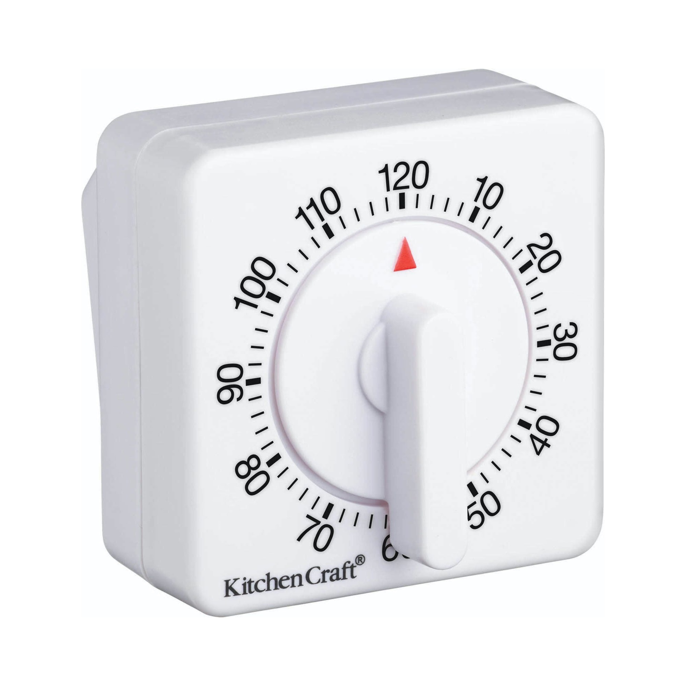
Notes:
We knew we had an excellent way to work when we were totally unable to do it without an egg timer. Let me step back.

Slide 3

Notes:
We paired 100% of the time.
This was 2000, we had read the Extreme Programming White Book.
Did it by the book, because couldn’t mess about.
Because we couldn’t mess about, we ran experiments & did whatever worked.

Slide 4
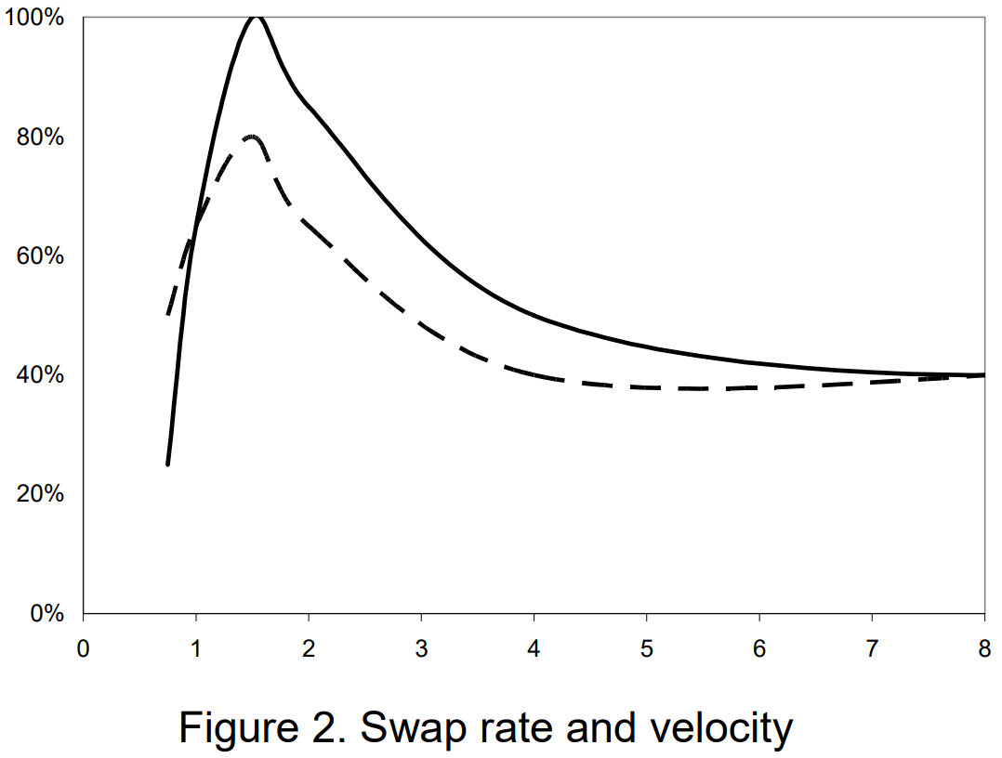
Pairing Duration (hours)
Notes:
Found some pairs were far more effective – even same people on different days.
Sought to establish why.
These were our results.

Slide 5
Notes:
But most effective was also hardest.
Team chose to use the egg timer. Not because we like pain, but because we understood the data.
Having finished Discovery, we now needed to Improve. And that means changing habits. For which we needs support, such as tools.

Slide 6
Choose How to Collaborate
Notes:
There are many ways to collaborate. PR, Peer, Pair, and Ensemble all work in different contexts. Many variations on each.
Intuition and ease may be misleading. Choose intentionally, based on data. And ease can be a valid factor!

Slide 7
Recommendation
Start off with pairing slide
Switch to experiment / engineering method slide
Notes:
Here’s where I make a recommendation about how you work.
…and because this is a talk about Pairing, I’m going to recommend…that you change your retro.
Start using data and lightweight experiments in your continuous improvement process (replaces traditional retro)

Slide 8
Our Results
Notes:
But first let’s talk about pairing
Walk through our results
…so if you’re going to pair promiscuously, make sure you experiment well!

Slide 9
What is Promiscuous Pairing?
Notes:
Speaker notes for slide 1

Slide 10
Isn’t This Obsoleted by Ensemble (Mob) Programming?
Notes:
Not really. Mob vs Promiscuous Pair vs slow Pair vs Peer vs Solo/PR feature comparison
But these are all generalizations. Different teams see different results. Different contexts need different things. So run the experiments yourself and choose.

Slide 11
Other Teams
Notes:
Mention MS team’s follow-up a year later
Surfaced all the problems. They had a traditional continuous improvement process, so couldn’t solve the problems in real time.

Slide 12
Change Patterns
Notes:
4 parts of changing something: identify problem, generate ideas, decide among them, implement them (partially), verify them.
4 common orderings: governance, retro, stage magic, and experiment.
Governance and retro are similar, but governance does first 3 steps in different context from last 2. And both governance and retro often skip verify – leading to silent success & failure.

Slide 13
Discovering
Notes:
Scientific Method
Social experiments
Goal: maximize learning, not success. Even if it means intentionally doing the wrong thing – Wordle example.
Avoid obvious invalidity problems
Test multiple options, including the current state
Vary details within the practice
Use qualitative and quantitative measures
Measure one level up and out when possible
Measure invariants, to see if they do vary
Write down the results in real-time, not in a retro after
Don’t adopt anything; try everything

Slide 14
Improving
Notes:
Engineering Method
Goal: improve, even if it costs learning.
Assumes knowledge is present
Now apply & refine best ideas.
Build consistency & habits.

Slide 15
Structure: overview
Notes:
Overall: alternate discovery with implementation
Each week, know which you are doing for each facet of your work
Retro format: shorts & longs. Shorts only apply for improvements, longs lead to experiments.

Slide 16
Discovery – how-to

Slide 17
Improvement – how-to
Focus on habits & fluency
Start by getting to consistency
Then refine the habit

Slide 18
Week structure
Retro (planning portion): longs & shorts
Discover 1 thing + Improve 0-1, or
Discover 0 things + Improve 1-3
Retro (demo portion) analyze results, make decisions
Note: this means your improvement week starts/ends about 10 min into your retro meeting!

Slide 19
Your Collaboration Style
Notes:
Choose it intentionally, based on data. Then improve it consistently.

Slide 20
First Next Step: Swap your Retro

Slide 21
Ask me Anything / Resources
QR code

