Slide 1


Data Diggers

Slide 2


Problem Statement

Slide 3

In today’s Commercial Banking landscape, there are strategic growth opportunities with diverse customers. Wells Fargo has innovative programs to support women and minority–owned business with banking products for near and longer term growth.
In order to better serve these customers or prospects, Wells Fargo needs an effective and automated technology tool(s) to identify the diversity dimensions of the ownership and/or the leadership of these commercial customers and/or prospects.
Currently this data is being combed from customer and prospect websites and other public data in a manual fashion. A new technology or tool will increase efficiency of this effort, reduce potential human bias, and generate more potential opportunities for diverse customer engagement.

Slide 4
The scope of this challenge include diverse owned or led businesses.
Diverse-Owned businesses include:
Minority Owned: where a business is more than 50% owned and controlled by individuals who are Black or African American, Hispanic or Latino , Native American or Indigenous, Asian-Pacific Americans and Asian-Indian Americans
Women Owned : where a business is more than50% owned and controlled by a person with disability, regardless of their ethnic background.
LGBTQIA+ Owned : where a business is more than 50% owned and controlled by a person who identifies as lesbian , gay , bisexual , transgender , queer, intersex, or asexual regardless of ethnic background.
Veteran Owned : where a business is more than 50% owned and controlled by individuals who are veterans regardless of their ethnic background

Slide 5
Challenge Description
This challenge anchors around leveraging technology , technology intelligence and potentially ethical AI or development tools to identify diverse owned , or led businesses.
Accuracy of insights and data gathering ; speed of execution and ability to source national or global diverse customer opportunities is key. Removing bias and ensuring optimal diverse customer identification is essential for success.

Slide 6

User Story 1
Logic to Identify diversity dimensions that apply to the companies in the prospect list
Description – Develop logic that identifies if the companies from the prospect list have applicable diversity dimensions. The list of diversity dimensions is as below:
Identify if the company is minority owned.
Identify if the company has women ownership
Acceptance Criteria – The platform should identify the applicable diversities to the companies in the prospect list.

Slide 7
User Story 2
Logic to assign diversity score to the diversity applicable identified companies
Description – There should be a logic which checks all the applicable diversities applied to the companies in the prospect list and then combine them to give the diversity score. Then preference would be given to the prospects. The platform should also give the flexibility to the business users to add new criteria to decide the diversity score.

Slide 8

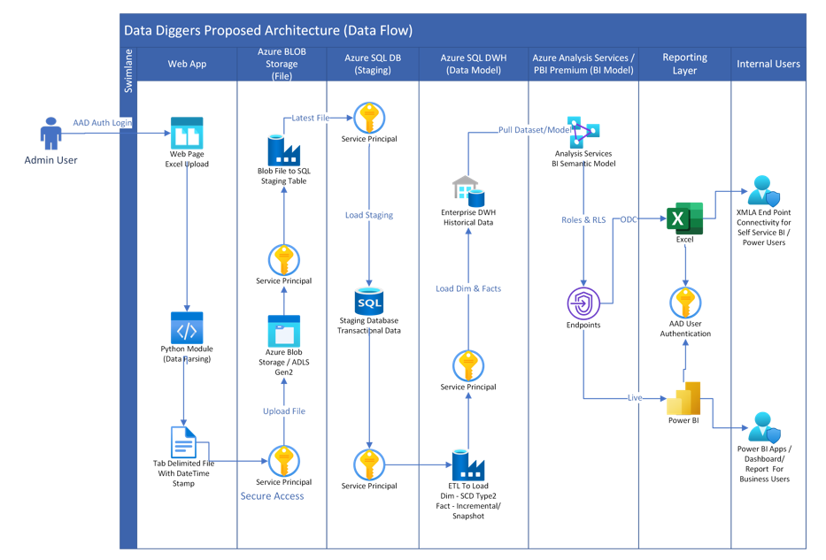
Data Flow Diagram

Slide 9
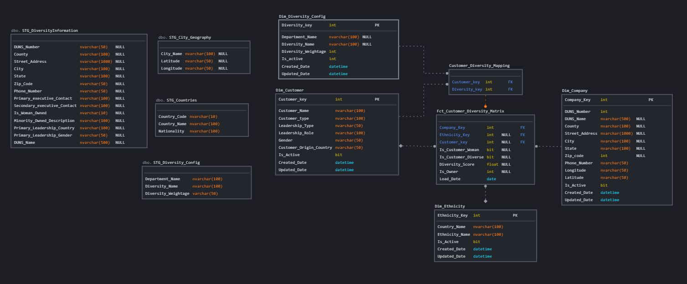
Data Model

Slide 10


