Slide 1
Team Members :
1. M.Ali Ahmed Roll number : BSCS-13016
He will manage all the technical part of the app. He will work at the backend development of the app and will write code according to the required functionality . He has good sense of creativity and design as well .
2.Ahmad Nawaz Roll Number : BSCS-13046
He will manage all the design changes in the app according to the requirements. His responsibility is to keep the app features in a way that it would be good for marketing and sales. He would look after the research / feedback of the potential users and end users and would keep feasibility notice of functionality which they want to add in our app.

Slide 2
Problem Domain :
Our problem domain is regarding food. We will make app where we will have digital menu of restaurants / cafes etc with pictures of dishes and small description
Interviewee :
Our interview consisted of people who go out to restaurants , cafes for having lunch , dinner etc. We also interviewed some of the owners of these places to know about their response,requirements and suggestions about our app. We also did interview of a person who made the menu for a cafe to know about what he sees while making a paper menu and what is his opinion about our app .

Slide 3
Name : Ayesha Haider
Age : 22
Student
We catched this girl at a cafe at MM alam road . She said she goes at least twice a week outside for lunch dinner etc. She choose places to eat by friends recommendations . On asking she said it would be great to see the picture and know the ingredients of dish before ordering them . On asking suggestions she said the app should be easy having variety of dishes and cafes / restaurants available on the board.
2 . Taimur Sheikh
Age : 30
Owner Zucchini Restaurant
He said we use simple paper menu because everyone uses this .

Slide 4
He said we don’t do pre ordering but we do reservations on call . Further on answering a question he said it would be great if they can get pre orders and reservations on app. He said it would be a great idea to compete our competitors by using this digital menu rather than paper. On asking to get on board so we can take pictures and see the ingredients to work on our app. He said we can do this by making some time on a specific day and by dealing properly on a paper.
3. Muhammad Farhan :
We also interviewed paper menu maker of a restaurant so we can know what information or material we need to make the app. He said we only mention name and price of the dish on menu. We make categories of different food items like desi , continental or desserts etc. He said profit margin is good and pricing is given to us by owners . At last he said it would be good to have digital menu and I think everyone would like to get on board with you and reach more customers by your portal.

Slide 5
Interview Results :
“ Wow that would be great “
“ We would definitely get on board with you to get more customers by your portal “
“ Make it simple and easy “
“ Great idea to compete with our competitors “
Mostly the result was good. People showed interest in knowing about food available on different restaurants prior ordering but some people also said they don’t like to do this as they were not interested in tech things .

Slide 6
Surprising :
“ Some owners of restaurants showed a positive response and welcomed us to continue making the app and assure us to get in board once completed.”
“ Some users were so interesting they said we want this to be launched now “
“ Some were not interested at all who don’t like to use tech things for normal day life “
“ People said it’s a unique idea better than foodpanda and eat oye . “

Slide 7
Discussion :
After looking at the interviewee results . We concluded we need a design for our app which is simple yet full of details and variety.
Food industry is a big market so we still can make place in it .
People are welcoming to unique ideas which gives value to their life .

Slide 8
Analysis :
We concluded that people need a place where they can see the reviews , pictures and prices of different dishes of different restaurants which can save their time for choosing what eat and also save their money from having bad food experience outside .
People don’t like apps which are complex so we need to make app which is simple and easy to use .
People get attracted to pictures more so we need good authentic pictures of food so we can have more visitors on our app.

Slide 9
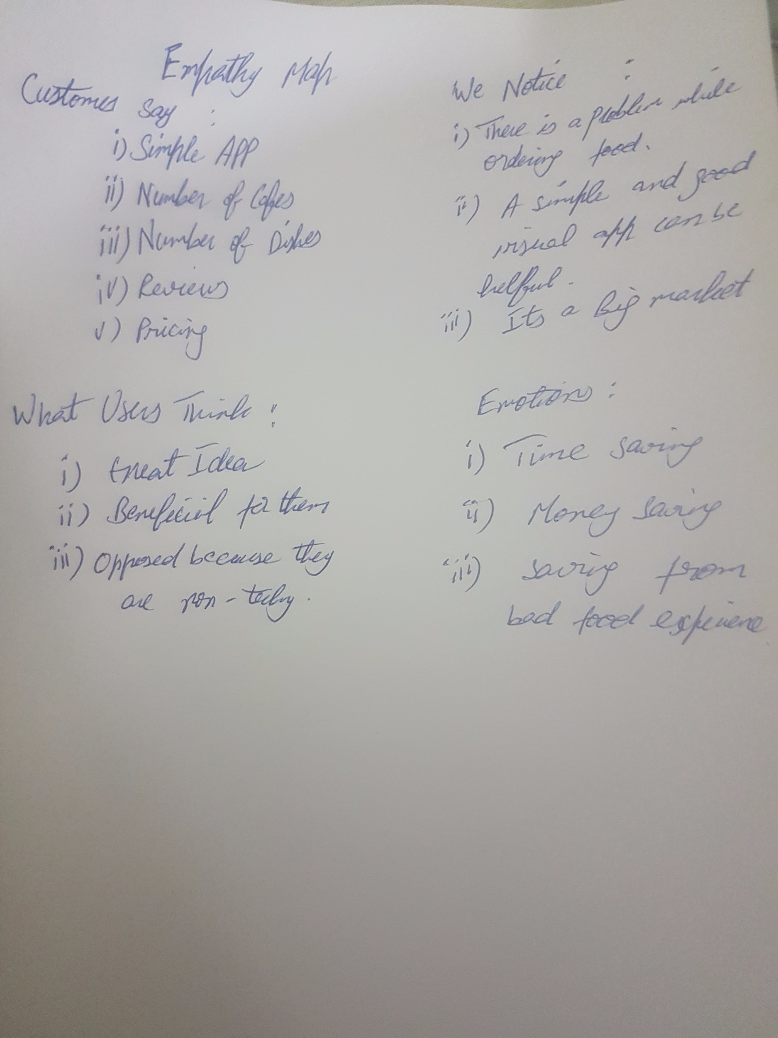

Slide 10
Summary :
We are going to make a app for people having food items with pictures and description which are available in restaurants and cafes so they can get to know which is according to their and which cafe provides it in most cheapest and best taste. After the survey we got to know our idea has great potential to work and make it possible in reality . We see a lot of users who are owners of restaurants and end users who goes outside to eat . We also evaluated people need simple and easy app which is not complex.

