Slide 1
Project Timeline
System Design
Development
Product Demo
Documentation
Training
&
Implementation
System Design: April 8 – 13, 2013
Development: April 15 – 20, 2013
Product Demo: May 2, 2013
Documentation: April 29 – May 4, 2013
Training & Implementation: May 6 – 11, 2013

Slide 2
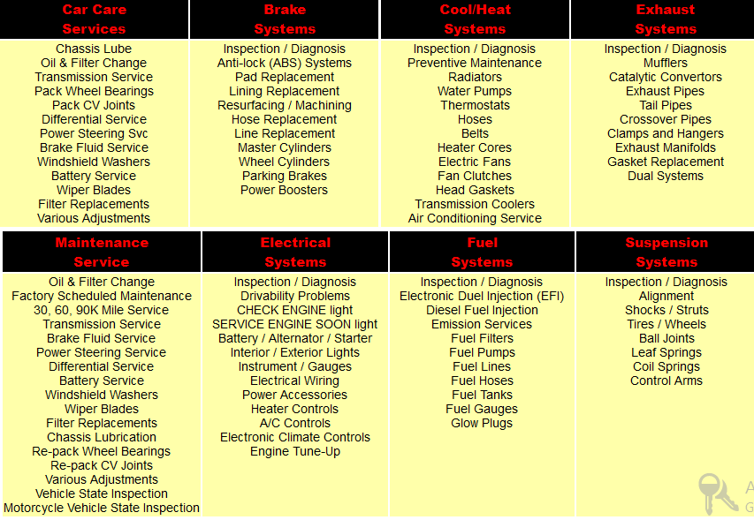
Labor types

Slide 3
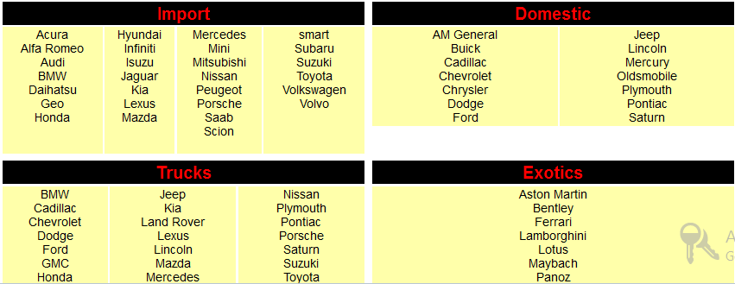
Makes

Slide 4
References
http://www.theautoshop.com/main/service.html
http://www.automotiveserviceshop.com/Greensboro-auto-service-repair.html

