Slide 1
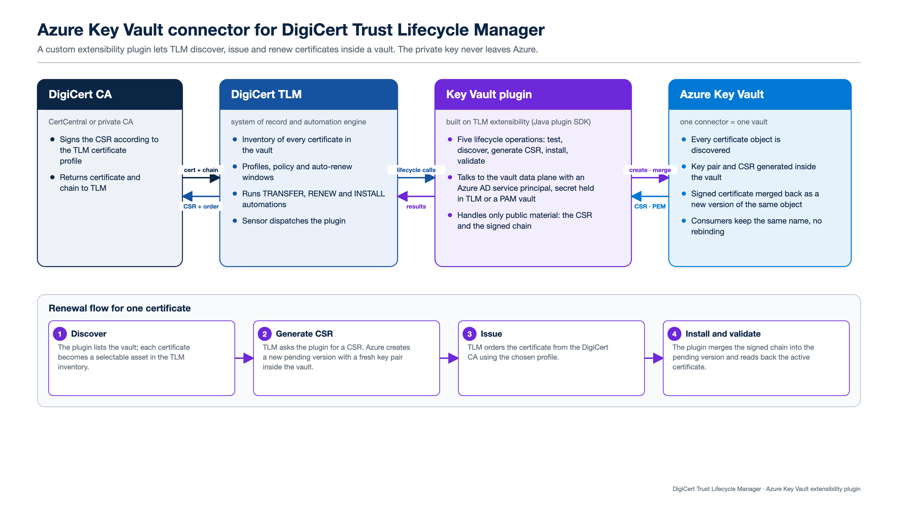
Notes:
Azure Key Vault connector for DigiCert TLM

Slide 2
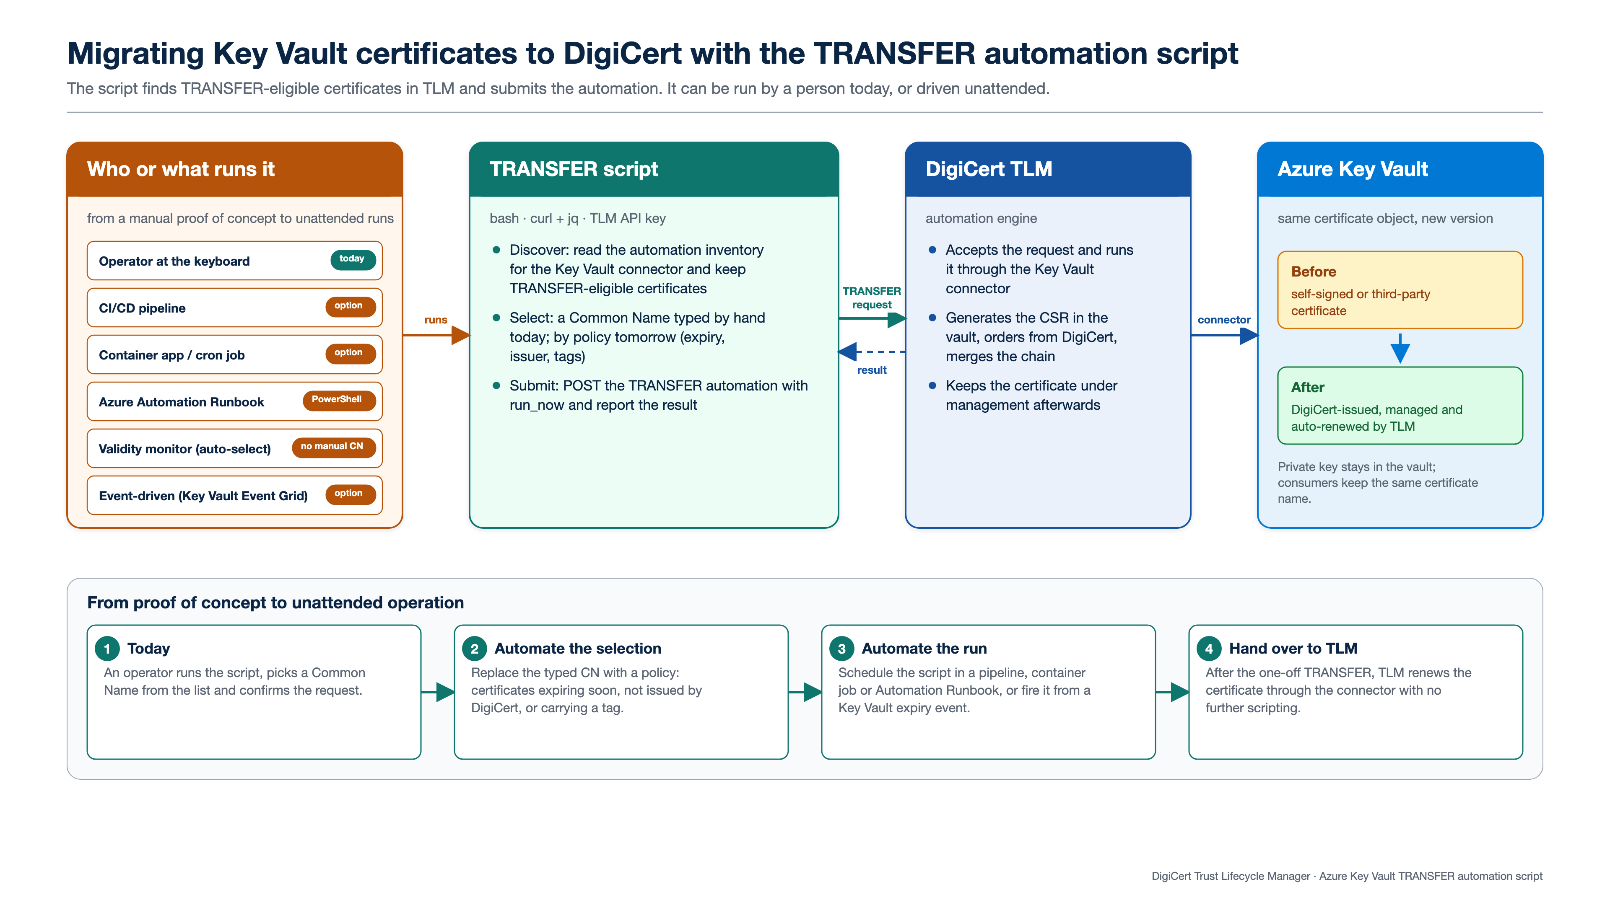
Notes:
TRANSFER automation script

