Slide 4
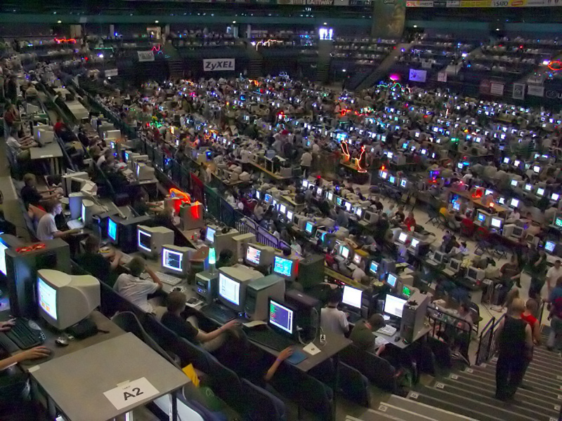
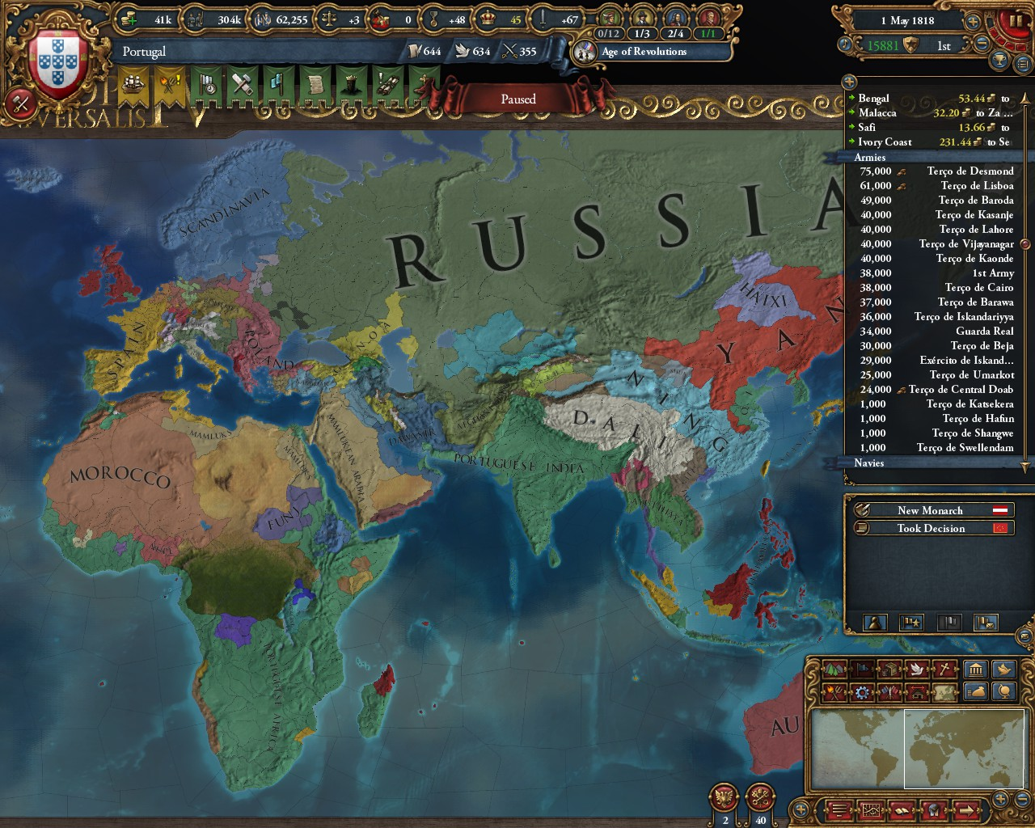
Art

Slide 5
Engineering
Computer science
Factories; interfaces, electronics, robots, AI, automation, ...
Infrastructure; 3D road modeling, simulation, water treatment plant machine interfaces, ...

Slide 6
Finances
Bank systems…
...where to even begin?
Websites, card readers, cards, security, administration, …
Also digital currency and blockchains; e.g. Bitcoin, etc.

Slide 7
Mathematics
Programming is obligatory in Swedish primary school maths. Why?

Slide 8
Mathematics
Approximation: Are we close to the answer yet?
Example: lim x→inf ( (x + x)/x )

Slide 9
Mathematics
Modeling: Understanding the world through numbers and shapes.

Slide 10
Education
“IKT”
Administration and grades
Digital books and resources
Communication with students and teachers

Slide 11
Nonprofit organisations (NGOs)
Websites
Membership administration: Signup form, database, mass communication (email lists, event signups)
Other administration: Accounting, etc.

