Slide 1

Common Operating Picture
Phase 1a Findings
December 2011
Prepared by COP Project Team

Slide 2
The Project Task…
Determine the information that should be included in
a Common Operating Picture considering:
Community and control perspectives
What information (and what source datasets) are most important to adding value to the information chain?
Where is the data to provide the information?
Is this data useful and fit for purpose?
What are the issues with the information datasets?
What else may be envisaged over next 5 years?

Slide 3
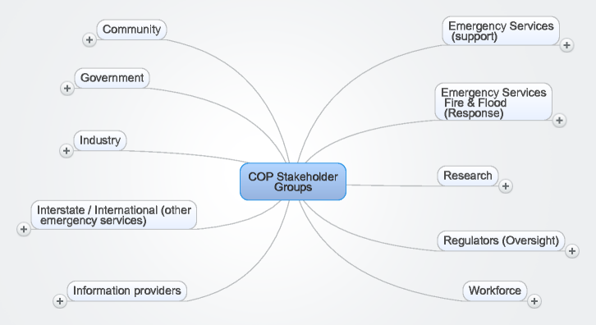
Summary of Stakeholder Groups

Slide 4
Approach to Project
Survey current and future users to determine demand
Analyse results
Survey agencies to determine data supply
Analyse results
Document findings

Slide 5
COP Principles…(derived from interviews, surveys and agency team members)
Facilitate the state control priorities, being saving lives, assets and the environment (in that order)
Enhance the flow of two-way real-time information between incident personnel and incident controllers as well as enhance the flow of information to and from the community
Be viewable/accessible (Internet-enabled) on multiple devices, whenever and wherever the community and/or control staff require
Have intuitive functionality that requires low training needs and is tailorable to role, location and community context
Be suitable for multi-hazard, multi-agency events and facilitate inter-agency working where required
Be as open and transparent as possible with information both between agencies themselves, and also between agencies and the community

Slide 6
COP Principles
Be spatially oriented while still supporting other forms of information sharing (email, short messages, short media news feeds etc.)
Support balanced views between timeliness and verification levels of data with a strong emphasis on providing Incident, Conditions and Predictive information
Be useful for pre-incident planning and daily use as well as during incidents and recovery
Be highly flexible and extendable so that additional views/capabilities can be provided via COP on an on-going basis
Be highly robust and scalable so that any dependencies on COP do not diminish community or agency access to information from current levels

Slide 7











Common Operating Picture (COP) - Conceptual Design
Common Operating Picture - our Conceptual Design
EMERGENCY SERVICE ORGANISATIONS
GOVERNMENT AND
GOVERNMENT BODIES
VIEWING LAYER
DEPARTMENT OF
HEALTH AND AGEING
INFORMATION ACCESS
DEPARTMENT
OF HOUSING
ENVIRONMENT
PLANS &
DOCUMENTS
INCIDENT
IMPACTS
INFORMED
PREDICTIONS
CONDITIONS
RISKS
& VALUES
READINESS
RESOURCES
INFORMATION ACCESS
MEDIA
VIEWING LAYER
INDUSTRY AND SUPPORT AGENCIES
PUBLIC
Viewing layers that are customised for type of viewer & role
Viewable on a large range of devices, anywhere, anytime
COP emphasis should be on enabling the free flow of tailored, contextualized information

Slide 8
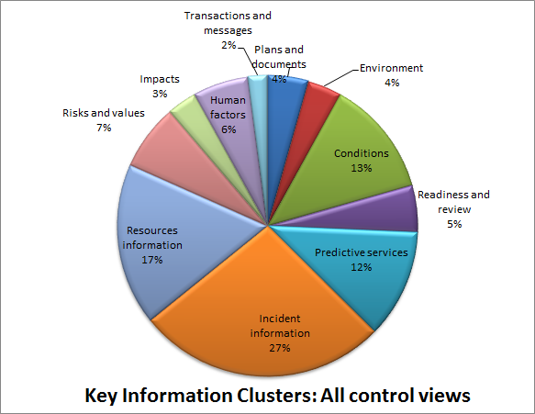
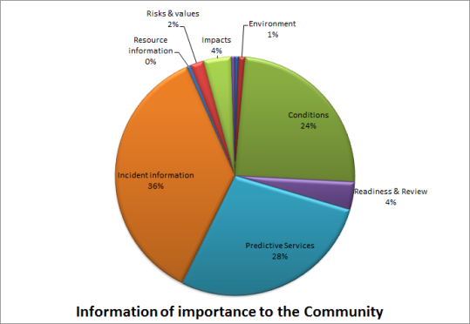
From the interviews and surveys we determined the information class weightings…for various views and event types…
See dynamic spreadsheet for views by role and type of event…

Slide 9
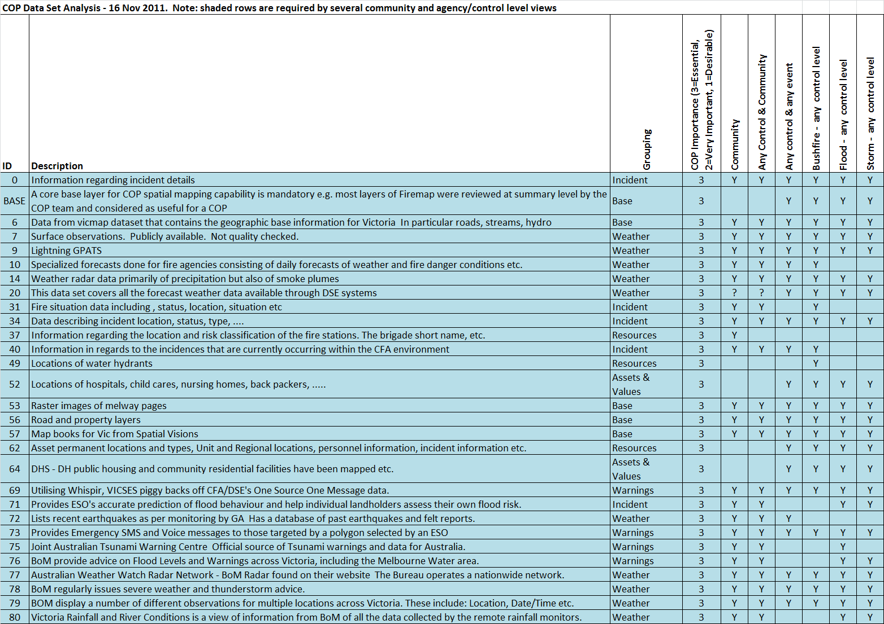
Information Datasets evaluated as being essential to COP (blue)
Note: There is no implied order in the listing. The listing is in Dataset ID order only for convenience.

Slide 10
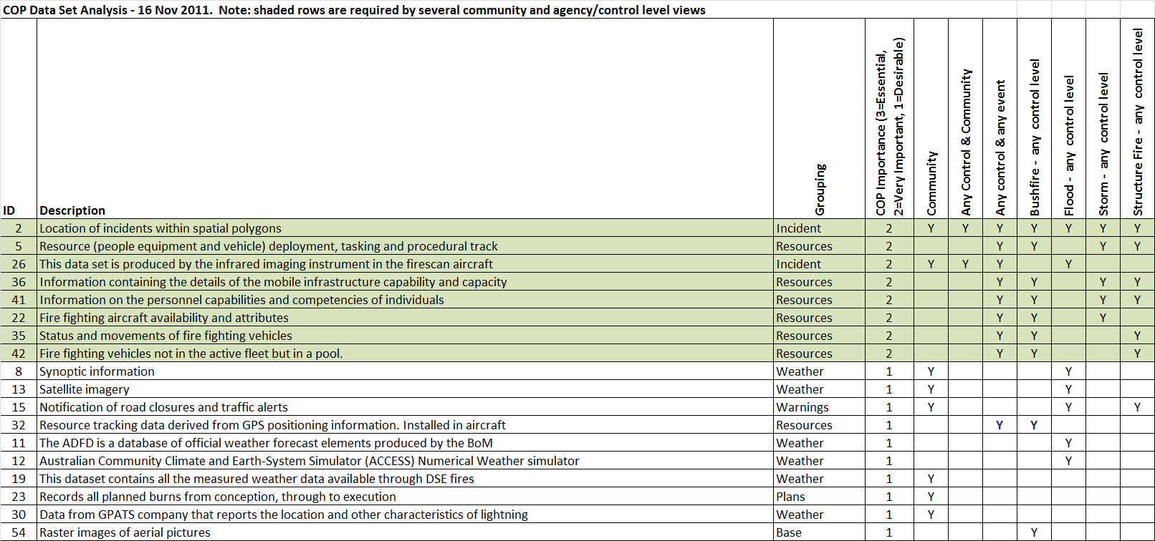
Information Datasets evaluated as being highly valuable (green) or useful (white) to COP
Note: There is no implied order in the listing. The listing is in Dataset ID order only for convenience.

Slide 11
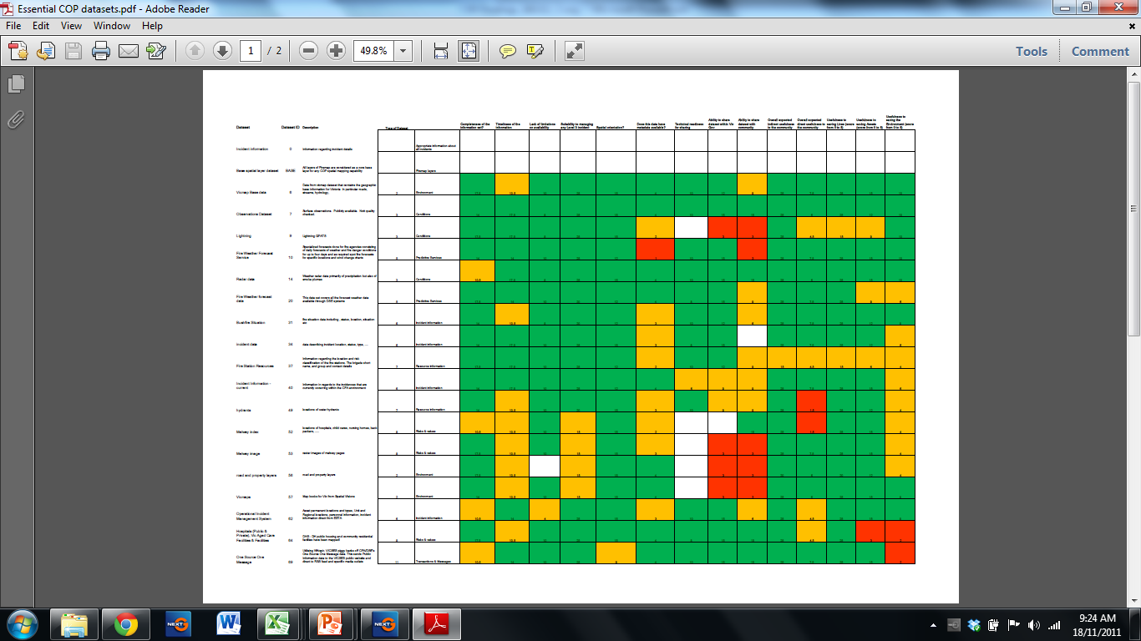
Each dataset has been subjected to evaluation on the basis of the weightings and other criteria such as ability to share…
See Excel dataset analysis toolkit

Slide 12
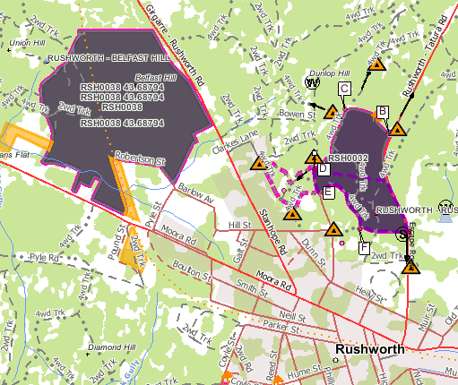
Information Data Set Groupings
Each of the high rated data sets has been included in one of the following groups:
  A core base layer for COP spatial mapping capability is mandatory e.g. most layers of Firemap were considered at summary level by the COP team and considered as useful for a COP
  Assets & Values
  Weather
  Incident
  Warnings
  Resources
  Plans
  Other

Slide 13
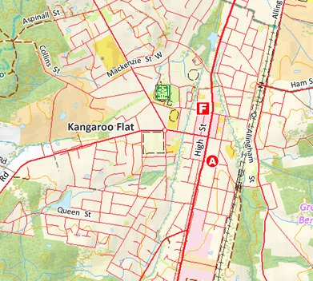
Base Information Dataset
Includes:
Vicmap layers
  Roads, Streams, Terrain, Vegetation
Melways
  Image, index
Datasets nominated for inclusion: BASE,6,52,53,56,57,64, 52
Notes:
BASE,6,52,53,56,57,64, 52

Slide 14
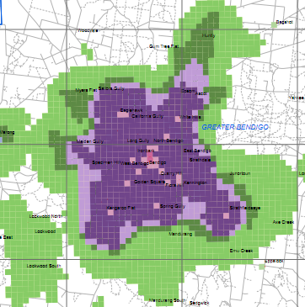
Assets and Values
Includes:
Population
Community Assets
  Schools,
  Hospitals, Aged Care, Nursing homes
  etc
Infrastructure
Environmental
Notes:
BASE,6,52,53,56,57,64, 52

Slide 15
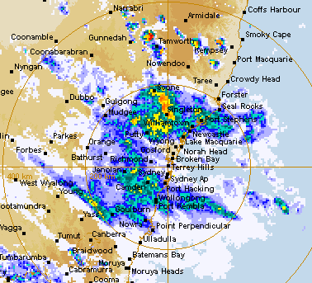
Weather
Includes:
Forecasts
  Fire, Rainfall, Wind speed
  Tsunami
Observations
  AWS Observations
  Rainfall
  Storms
  Lightning
  River conditions, tides
  Earthquakes
Datasets nominated for inclusion: 9,4,10,71,72,76,77,78,79,80,81,83,8,11,12,13,19,30
Notes:
9,4,10,71,72,76,77,78,79,80,81,83,8,11,12,13,19,30

Slide 16
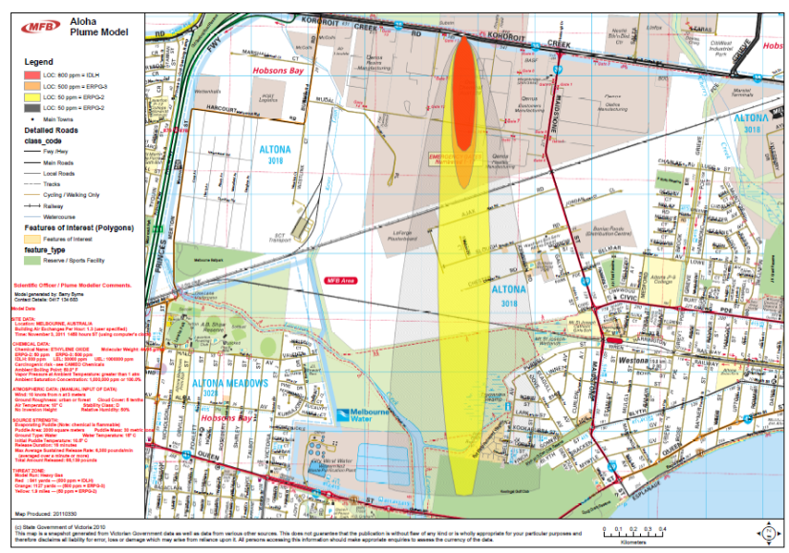
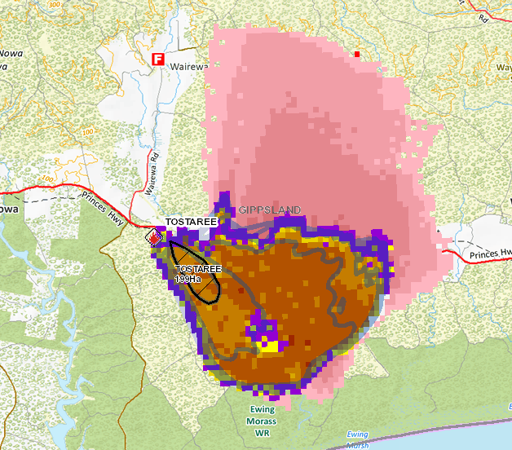
Incident
Data:
Type
  Fire / Flood / Storm / Burn
Location
  Point / Area
Significance
Predictions
  Plume models, Fire spread, Flood height
Potential Impact Zone
Imagery
  Firescan, Air photo / Satellite, Photos / video
Datasets nominated for inclusion: 0,31,34,39,40,85,2,54,18,23,26
Notes:
0,31,34,39,40,85,2,54,18,23,26

Slide 17

Warnings
Data:
Bans and Restrictions
  Total Fire Bans
  Fire danger period
Weather Warnings
  Fire, Storm, Tsunami
Incident Specific Warnings
  OSOM, Emergency Alert
Road closures
Evacuation Information
Datasets nominated for inclusion: 10,69,73,76,78,81,15
Notes:
10,69,73,76,78,81,15

Slide 18
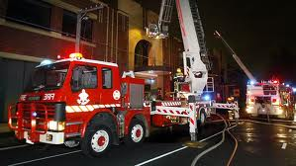
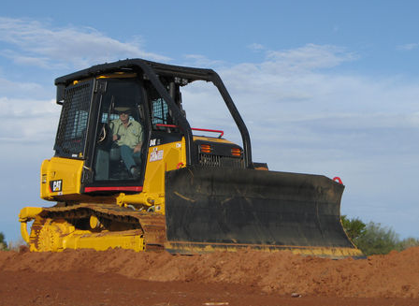
Resources
Data:
People, Vehicles, Equipment, facilities
  Too many to list here
Capacity – How many
Capability – What they can do
Location – Where are they
Deployment and Tasking
Issues:
Agencies do not have same terminology for all asset types
Location has more than one meaning (eg: GPS or base address)
Datasets nominated for inclusion: 37,49,62,5,22,32,35,36,41,42
Notes:
37,49,62,5,22,32,35,36,41,42

Slide 19
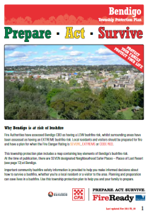
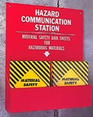
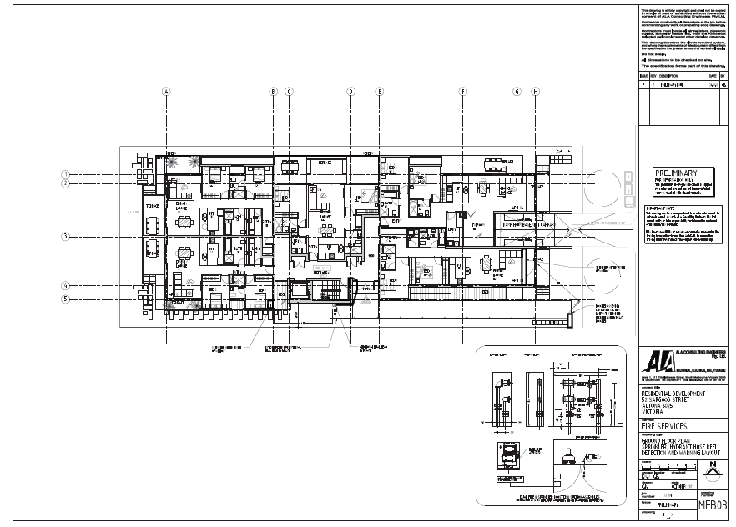
Plans
Includes:
Township Protection Plans
Municipal plans
Preparedness plans
Building Plans
Hazmat Information
Planned Burns

Slide 20
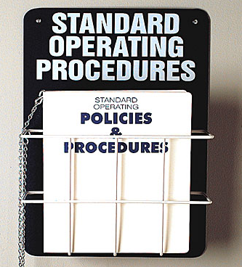
Procedures & Documents
Data:
Documents
Forms
Aid memoir
Standard Operating procedures
Meeting schedules
Media Monitor feed
Issues:
Data sets of this type may not have rated highly in the analysis however may need to be considered

Slide 21
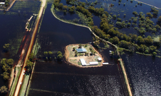
Impacts
Data:
Displaced Persons
Houses lost
Economic impact
Infrastructure at risk
Issues:
Data sets of this type may not have rated highly in the analysis however needs to be considered

Slide 22
Actions: Information Groups Required for COP
1
1
LEGEND
1 = Base Data - The data that is found on most maps, roads, streams, topography etc.
2 = Asset & Value - Those things threatened by an emergency. Life, property, environment
3=Weather - Forecast and observed weather including predictions
4=Incident - Information about the incident, location, size, behaviour, significance etc. including some predictive information
5=Warnings - Warnings about the fire danger period, Total Fireban day, or incident
6=Resources - Information about agency personnel, vehicles, equipment and infrastructure
7=Plans - Pre prepared plans – township protection, municipal, building, hazmat, planned burns, etc.
8=Procedures - Documents that inform agencies on how to prepare, respond and recover
9=Impacts - Information about what has been impacted by an incident
8
3
8
3
2
4
6
5
5
4
2
Ease of Implementation
7
9
9
6
7
Degree of Added Benefit of Providing via COP
Items in the shaded green zone offer the greatest additional benefit AND/OR are easiest to implement.
Yellow circles are Community Perspective, Blue circles are Agency Perspective
Notes:
Base Data –Assets & Values –Weather –
Incident –
Warnings –Resources –
Plans –
Procedures –
Impacts –

Slide 23
Major Findings/Recommendations for Action
COP – Links to common plans relevant to hazard
Portal access for Agency & Community viewing of COP
Agencies publish incident data in common standard
COP – Ingest & distribute red flag & other warnings
COP - spatial view contextualised to individual need
4
1a
Agencies to publish warnings in agreed standards (eg CAP1.2 / GeoRSS)
45
17
COP – include links to other services
7
29
46
Publish data in standard form for Social Media
COP Information delivered to wide range of devices, anywhere anytime
9
Share schedule of daily meetings/briefings
21
Emergency response facilities & infrastructure included in COP
36
30
1b
Ease of Implementation
Assets at risk info to be available in advance
COP – Highly Internet enabled
Capture significance of each incident & display this
5
31
COP views selectable as pre-configured options
19
13
12
COP display should meet approved accessibility standards
16
Tailor display to suit requirement
Agencies to publish potential incident data in agreed standards
15
22
3
Warnings from Agencies (eg BOM) to publish warnings in agreed standards
Allow users to setup filters & triggers
Agencies to share incident info on resources & location
Degree of Benefit
Legend: Items in the shaded green zone offer the greatest benefit AND/OR are easiest to implement. However, all the findings are recommended to be implemented for COP v1.0

Slide 24
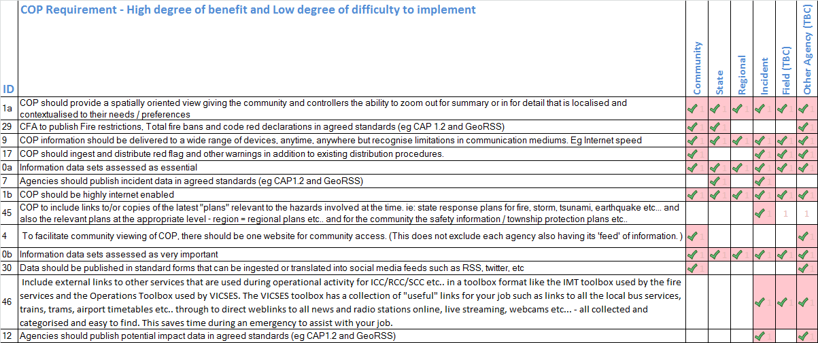
Findings listed in order of Benefit/Ease of Implementation

Slide 25
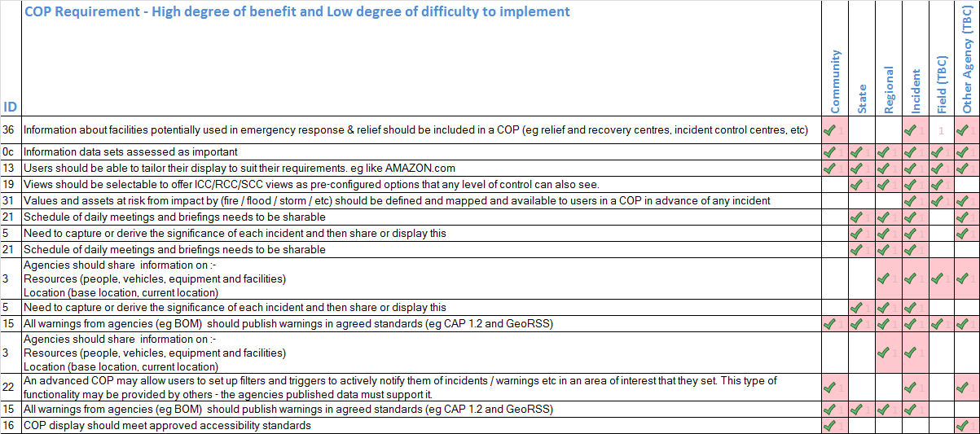
Findings listed in order of Benefit/Ease of Implementation – Cont’d

Slide 26
Summary
The COP Phase 1a project has gathered information from over 240 interviews/surveys of all relevant stakeholders to identify their information requirements in an emergency, for pre-planning and recovery
COP initially is regarded as a viewing platform, accessing the key information datasets.
The information from our findings and dataset evaluations will inform the next phase of the COP project, which is the specification and design of a viewing platform
We have sought and acted on feedback from Chief Officers
We have published a final report with recommendations including a prioritised list of actions (summarised in this slide pack)

Slide 27
Conclusion
The agency Chief Officers have reviewed this pack during individual interviews and have agreed with the findings as expressed. They have also offered their constructive feedback which has been incorporated into this pack and the final report.
The Chiefs also offered their appreciation of the COP team efforts.
The COP team thanks the Chiefs and agencies for their time and availability.
Frank Stockton, COP Team Leader, Dec, 2011

