Slide 1
Family Planning Landscape of Indonesia
Inang Winarso – PTSU
FP2020 CC Meeting , Dec 14. 2016

Slide 2
Introduction
Country Engagement Working Group (2013)
Requested all committed countries to provide information on its FP situation
Landscaping exercise using the matrix given by the CEWG
Objective
To help gain a better understanding of FP situation in all committed countries
To be used as reference by the FP2020 Reference group and the CEWG
Indonesia CC submitted to the CEWG in Dec 2013
Indonesia CC feels the need to update the situation after 3 years:
To inform the Country Committee on the latest situation
Use the opportunities and address the challenges ➔ Discuss way forward to achieve the committed targets
Strategic Planning of FP 2015 – 2019 - revised 26 Sept 2016

Slide 3
Landscaping Matrix 2016
A working documents
Still needs more inputs
Elements of information in the matrix:
Government Contacts
FP Plan
FP Committee
Partners in FP
Key Metrix

Slide 4
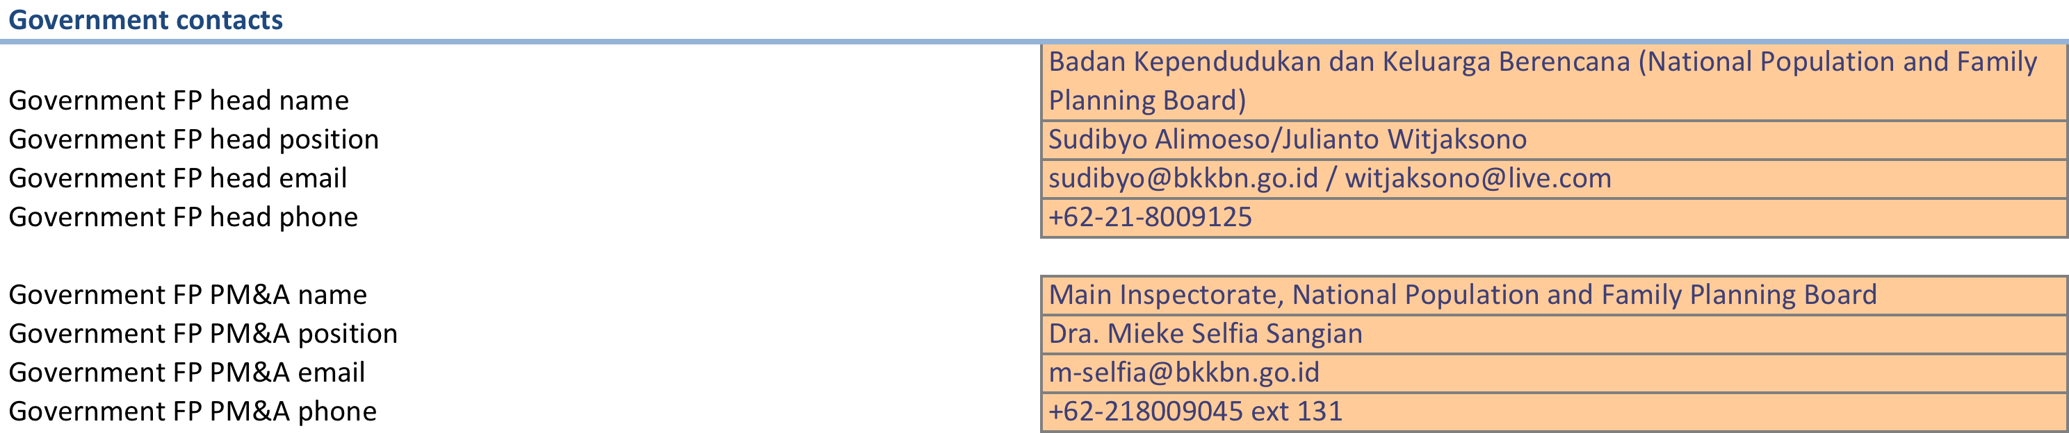
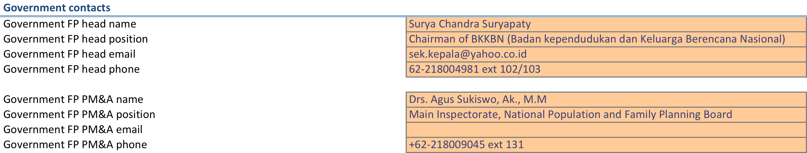
Government Contacts
2013
2016

Slide 5
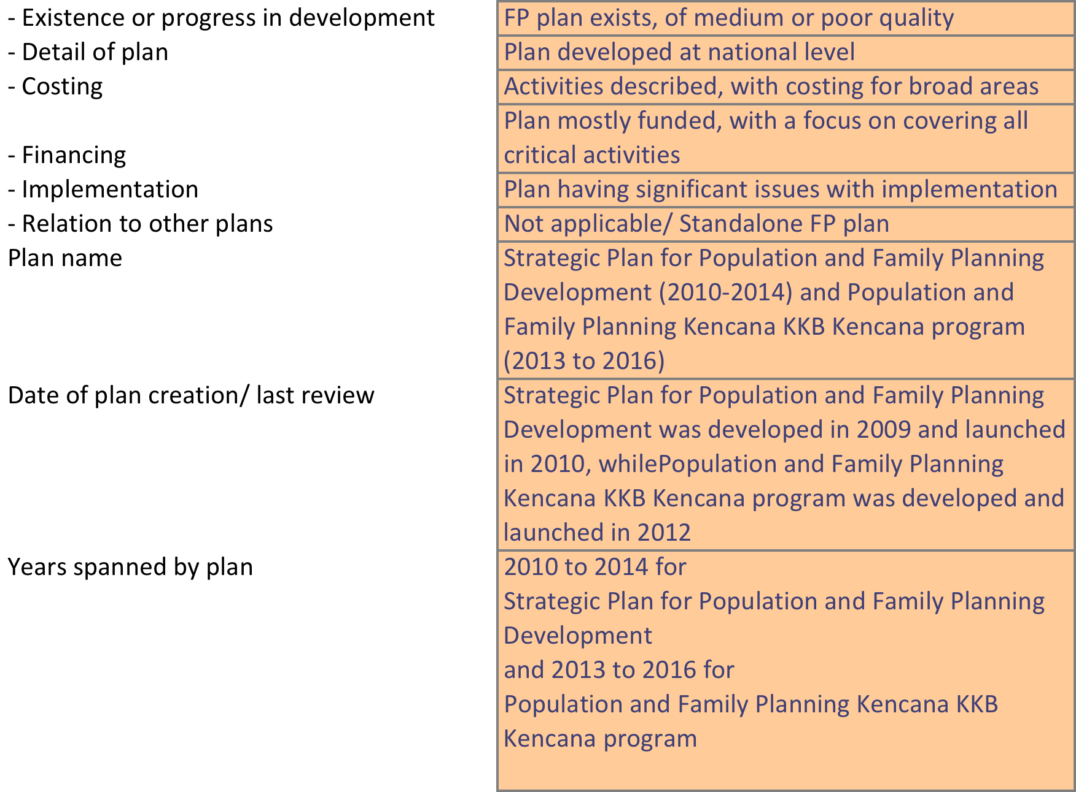
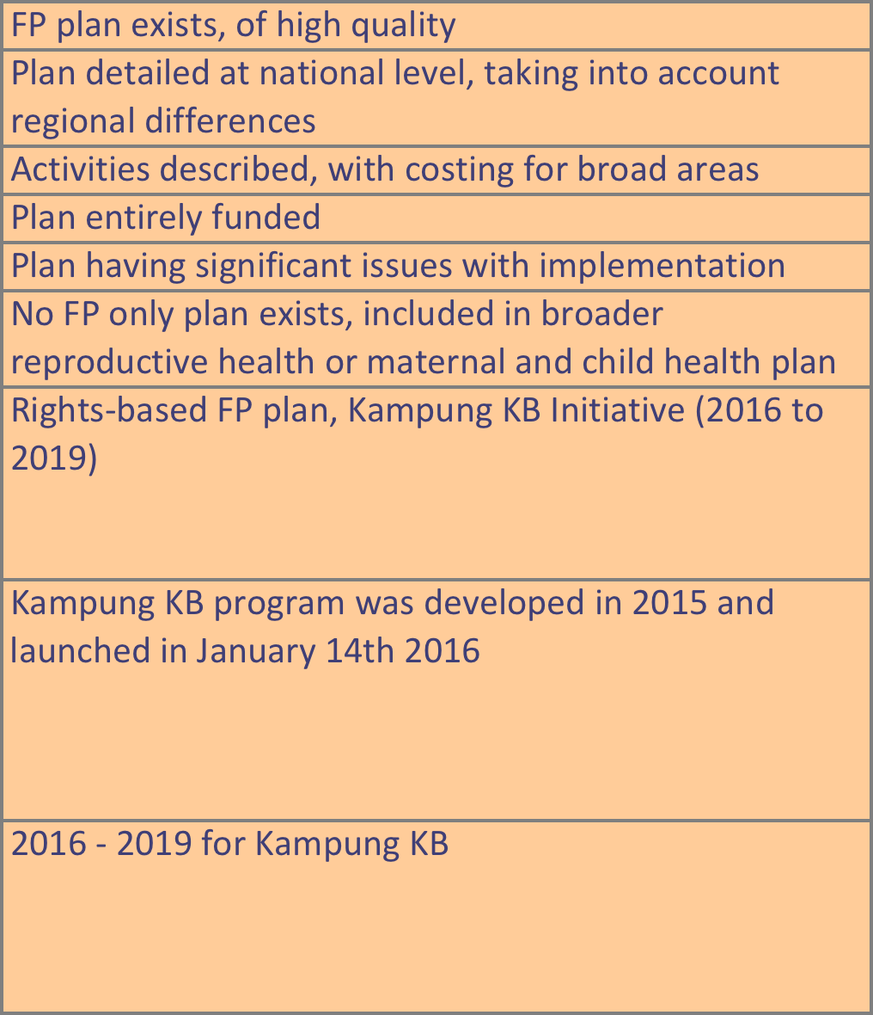
FP Plan
2013
2016

Slide 6
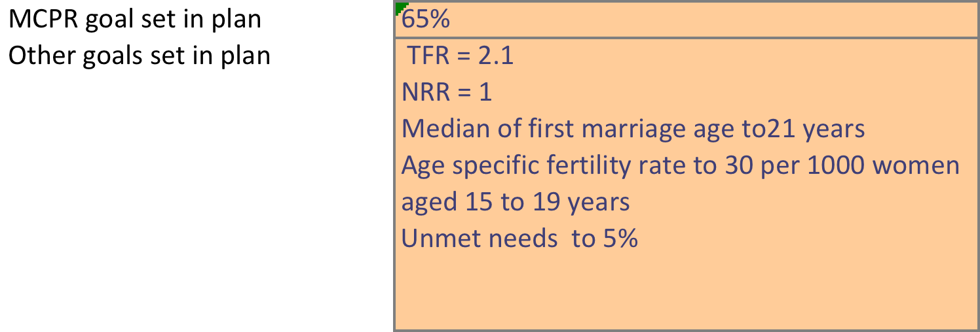
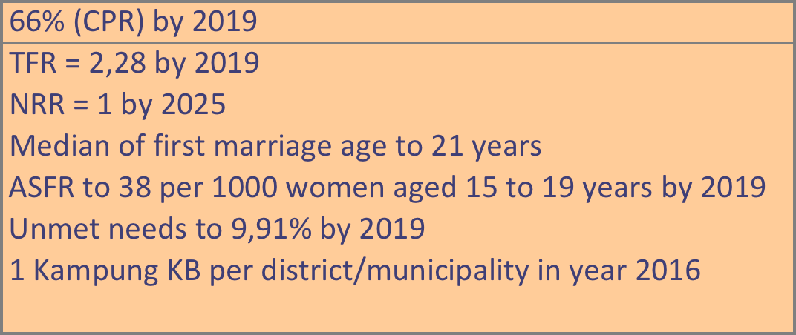
Goals
2013
2016

Slide 7
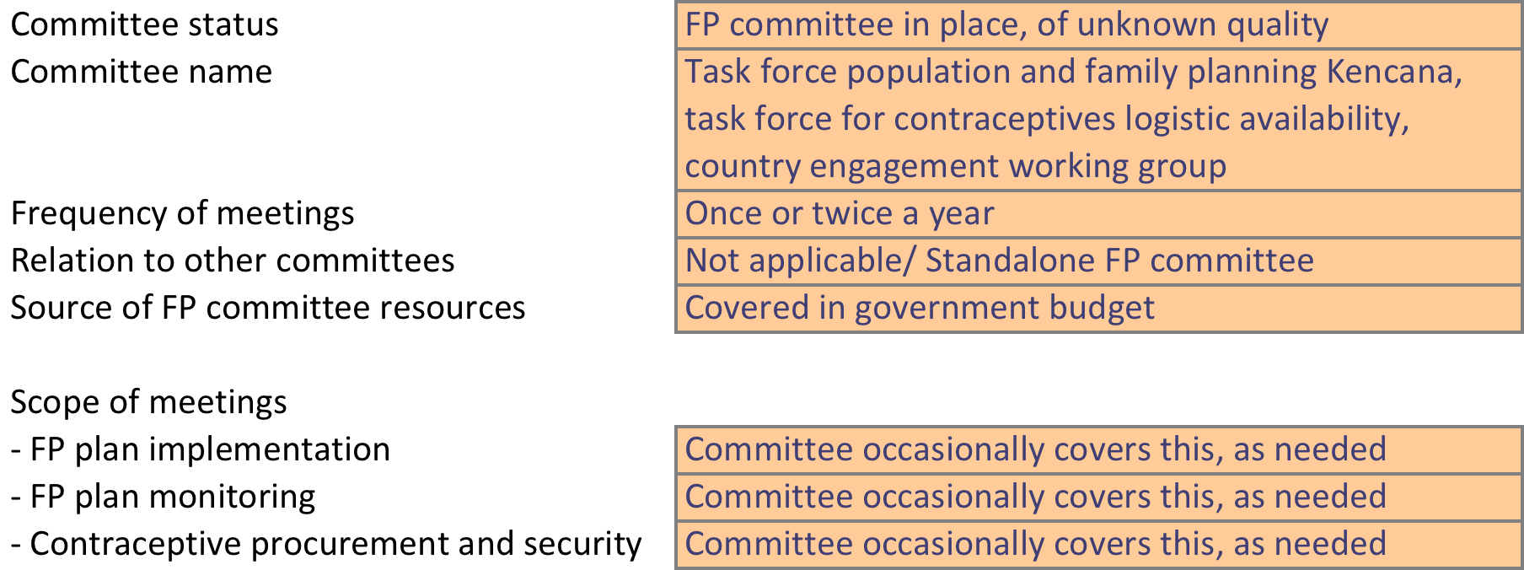
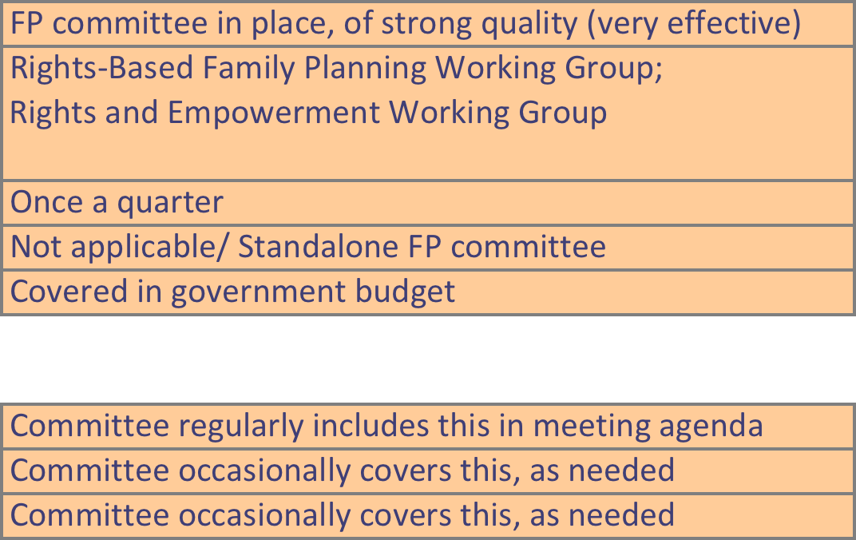
FP Committee
2013 2016

Slide 8
FP Partners
2013 2016
Status | Partnership coordination unit in place, of medium or poor quality, e.g. due to involvement of few types of partners
Committee name | Country engagement working group
Frequency of meetings | Once a month
Coordinated by | BKKBN
Topics covered - FP, RH, general health | FP coordination only
Partnership coordination unit in place, of strong quality, e.g. has representatives from donors, civil society, NGOs, etc.
FP2020 Country Committee
Once a quarter
BKKBN
FP coordination only
Civil society present in FP in country | Faith-based foundations with their networks (Muhammadiyah, NU), women NGOs
NGOs present in FP in country | JHPIEGO, AFP/JHU/CCP, PKBI/IPPF
Implementing partners present in FP in country | AFP/JHU/CCP, PKBI/IPPF, JNPK, PKMI
Private sectors present in FP in country | Pharmaceutical companies, private hospitals, midwives, medical schools
Key gaps/needs in partner support | Currently limited partners are supporting FP and the need to have better coordination
Profession-based society, such as Ikatan Bidan Indonesia (IBI)
YCCP, YKB, YKP, JHPIEGO, AFP/JHU/CCP, PKBI/IPPF
AFP/JHU/CCP, PKBI/IPPF, JNPK, PKMI
Pharmaceutical companies, private hospitals, private clinics.
Capacity building, technical assistance, and data information improvement and synchronization needed.

Slide 9
Key Metrix
2013
 |  |  | Date (year) |  | Source
DHS - CPR | 61.4% |  | 2007 |  | DHS
DHS - MCPR | 57.4% |  | 2007 |  | DHS
DHS - Unmet need | 13.1% |  | 2007 |  | DHS
 |  |  | Date (year) |  | Source
Most recent CPR estimate (e.g., country survey) | 61.90% |  | 2012 |  | DHS preliminary report
Most recent MCPR estimate (e.g., country survey) |  |  | 2012 |  | DHS preliminary report
Most recent unmet need estimate (e.g., country survey) | 11.40% |  | 2012 |  | DHS preliminary report
2016
 |  |  |  | Date (year) |  | Source
DHS - CPR |  | 61.9% |  | 2012 |  | DHS
DHS - MCPR |  | 57.9% |  | 2012 |  | DHS
DHS - Unmet need |  | 11.4% |  | 2012 |  | DHS
 |  |  |  | Date (year) |  | Source
Most recent CPR estimate (e.g., country survey) |  | - |  | -
Most recent MCPR estimate (e.g., country survey) |  | - |  | -
Most recent unmet need estimate (e.g., country survey) |  | - |  | -

Slide 10
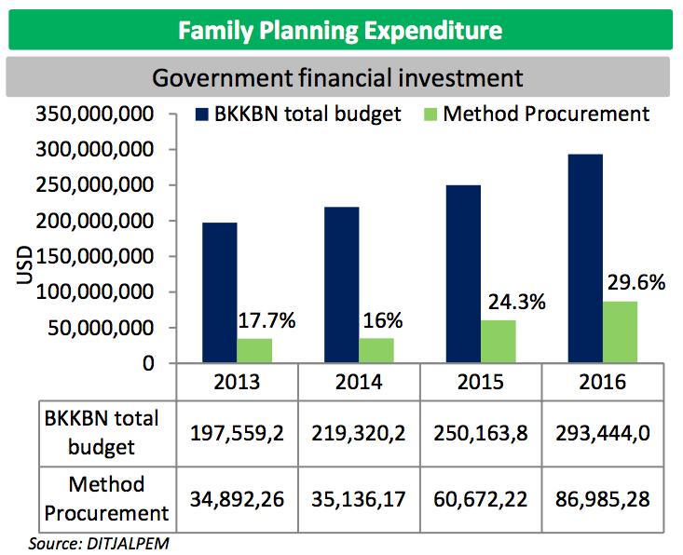

Slide 11
Conclusion
FP Plan
Kampung KB is an inclusive, comprehensive and intersectional village-based programme
Conforms to Village Law no.6/2014
Goals
More realistic and achievable targets in 2016 than those in 2013 - especially targets for TFR and Unmet need
FP Committee/working groups and FP Partners
This year committee and working group meetings are more intensive and of higher quality
FP Budget – increase in budget expenditure and method procurement since 2013

Slide 12
Way Forward
Needs policy on management and empowerment of FP facilitators in provincial and district level.
Needs policy to include unmarried people as target of family planning programme
Needs synchronized FP policies and database between BKKBN, BPJS, MoH, Ministry of Home Affairs, and District government.
FP services mechanism: in reference to MoH regulation No.52/2016: Standard Cost for Services Provided by BPJS
Chapter 2 : article 3 section 2.g, article 11, section 11.h
Chapter 3 : article 13, section 1.k ( tubectomy interval)
Data of contraceptive market share in private companies
In 2017 IDHS will be conducted

Slide 13
Thank You

