Slide 1
FP 2020
Working Group on Rights & Empowerment
(WGRE)
Jakarta, 14 Desember 2016

Slide 2
Main Responsibility of WGRE
To make sure that the implementation of FP services is based on rights and empowerment/ using rights based approach.

Slide 3
Team Member WGRE
Coordinator: Ninuk Widyantoro, Psychologist
Members:
- Dr. Setyawati Budiningsih, MPH (lecturer)
- Dra. Maria Ulfah Anshor, M.Si (female moslem activist)
- Dr. Reny Bunjamin, MPH (General practitioner &
public health expert)
- Dr. Kadek Sugiharta, Sp.OG (ob-gyn specialist)
- Indra Supradewi, MKM (IBI and lecturer)
- Angga Dwi Martha (youth advocate UNFPA)
Note:
propose to be added with representative of UNFPA, BKKBN (KB KR),
Kemenkes, Herna Lestari (YPKP)

Slide 4
Rights & Empowerment
Client Rights (IPPF)
Self Esteem
Information
Access
Choice
Security
6. Privacy
7. Confidentiality
8. Comfort
9. Sustainability
10. Opinion

Slide 5
Empowerment
Effort to empower client with knowledge (SRHR/FP) and information, psychological support and encouragement so client will be able to make informed choice and consent.

Slide 6
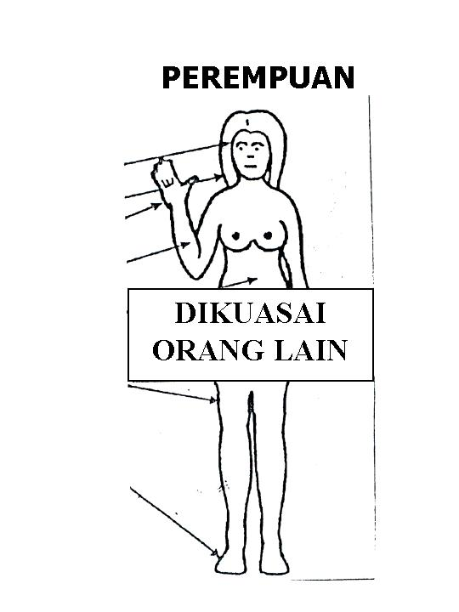
Fulfill Woman’s Reproductive Rights
Woman = human who has womb/ reproductive system
WOMAN
Right to be able to choose/ decide for her self
Susceptible
to violation
of
woman’s right
CONTROLLED BY OTHER PEOPLE
Controlled by:
Husband
Doctor
Family planning officer
State
Gambar. M. Fathalla
Source: Mahmoud Fathalla translated by Prof. Saparinah Sadli

Slide 7
Failure in empowering women because factor of
values, culture, religion, gender inequity
that handcuff the women

Slide 8
WGRE Contribution with right-based FP Strategy
Output 2.2 on increased involvement of community level stakeholders including women’s groups under Outcome 2 related to increased demand for modern methods of contraception
Output 3.6 on establishing functional accountability system under Outcome 3 related to stewardship/governance and enabling environment
Output 4.2 on operations research under Outcome 4 on innovations and operations research.

Slide 9
Develop Plan/ Activities (2017 – 2019)
End of 2016
Exploring SRHR FP need of the disability group.
Year of 2017
Pilot program for community rights and empowerment.
Year of 2018
Focus on empowerment on young people
Year of 2019
Lesson learned and operational research?

Slide 10
We are looking forward
to work closely with
working group Right-based FP strategy.

