Slide 1
RIGHTS & EMPOWERMENT WORKING GROUP

Slide 2
Background
Task of WG 2 : To identify the current barriers that prevent women from their right to exercise access to FP information and services to meet their reproductive goals (policy, health system barriers, social& cultural)
Supported by the Ford Foundation, the WG2 has conducted a KAP survey in Jakarta, Bali and Lombok :
Methods: Qualitative using semi-structured questionaire
Informants (145): decision maker, health care providers, religious & community leaders, community (male, female, adolescents). Age ranged from 15 – 64 years old and level of education from elementary school up to magister.

Slide 3
The History of SRHR/FP - International
1994
International Conference on Population and Development (ICPD) in Cairo → Paradigm switch from Family Planning (FP) to Sexuality and Reproductive Health and Rights (SRHR)
1995
Fourth World Conference on Women in Beijing → women’s health rights
WHO SEARO → Essential RH Package (PKRE ) & Comprehensive RH Package (PKRK)
1999
Cairo+5 → priority issues: SRHR for young people, management of unsafe abortion
2000
2015
MDGs → targets
SDGs

Slide 4
The History of SRHR/FP - national
1970
FP was introduced
1996
National Workshop on RH → adopted definition of RH and PKRE & PKRK

Slide 5
SRHR/FP Situation in the Country
National Population Growth Rate (percent per year) | 1.49 (Population Census 2010)
TFR (birth per woman) | 2.6 (IDHS 2012)
CPR on Modern Method -- married women (percent) | 57.9 (IDHS 2012)
Unmet need (percent) | 11 (IDHS 2012)
ASFR 15-19 yr per 1.000 women | 48 (IDHS 2012)
female median age at first marriage (years) | 20 (IDHS 2012)
Maternal Mortality Rates (per 100.000 live births) | 359 (IDHS 2012)
Infant Mortality Rates (per 1000 live births) | 32 (IDHS 2012)

Slide 6
KEY RESEARCH FINDINGS

Slide 7
Recent FP Situation
Changes of structure since the decentralization
“Terjadinya perubahan struktur BKKBN di daerah menjadi BPPKB sehingga sering terjadi penempatan pegawai yang tidak pas. Orang Indonesia menunggu dari atas sehingga harus ada kejelasan dari pusat mau dibawa ke mana program KB.“ (DM)
Lack of coordination with other stakeholders
“Program KB sebenarnya berjalan, hanya tidak signifikan, hal ini karena koordinasi Kemkes-BKKBN tidak berjalan optimal, tidak ada pemahaman yang jelas tentang tupoksi masing-masing. Dari pusat ke daerah tidak jelas.” (LP)

Slide 8
FP PROGRAM & IMPLEMENTATION
Target oriented
“……harus diakui sulit menaikkan jumlah akseptor karena tidak ada program yang jelas, rutin dan fokus.” (A)
“Sebenarnya KB sudah menjadi bagian dari setiap Puskesmas dan Pustu, memastikan KB terpenuhi dengan cara berjejaring dengan bidan untuk memotivasi ibu hamil supaya mereka mau berKB..”. (LP)
Various programs, not focus to FP
Health services for adolescence focus on HIV prevention, not on FP. Only few NGOs, such as PKBI has the courage to provide SRHR services to the adolescent.

Slide 9
Knowledge & Skill of Health Providers
Limited number of competent, knowledgable, broad-minded and skillful personnel reliable in providing comprehensive SRHR/FP.
Lack of knowledge of FP/SRHR
Training on FP: very rare and not routinely done.
More active involvement of FP personel is expected especially for community empowerment.

Slide 10
SRHR/FP Services
Lack of awareness/empathy to women’s health issues (safe abortion, child marriage, Adolescents SRHR).
Counseling is part of FP services but it tends to lead and advise the client to use certain methods.
“Begitu tiba di Poli, biasanya langsung ditimbang berat badannya, lalu ditensi. Selanjutnya baru disuntik KB. Bidan tidak banyak menjelaskan mengenai kontrasepsi itu sendiri.” (R,P,L)

Slide 11
FP Logistics
FP logistic is not always reliable to secure contraceptive demand.
“Semua jenis kontrasepsi tersedia: Kondom, Pil, Suntik 3 bulanan (Depoprovera yang tidak mengganggu ASI), Depoprogestin, Cyclofem (untuk 1 bulan) juga IUD dan Implant yang sedang banyak didrop oleh BKKBN. Jika ada peminat Sterilisasi, maka klien tersebut dirujuk ke RSD.” (AAD)
“Perencanaan pengadaan alkon dilakukan dengan melihat kecenderungan pemakaian alkon selama 6 bulan yang lalu, lalu dilihat sisa stok yang masih ada. Akhir-akhir ini sedang banyak dropping IUD dan Implant dari BKKBN meskipun tidak dipesan sebanyak yang diberikan.” (AAD)

Slide 12
Community Empowerment
Still lack of comprehensive/essential knowledge of contraceptive methods
“Saya tidak tahu kepanjangan KB, agar tidak hamil terlalu cepat. “ (M,P,L)
“Pil diminum setelah berhubungan kalau tidak berhubungan tidak diminum. “ (M,L,M)
Women experienced side effects, but keep using contraceptives (pills and injectables)
They are quite satisfied with Puskesmas services, however, they expected to get more information and share of experiences and complaints during counseling.
Short term methods (pills, injectable) arepreferable among married couples; condom is very rare

Slide 13
Community Empowerment
Some male informants had limited knowledge about male contraceptives.
Source of FP information for married women/men: health providers, especially midwives (16).
Religious & community leaders in Bali are more permissive toward any contraceptive methods
“Semua metode sesuai dengan ajaran agama Hindu, oleh karena disini ber KB bisa menunda kehamilan, menjarangkan hamil atau stop tidak ingin hamil lagi. Ibu-ibu bisa menjaga kesehatan dan berbakti pada Tuhan Yang Maha Esa.”(NL)
Among 3 (three) areas study, premarital intercource is prominent in Bali. About 50 percent male used condom

Slide 14
Discussion & Recommendation
More active involvement of FP personel is expected especially for community empowerment.
Health providers needs to be upgraded/refreshed (knowledge & skills)
Need clear policy division between MOH and BKKBN in RH. Coordination among BKKBN, MOH, and related authorities/stakeholder for effective implementation, especially at district level.
Government must guarantee the availability of contraceptives according to the community demand
Reconsider the need of regulation that allow the unmarried couple to access the contraceptive methods

Slide 15
Tindak lanjut
Menjalin komitmen & koordinasi bersama
Berbasis tujuan bersama “TRUST” & keterbukaan
Menyepakati tujuan baru bersama

Slide 16
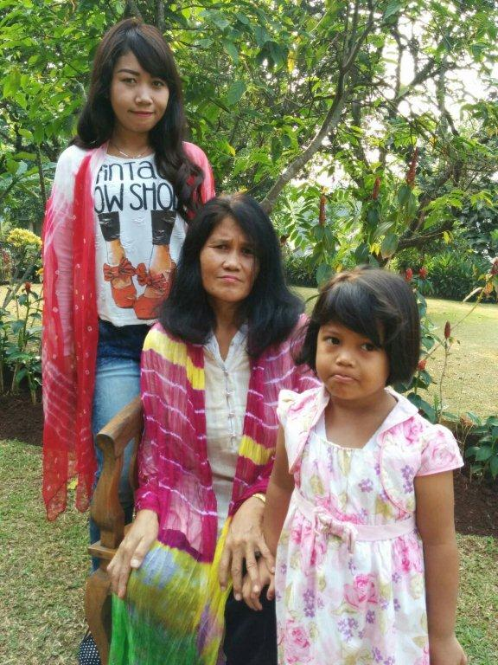
TERIMA KASIH

