Slide 1
車載監控系統
指導老師 : 陳朝烈 analysis
組員 : 葉日勝 黃柏儒 黃少鏞 楊豐瑞

Slide 2
OUTLINE
功能分析
資料流分析
活動分析
1
2
3

Slide 3
1
功能分析
駕駛者:
可透過螢幕看到三個方位影像，並且上傳雲端。
MCU會接受到管理者指示警告駕駛者不良駕駛行為。
雲:
接收到三方圖片做縫合處裡
妥善分配運算資源
管理者:
以環景的方式投射在UI上，監視駕駛者行為模式
下達警告指令
MQTT
M
UDP
UDP
UI
CAMERA
MCU
RASPBERRY

Slide 4
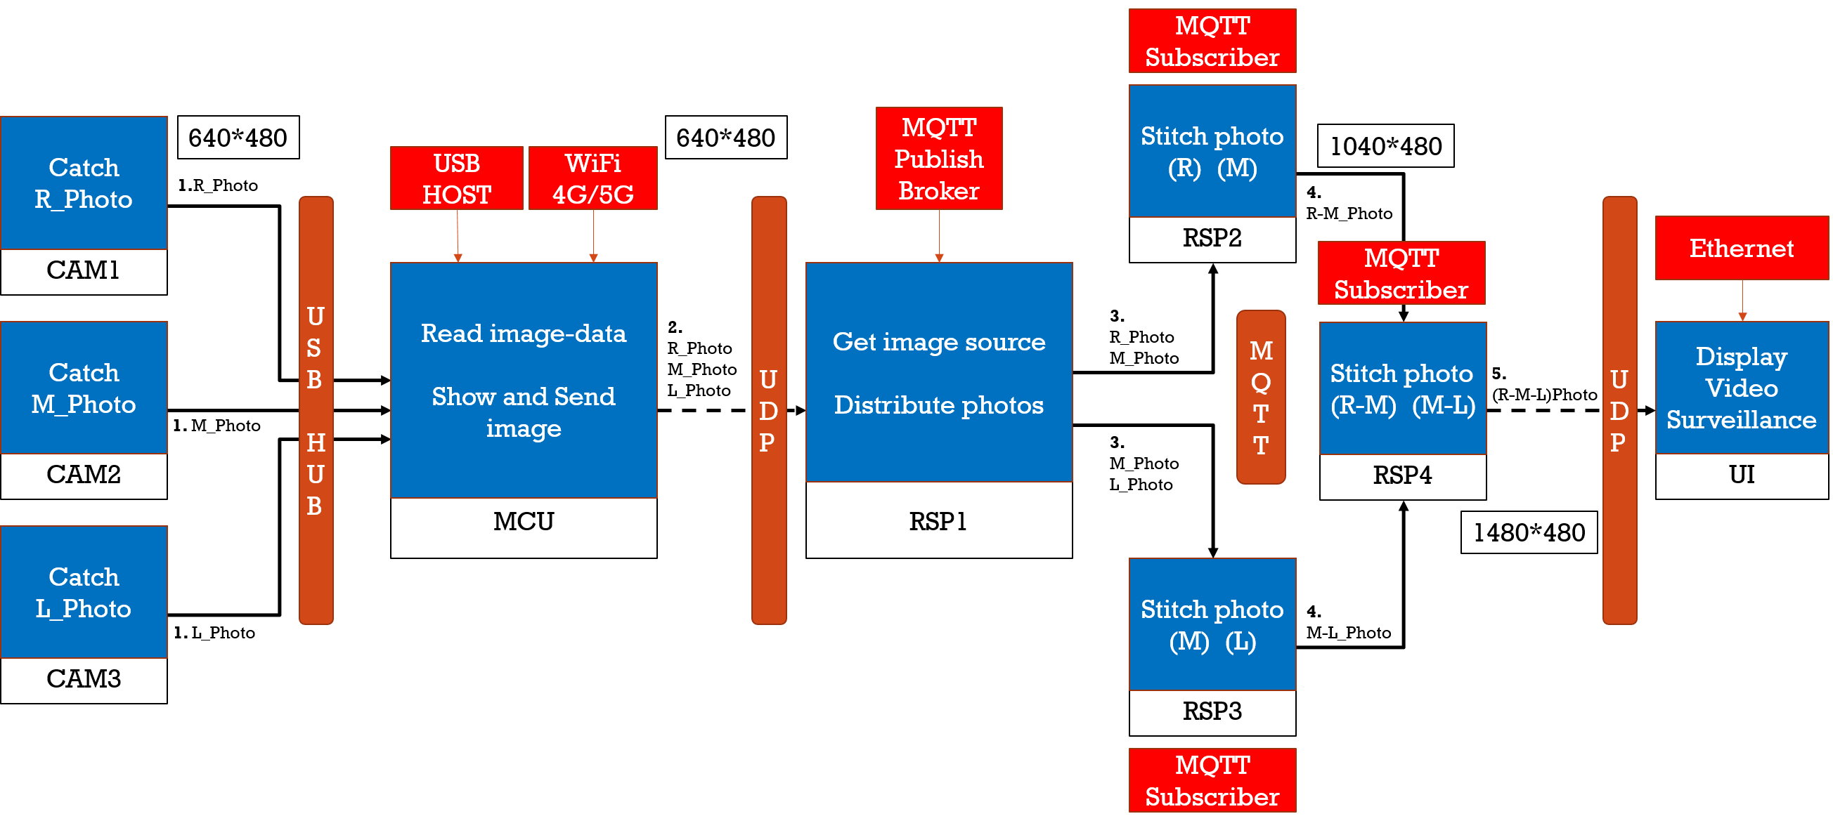
2
資料流分析

Slide 5
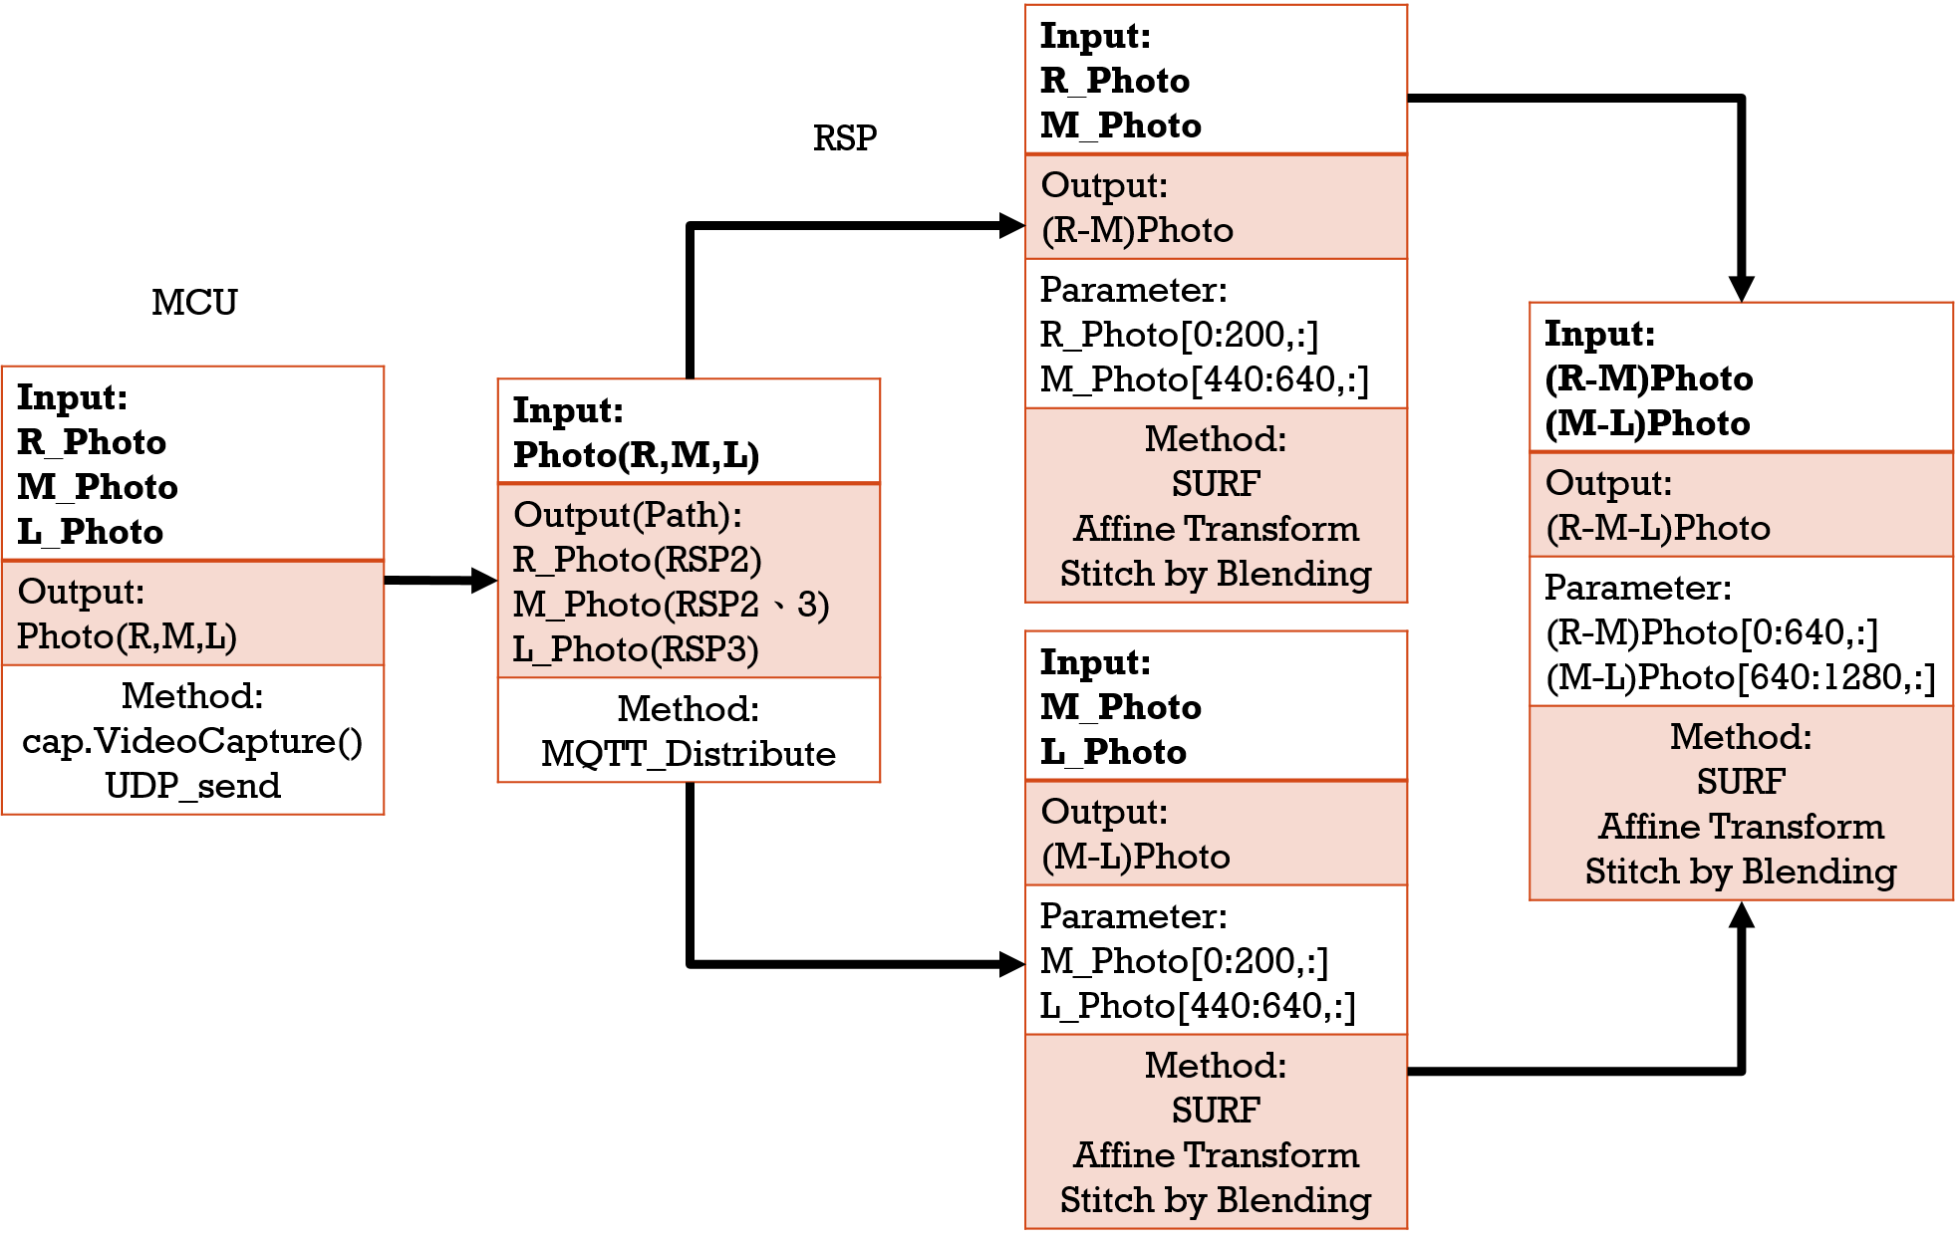
2
資料流分析

Slide 6
udp
Input:
Output:
Method:

Slide 7
MQTT
Input:
Output:
Parameter:
Method:

Slide 8
mcu
Input:
Image1, Image2, Image3
Output:
Image[3]{Image 1, Image 2, Image 3}
Parameter: null
Method:
由USB輸入3個方向影像，存入陣列，由UDP(4G)傳送

Slide 9
rsp1
Input:
Image[3]{Image 1, Image 2, Image 3}
Output:
對應raspberry，由MQTT輸出
傳送Image[1], Image[2] =>RSP2
傳送Image[2], Image[3] =>RSP3
Parameter:
ID:樹梅派ID
Image[]:影像內容
Method:
Send Image(image[], ID); //由MQTT傳送到指定的raspberry
Ex: Send Image(image[1] [2], RSP2);

Slide 10
rsp2
Input:
Image[1], Image[2]
Output:
Result1
Parameter:
Method:
ImageKP KeyPointDetector(Image)
ImageFE FeatureExtraction(ImageKP)
ImageFM FeatureMatching(ImageFE)
Image[1]: ImageA1 Affine(ImageFM) / Image[2]: ImageA2 Affine(ImageFM)
Result1 Stitch(ImageA1, ImageA2)

Slide 11
rsp3
Input:
Image[2], Image[3]
Output:
Result2
Parameter:
Method:
ImageKP KeyPointDetector(Image)
ImageFE FeatureExtraction(ImageKP)
ImageFM FeatureMatching(ImageFE)
Image[2]: ImageA1 Affine(ImageFM) / Image[3]: ImageA2 Affine(ImageFM)
Result2 Stitch(ImageA1, ImageA2)

Slide 12
rsp4
Input:
Result1, Result2
Output:
Result3
Parameter:
Method:
ImageKP KeyPointDetector(Image)
ImageFE FeatureExtraction(ImageKP)
ImageFM FeatureMatching(ImageFE)
Result1: ImageA1 Affine(ImageFM) / Result2 : ImageA2 Affine(ImageFM)
Result3 Stitch(ImageA1, ImageA2)

Slide 13
ui
Input: Result3
Output:
Parameter:
Method:

Slide 14
MQTT
Subscriber
RSP2
Stitch photo
(R) (M)
CAM1
640*480
640*480
MQTT
Publish
Broker
Catch
R_Photo
1040*480
USB
HOST
WiFi
4G/5G
1.R_Photo
4.
R-M_Photo
USB
HUB
UDP
UDP
Ethernet
MQTT
Subscriber
MCU
Read image-data
Show and Send image
RSP1
Get image source
Distribute photos
2.
R_Photo
M_Photo
L_Photo
3.
R_Photo
M_Photo
MQTT
UI
CAM2
Display
Video
Surveillance
Catch
M_Photo
RSP4
Stitch photo
(R-M) (M-L)
5.
(R-M-L)Photo
1. M_Photo
3.
M_Photo
L_Photo
CAM3
1480*480
Catch
L_Photo
RSP3
Stitch photo
(M) (L)
4.
M-L_Photo
1. L_Photo
MQTT
Subscriber

Slide 15
Input: R_Photo M_Photo
Output: (R-M)Photo
Parameter: R_Photo[0:200,:] M_Photo[440:640,:]
Method: SURF Affine Transform Stitch by Blending
RSP
MCU
Input: (R-M)Photo (M-L)Photo
Output: (R-M-L)Photo
Parameter: (R-M)Photo[0:640,:] (M-L)Photo[640:1280,:]
Method: SURF Affine Transform Stitch by Blending
Input: R_Photo M_Photo L_Photo
Output: Photo(R,M,L)
Method: cap.VideoCapture() UDP_send
Input: Photo(R,M,L)
Output(Path): R_Photo(RSP2) M_Photo(RSP2、3) L_Photo(RSP3)
Method: MQTT_Distribute
Input: M_Photo L_Photo
Output: (M-L)Photo
Parameter: M_Photo[0:200,:] L_Photo[440:640,:]
Method: SURF Affine Transform Stitch by Blending

Slide 16
2
資料流分析
Step1:UDP收取車輛傳輸的3個角度照片(照片1 2 3)，並利用MQTT分送至3個node(node1 2 3)做分散式運算
Step2:node同步收取照片後找出keypoints
Step3:node2找出的keypoints丟至node1及node3
Step4:node1將照片1、2合併node3將照片2、3合併
Step5:做affine並丟回Master
Step6:合併node1及node2合併的照片變成一張廣角圖
Final：利用UDP丟至行控中心的UI段端進行監控

Slide 17
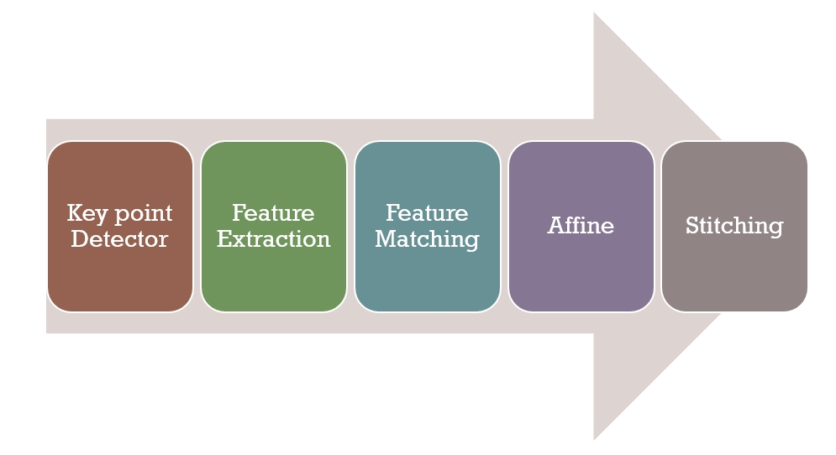
3
活動分析

