Slide 1
車載監控系統
指導老師 : 陳朝烈
組員 : 葉日勝 黃柏儒 黃少鏞 楊豐瑞

Slide 2
OUTLINE
功能分析
資料流分析
活動分析
1
2
3

Slide 3
1
功能分析
駕駛者:
可透過螢幕看到三個方位影像，並且上傳雲端。
MCU會接受到管理者指示警告駕駛者不良駕駛行為。
雲:
接收到三方圖片做縫合處裡
妥善分配運算資源
管理者:
以環景的方式投射在UI上，監視駕駛者行為模式
下達警告指令
MQTT
M
UDP
UDP
UI
CAMERA
MCU
RASPBERRY

Slide 4
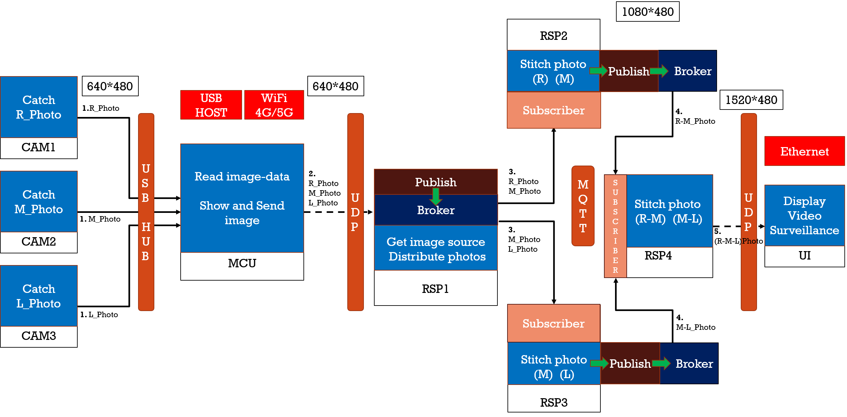
2
資料流分析

Slide 5
2
資料流分析
M
R
L
M
L
M
R
L
M
R
L
M
R
L
M
R
R
L
M

Slide 6
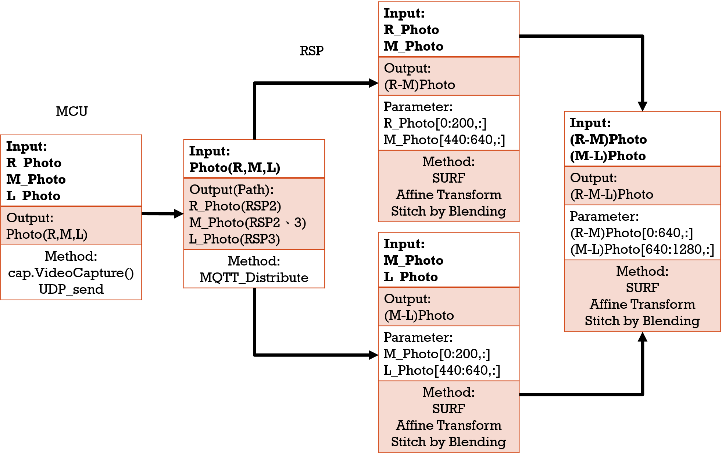
2
資料流分析

Slide 7

Udp(被監控端)
Udp(監控端)
INPUT
INPUT
METHOD
L_Photo
使用Socket搭建Ethernet，為了可以加強傳送的即時性，以UDP方式對傳輸端傳送。
M_Photo
(L-M-R)Photo
R_Photo

Slide 8
mcu
INPUT
OUTPUT
PARAMETER
METHOD
L_Photo
Image[3]
由USB輸入3個方向影像，存入陣列，由UDP(4G)傳送
{L_Photo,
M_Photo,
R_Photo}
Null
M_Photo
R_Photo

Slide 9
Rsp1 (Distribute photo)
OUTPUT
To RSP2
INPUT
M_Photo,
R_Photo
PARAMETER
METHOD
Image[3]
Topic
(MQTT Topic)
Read Image[];
{L_Photo,
M_Photo,
R_Photo}
Send Image(image[],Topic);
OUTPUT
Image[]
(影像內容)
//由MQTT傳送到指定的raspberry
To RSP3
L_Photo,
M_Photo

Slide 10
Rsp2 (Stitch photo)
INPUT
OUTPUT
PARAMETER
METHOD
Topic
(MQTT Topic)
KeyPoints Detector – data array
Feature Extraction – data array
Feature Matching - image
Affine - image
Stitch - image
M_Photo
M-R_Photo
R_Photo
Image[]
(影像內容)

Slide 11
Rsp3 (Stitch photo)
INPUT
OUTPUT
PARAMETER
METHOD
Topic
(MQTT Topic)
KeyPoints Detector – data array
Feature Extraction – data array
Feature Matching - image
Affine - image
Stitch - image
L_Photo
L-M_Photo
M_Photo
Image[]
(影像內容)

Slide 12
Rsp4 (Stitch photo)
INPUT
OUTPUT
PARAMETER
METHOD
M-R_Photo
KeyPoints Detector – data array
Feature Extraction – data array
Feature Matching - image
Stitch - image
L-M-R_Photo
Null
L-M_Photo

Slide 13
MQTT
INPUT
OUTPUT
PARAMETER
METHOD
Topic 1 : M_Photo, R_Photo
Topic 1 : M_Photo, R_Photo
為降低雲溝通的流失，所以選擇QOS2的方式搭建。
Topic 2: L_Photo, M_Photo
Topic 2: L_Photo, M_Photo
Topic
Topic 3 : M-R_Photo
Topic 3 : M-R_Photo
Topic 4 : L-M_Photo
Topic 4 : L-M_Photo

Slide 14
ui
INPUT
OUTPUT
PARAMETER
METHOD
UDP接受資料，透過C# Form呈現介面，畫面藉由VGA or HDMI
顯示影像
(VGA or HDMI)
Null
L-M-R_Photo

Slide 15
1080*480
RSP2
Stitch photo
(R) (M)
Publish
Broker
CAM1
640*480
640*480
Catch
R_Photo
USB
HOST
WiFi
4G/5G
Subscriber
1520*480
1.R_Photo
4.
M-R_Photo
USB
HUB
UDP
UDP
Ethernet
MCU
Read image-data
Show and Send image
2.
R_Photo
M_Photo
L_Photo
Publish
3.
R_Photo
M_Photo
MQTT
RSP1
CAM2
Get image source
Distribute photos
Catch
M_Photo
RSP4
Stitch photo
(R-M) (M-L)
S
U
B
S
C
R
I
B
E
R
UI
Display
Video
Surveillance
Broker
1. M_Photo
3.
M_Photo
L_Photo
5.
(L-M-R)Photo
CAM3
Catch
L_Photo
Subscriber
RSP3
1. L_Photo
Stitch photo
(M) (L)
4.
L-M_Photo
Publish
Broker

Slide 16
Input: R_Photo M_Photo
Output: (R-M)Photo
Parameter: R_Photo[0:200,:] M_Photo[440:640,:]
Method: SURF Affine Transform Stitch by Blending
RSP
MCU
Input: (R-M)Photo (M-L)Photo
Output: (R-M-L)Photo
Parameter: (R-M)Photo[0:640,:] (M-L)Photo[640:1280,:]
Method: SURF Affine Transform Stitch by Blending
Input: R_Photo M_Photo L_Photo
Output: Photo(R,M,L)
Method: cap.VideoCapture() UDP_send
Input: Photo(R,M,L)
Output(Path): R_Photo(RSP2) M_Photo(RSP2、3) L_Photo(RSP3)
Method: MQTT_Distribute
Input: M_Photo L_Photo
Output: (M-L)Photo
Parameter: M_Photo[0:200,:] L_Photo[440:640,:]
Method: SURF Affine Transform Stitch by Blending

Slide 17
2
資料流分析
Step1:UDP收取車輛傳輸的3個角度照片(照片1 2 3)，並利用MQTT分送至3個node(node1 2 3)做分散式運算
Step2:node同步收取照片後找出keypoints
Step3:node2找出的keypoints丟至node1及node3
Step4:node1將照片1、2合併node3將照片2、3合併
Step5:做affine並丟回Master
Step6:合併node1及node2合併的照片變成一張廣角圖
Final：利用UDP丟至行控中心的UI段端進行監控

Slide 18
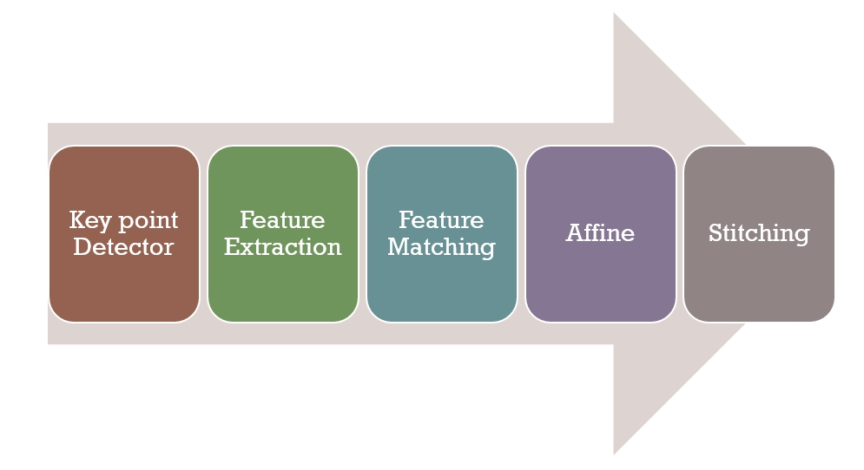
3
活動分析

