Slide 1
車載監控系統
指導老師 : 陳朝烈 analysis
組員 : 葉日勝 黃柏儒 黃少鏞 楊豐瑞

Slide 2
OUTLINE
功能分析
資料流分析
活動分析
1
2
3

Slide 3
1
功能分析
駕駛者:
可透過螢幕看到三個方位影像，並且上傳雲端。
MCU會接受到管理者指示警告駕駛者不良駕駛行為。
雲:
接收到三方圖片做縫合處裡
妥善分配運算資源
管理者:
以環景的方式投射在UI上，監視駕駛者行為模式
下達警告指令
MQTT
M
UDP
UDP
UI
CAMERA
MCU
RASPBERRY

Slide 4
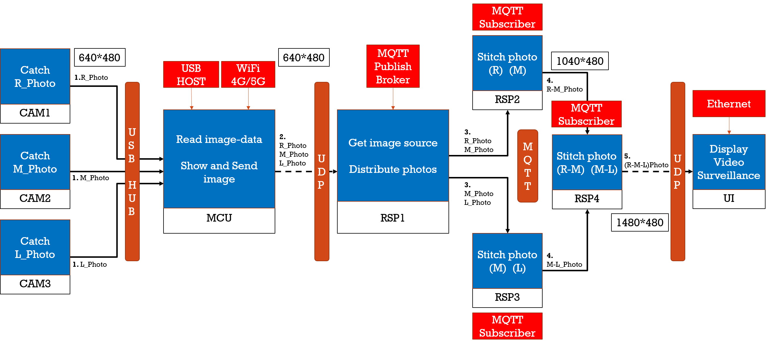
2
資料流分析

Slide 5
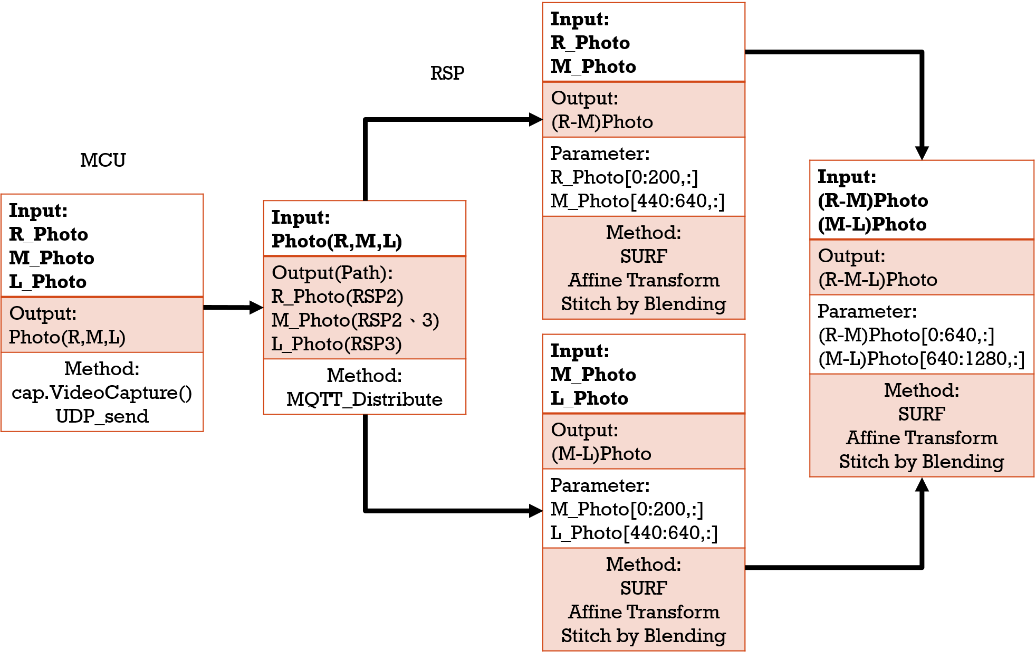
2
資料流分析

Slide 6

Udp(被監控端)
Udp(監控端)
INPUT
INPUT
METHOD
R_Photo
使用Socket搭建Ethernet，為了可以加強傳送的即時性，以UDP方式對傳輸端傳送。
M_Photo
(R-M-L)Photo
L_Photo

Slide 7
mcu
INPUT
OUTPUT
PARAMETER
METHOD
R_Photo
Image[3]
由USB輸入3個方向影像，存入陣列，由UDP(4G)傳送
{R_Photo,
M_Photo,
L_Photo}
Null
M_Photo
L_Photo

Slide 8
Rsp1 (Distribute photo)
OUTPUT
To RSP2
INPUT
R_Photo,
M_Photo
PARAMETER
METHOD
Image[3]
ID
(樹梅派ID)
Send Image(image[], ID);
{R_Photo,
M_Photo,
L_Photo}
//由MQTT傳送到指定的raspberry
OUTPUT
Image[]
(影像內容)
Ex: Send Image(image[1] [2], RSP2);
To RSP3
M_Photo,
L_Photo

Slide 9
Rsp2 (Stitch photo)
INPUT
OUTPUT
PARAMETER
METHOD
KeyPoints Detector(Image)
Feature Extraction(ImageKP)
Feature Matching(ImageFE)
R_Photo Affine(ImageFM)
Result 1 Stitch(R_Photo , M_Photo )
R_Photo
Result 1
Null
M_Photo

Slide 10
Rsp3 (Stitch photo)
INPUT
OUTPUT
PARAMETER
METHOD
KeyPoints Detector(Image)
Feature Extraction(ImageKP)
Feature Matching(ImageFE)
L_Photo Affine(ImageFM)
Result 2 Stitch(M_Photo , L_Photo )
M_Photo
Result 2
Null
L_Photo

Slide 11
Rsp4 (Stitch photo)
INPUT
OUTPUT
PARAMETER
METHOD
Result 1
KeyPoints Detector(Image)
Feature Extraction(ImageKP)
Feature Matching(ImageFE)
Result 3 Stitch(Result 1, Result 2)
Result 3
Null
Result 2

Slide 12
MQTT
INPUT
Publisher(RSP1 to RSP2): L_Photo, M_Photo
Publisher(RSP1 to RSP3): M_Photo, R_Photo
PARAMETER
METHOD
Publisher(RSP2 to RSP4): L_M_Photo
為降低雲溝通的流失，所以選哲QOS2的方式搭建。
Publisher(RSP3 to RSP4): M_R_Photo
Null
OUTPUT
Subscriber(RSP1 to RSP2): L_Photo, M_Photo
Subscriber(RSP1 to RSP3): M_Photo, R_Photo
Subscriber(RSP2 to RSP4): L_M_Photo
Subscriber(RSP3 to RSP4): M_R_Photo

Slide 13
ui
INPUT
OUTPUT
PARAMETER
METHOD
UDP接受資料，透過C# Form呈現介面，畫面藉由VGA or HDMI
顯示影像
(VGA or HDMI)
Null
R_M_L_Photo

Slide 14
MQTT
Subscriber
RSP2
Stitch photo
(R) (M)
CAM1
640*480
640*480
MQTT
Publish
Broker
Catch
R_Photo
1040*480
USB
HOST
WiFi
4G/5G
1.R_Photo
4.
R-M_Photo
USB
HUB
UDP
UDP
Ethernet
MQTT
Subscriber
MCU
Read image-data
Show and Send image
RSP1
Get image source
Distribute photos
2.
R_Photo
M_Photo
L_Photo
3.
R_Photo
M_Photo
MQTT
UI
CAM2
Display
Video
Surveillance
Catch
M_Photo
RSP4
Stitch photo
(R-M) (M-L)
5.
(R-M-L)Photo
1. M_Photo
3.
M_Photo
L_Photo
CAM3
1480*480
Catch
L_Photo
RSP3
Stitch photo
(M) (L)
4.
M-L_Photo
1. L_Photo
MQTT
Subscriber

Slide 15
Input: R_Photo M_Photo
Output: (R-M)Photo
Parameter: R_Photo[0:200,:] M_Photo[440:640,:]
Method: SURF Affine Transform Stitch by Blending
RSP
MCU
Input: (R-M)Photo (M-L)Photo
Output: (R-M-L)Photo
Parameter: (R-M)Photo[0:640,:] (M-L)Photo[640:1280,:]
Method: SURF Affine Transform Stitch by Blending
Input: R_Photo M_Photo L_Photo
Output: Photo(R,M,L)
Method: cap.VideoCapture() UDP_send
Input: Photo(R,M,L)
Output(Path): R_Photo(RSP2) M_Photo(RSP2、3) L_Photo(RSP3)
Method: MQTT_Distribute
Input: M_Photo L_Photo
Output: (M-L)Photo
Parameter: M_Photo[0:200,:] L_Photo[440:640,:]
Method: SURF Affine Transform Stitch by Blending

Slide 16
2
資料流分析
Step1:UDP收取車輛傳輸的3個角度照片(照片1 2 3)，並利用MQTT分送至3個node(node1 2 3)做分散式運算
Step2:node同步收取照片後找出keypoints
Step3:node2找出的keypoints丟至node1及node3
Step4:node1將照片1、2合併node3將照片2、3合併
Step5:做affine並丟回Master
Step6:合併node1及node2合併的照片變成一張廣角圖
Final：利用UDP丟至行控中心的UI段端進行監控

Slide 17
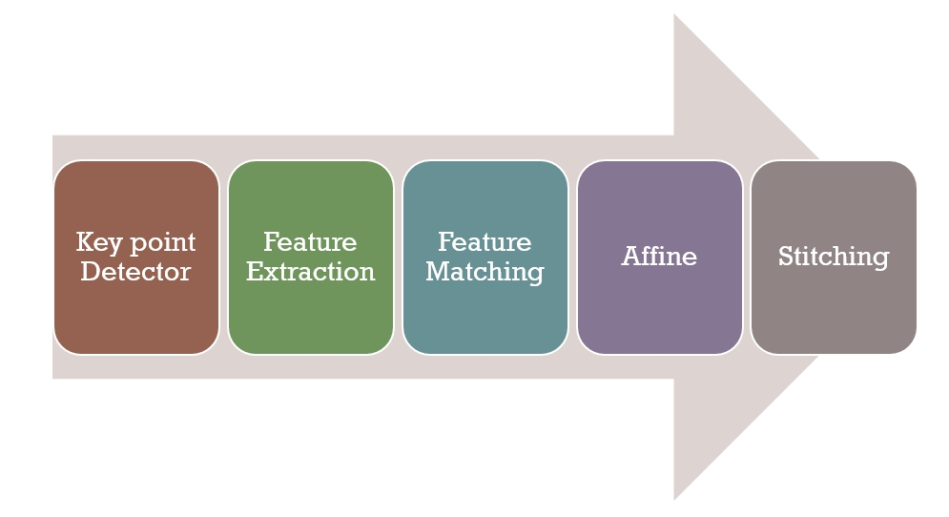
3
活動分析

