Slide 1
DigiPres North:
Starting a new Community of Practice in the North of England
Bryony Hooper, University of Sheffield and Dorothy Waugh, University of York

Slide 2
What we are sharing
Define the Community
Define the Need
Our Inspiration
Place the Community at the Centre
Challenges
Growth and Sustainability
Notes:
Define the Community
Define the Need
Our inspiration (so that we do not reinvent the wheel)
Place the community at the centre
Challenges (and opportunities!)
Growth and Sustainability

Slide 3
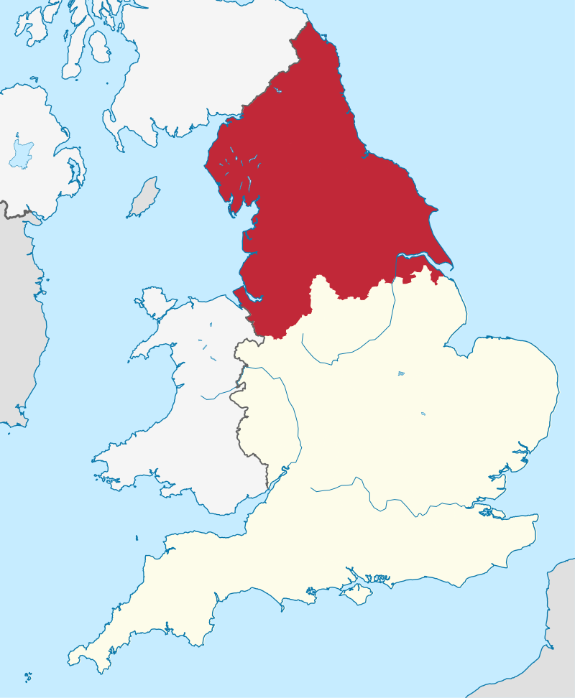
Geographical Community
North of England:
North West,
North East,
Yorkshire and the Humber
Notes:
Firstly, this community of practise is a geographical community, for those based in the North of England
Generally speaking, the areas North West, North East and Yorkshire and the Humber are considered “The North”.
Without sounding like the tourist board for the region(!), the north of England is a diverse region, both in terms of the geography, economy, and the people who live there. It includes major cities like Manchester, Leeds and Newcastle along with rural countryside like the Lake District and the North Yorkshire Moors.
In part because of the decline of heavy Industry centered in the region and the subsequent impact it had on the societies reliant on those industries, the region has higher levels of deprivation in comparison to the south, and there is still a disparity between the south of England, midlands and the north (both in terms of standards of living and capital investment).
HOWEVER, it is not a complete and true picture to simply say “It’s grim up North!” Yes, many councils are underfunded and under resourced, but we also have pockets of affluence and major national organisations based in the area.
In terms of those working in the area doing Digital Preservation (or at least thinking about digital preservation), we have :
Local authorities
Universities
Specialist repositories
Estate archives
& Banking and industry archives
Some colleagues work in dedicated digital preservation roles, some work as archivists or records officers (squeezing DP in where they can). Some work as a team, and others are lone workers. The region is also varied in terms of how far along community members are in terms of their DP journey.

Slide 4

Define the Need
Inspired and Motivated by:
Other growing COPs
Gap in localised support
Barriers to support
The response we received
Notes:
And so to explain why we felt there was a need to develop a Digital Preservation community of practise for the North of England.
We were inspired by the success of other regional Communities of Practise and what they had achieved. And Dorothy will talk more to this first point in the next slide
We knew there was a gap in localised support, including:
Training and peer led support specifically related to digital preservation.
A space where people could openly share and discuss issues & problems with their peers (especially useful for those lone practitioners)
A place to network and share their work that was not on a national or international level
And an organised collective that could advocate for supporting the upskilling of practitioners in the region.
We were motivated by the known Barriers to (accessing) support
CAPACITY. We have community members who only have one day per week dedicated to Digital Preservation (and perhaps some that have even less time exclusively allocated to the task – but didn’t feel comfortable sharing that fact!).
If the support isn’t local, it means significant travel to training events and conferences, funding for which is severely limited in many services in the region that we’ve spoken to.
And the Costs associated with support and training (beyond travel).
Access to training in DP generally comes with a cost, and many organisations in the region have limited resources (including staff time) to undertake them
Ability to afford DPC membership was especially highlighted by those working in the local authority sector. While the DPC and others offer some free events and resources, a lot of resources sit behind a paywall barrier.
The response we received was unbelievable! We had over 80 expressions of interest, and over 50 participants signed up for our first online meeting. If we hadn’t already believed there was need in the region, we did now!

Slide 5

Our Inspiration
Existing communities of practice…
MidiPres
Australasia Preserves
Atlanta-Area Digital Archives Group
Bitcurator Forum
Notes:
Throughout all of this, we have been inspired by active communities around the world that are already leading the way. Bryony and I took inspiration from two groups in particular.
MidiPres is a community of practice for digital preservation practitioners working across the Midlands region of England–and Bryony and I chatted extensively with its co-founders, Rachel McGregor and Laura Peurt, and borrowed many of our ideas for DigiPres North from the MidiPres group. In particular, we modelled our terms of reference and our approach to organising the group on the incredible work already undertaken by the MidiPres group. We’re hoping to have ongoing regular catch-ups with Rachel and Laura at MidiPres to compare notes, identify shared challenges, and generally support each other.
Another community to which we owe a debt of gratitude is the Atlanta-Area Digital Archivists group, based in Atlanta, GA, which I was part of in my previous role at Emory University. During my time as part of the group we organised outreach events together, informal workshops and show-and-tells, tours, and generally provided a welcoming and positive space to ask questions and share ideas.
Australasia Preserves, which we heard about earlier, was another community from which we took inspiration. Big thank yous to Jaye and members of that group!
And then of course there are communities of practice not focused on a specific geographic region, but still organised around similar goals. In particular, the BitCurator Consortium has been another source of inspiration–and we borrowed heavily from their code of conduct as we developed our own.
So certainly Bryony and I did not start this from scratch and it’s been incredibly valuable to look at other groups doing similar things and think about where we can borrow and reuse ideas. Were it not for these existing groups, I’m not sure that Bryony and I would have taken the steps to establish DigiPres North. And hopefully at some point, DigiPres North will be able to feed back into this knowledge sharing and help this community of communities to grow and support each other.
I’m going to hand over now to Bryony who will talk a little bit about what we have done so far.

Slide 6

Place the Community at the Centre
Survey
Code of Conduct
Terms of Reference
Feedback
Notes:
Important to the community is the people. For a community cannot exist without them!
We wanted to know about the needs within the community so we could make sure that we met them. We did this in the first instance via a survey, and asked a range of questions, including what should the group be for? And What did they want to get out of it?
I’ll quickly run through a couple of the survey questions responses as they helped guide us in terms of community wants and needs.

Slide 7
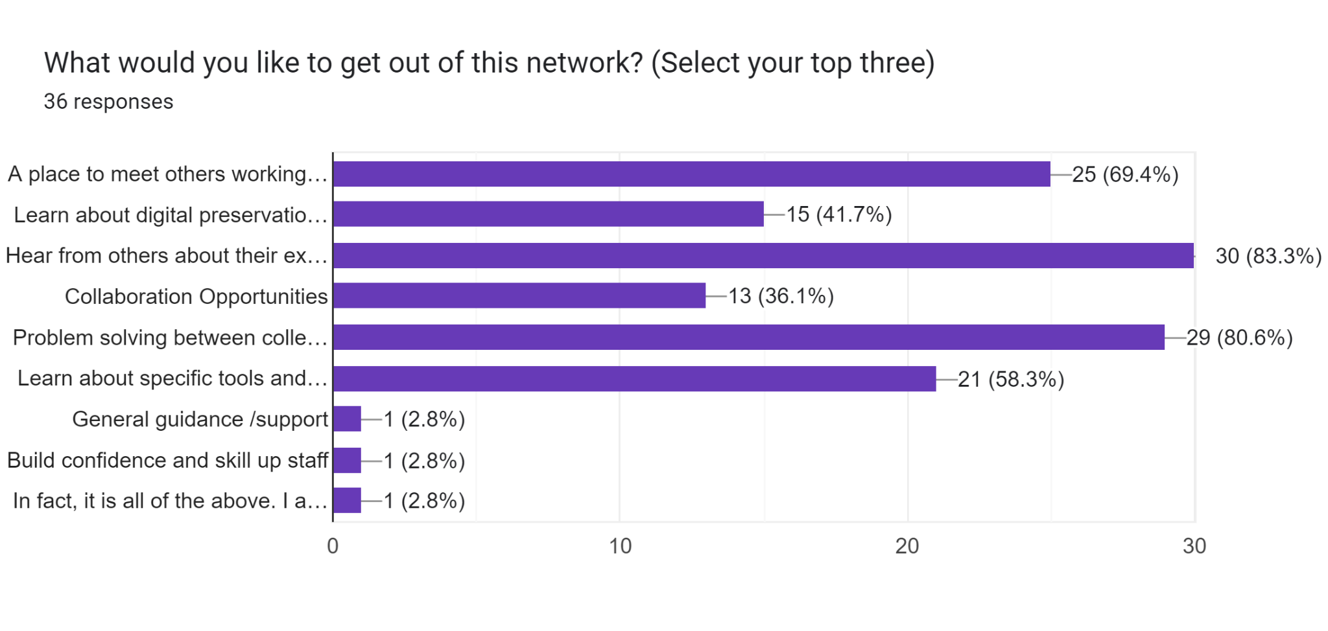
Q: What would you like to get out of this network?
Notes:
Top three responses in terms of what they wanted from the COP were:
Hear from others about their experiences
Problem solving between colleagues
A place to meet others working in the region

Slide 8
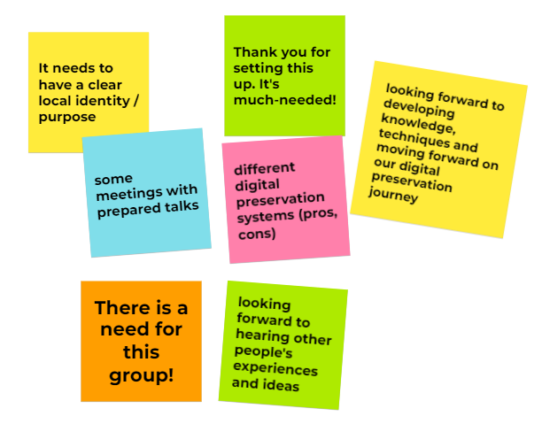
Any other thoughts (highlights)
Notes:
And I wanted to share the free text Any Other Thoughts we received:
Not least that they show people wanted DigiPres North, but also that we needed to ensure in some way that we have a local Identity and Purpose.

Slide 9
Place the Community at the Centre
Survey
Code of Conduct
Terms of Reference
Feedback
Notes:
To ensure the community was placed at the centre, we shared a code of conduct with the group:
The Code of Conduct highlights that DigiPres North aims to create a supportive community of practice for archivists and practitioners working in the region. The goal of the Code of Conduct is to help create an environment that is safe, welcoming, and inclusive, and which fosters participation and community.
The Terms of reference, explain the goals of the community of practice. These goals reiterate the defined needs for a community of practise in the north, including:
Create an active network of practitioners in the region;
Enhance our collective ability to advocate for digital preservation within our own institutions and across the region;
AND Widen and lower the bar for participation in digital preservation activities at institutions and organisations across the region;
Both the Code of Conduct and the Terms of reference were shared with the community for comment and input (and I have bought copies with me in case anyone would like to read them in full).
The terms of reference also stipulate that, “Evaluation of how effectively the group is achieving its objectives will be built into each meeting. Members will be invited to offer feedback or make suggestions for future meetings and the group’s development”.

Slide 10
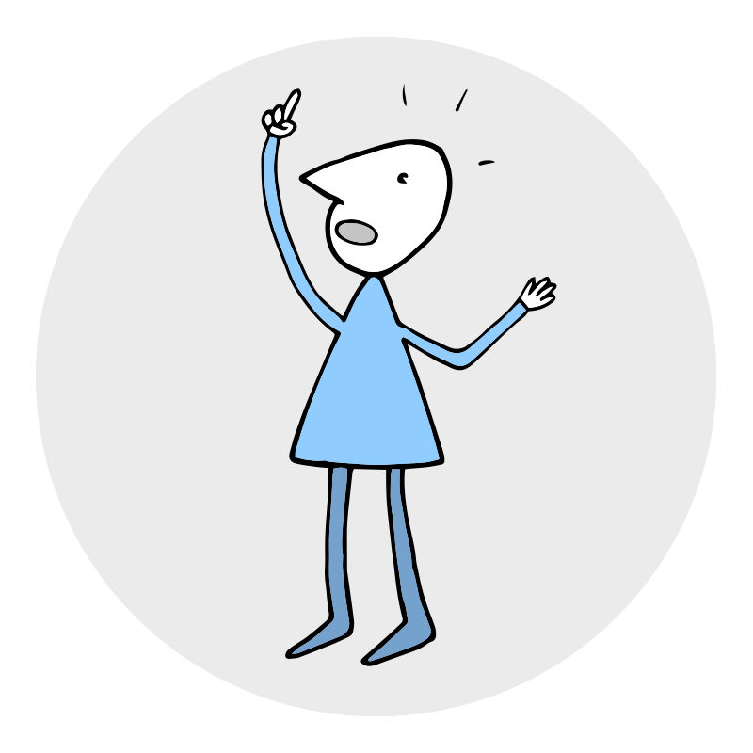
Challenges
Creating a welcoming, informal space for discussion and networking online;
Supporting participation in light of tight budgets, limited funding for travel, and high demands on time;
Defining our identity and purpose.
Notes:
So, I’m going to talk now about challenges.
Probably foremost in our minds has been the size of the group and how best to organise ourselves given that size. We have about 90 people in total who have registered an interest in the group and we usually see around 40 attend each meeting. I think this number has likely exceeded what Bryony and I had expected when we first put out a call for interested participants and one of the primary questions that we’ve been grappling with is how we can maintain the kind of local, informal environment for what has turned out to be a relatively large group. To date, our meetings have all been held online--so how do we create a cosy, welcoming space for informal discussion and networking on a Zoom call where you have to page through multiple screens of participants?
Of course, in-person meetings would present one possible solution to this question, but (and I’m going to ask Jaye and anyone else from Australasia Preserves to cover their ears for a moment here) for those of us in little England, the north is quite a large region–so, even though DigiPres North is intended to support a local community, a physical, in-person meeting has proved a tall order so far. Many of us are working at organisations currently operating under increasingly tight budgets and where funding to support travel is very limited (I’ll ask you to note at this point the fact that I am not in the room with you as evidence!). Many participants in DigiPres North have expressed interest in in-person meetings and we haven’t ruled this idea out–but we are conscious that we would need to think carefully about how we could plan this in such a way that supports as wide attendance as possible.
I’ll note here too that one idea floated early on in the development of DigiPres North was the possibility of dividing the group into several smaller groups in order to better facilitate informal discussion and the occasional in-person meeting. We thought about splitting into smaller sub-regions of the north or dividing ourselves up by type of organisation–but in each case, members of the group saw real value in keeping membership broad: we want to hear from colleagues across the region and across a range of organisations (not just those similar to our own).
In order to address some of these challenges, we’ve looked to groups like the DPC and the BitCurator Consortium who have found ways to create that sense of community in an online environment. We’re thinking about how we might use breakout rooms to foster discussion and we’re looking to examples like the BitCurator User Forum’s Great Question! sessions for ideas about how we could format meetings in order to encourage broad participation.
Finally, I’ll refer back to Bryony’s earlier comments about defining the need for this group. We’ve established, we hope, that there is a need for this group–and I think one of our ongoing challenges will be making sure that we continue to fill it. One piece of feedback that we received early on when we first put out the call for this group is that it needs to have a clear identity and purpose. We think it does but I think the onus is on us to make sure we are delivering on that and thinking about what separates us from other amazing communities of practice like the DPC, BitCurator Consortium, Archivematica Users Group, etc. In other words, why do we need DigiPres North in addition to those other spaces?

Slide 11

Growth and Sustainability
Being useful! Is there still a need for this group and are we filling that need?
Mechanisms for feedback;
Establishing a committee;
Sharing administrative responsibilities;
Finding a long-term “home” for DigiPres North content.
Notes:
Which leads us quite nicely into our next slide which focuses on the growth and sustainability of the group. One thing that is crucial to the long-term sustainability of the group is that it stays useful. I think that’s something we want to make sure we’re actively considering throughout the life of the group–is there still a need for a group like this, and if so, are we filling that need? One thing that we’re looking at right now are the mechanisms for feedback that are available to members so that there’s an open invitation and clear method for providing that feedback and hopefully a bit of an expectation that if you are part of the group then you are also taking on some responsibility for shaping the group and providing that feedback about it’s ongoing usefulness, so that we can continue to refine the group’s purpose and reflect on whether the way the group is working fulfils that purpose.
One of the key steps that we’ve taken so far in relation to growth and sustainability is to establish a small committee to help run the group. This is very informal at the moment–we put a call out for volunteers, there’s no structure to the committee or anything like that–but we hope it will enable wider levels of input in terms of planning meetings, thinking through the organisation of the group, and, again, really focusing on making sure that we are meeting the needs of the group. And we’re hoping that this committee, in combination with some of the mechanisms for feedback that I mentioned earlier will really ensure that every member of the group feels able to contribute to this ongoing process of refinement and growth.
One of the other things that having a committee does is it allows me and Bryony to share some of the administrative responsibilities and reduces the risk of things grinding to a halt because there are just one or two people keeping tabs of things.
The technology that we use to run the group presents another challenge. All of our documentation is stored using the University of York’s Google Drive and, of course, all associated with my staff account, we host our online meetings using the University of York’s Zoom account. If I were to leave the University of York or if the University were to tighten up restrictions on how I am able to share access to those platforms, that could cause a problem for the group. So reliance on technical infrastructure associated with a single group member–that’s another challenge that we will have to address at some point.
It is often difficult to find a long-term “home” for content not tied to a single institution. Whether or not that is something that the larger, sort of “umbrella” organisations like the DPC or Educopia could help provide a solution for, if these sorts of communities continue to grow–perhaps an interesting question!
To wrap up, we just wanted to finish by saying that we were really happy to be invited to participate today. As we mentioned earlier in our presentation, learning from other communities has been really invaluable and I think the long-term sustainability and growth and usefulness of DigiPres North is certainly made more likely given the existence of other communities and opportunities to make these connections between the communities and share and learn from each other.
Thank you so much for listening.

Slide 12
Thank you!
Bryony Hooper: b.hooper@sheffield.ac.uk
Dorothy Waugh: dorothy.waugh@york.ac.uk

