Slide 1
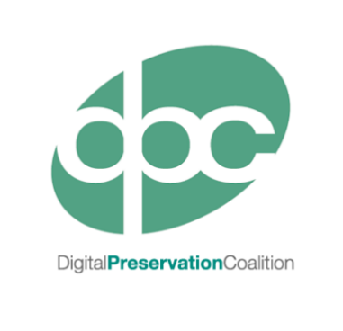
Registries of Good Practice Andy Jackson Preservation Registries Technical Architect

Slide 2
Registries of Good Practice Project
Project:
A collaboration between the Digital Preservation Coalition (DPC) and Yale University Library (YUL).
“To explore and develop different approaches to analyse, collate, present and, most importantly, make discoverable the many existing registries and collections of digital preservation good practice.”
Workstreams:
Practical Registries:
Making the most of our existing format/software/tool/action/workflow registries.
Registries of Practice:
Helping practitioners find out what others have done, to improve their own practice.
Maintaining Registries:
Supporting those who create and maintain the registries of information we need.

Slide 3
Registries of Practice: The iPRES Publications Index
[link]

