Slide 1
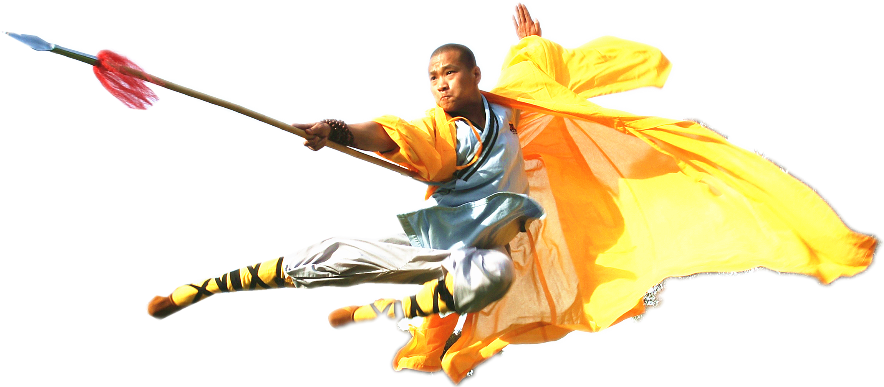

Slide 2
Facebook Graph Search
People from Pitesti, Romania who live in The Netherlands
https://www.facebook.com/search/106123262753066/residents/present/107982395900869/home-residents/intersect

Slide 3
R
Programmeertaal en omgeving voor statistische analyse en grafische presentatie van data
Vrij verkrijgbaar (Open Source)
www.r-project.org

Slide 4
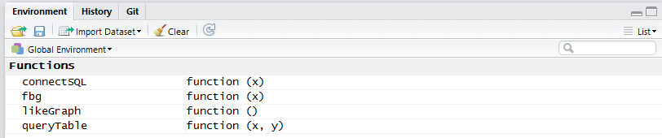
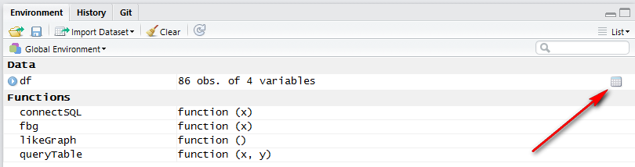
Stappenplan
source fbscripts.R
df <- read.csv(“demo.csv”)
df$id <- as.character(df$id)
table(df$gender)
table(df$locale)

Slide 5
userList <- capture.output(write.table(matrix(as.character(df$id),nrow=1), sep=",",row.names=FALSE, col.names=FALSE, quote=FALSE))
sink('facebookobjects.py')
cat("objects = [\n")
cat(userList)
cat("]")
sink()
dd

Slide 6
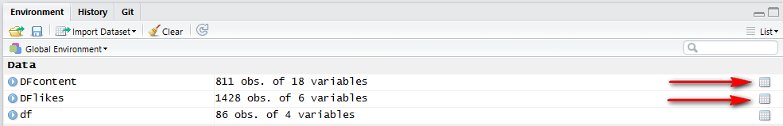
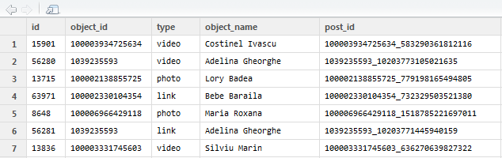
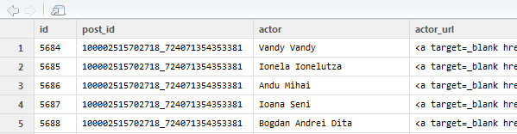
connectSQL(‘database.db’)
queryTable(‘stream’,’likes’)

Slide 7
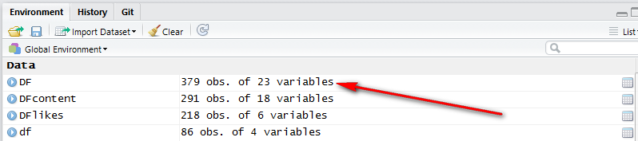

likeGraph()
dd

Slide 8
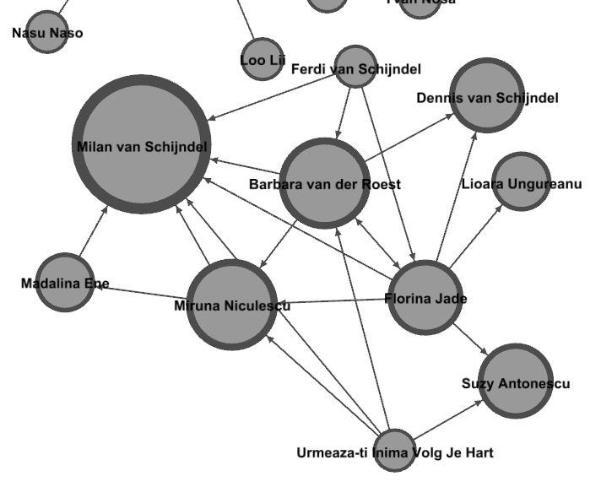
write.graph(g,'c:\\temp\\pitesti\\demo.graphml',format = 'graphml')

Slide 9
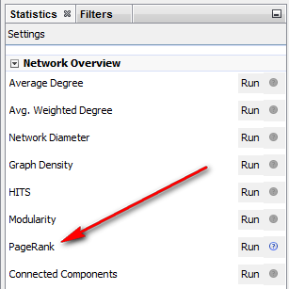
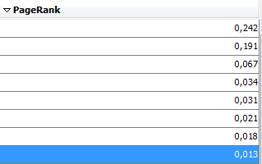
PageRank

